Slide 1

Diwali Sales Data Analysis Report
Author: Jayashree Saha
Email: saha.jayashree91@gmail.com
Ph no: 9051222106

Slide 2
Outline
Executive Summary
Introduction
Methodology
Results
Conclusion
Appendix

Slide 3
Executive Summary
Analyzing the Gender wise Sales distribution
Understanding the Sales Performance on Marital Status
Understanding Sales Performance Among the Age Categories
Understanding top 5 performing Products Categories
Finding Out Top 5 performing States
Understanding the relation between Occupation and purchase power

Slide 4
Introduction
We are given a dataset on Diwali Sales of a Retail Store. The dataset has information about count of sales and total sales among Product Categories and various segments.
We want to analyze the following questions:
Gender impact on Sales
Marital Status impact
Age Impact
Occupation Impact
State Wise Performing
Product Category Wise Performance

Slide 5

METHODOLOGY
Data Collection through:
Client has provided the historical data in csv format
Dataset Link: https://drive.google.com/file/d/1mGY1doT8RRTgIS0eZsiexHOjUIel9pvo/view?usp=sharing
Data Wrangling
Filtering the data
Dealing with missing values
Dealing with outliers
Data Analysis & Visualization using:
Pandas
Matplotlib & Seaborn

Slide 6
Data Collection
Data
Collection
Client has provided the historical data in csv format
Data is then loaded as Data Frame using Pandas Library
Dataset Link: https://drive.google.com/file/d/1mGY1doT8RRTgIS0eZsiexHOjUIel9pvo/view?usp=sharing

Slide 7
Data Wrangling
In the data set, there are duplicate entries. We filtered them out to get unique row entries.
There are two columns which did not have any data. They are dropped.
There are null values corresponding to many features. It is dropped depending on importance and percentage of null values and some places it is filled with mode, given that the features are object data type.
A new column is created for marriage status where ‘Married’ = 1 and ‘Unmarried’ = 0
‘Orders’ and ‘Amount’ columns has outliers which are filtered out using IQR
Filtering Duplicate Entries
Dropping Columns with no data
Filling With Null Values
Detecting & Removing Outliers

Slide 8

DATA VISUALIZATION

Slide 9
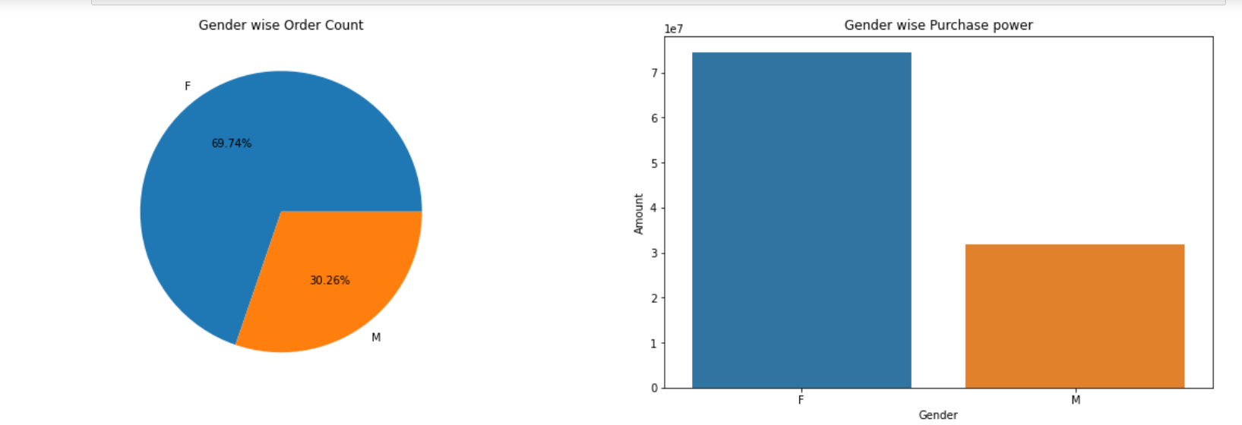
Gender wise Analysis
Conclusion
Females places more orders and their purchase power is also higher.

Slide 10
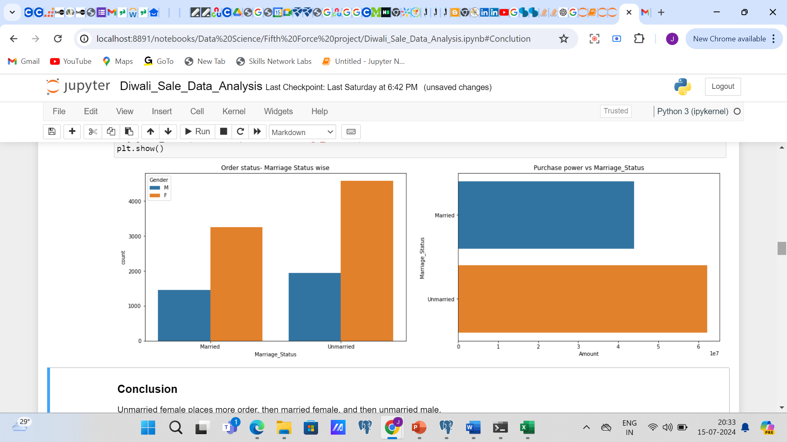
Marital Status wise Analysis
Conclusion
Unmarried female places more order, then married female, and then unmarried male

Slide 11
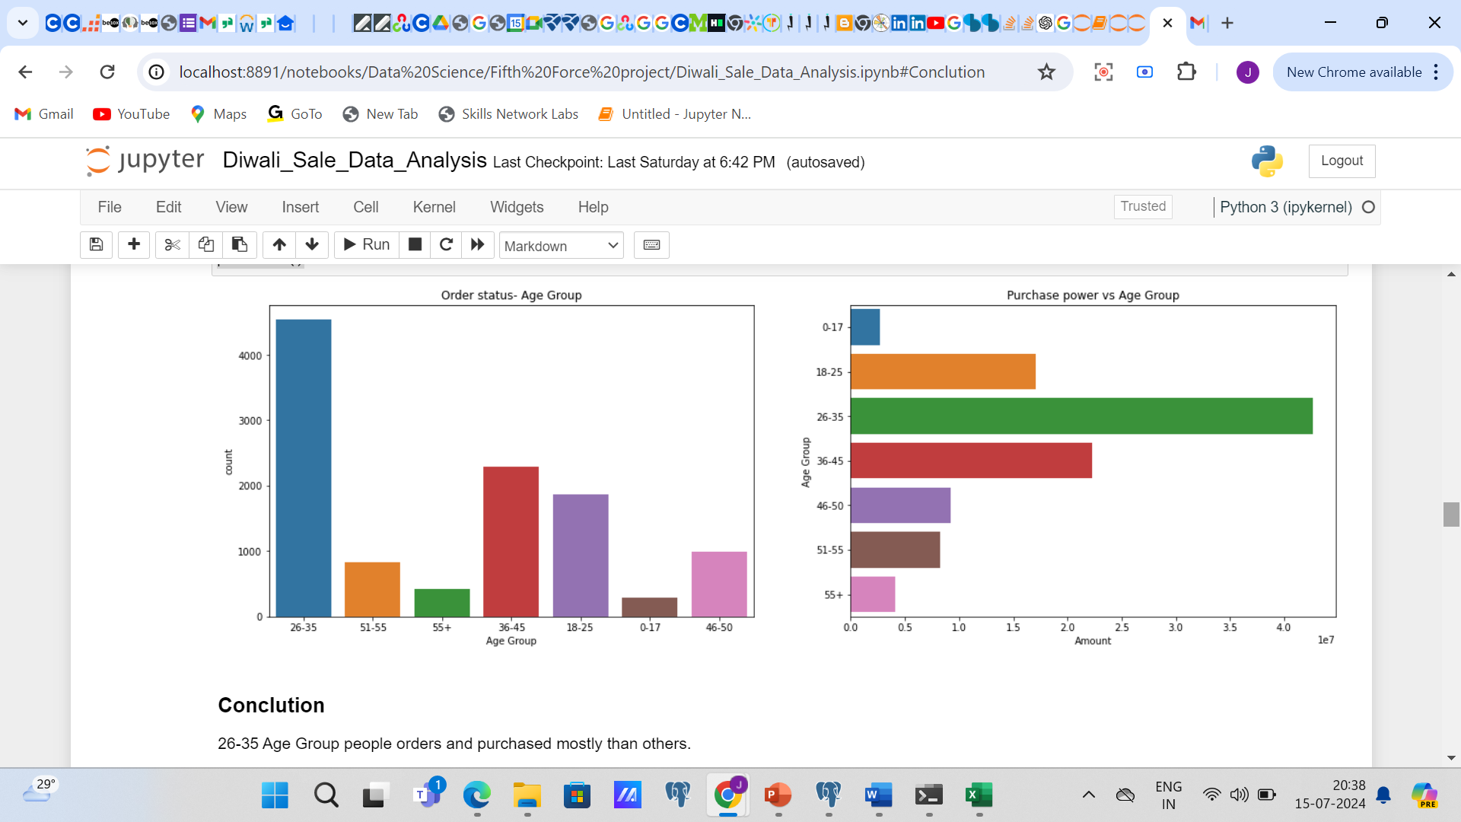
Age Group wise Analysis
Conclusion
26-35 Age Group people orders and purchased mostly than others.

Slide 12
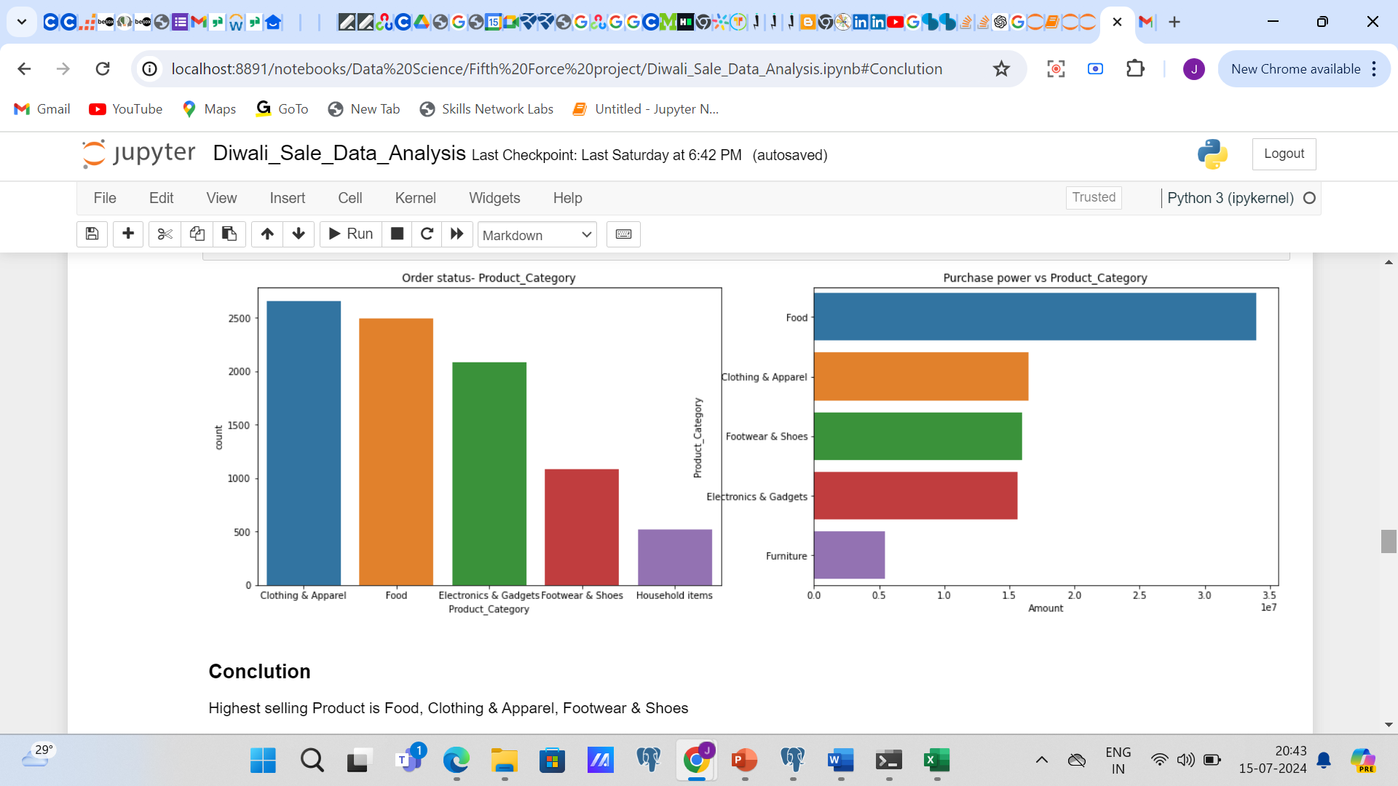
Product Category wise Analysis
Conclusion
Highest selling Product is Food , then Clothing & Apparel and then Footwear & Shoes.

Slide 13
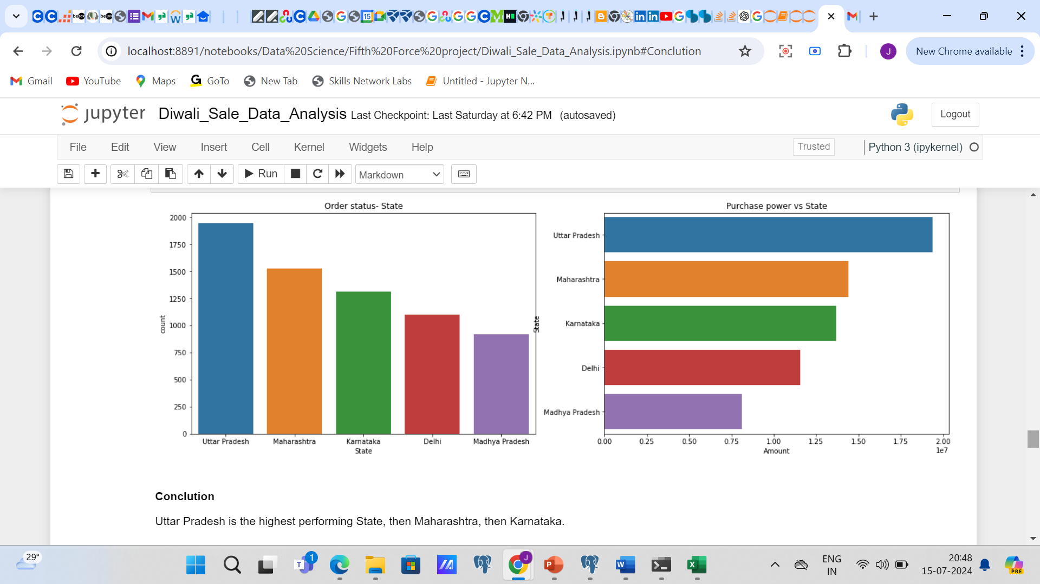
State wise Analysis
Conclusion
Uttar Pradesh is the highest performing State, then Maharashtra, then Karnataka.

Slide 14
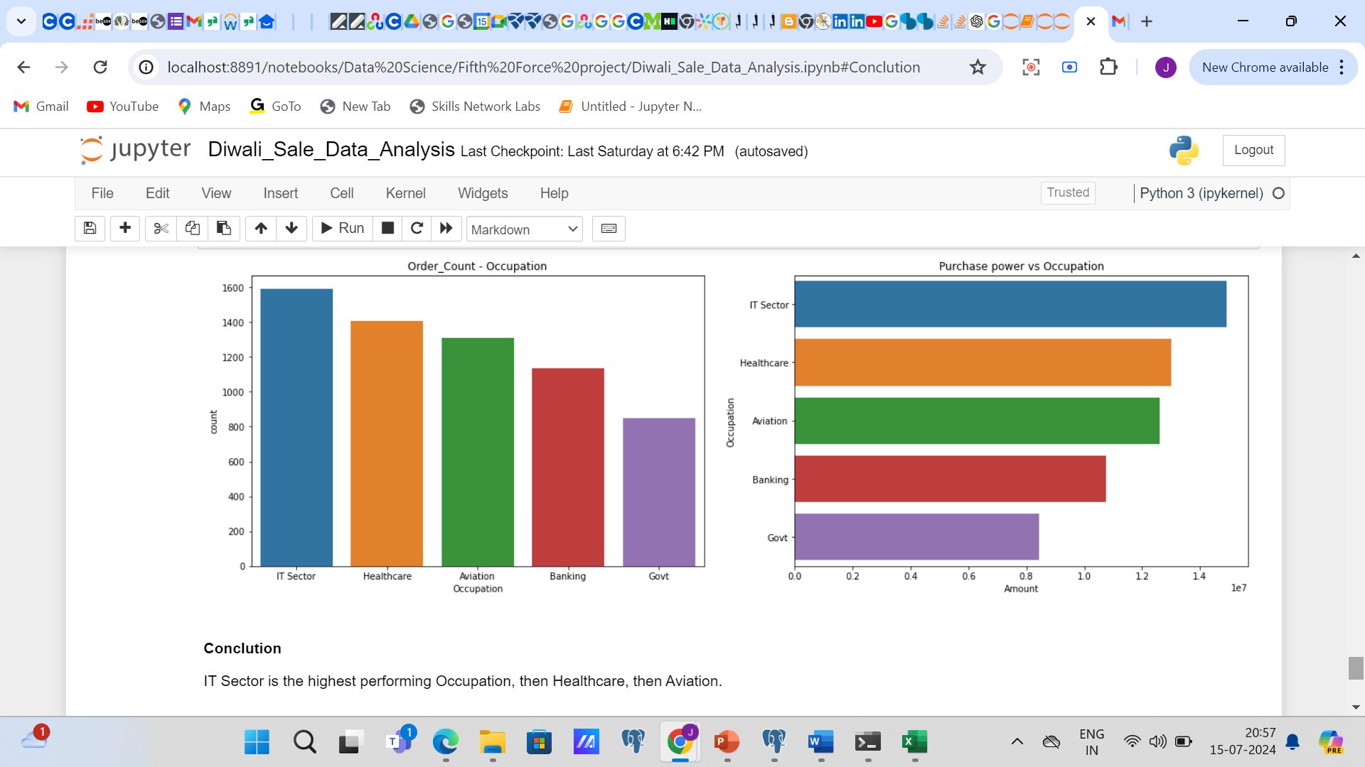
Occupation wise Analysis
Conclusion
IT Sector is the highest performing Occupation, then Healthcare, then Aviation.

Slide 15
Conclusion
Females places more orders and their purchase power is also higher.
Unmarried female places more order, then married female, and then unmarried male.
26-35 Age Group people orders and purchased mostly than others.
Highest selling Product is Food, Clothing & Apparel, Footwear & Shoes.
Uttar Pradesh is the highest performing State, then Maharashtra , then Karnataka.
IT Sector is the highest performing Occupation, then Healthcare, then Aviation.

Slide 16
Final Suggestion
Women Customers age between 26 to 35 should be targeted more through ads and coupons.
Customized Campaigns targeting professionals from IT Sector, HealthCare & Aviation, should be given preference.
More Stocks should be maintained for product category like Food, Clothing & Footwear .

Slide 17

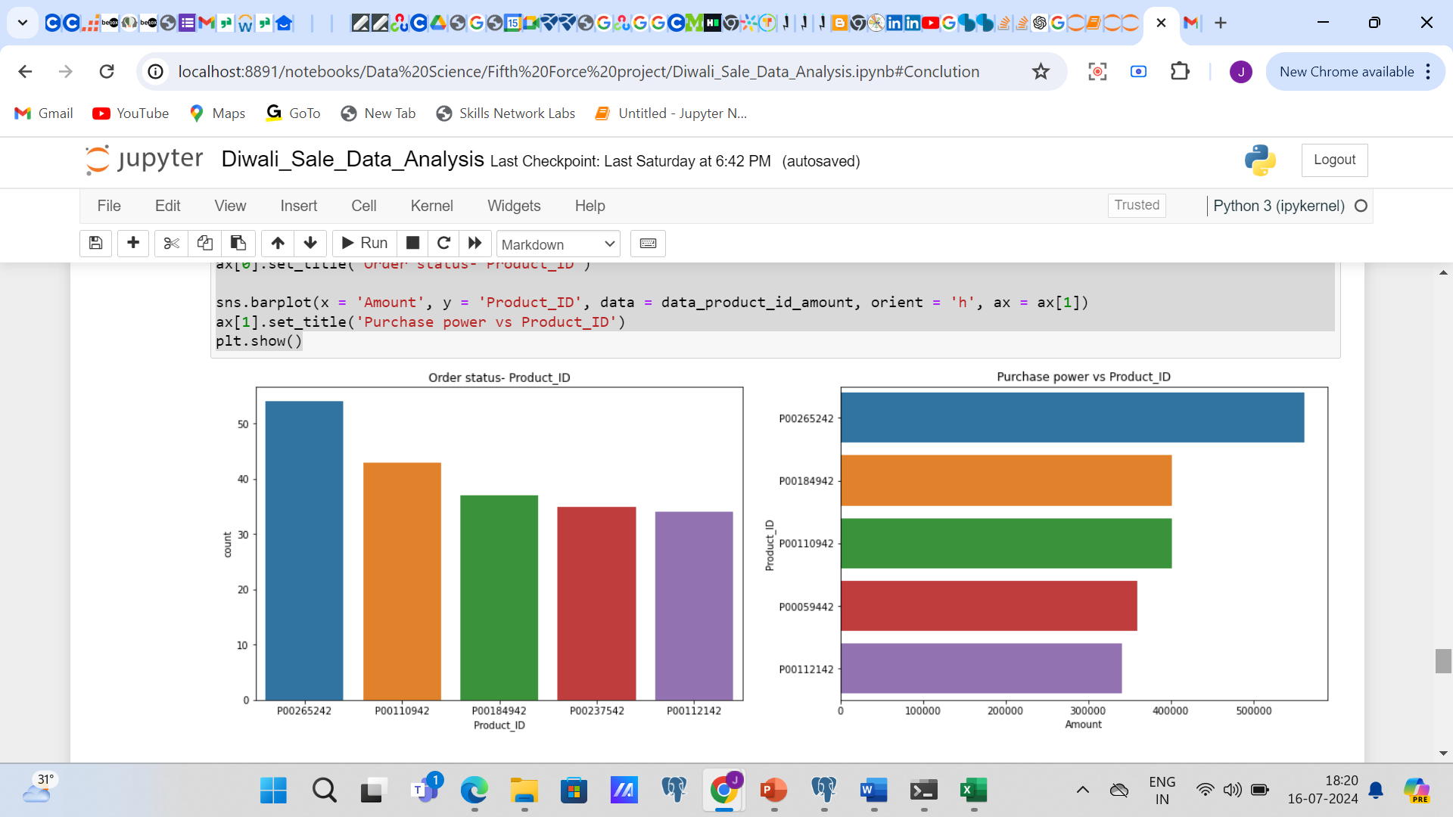
Product ID wise Analysis

Slide 18

Thank You
Jayashree Saha

