Slide 1

GROUP-1 . AUCTON SYSTEM .
PRESENTED BY :
Chinta Jayasree (46294684)
Potnuru Ramya (46294683)
Chandrikakumari Sasapu (46282518)
Rohini Gokake (46294642)
Mounika Pallade (46294672)

Slide 2
CONTENTS
Introduction
Requirements
Problem statement
Functional specifications
Technical Specification
Hardware and software
modules
Flow Chart
ER Diagram
Benefits
conclusion

Slide 3
INTRODUCTION
An auction is a sales event where in potential buyers place competitive bids on assets or services either in an open or closed format. Auctions are popular because buyers and sellers believe they will get a good deal buying or selling assets.
An online auction APPLICATION that holds online auctions of various products on a website and serves sellers and bidders accordingly
The system is designed to allow users to set up their products for auctions and bidders to register and bid for various products available for bidding.

Slide 4
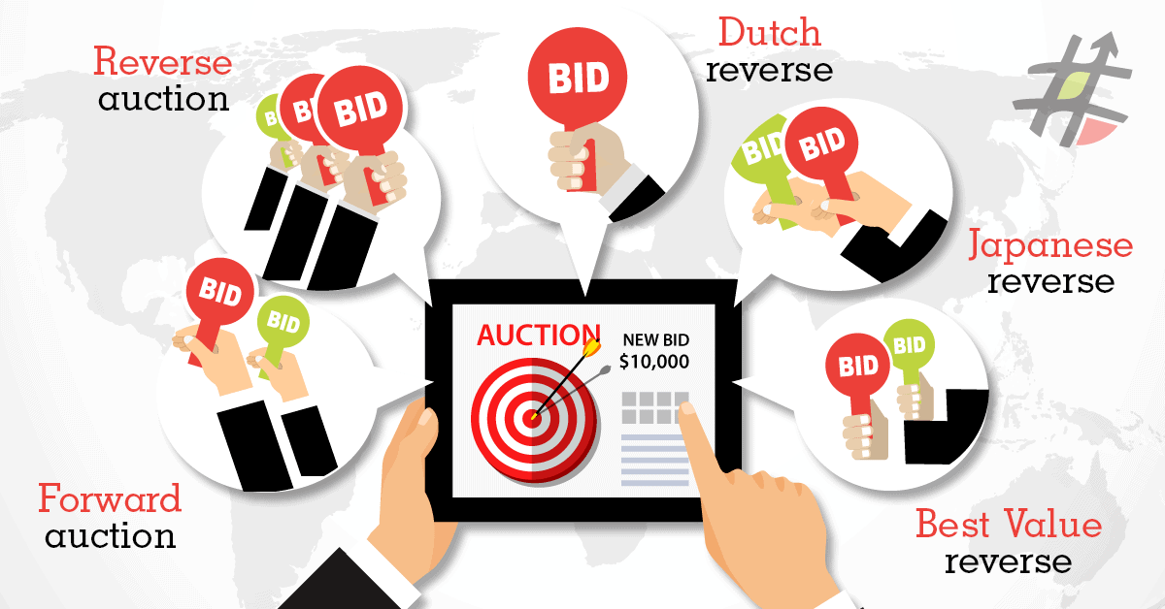
REQUIREMENTS
Problem Statement.
Functional Specifications.
Technical Specifications

Slide 5
PROBLEM STATEMENT
A online auction system is being designed for the user, so that they can easily take part in the bidding conducted online. The bidding takes place in a normal form way the people interested to buying the things placed in auction are supposed to bid for the particular product in a particular time period. The person placing the highest bid gets the right to own the item at the end of the bid. Bid is the exact amount of money offered on an item in auction in the bid by seller. The buyer with the highest bid is the one who finalizes the purchase of the item with the seller of the item. Winner is generally the person offering the highest bidding amount is called the winner of the auction

Slide 6
FUNCTIONAL SPECIFICATIONS
Login:
System will allow the user to login.
System will verify the user name and password.
System will not allow user to login with invalid username or password.
System will be able to remember username and password
Registration or create account:
System will allow users to create account.
Browsing and database search:
System will allow user to search products that are available for auction.
System shall display the result.
System will allow the bidder to bid on desired product.

Slide 7
My Auction:
FR10. System will allow users to post the ad for product they want to sell.
FR11. System will allow users view their active bids (that are in progress).
FR12. System will allow user to view their expired bids.
Purchase History:
FR13. System will allow the user to view their purchase history.

Slide 8
TECHNICAL SPECFICATION
Load data in a linked list to store all details in a file.
Making appropriate use of data structures and file handling.
Data validations

Slide 9
HARDWARE AND SOFTWARE
C language
Ubuntu/Linux terminal
System with i3 processor

Slide 10
MODULES
Login/user registration : Those who wish to take part in bidding or seller products at the site have to register at the site as seller or buyer
Admin: This module is for the administrator who may delete fake or unwanted ads
Seller : This is the seller module where the seller posts a product up for auctions.
Buyer : Here the buyer or the product bidder can see a list of products up for bidding and place his/her bid on the product.
Auction : This page is the interface for both buyer and seller, to see the profile of bidding history of items
Bidding Module : The module is for bidding on any selected item.

Slide 11
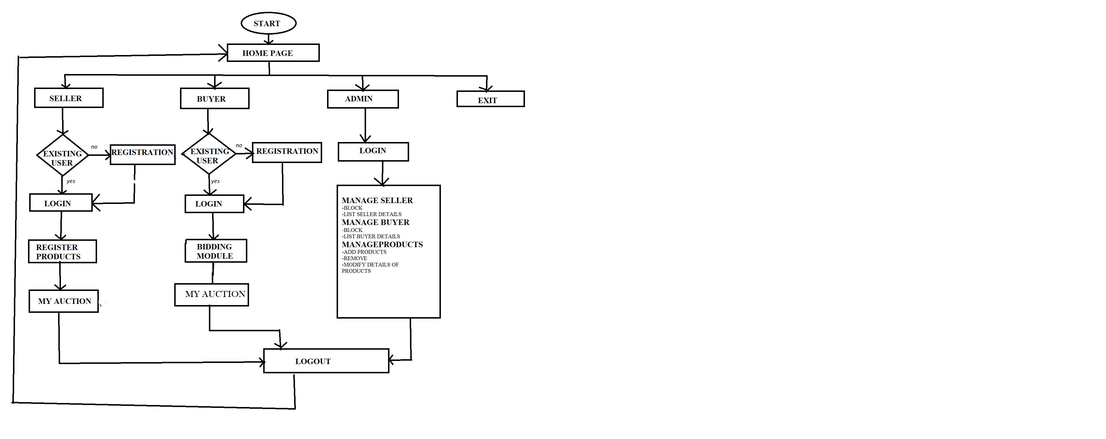
FLOW CHART

Slide 12
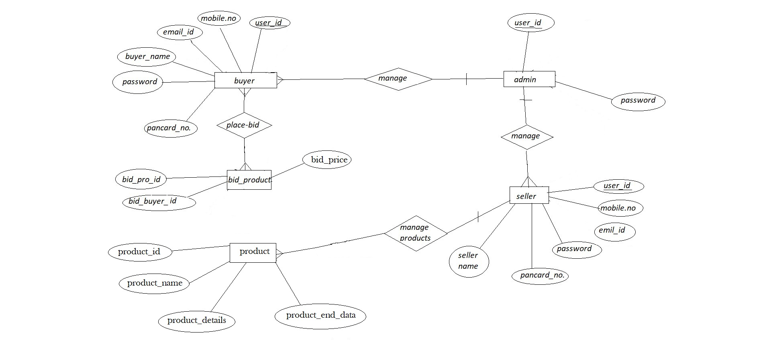
ER DIAGRAM

Slide 13
BENEFITS
No noisy crowds like conventional system where users have to sit and bid.
Excludes general frustration that usually happens while bidding in conventional system.
No schedule constraint that means bidder can bid any time and from anywhere.
The bidding process can be conducted on a global scale.

Slide 14

LIMITATIONS
Internet connection may be slow which can effect site efficiency
Lack of computer knowledge
Server problem

Slide 15
CONCLUSION
In present fast growing technology and software world web application are playing important role in increasing business mainly online purchase related websites are growing fast in every field.
Considering present trend this online auction system website is developed to help users to sell products based on live bid. The bidding process can be conducted on a global scale.

Slide 16


