Slide 1

AI reinvention made real
Accenture Innovation Challenge 2026

Slide 2

Team details
TEAM NAME: InsightForge
Muggu Jaya Sree (Team Leader)
College: Indian Institute of Technology Indore
Stream: Metallurgical Engineering and Materials Science
Year of graduation: 2027

Slide 3





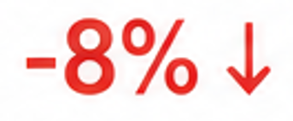





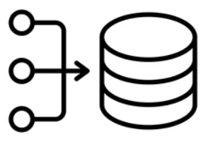

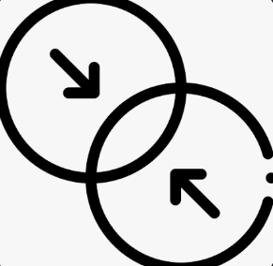



Describe the problem statement (200 words)
Business Intelligence: From “What Happened?” to “Why and What Next?”
THE GAP
Regional Revenue
?
→
Business dashboards show WHAT changed, but rarely explain WHY it changed or WHAT action should follow.
WHY?
Sales Data
Customer
Feedback
Operations
Reports
Market
Trends
Pricing &
Promotions
Example: A dashboard may show regional revenue dropped by 8%, but finding the reason still requires manual investigation.
→
→
Decision delayed
Analyst manually investigates multiple sources
Hours / Days
THE CHALLENGE
Multiple Data Sources
Signal vs. Noise
CORRELATION ≠ CAUSATION
Analysts must connect fragmented structured and unstructured data.
Normal fluctuations can be mistaken for meaningful changes, leading to false alarms or missed issues.
It is easy to confuse correlation with causation, resulting in incorrect conclusions and misguided actions.
WHAT BUSINESSES NEED
An intelligent KPI storytelling engine that can:
The system should also communicate uncertainty when evidence is insufficient, rather than generating unsupported conclusions, while keeping the final decision with the human.
→
→
→
→
DETECT
INVESTIGATE
COMBINE
EXPLAIN
RECOMMEND
Meaningful changes
Likely drivers
Structured + Unstructured data
The story in natural language
Next steps

Slide 4
Proposed solution (200 words) : KPI Storytelling Engine
HOW IT WORKS
1
DETECT
2
INVESTIGATE
3
COMBINE EVIDENCE
5
RECOMMEND
4
EXPLAIN
SQL + ML / Statistical Analysis
KPI / Driver Analysis
Structured Data + Unstructured Data
LLM + Evidence Layer
Next Best Action
Signal Detection
Driver Analysis
Evidence Sources
Key Insight
Recommended Actions
Identify meaningful changes and separate signal from normal variation.
Break down KPI changes across key business dimensions to identify and rank likely drivers.
Sales Data
CRM/ Customer Feedback
Operations Data
Reports / Market Data
✓ Review pricing strategy
Generate an evidence-backed explanation with confidence and uncertainty.
✓ Address top customer issues
✓ Monitor impact over time
SOLUTION ARCHITECTURE
EXAMPLE OUTPUT
DATA SOURCES
INGEST & PREPROCESS
KPI: Customer Churn Period: Q2 2025 Change: +12%
AI Insight
Enterprise customers are churning primarily due to service delays and unresolved issues.
Recommended Action
Prioritize at-risk customers and resolve recurring support issues.
AI & ANALYTICS
STORY & ACTION
DELIVERY
→
→
→
Data Ingestion Cleaning Feature Engineering
→
Change Detection Driver Analysis Ranking
Insight Generation Natural Language Narrative Recommendations Uncertainty
Dashboards Alerts Reports APIs
Sales & Finance CRM & Feedback Operations Market data
Key Drivers
Support delays ↑ 28%
Product usage ↓ 19%
Renewal rate ↓ 15%
Confidence: Medium | Human Review Recommended

Slide 5
Thank you

