Slide 1
EASWARI ENGINEERING COLLEGE
Department of Information Technology
ELLIPTICAL SEIZURE CLASSIFICATION FROM ELECTROENCEPHALOGRAPHY SIGNALS AND 2-D IMAGES: A COMPREHENSIVE APPROACH
PROJECT BY:
Jayasri. S. V
310620205030 Kavya Mishra
310620205038
SUPERVISOR:
Mrs. M. Anita
(Assistant Professor)
Information Technology

Slide 2
AGENDA
❖Abstract
❖Objective and Goals
❖Literature Survey
❖Proposed Work
❖Architecture of Proposed Work
❖List of Modules
❖Methodology
❖Output Screenshots
❖Conclusion
❖References

Slide 3
ABSTRACT
Electroencephalography (EEG) signals - understanding and diagnosing epileptic seizures.
Accurate classification of different seizure types is crucial for effective medical intervention and patient care.
Novel approach for seizure type classification utilizing deconstructed EEG signals generate detailed input images for a deep learning model.
Creation of comprehensive input images, offering a fine-grained representation of the underlying neural activity.
A deep learning model is then trained on these images, enabling accurate classification of different seizure types.
The results demonstrate the effectiveness of this approach, showcasing promising potential for improved seizure classification and enhanced diagnostic accuracy in the field of epilepsy research and clinical practice.

Slide 4
OBJECTIVE AND GOALS
OBJECTIVE:
The primary objective of this project is to develop an effective method for classifying different types of seizures using electroencephalogram (EEG) signals.
GOAL:
The project's goal is to design and train a deep learning model, a combination of Convolutional Neural Network (CNN) and Long Short-Term Memory (LSTM) networks.
The project differentiates between various seizure categories and potentially identifies when a patient is not experiencing a seizure (seizure-free state).

Slide 5
LITERATURE SURVEY
S.NO | TITLE | YEAR | OBJECTIVE | DISADVANTAGE
1. | Seizure Types Classification by Generating Input Images With in-Depth Features From Decomposed EEG Signals for Deep Learning Pipeline | 2022 | Enhance classification of seizure types using electroencephalogram (EEG) signals by leveraging advanced signal decomposition techniques and constructing a hybrid deep learning (DL) pipeline. | The process of overlapping the EEG signal segments in the segmentation step leads to data redundancy and over-fitting issues which requires more computational resource.
2. | Deep learning-based electroencephalography analysis | 2020 | Detect epileptic seizures in real-time by monitoring vital physiological signs and body movements. | Uses traditional machine learning methodology which might not be suitable as it fully relies on pre-defined hand-crafted features

Slide 6
LITERATURE SURVEY
S.NO | TITLE | YEAR | OBJECTIVE | DISADVANTAGE
3. | Machine Learning for Predicting Epileptic Seizures Using EEG Signals | 2021 | Cutting-edge machine learning (ML) techniques applied to early prediction of epileptic seizures using EEG signals, assessing their potential to transform clinical practice. | Performs only detections of seizures and does not classify making it difficult to cure
4. | seizure type classification using EEG based on Gramian angular field transformation and deep learning | 2021 | Employ the gramian angular summation field technique to transform 1D EEG signals into informative 2D images, enabling automatic feature extraction and efficient classification using CNN. | It becomes quite challenging when analyzing 1D EEG signals by converting them into 2D images through gramian angular summation field technique.

Slide 7
PROPOSED WORK
EEG signals are decompose into multiple subcomponents to reveal hidden features within the data.
Hilbert Vibration Decomposition (HVD) is used to break down the EEG signals into their subcomponents while preserving phase information.
From the decomposed subcomponents, first three subcomponents are selected as they have high energy.
Continuous Wavelet Transform to convert these subcomponents into 2D images.
The classification task is performed using a hybrid deep learning pipeline.
This pipeline combines two types of neural networks: Convolutional Neural network (CNN) and long short-term memory (LSTM) in a serial manner.
t-SNE (t-Distributed Stochastic Neighbor Embedding) algorithm is used to reduce the dimensionality of the features extracted from CNN and to provide a clustered view of the 6 types of seizure

Slide 8
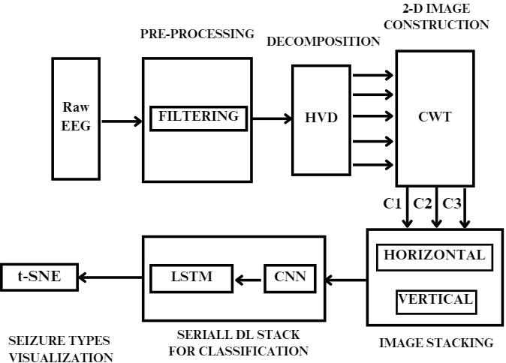
ARCHITECTURE

Slide 9
LIST OF MODULES
Module 1 : Data Collection and Preprocessing
Module 2 : EEG Signal Decomposition
Module 3 : Image Generation
Module 4 : Image Stacking
Module 5 : Feature Extraction and Classification
Module 6 : Classification Visualization

Slide 10
METHODOLOGY
Data collection and Preprocessing
The dataset (TUH – Temple University Hospital) contains EEG recordings.
The recordings are stored in European Data Format (EDF).
Preprocessing:
This data set is already free from noise and other irrelevant signals that range over 50Hz.
Butterworth 5th order filter can be used if necessary.

Slide 11
METHODOLOGY
Hilbert Vibration Decomposition (HVD)
The purpose of applying HVD is to extract meaningful features from the EEG signals.
HVD is a signal processing technique that decomposes non-stationary signals into a set of oscillatory components with varying frequencies, amplitudes, and phases
But we are classifying only based on frequency.
By decomposing EEG signals using HVD, we can extract several subcomponents that capture different aspects of the underlying neural activity.
We save each of the subcomponents in a csv file.

Slide 12
METHODOLOGY
Continuous Wavelet Transform (CWT)
Using CWT, we generate 2D using sonograms.
By generating sonogram images for the obtained subcomponents, we can visualize how the frequency characteristics of the EEG signal change over time within each frequency band (for which we have classified in HVD as subcomponents).
Sonograms can highlight patterns or features in the signal that may not be apparent in the time-domain or frequency-domain representations alone.
These patterns can potentially contain valuable information for distinguishing between different types of seizures or other neurological phenomena.
Each subcomponent will have one 2D image, which is stored manually in the drive for image stacking.

Slide 13
METHODOLOGY
Convolutional Neural Network (CNN) and Long Short Term Memory (LSTM) Model Training
CNNs are effective for learning spatial features from image data.
LSTMs are well-suited for capturing temporal dependencies in sequential data.
By passing the stacked images through a CNN, we can extract hierarchical spatial features that capture the discriminative characteristics of different types of seizures.
These features are then fed into an LSTM to capture temporal dependencies and further refine the feature representations for classification.
Training a CNN-LSTM model in a serial manner enables end-to-end learning of features and classification.
CNN-LSTM models can automatically learn discriminative features directly from the input data which eliminates the need for manual feature engineering and making the classification process more data-driven.

Slide 14
METHODOLOGY
t-Distributed Stochastic Neighbor Embedding (t-SNE)
t-SNE enables visualization of clusters and patterns that may exist in the data.
This facilitates a better understanding of the distribution of different types of seizures and their relationships.
The output features from the CNN and LSTM models are lower-dimensional representations that capture relevant information extracted from the input signals.
Applying t-SNE to these features allows for more effective dimensionality reduction and visualization.
t-sne allows us to assess how well different types of seizures are separated in the feature space.

Slide 15
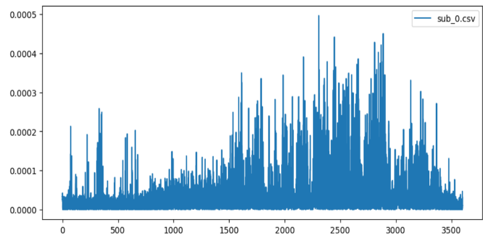
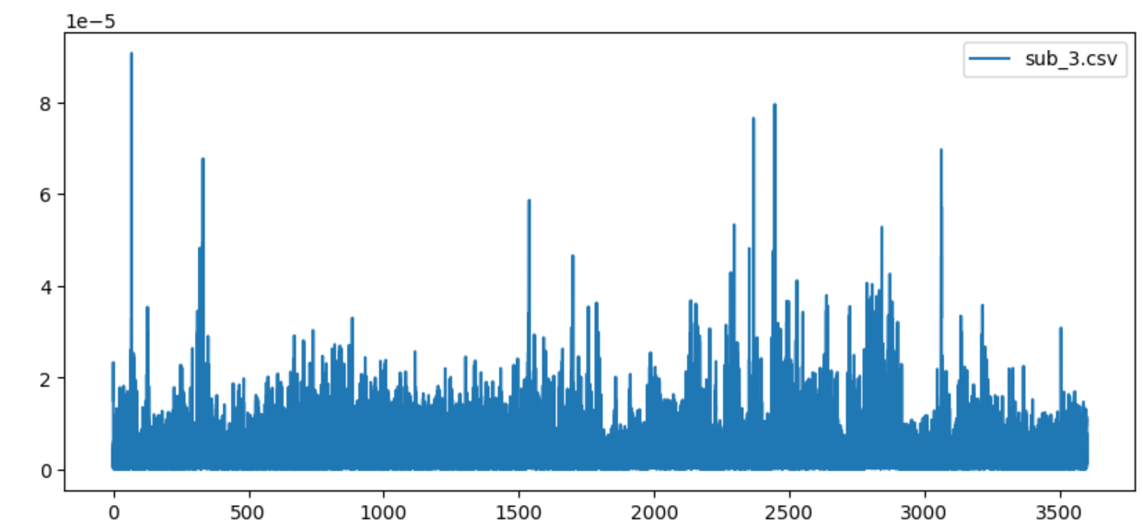
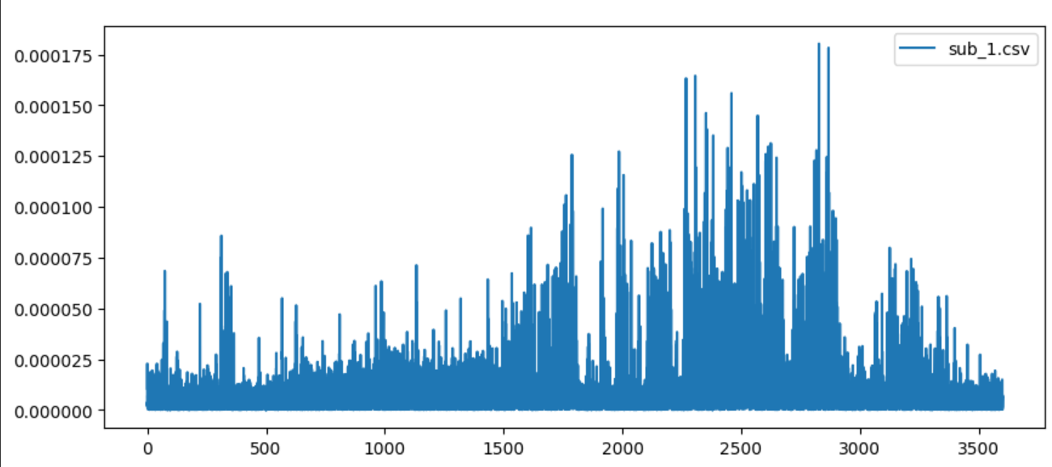
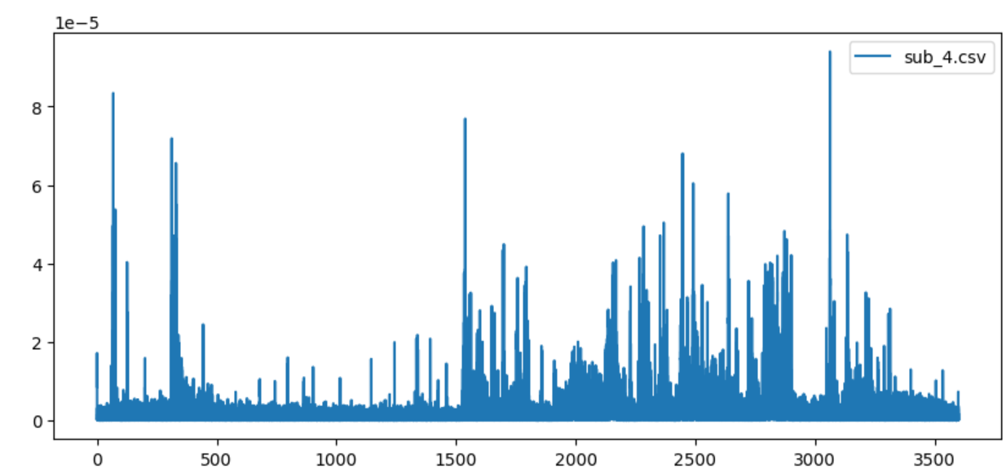
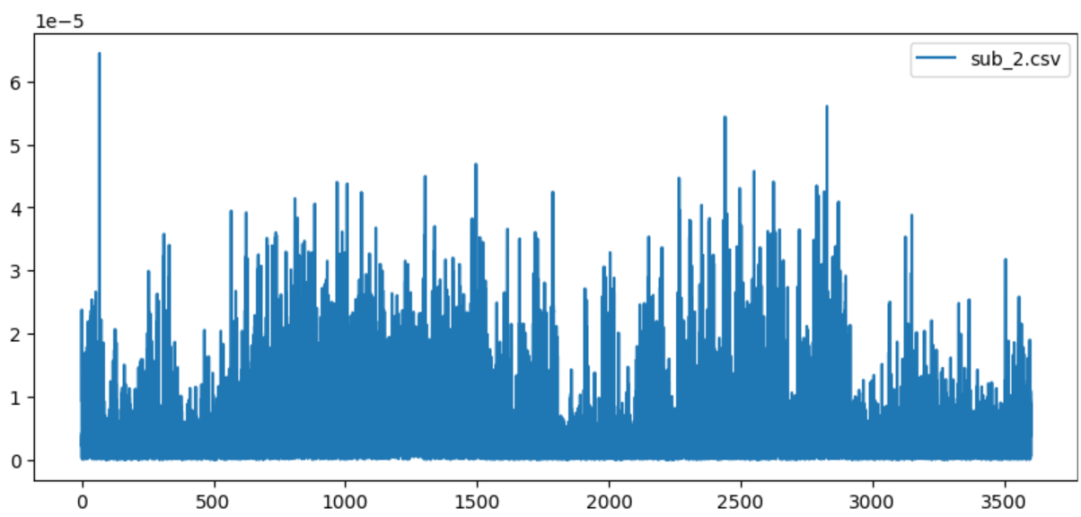
OUTPUT SCREENSHOT
HVD Subcomponent Plotting:
Fig.4.2.3.6 HVD plotting for sub_4

Slide 16
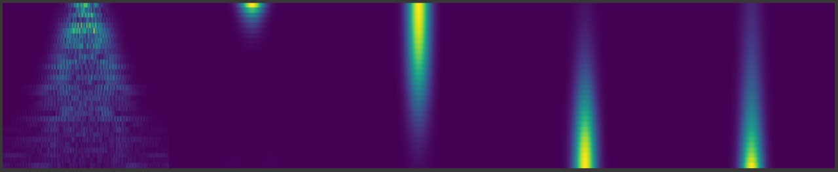


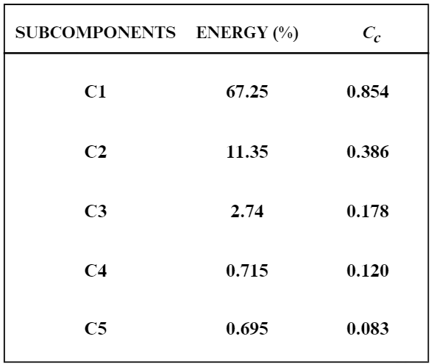
OUTPUT SCREENSHOT
CWT Image:
2D Image of sub_0
2D Image of sub_1
2D Image of sub_2
Energy Percentage of each subcomponent

Slide 17
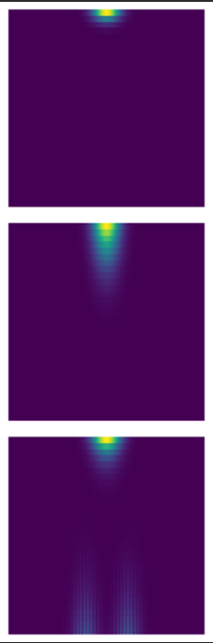
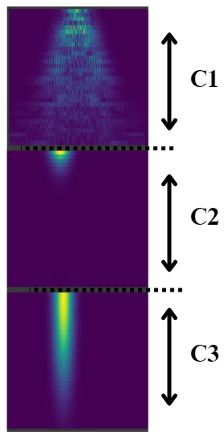
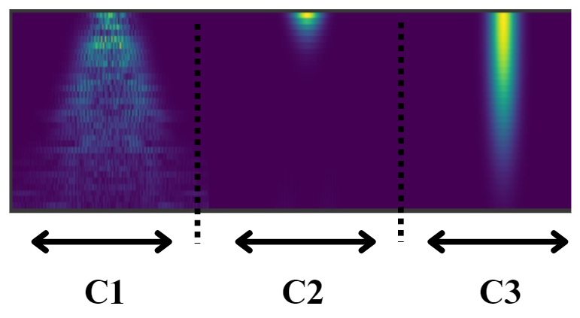
OUTPUT SCREENSHOT
Image Stacking:
Seizure Patient’s Vertical and Horizontal Stacking
Seizure Free Patient’s Vertical stacking

Slide 18
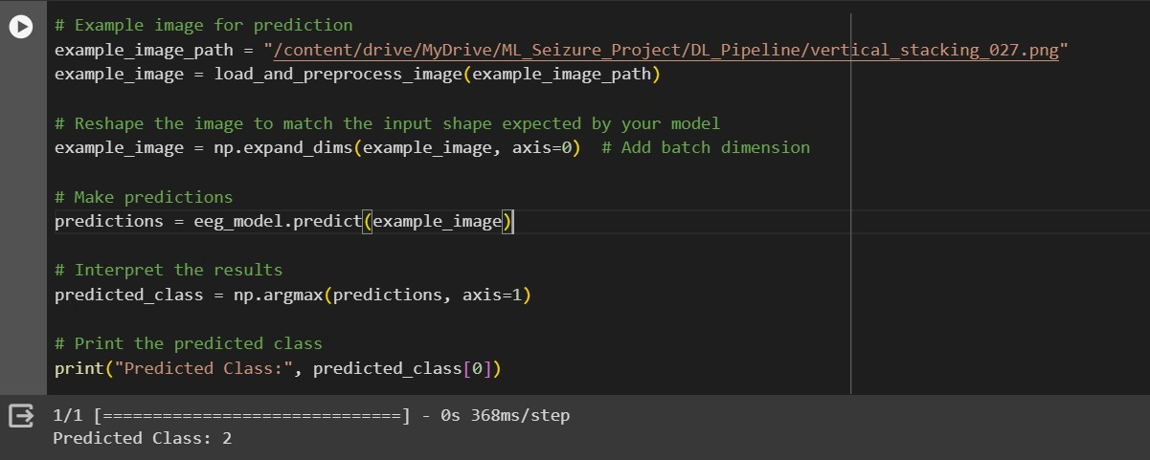
OUTPUT SCREENSHOT
Seizure Classification:
Patient 27 is said to have seizure type 2- CPS (Complex Partial Seizure)

Slide 19
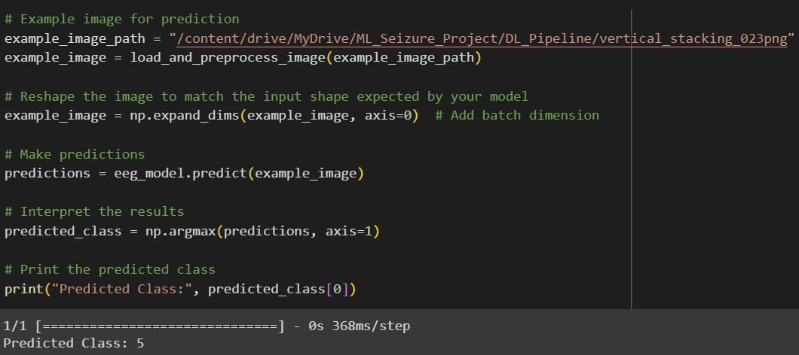
OUTPUT SCREENSHOT
Seizure Classification:
Patient 23 is said to have seizure type 5- SF (Seizure Free)

Slide 20
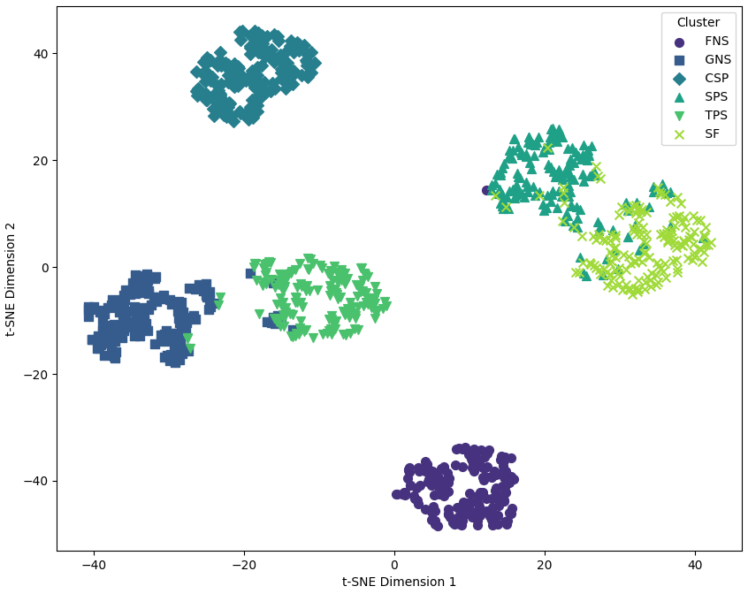
OUTPUT SCREENSHOT
t-SNE visualization of six seizure types:

Slide 21
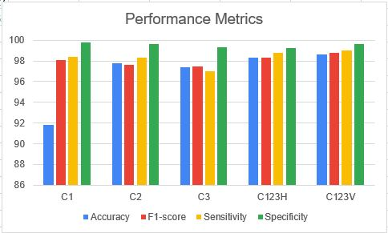
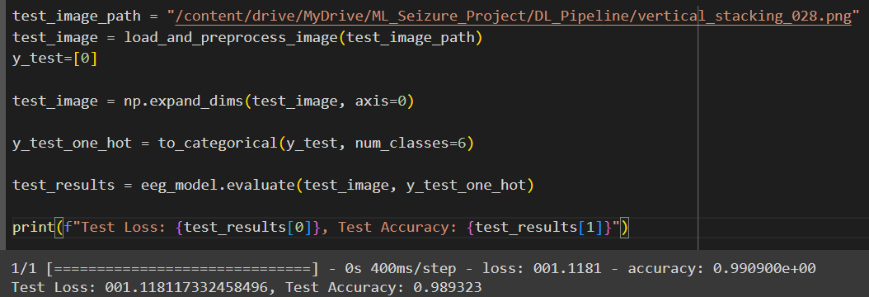
OUTPUT SCREENSHOT
Accuracy score of the model
Performance Metrics
98.93%

Slide 22
CONCLUSION
This project addresses a critical need in the medical field by utilizing deep learning to automate and enhance the classification of seizure types.
This ultimately leads to improved patient care, early intervention, customized treatment, and a better understanding of seizure disorders.
This research makes a substantial contribution to the area of neurology by successfully categorizing seizure types with such high accuracy.
In addition to streamlining medical procedures, the hybrid DL pipeline's accurate and automatic categorization gives medical staff members insightful information that helps them provide patients with individualized treatment.

Slide 23
REFERENCE
A. Shankar, S. Dandapat and S. Barma, "Seizure Types Classification by Generating Input Images With in-Depth Features From Decomposed EEG Signals for Deep Learning Pipeline," in IEEE Journal of Biomedical and Health Informatics, vol. 26, no. 10, pp. 4903-4912, Oct. 2022, doi: 10.1109/JBHI.2022.3159531.
A. Shoeibi et al., “Epileptic seizures detection using deep learning techniques: A review,” Int. J. Environ. Res. Public Health, vol. 18, no. 11, May 2021, Art. no. 5780
Rasheed K, Qayyum A, Qadir J, Sivathamboo S, Kwan P, Kuhlmann L, O'Brien T, Razi A. Machine Learning for Predicting Epileptic Seizures Using EEG Signals: A Review. IEEE Rev Biomed Eng. 2021;14:139-155. doi: 10.1109/RBME.2020.3008792. Epub 2021 Jan 22. PMID: 32746369.
A. Shankar, S. Dandapat, and S. Barma, “Seizure type classification using EEG based on Gramian angular field transformation and deep learning,” in Proc. IEEE 43rd Ann. Int. Conf. Eng. Med. Biol. Soc., Mexico, Nov. 2021, pp. 3340–3343.

Slide 24
THANK YOU

