Slide 1

Web Scrapping of Bus Routes for Data Analysis
by,
Jayasri DHANAPAL

Slide 2

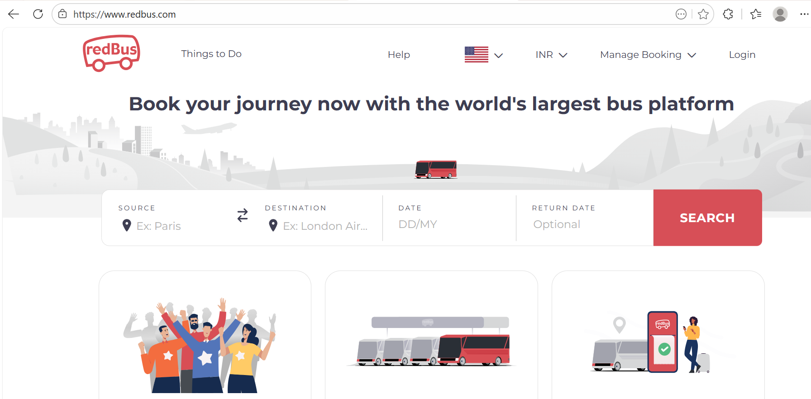
Objective
This project presents an applied study on how web-based transportation data can be analyzed to support informed decision-making.
It focuses on bus travel information such as pricing, passenger ratings, and seat availability to understand service quality and travel patterns.
The work demonstrates how real-world online data can be transformed into structured insights for analytical and practical use.

Slide 3
Motivation Behind the Project
Bus travel information such as price, ratings, and seat availability is often presented across different pages and sections of a website.
This makes it difficult for travelers to compare options and make confident decisions.
This project is motivated by the need to combine scattered travel details into a single analytical view.
The unified view enables clear comparison, pattern identification, and data-driven decision-making.

Slide 4
Justification for RedBus Platform
The project required a source that represents real-world bus travel choices and behavior.
RedBus presents bus information in a consistent format across routes and operators, making comparison meaningful.
It provides essential travel details such as price, ratings, timings, and seat availability in one platform.
Choosing this website allows the analysis to reflect practical travel scenarios rather than hypothetical data.

Slide 5
Significance of Bus Travel Data
Bus travel data provides insights into passenger preferences and operator performance.
Price reflects affordability and market positioning.
Rating shows passenger satisfaction and perceived service quality.
Seats Available indicates demand patterns and peak travel periods.
Benefit: Analyzing these dimensions together gives a complete view of travel value, helping travelers and operators make informed decisions.

Slide 6
Structured and Organized Data
Online bus data is primarily designed for human viewing, not analysis, which makes direct comparison difficult.
Structuring the data ensures that all travel details (price, ratings, seats, duration, operators) are consistently aligned for each bus route.
Organized data allows us to identify trends, compare operators fairly, and extract actionable insights.
Benefit: Converts scattered information into a reliable, decision-ready dataset that supports meaningful analysis.

Slide 7
Making Data Meaningful for Analysis
Once the data was structured, it still needed to be interpretable and decision-ready.
Transformations included:
  Converting duration into minutes for easier comparison
  Categorizing prices into budget, standard, premium
  Identifying peak vs non-peak travel hours
Purpose: These transformations turn raw numbers into actionable insights that can guide travelers and operators.
Benefit: Enables quick understanding of travel patterns, cost-quality trade-offs, and demand trends.
Bus_ID | Departure | Arrival | Duration | Duration_Minutes | Seats | Single_Seats | Price | Onwards | Operator | Bus_Type | Rating
26409654 | 23:15 | 06:10 | 6h 55m | 415 | 42 | 10 | 1250 | Onwards | Jayavin Travels | A/C Seater / Sleeper (2+1) | 4.4
44319378 | 21:55 | 04:30 | 6h 35m | 395 | 36 | 12 | 585 | Onwards | HYBUS | Bharat Benz A/C Sleeper (2+1) | 4.5
36258160 | 21:35 | 05:00 | 7h 25m | 445 | 24 | 8 | 1600 | Onwards | PADMAVATHI TRAVELS | A/C Sleeper (2+1) | 4.3
37971794 | 22:45 | 05:45 | 7h | 420 | 25 | 6 | 1400 | Onwards | Krish Travels | Bharat Benz A/C Seater /Sleeper (2+1) | 4.2

Slide 8
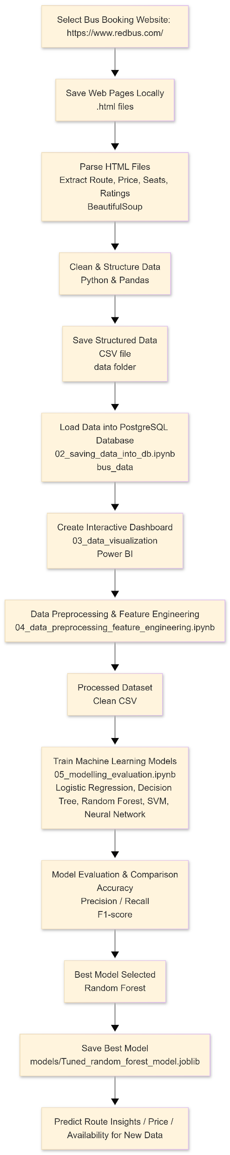
Project Architecture
Shows the end-to-end workflow of the project:
  1.Data Collection: Web scraping bus travel data from RedBus
  Data Cleaning & Structuring: Removing inconsistencies and organizing into clear fields
  Data Transformation: Converting raw data into actionable metrics (price categories, duration, peak hours)
  Machine Learning Models: Logistic Regression, Decision Tree, Random Forest, SVM, KNN for predictive insights
  Dashboard Visualization: Interactive exploration of insights
Purpose: Illustrates how raw online data is transformed into actionable, decision-ready insights.
Benefit: Helps viewers understand the logical flow of the project without looking at code.

Slide 9
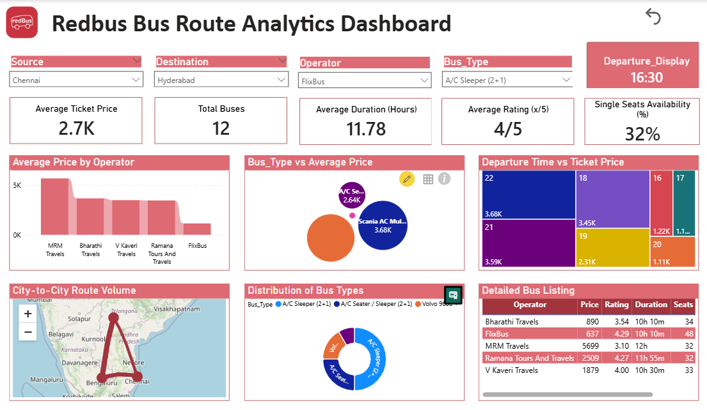
Interactive Dashboard for Data Exploration

Slide 10
Continued..
The dashboard allows dynamic exploration of bus travel data.
Key Features:
  Filter by Price, Rating, Seats, Departure/Arrival time
  Compare multiple routes and operators
  Reset button to explore different scenarios easily
Purpose: Converts structured and transformed data into a user-friendly interface for insights.
Benefit: Enables travelers and operators to make quick, data-driven decisions without analyzing raw data.

Slide 11
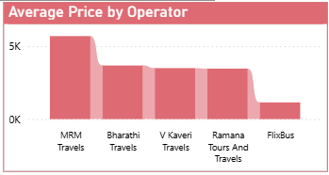
Route-Wise Price Comparison
Ticket price is one of the most influential factors for travel decisions.
Analyzing pricing across routes and operators helps to:
  Identify affordable options for travelers
  Detect premium or unusually low-priced services
  Understand operator pricing strategies in the market
Benefit: Supports economically informed decisions and highlights value-for-money travel options.

Slide 12
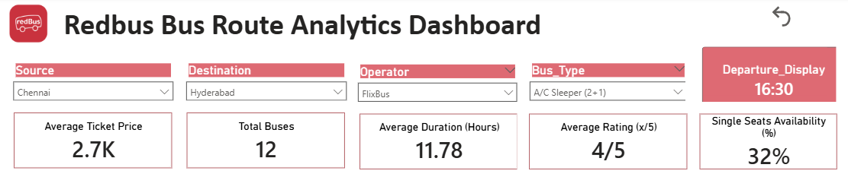
Evaluating Service Quality Through Ratings
Ratings reflect real passenger experiences and overall service quality.
Comparing ratings with price shows:
  Whether higher cost correlates with better service
  Which operators provide high-quality service at reasonable prices
Benefit: Helps travelers make value-driven choices, not just follow price or popularity.
Operators can identify areas for service improvement.

Slide 13
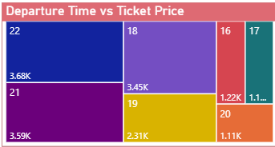
Analyzing Demand Based on Departure Time and Price
Travel demand often depends on departure time and ticket pricing.
Purpose: Identify high-demand time slots and price patterns.
Benefits:
  Travelers can choose optimal departure times for cost or convenience
  Operators can adjust pricing dynamically based on demand
  Highlights peak hours and pricing trends

Slide 14
Machine Learning Models & Predictive Insights
Objective: Predict the Price Category of bus routes using processed features.
Purpose: Help operators and travelers understand cost patterns and optimize planning.
Models Implemented:
  Logistic Regression
  Decision Tree
  Random Forest
  Support Vector Machine (SVM)
  Neural Network (MLP Classifier)
Model | Accuracy | F1 Score
Logistic Regression | 0.78 | 0.77
Decision Tree | 1.00 | 1.00
Random Forest | 0.94 | 0.94
SVM | 0.72 | 0.71
Neural Network | 0.86 | 0.86

Slide 15
Key Insights from Bus Travel Data
Price, Ratings, Seats: Identify demand patterns and service quality across routes.
Departure Time Analysis: Reveals peak-hour trends and pricing patterns.
Machine Learning Models: Decision Tree & Random Forest accurately predict Price Categories.
Dashboard: Enables interactive exploration for travelers and operators.

Slide 16
Conclusion
The project demonstrates how raw travel data can be converted into practical insights.
Insights from pricing, ratings, seats, and departure times help travelers and operators make informed choices.
Machine Learning models and dashboards enable accurate predictions and dynamic exploration of trends.
Overall, the project highlights the value of data science in real-world applications.

