Slide 1
Fashion MNIST Images Classification CNN & VIT
Jayasri Maditati

Slide 2
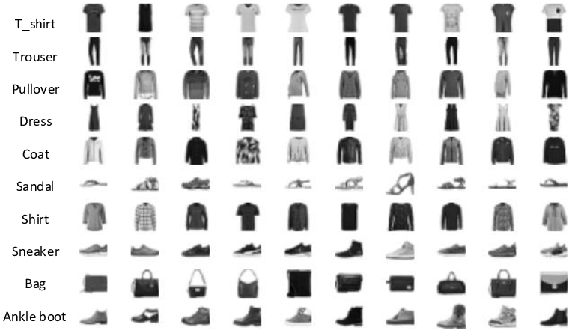
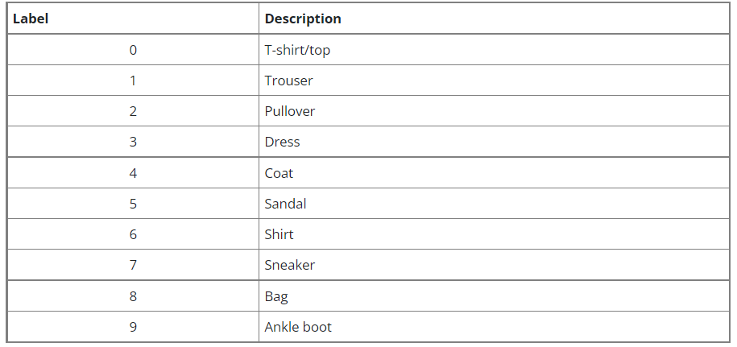
Fashion MNIST Dataset
Shape : (28,28,1) Training Samples: 60,000 Test Samples : 10,000

Slide 3
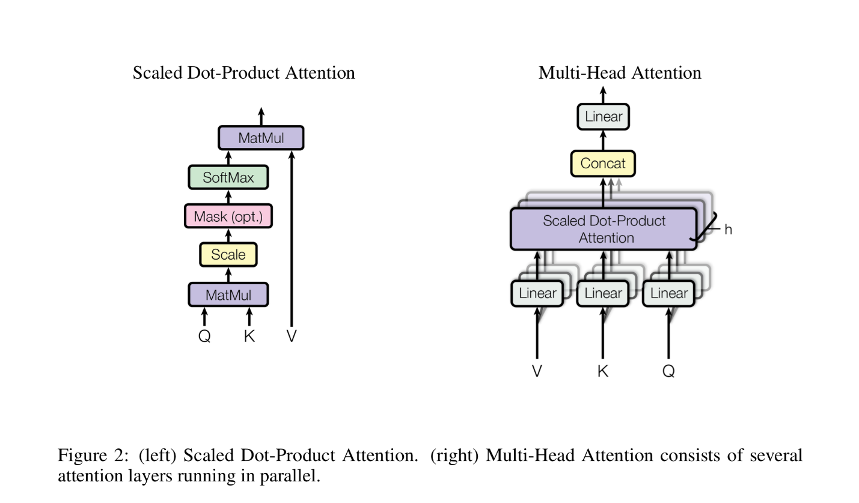
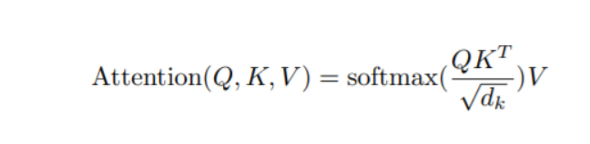
Transformers: Multi Head Self Attention
Notes:
The Multi-Head Attention layer split inputs into several heads so that each head can learn different levels of self-attention. The outputs of all the heads are then concatenated and passed through the Multi-Layer Perceptron.
The multiple attention heads help learn local and global dependencies in the image.

Slide 4
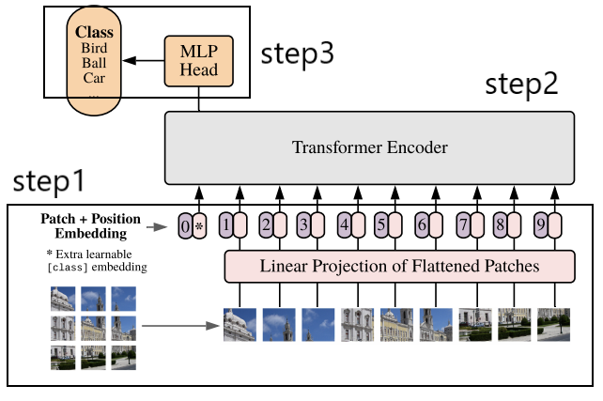
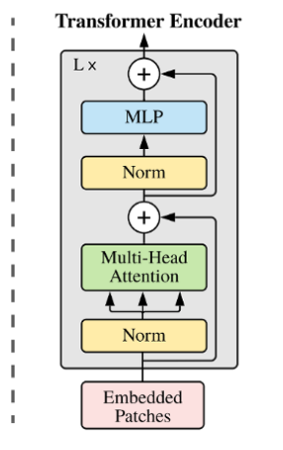
Vision Transformer

Slide 5
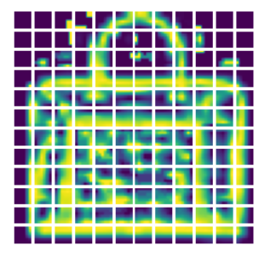
Step 1: Patch Encoder
Input Images (28,28,1)
Split Images into Patches (tf.image.extract_patches)
(Patch Size: 6, Number of patches: 144)
Flatten 2D images into 1D Patches using fully connected layer (64 Dimensions)
Patch size: 6 X 6
Patches per image: 144
Patch Encoder
Projection(Patch)+ Positional Embedding
Shape(None,144,64)
Notes:
For a standard 28×28 MNIST image, we’d have to deal with 784 pixels. If we were to pass this flattened vector of length 784 through the Attention mechanism, we’d then obtain a 784×784 Attention Matrix to see which pixels attend to one another. This is very costly even for modern-day hardware. This is why the paper suggests breaking the image down into square patches as a form of lightweight “windowed” Attention.
If we do not provide the transformer with the positional information, it will have no idea of the images’ sequence (which comes first and the images that follow it). So we will be using Positional Encodings/Embeddings that establish a certain order in the inputs.

Slide 6
Embedded Patches (No. of Patches, dim)
Layer Normalization
Residual
Multi Head Attention(4 Heads)
8 Transformer Layers
Layer Normalization
Residual
2 layer MLP
Layer Normalization
(No.of Patches, dim)
Flatten

Slide 7
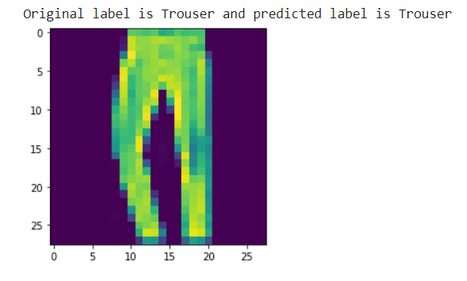
Step3: Dense Network (Classifier)
Flattened Output from Transformer Encoder
MLP (2048, 1024)
Classifier(Dense Network)
(None, 10)

Slide 8
CNN vs Transformers
CNN | Transformers
Feature Map | Attention map
Pixels | Patches
Batch Normalization | Layer Normalization
Doesn't Outperforms on large datasets | Outperforms CNN over large datasets
pooling or Strided convolution to change spatial dimension an input shape | complex transformation beyond simple scaling - MLP
Translation Invariant | By performing self attention across of patches of pixels and it needs large dataset to achieve
Notes:
Are Vision Transformers going to replace CNNs in computer vision tasks?
CNN’s have ruled in computer vision tasks so far. An image is based on the idea, that one pixel is dependent on its neighboring pixels, and the next pixel is dependent on its immediate neighboring pixels (be it color, brightness, contrast, and so on). CNN’s work on this idea, and uses filters on a patch of an image to extract important features and edges. This helps the model to learn only the necessary important features from an image, and not details of each pixel of an image.
However, if entire image data is fed into a model, rather than just the parts that the filters can extract (or it considers important), the chances of the model performing better are higher. This is exactly what is happening inside a Visual Transformer. This can be one reason why in this case, Vision Transformers work better than most CNN models.
But why are we trying to replace convolutional neural networks (CNNs) for computer vision applications? This is because transformers can efficiently use a lot more memory and are much more powerful when it comes to complex tasks. This is, of course, according to the fact that you have the data to train it.

Slide 9
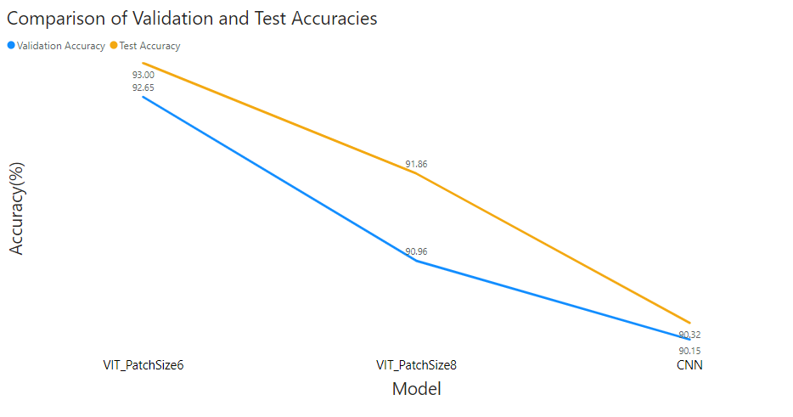
Notes:
Impact of dataset size
The size of the dataset seems to play a major role in the vision transformer model. Since transformers lack inherent biases present in CNNs, i.e., locality, equivariance, and translation, they tend to generalize poorly on mid-sized datasets such as ImageNet.
But, when trained on the ImageNet-21 and JFT-300M (Google’s in-house dataset), which are larger datasets with about 14M-300M images, it was found that inductive bias was outperformed. They also found the accuracy to increase with the larger datasets.
Conclusion:
Sure, these scores are great. Although I, like many others, still believe we’re far from a reality where Transformers perform most up/downstream tasks. Their operations are compute-heavy, training takes ages on decent hardware, and the final trained model is too large to host on hacky servers (for projects, at least) without severe latency issues during inference. It has its shortcomings that have to be dealt with before becoming the convention in industry applications.
Yet, this is just the beginning; I’m sure there’ll be tons of research in this area to make Transformer architectures more efficient and lightweight. Till then, we’ve got to keep swimming.

Slide 10
APPENDIX
Notes:
Impact of dataset size
The size of the dataset seems to play a major role in the vision transformer model. Since transformers lack inherent biases present in CNNs, i.e., locality, equivariance, and translation, they tend to generalize poorly on mid-sized datasets such as ImageNet.
But, when trained on the ImageNet-21 and JFT-300M (Google’s in-house dataset), which are larger datasets with about 14M-300M images, it was found that inductive bias was outperformed. They also found the accuracy to increase with the larger datasets.
Conclusion:
Sure, these scores are great. Although I, like many others, still believe we’re far from a reality where Transformers perform most up/downstream tasks. Their operations are compute-heavy, training takes ages on decent hardware, and the final trained model is too large to host on hacky servers (for projects, at least) without severe latency issues during inference. It has its shortcomings that have to be dealt with before becoming the convention in industry applications.
Yet, this is just the beginning; I’m sure there’ll be tons of research in this area to make Transformer architectures more efficient and lightweight. Till then, we’ve got to keep swimming.

Slide 11
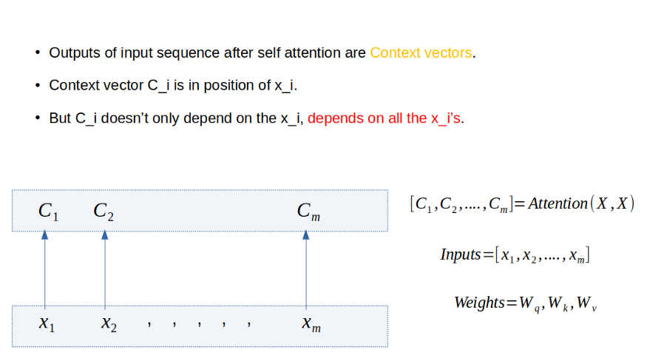
Notes:
Impact of dataset size
The size of the dataset seems to play a major role in the vision transformer model. Since transformers lack inherent biases present in CNNs, i.e., locality, equivariance, and translation, they tend to generalize poorly on mid-sized datasets such as ImageNet.
But, when trained on the ImageNet-21 and JFT-300M (Google’s in-house dataset), which are larger datasets with about 14M-300M images, it was found that inductive bias was outperformed. They also found the accuracy to increase with the larger datasets.
Conclusion:
Sure, these scores are great. Although I, like many others, still believe we’re far from a reality where Transformers perform most up/downstream tasks. Their operations are compute-heavy, training takes ages on decent hardware, and the final trained model is too large to host on hacky servers (for projects, at least) without severe latency issues during inference. It has its shortcomings that have to be dealt with before becoming the convention in industry applications.
Yet, this is just the beginning; I’m sure there’ll be tons of research in this area to make Transformer architectures more efficient and lightweight. Till then, we’ve got to keep swimming.

Slide 12
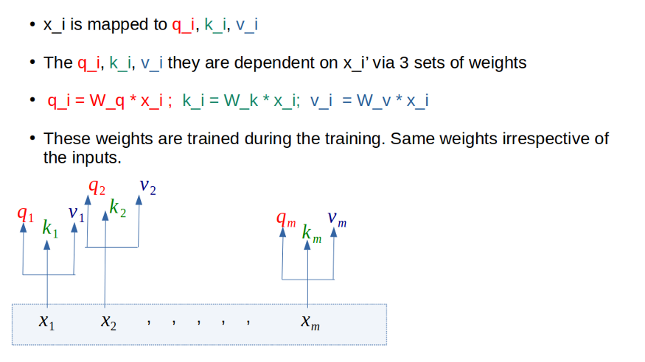
Notes:
Impact of dataset size
The size of the dataset seems to play a major role in the vision transformer model. Since transformers lack inherent biases present in CNNs, i.e., locality, equivariance, and translation, they tend to generalize poorly on mid-sized datasets such as ImageNet.
But, when trained on the ImageNet-21 and JFT-300M (Google’s in-house dataset), which are larger datasets with about 14M-300M images, it was found that inductive bias was outperformed. They also found the accuracy to increase with the larger datasets.
Conclusion:
Sure, these scores are great. Although I, like many others, still believe we’re far from a reality where Transformers perform most up/downstream tasks. Their operations are compute-heavy, training takes ages on decent hardware, and the final trained model is too large to host on hacky servers (for projects, at least) without severe latency issues during inference. It has its shortcomings that have to be dealt with before becoming the convention in industry applications.
Yet, this is just the beginning; I’m sure there’ll be tons of research in this area to make Transformer architectures more efficient and lightweight. Till then, we’ve got to keep swimming.

Slide 13
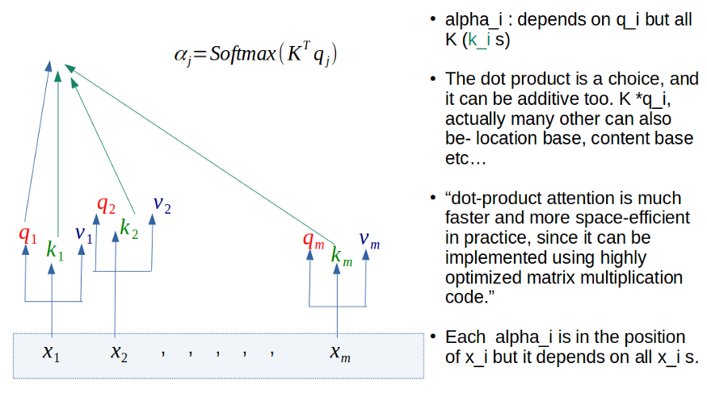
Notes:
Impact of dataset size
The size of the dataset seems to play a major role in the vision transformer model. Since transformers lack inherent biases present in CNNs, i.e., locality, equivariance, and translation, they tend to generalize poorly on mid-sized datasets such as ImageNet.
But, when trained on the ImageNet-21 and JFT-300M (Google’s in-house dataset), which are larger datasets with about 14M-300M images, it was found that inductive bias was outperformed. They also found the accuracy to increase with the larger datasets.
Conclusion:
Sure, these scores are great. Although I, like many others, still believe we’re far from a reality where Transformers perform most up/downstream tasks. Their operations are compute-heavy, training takes ages on decent hardware, and the final trained model is too large to host on hacky servers (for projects, at least) without severe latency issues during inference. It has its shortcomings that have to be dealt with before becoming the convention in industry applications.
Yet, this is just the beginning; I’m sure there’ll be tons of research in this area to make Transformer architectures more efficient and lightweight. Till then, we’ve got to keep swimming.

Slide 14
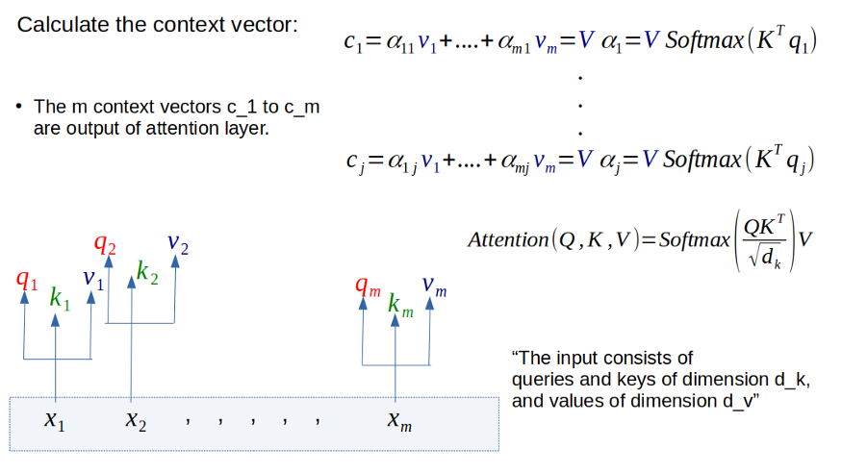
Notes:
Impact of dataset size
The size of the dataset seems to play a major role in the vision transformer model. Since transformers lack inherent biases present in CNNs, i.e., locality, equivariance, and translation, they tend to generalize poorly on mid-sized datasets such as ImageNet.
But, when trained on the ImageNet-21 and JFT-300M (Google’s in-house dataset), which are larger datasets with about 14M-300M images, it was found that inductive bias was outperformed. They also found the accuracy to increase with the larger datasets.
Conclusion:
Sure, these scores are great. Although I, like many others, still believe we’re far from a reality where Transformers perform most up/downstream tasks. Their operations are compute-heavy, training takes ages on decent hardware, and the final trained model is too large to host on hacky servers (for projects, at least) without severe latency issues during inference. It has its shortcomings that have to be dealt with before becoming the convention in industry applications.
Yet, this is just the beginning; I’m sure there’ll be tons of research in this area to make Transformer architectures more efficient and lightweight. Till then, we’ve got to keep swimming.

