Slide 1
NETWORK TRAFFIC ANALYSIS
CYBER SECURITY
Presented By:
S.Jayasri
Salem college of engineering and technology
Computer science and engineering

Slide 2
OUTLINE
Problem Statement (Should not include solution)
Proposed System/Solution
System Development Approach (Technology Used)
Algorithm & Deployment
Result (Output Image)
Conclusion
Future Scope
References

Slide 3
Problem Statement
The ever-growing volume and complexity of network traffic make it increasingly difficult to distinguish between legitimate activity and malicious threats. Traditional security measures like firewalls are no longer sufficient to catch sophisticated cyberattacks that exploit vulnerabilities and blend in with normal network operations.

Slide 4
Proposed Solution
Data Collection:
Packet Capture: Capturing full network packets for deep inspection (useful for forensics but resource-intensive)
API Integration: Pulling data directly from network devices and security tools through APIs.
Data Preprocessing
Data Cleaning: Cleanse the collected data to remove errors and inconsistencies.
Normalization: Format the data into a consistent structure for easier analysis. This might involve converting timestamps to a common format or scaling numerical values.
Machine Learning and Behavioral Analytics:
Implement a system that continuously monitors network traffic data (flow records, telemetry) using machine learning algorithms.

Slide 5
System Approach
Data Analysis and Threat Detection:
Baseline Creation: Establish a baseline for "normal" traffic patterns within your network. This involves analyzing historical data to understand typical user behavior, application usage, and traffic volumes.
Anomaly Detection: Implement anomaly detection techniques to identify deviations from the established baseline. These techniques can be statistical (e.g., identifying unusual traffic volumes) or machine learning-based (e.g., using algorithms to detect patterns indicative of malicious activity).
Alerting
Alert Generation: Generate alerts based on the identified anomalies and threat correlations. Prioritize alerts based on severity and potential impact.

Slide 6
Algorithm & Deployment
Statistical Anomaly Detection:
Mean and Standard Deviation: Flags traffic exceeding a certain number of standard deviations from the average.
Interquartile Range (IQR): Identifies outliers falling outside the IQR, which encompasses the middle 50% of data points.
Machine Learning (ML) Algorithms:
Supervised Learning: Requires labeled data (normal vs. malicious) for training models like Support Vector Machines (SVM) or Random Forests to identify malicious patterns.
Unsupervised Learning: Analyzes unlabeled data to group similar traffic flows. K-Means clustering can be used to segment traffic based on features like source/destination IP, protocol, or port usage.
Deployment Considerations for Network Traffic Analysis
Data Collection and Storage:
Choose efficient methods like flow data collection for real-time analysis. Packet capture might be needed for forensic investigations but requires significant storage.
Network Infrastructure Integration:
Integrate seamlessly with existing network devices (firewalls, switches) and security tools (IDS/IPS) through APIs or agent deployment for comprehensive data collection.
Security:
Implement robust security measures to protect sensitive network traffic data at rest and in transit. Encryption and access controls are crucial.

Slide 7
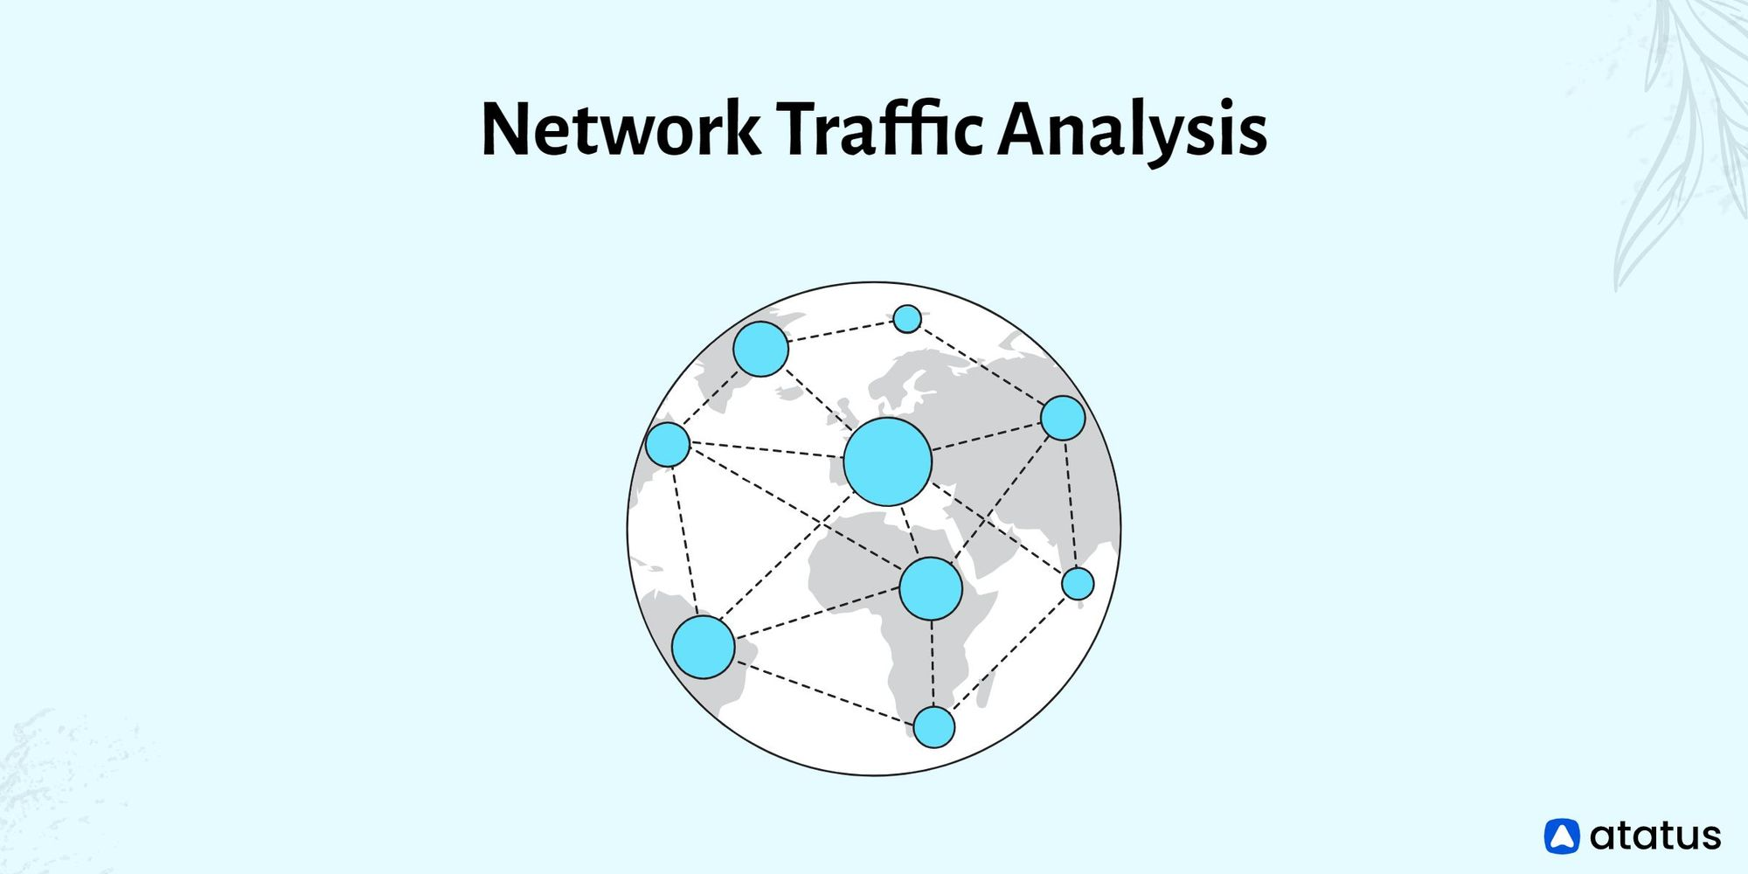
Result
Improved Threat Detection:
By analyzing patterns and deviations from normal traffic behavior, NTA can proactively identify malicious activities like malware communication, lateral movement within the network, or data exfiltration attempts.
Machine learning algorithms can detect even sophisticated threats that bypass traditional signature-based security solutions.
Enhanced Network Visibility:
NTA provides a comprehensive view of network activity, including both north-south traffic (entering and leaving the network) and east-west traffic (communication within the network).
This visibility helps identify potential vulnerabilities and suspicious communication patterns that might be missed by traditional security measures.

Slide 8
Conclusion
Key takeaways to emphasize in your conclusion:
Proactive Threat Detection: NTA empowers organizations to move beyond reactive security measures. By identifying anomalies and suspicious patterns, it allows for early detection and mitigation of threats before they can cause significant damage.
In conclusion, network traffic analysis offers a powerful and multifaceted approach to cybersecurity. By leveraging its capabilities, organizations can significantly enhance their ability to detect, respond to, and ultimately prevent cyber threats.

Slide 9
Future scope
The future of network traffic analysis (NTA) is bright, driven by advancements in technology and the ever-evolving threat landscape.
Integration with Cloud and IoT Security:
As cloud adoption and the Internet of Things (IoT) continue to rise, NTA solutions will need to adapt to analyze traffic from these dynamic environments.
Expect to see tools capable of handling the unique challenges of cloud-based infrastructure and the ever-growing volume of data generated by IoT devices.
Focus on Deception and Honeypots:
NTA might be integrated with deception technologies. By planting honeypots (decoy systems) within the network, security teams can lure attackers and leverage NTA to analyze their network traffic patterns, helping to identify their tactics and techniques.

Slide 10
References
Here are some references for network traffic analysis:
"Practical Packet Analysis: Using Wireshark to Solve Real-World Network Problems" by Chris Sanders
"Network Forensics: Tracking Hackers through Cyberspace" by Sherri Davidoff and Jonathan Ham - This book covers network forensics techniques, including analyzing network traffic to detect and investigate security incidents.
"Applied Network Security Monitoring: Collection, Detection, and Analysis" by Chris Sanders, Jason Smith, and Jake Williams - This book focuses on network security monitoring, including traffic analysis techniques for threat detection and response.
These references cover various aspects of network traffic analysis,from basic techniques to advanced topics like network forensics and security monitoring. Depending on your specific interests and level of expertise, you can choose the most relevant resources for your needs.

Slide 11
THANK YOU

