Slide 1
REACT JS
DAY 27
INNOLIFT VENTURES
COMPONENTS,JSX,PROPS
FULL STACK WEB DEVELOPMENT INTERSHIP

Slide 2
OUTCOMES
What is React?
Why React?
React vs React Native
React vs Traditional Websites
SPA (Single Page Application)
React Ecosystem (Next.js & TypeScript)
Installing React Vite
Components
JSX
Props

Slide 3
What is react?
React is an open-source JavaScript library used to build fast, interactive, and reusable User Interfaces (UI) for modern web applications. It was developed by Facebook (Meta) and officially released in 2013.
Key Features
Component-Based – Build applications using reusable UI components.
Virtual DOM – Updates only the changed parts of the page for better performance.
Single Page Application (SPA) – Loads one HTML page and updates content without full page reloads.
JSX – Write HTML-like syntax inside JavaScript for easier UI development.
Declarative UI – Describe how the UI should look, and React updates it automatically.
Library, Not a Framework – Focuses only on the UI layer, giving developers flexibility to choose other tools.

Slide 4
Why Developers Choose React
Fast Performance – Uses Virtual DOM to update only the changed parts of the page.
Reusable Components – Build once and reuse components across the application.
Easy to Develop & Maintain – Declarative approach makes code clean, simple, and easy to manage.
Supports Single Page Applications (SPA) – Provides a smooth user experience without full page reloads.
Large Community & Ecosystem – Backed by Meta (Facebook) with strong community support and many libraries.
"React is popular because it's fast, reusable, easy to maintain, and widely used by companies to build modern web applications."

Slide 5
Traditional Website vs React (SPA)
Traditional Website | React Application (SPA)
Loads a new HTML page for every request | Loads one HTML page initially
Full page reload on navigation | No full page reload
Requests the server for every page | Updates content inside the browser
Directly updates the DOM | Uses Virtual DOM for faster updates
Slower user experience | Faster and smoother user experience
Code is less reusable | Uses reusable components
Best for simple websites | Best for dynamic, interactive web applications

Slide 6
Virtual DOM
Virtual DOM is a lightweight copy of the Real DOM.
React updates the Virtual DOM first instead of the Real DOM.
React compares the Virtual DOM with the Real DOM (Diffing).
Only the changed elements are updated in the Real DOM.
This reduces unnecessary page updates and improves performance.

Slide 7
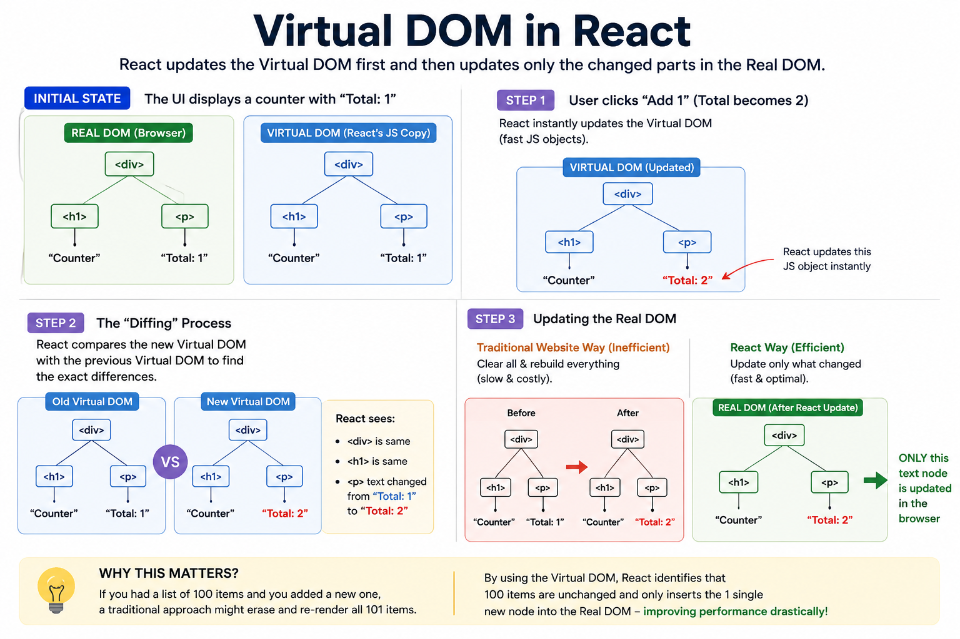
VIRTUAL DOM

Slide 8
What is Single Page Application (SPA)
A Single Page Application (SPA) is a web application that loads a single HTML page initially.
Instead of reloading the entire page, it updates only the required content dynamically using JavaScript.
This provides a fast, smooth, and responsive user experience.
Example:
📍 Google Maps – Switching between Map and Satellite view updates the interface instantly without reloading the entire page.

Slide 9
React vs React Native
Feature | React JS | React Native
Purpose | Builds interactive web applications | Builds native mobile applications
Target Platform | Web Browsers | Android & iOS
Rendering | Renders HTML using the Virtual DOM (ReactDOM) | Renders Native UI Components (No HTML/DOM)
Language | JavaScript (JSX) | JavaScript (JSX)
Styling | CSS, SCSS, Tailwind, Bootstrap | StyleSheet API (CSS-like styling)
Example Applications | Gmail, Facebook Web, Netflix Web | Facebook App, Instagram, Shopify, Discord Mobile

Slide 10
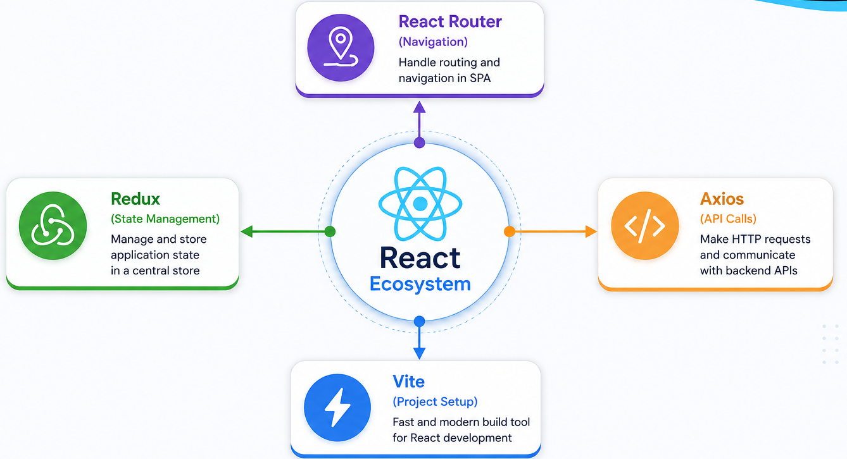
REACT ECOSYSTEM

Slide 11
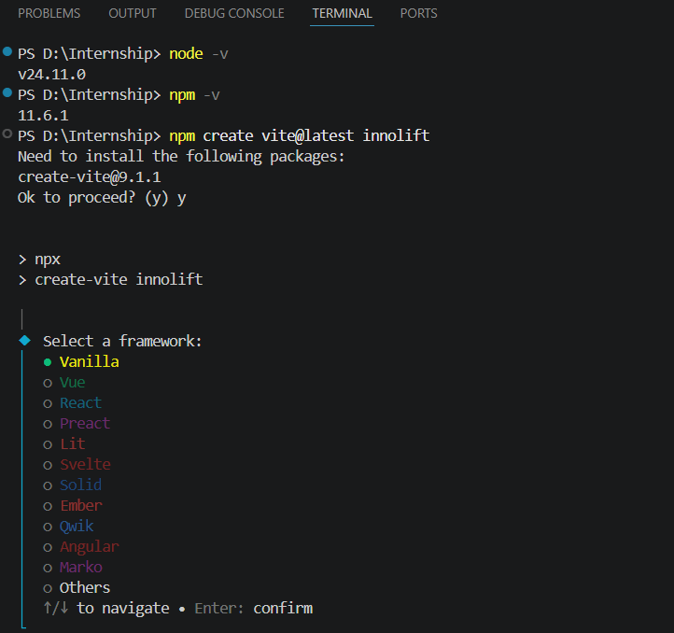
INSTALLATION
Prerequisites
Node.js installed (v18+ recommended) — check with node -v
VS Code (or any code editor)
Environment Setup: Verified Node.js (v24.11.0) and npm (v11.6.1) runtime environment in the terminal.
Project Initialization: Used Vite (create-vite@9.1.1) via npm to scaffold a new modern web project named innolift.
Framework Selection: Configured the project setup interface to select and configure the desired frontend framework/template.
Workflow Readiness: Established a fast and optimized local development foundation ready for application building.

Slide 12
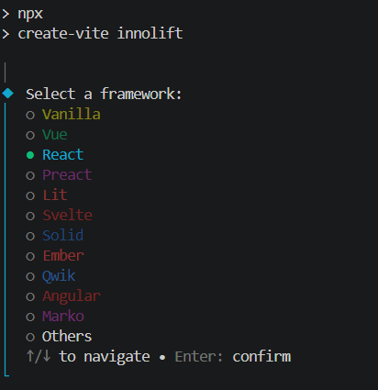
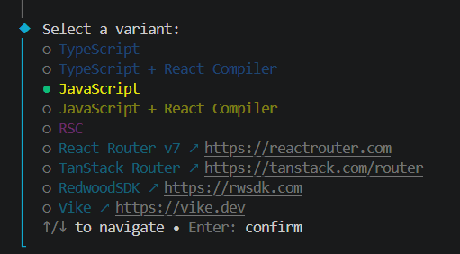
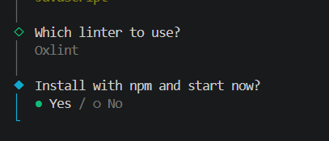
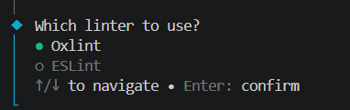
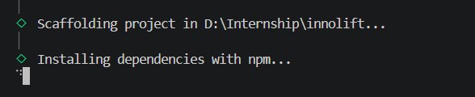
INSTALLATION
4. INSTALL DEPENDENCIES
2. SELECT JAVASCRIPT
CREATE PROJECT
&
SELECT REACT
3. SELECT OXLINT
5. INSTALLATION IN PROGRESS...

Slide 13
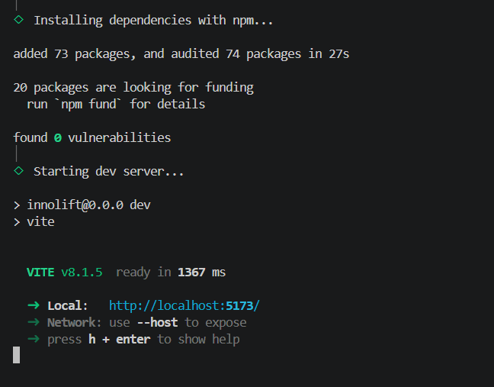
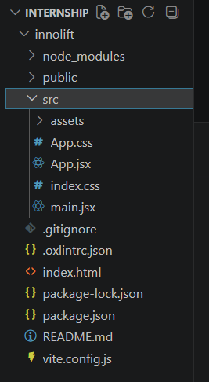
INSTALLATION
6. INSTALLAION COMPL ETED SUCCESSFULLY
7. PROJECT FOLDER CREATED SUCCESSFULLY

Slide 14
What is Vite?
Vite is a modern build tool used to create and develop React applications.
It provides fast project setup and high-performance development.
It automatically starts a local development server for your application.
Supports Hot Module Replacement (HMR) for instant updates without refreshing the browser.
Supports multiple frameworks such as React, Vue, Angular, Svelte, and more.
Key Features
⚡ Fast Project Setup
🚀 Instant Live Reload (HMR)
📦 Optimized Build Process
🌐 Built-in Local Development Server
🔧 Supports Multiple Frameworks

Slide 15
React Folder Structure
Folder | What it does
node_modules/ | All installed packages live here — never touch this
public/ | Static files like favicon, images — served as-is
src/ | Your workspace — all your code goes here
src/assets/ | Images, icons, fonts used inside components

Slide 16
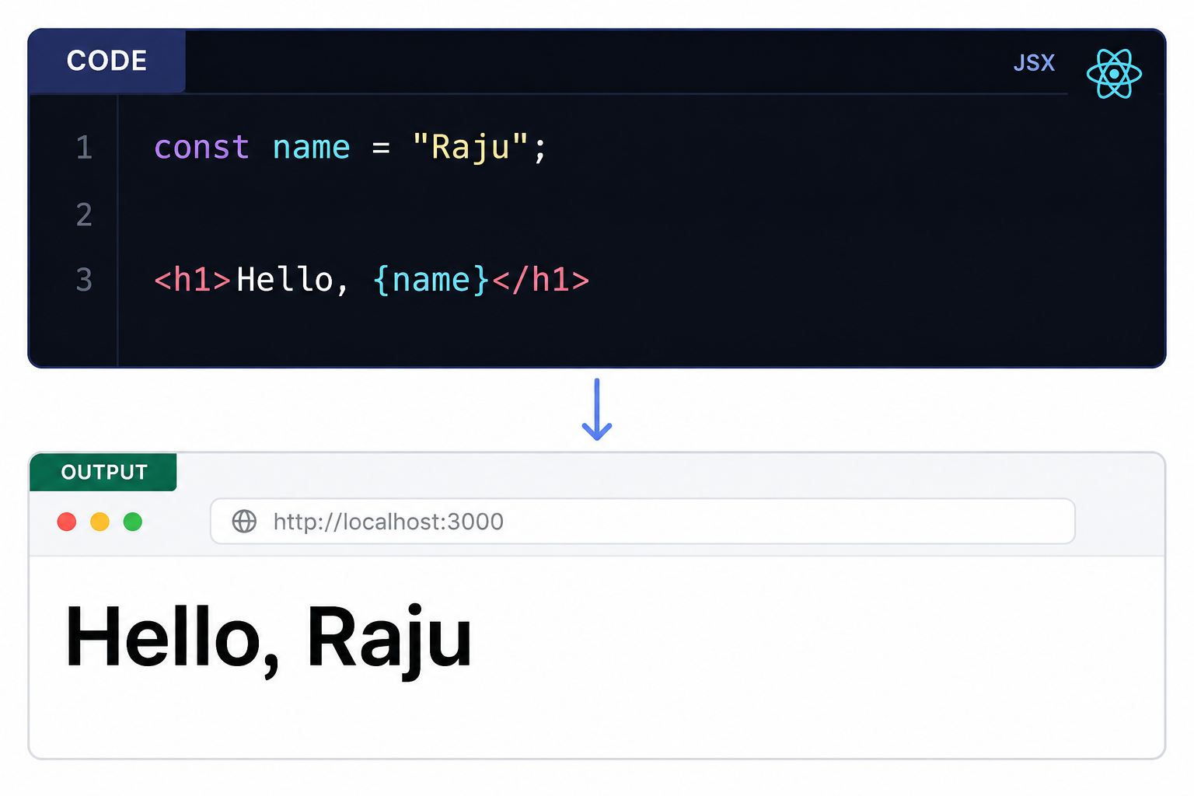
JSX
JSX (JavaScript XML) is a syntax extension that allows developers to write HTML-like code inside JavaScript. It makes creating React user interfaces simple, readable, and easy to maintain.
Key Features
📝 Write HTML-like syntax inside JavaScript.
⚡ Makes UI code simple and readable.
🔄 Supports JavaScript expressions using {}.
🎨 Use className instead of class for CSS.
🔧 JSX is converted into JavaScript by Babel before running in the browser.

Slide 17
Components
A React Component is an independent, reusable building block used to create the user interface (UI).
Reusability – Write once and reuse the same component throughout the application.
Maintainability – Changes made in one component are automatically reflected wherever it is used.
Scalability – Easily build and manage large applications by combining multiple components.
Code Organization – Breaks the UI into smaller, independent, and easy-to-manage pieces.
Improved Development Efficiency – Reduces duplicate code, simplifies debugging, and speeds up development.
Examples
Navbar
Button
Card
Footer
Login Form

Slide 18
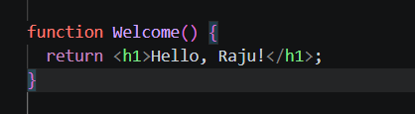
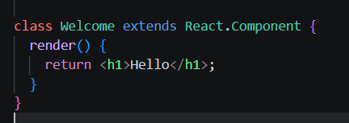
Types of Components
1. FUNCTIONAL COMPONENTS (RECOMMENDED)
Simple JavaScript functions.
Accept Props as input.
Return JSX.
Most commonly used in modern React.
2. CLASS COMPONENTS (OLDER)
Created using ES6 classes.
Can manage internal state.
Mostly found in older React projects.

Slide 19
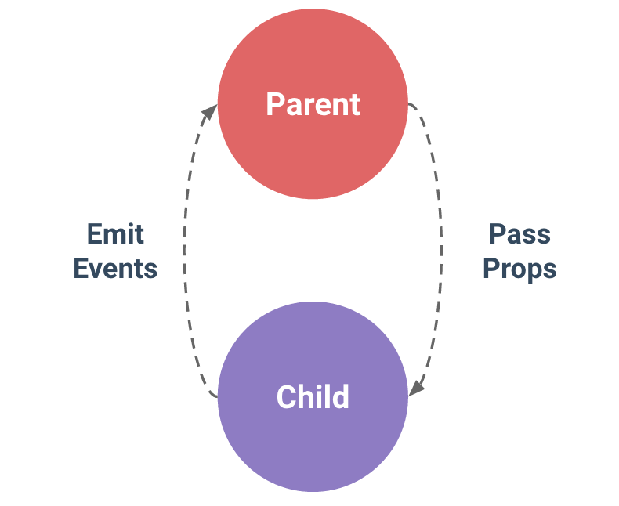
PROPS
Definition
Props (Properties) are used to pass data from a Parent Component to a Child Component. They allow components to receive different data and make them reusable.
Key Points
Props stands for Properties.
Used to pass data from Parent → Child components.
Props are received as a JavaScript object inside the child component.
Props are read-only and cannot be modified by the child.
They make components dynamic, reusable, and easy to maintain.

Slide 20
📌 Task 01 – React Project Setup
Objective
Create a new React project using Vite and run it successfully.
Instructions
Install Node.js (if not already installed).
Create a new React project using Vite.
Install the required dependencies.
Run the development server.
Verify that the application loads successfully in the browser.

Slide 21
📌 Task 02 – Build a student profile using JSX
Objective
Create a simple Student Profile page using JSX.
Instructions
Display the following information:
Student Name
Department
College
Email
Skills
Use appropriate HTML elements such as headings, paragraphs, lists, and divs.
Organize the content with proper formatting.

Slide 22
Task 03 – Create Reusable Components
Objective
Convert the Student Profile into reusable React Components.
Instructions
Create separate components for:
Header
Student Profile Card
Footer
Import and render all components inside App.jsx.
Maintain a clean and organized project structure.

Slide 23
📌 Task 04 – Display Multiple Student Profiles using Props
Objective
Pass data between components using Props.
Instructions
Reuse the Student Profile Card component.
Display at least three student profiles using different data.
Pass all student information through Props.
Ensure the UI remains clean and consistent.

Slide 24
Thank You

