Slide 1










Python Project
TITLE : Paint Application
Name: Sankarasetty Jaya Sri Ram
Registration no: 12300855
Section: K23UP
Roll no: 09
Submitted To:
Aman Kumar

Slide 2





Introduction
The Paint Application is designed for both beginners and experienced users, offering an intuitive and enjoyable painting experience.
Its purpose is to provide a user-friendly tool that allows for creative expression and artistic exploration.

Slide 3

Overview
Core Idea
Key Features
The application aims to provide a comprehensive and user-friendly platform for drawing and painting, allowing users to create visually appealing artwork.
It offers a range of drawing tools, a color picker, a variety of shapes, and functionality to save and load artwork.

Slide 4




Application Architecture
Canvas
1
The core visual component, displaying the artwork and allowing for interaction with the user.
Event Handler
2
Manages user input, such as mouse clicks and keyboard strokes, and translates them into actions on the Canvas.
Toolbars
3
Provide access to various tools, such as brushes, shapes, colors, and save/load functionality.

Slide 5
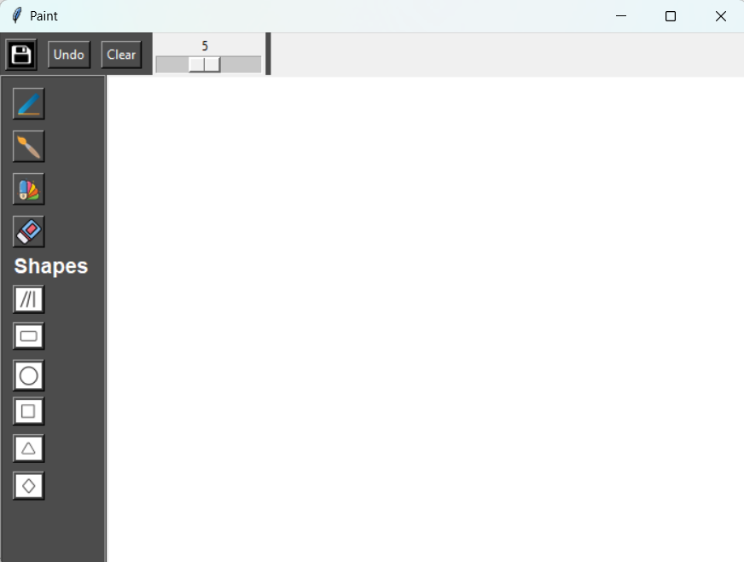





Key Features
Shape Drawing
Color Picker
Allows users to draw basic shapes like squares, rectangles, circles, and lines with customizable properties.
Provides an interface for choosing different colors for drawing, with a variety of palettes and color mixing options.
Pen and brush
Save Functionality
Includes sizes from one to ten from thin lines to wide strokes with varying degrees of opacity.
Allows users to save their artwork in a variety of file formats for future use or sharing.

Slide 6
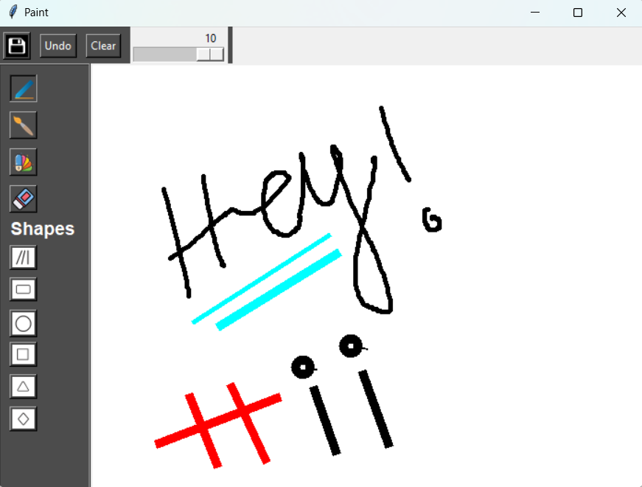

Design Choices
1
2
3
Tkinter
PIL
User Experience
Chosen for its simplicity and ease of use for developing the GUI, allowing for rapid prototyping and development.
Utilized for image processing, handling image loading, saving, and manipulation, providing a robust framework for image operations.
Focused on a user-friendly and intuitive design, with clear navigation and tool placement.

Slide 7

Conclusion and Future Enhancements
1
2
User-Friendly
Creative Expression
The Paint Application provides a user-friendly and intuitive interface for drawing and painting.
It empowers users to create visually appealing artwork through its variety of tools and features.

