Slide 1
SMS Spam Detection
Project - Data Exploration Unstructured data and No code AI/ML Name: Jayasudhaa T N
12/9/2024

Slide 2
Contents / Agenda
Data Dictionary
Business Problem Overview and Solution Approach
Exploratory Data Analysis
Model Performance Summary
Insights & Recommendations
Appendix

Slide 3
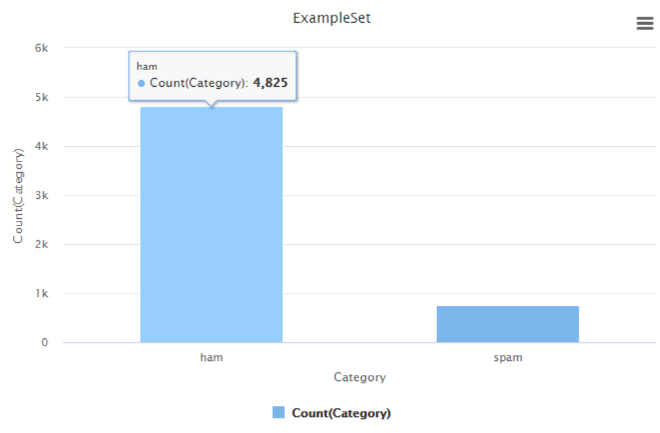
Data Dictionary
Category: Contains the labels 'spam' or 'ham' for the corresponding text data
Message: Contains the SMS text data
The SMS text message dataset contains
5,572 examples,
with 2 regular attributes and
no special attributes.

Slide 4
Executive Summary
Cyber Solutions aims to enhance security against cyber attacks targeting organizations through SMS messages. As a Data Science Manager, I have been tasked with building a spam detection model to classify SMS messages as "spam" or "ham" (non-spam) using machine learning. The dataset contains labeled SMS texts, which will be preprocessed, vectorized, and used to train several classification models.

Slide 5
Executive Summary
Our approach involves:
Data Preprocessing: Cleaning and preparing the data by removing irrelevant characters and normalizing the text.
Feature Extraction: Using techniques like TF-IDF to convert text into meaningful numerical features.
Model Development: Training and evaluating models, such as Decision Tree, Random Forest to classify SMS messages accurately.
Deployment: Implementing the selected model for real-time classification of SMS messages and continuously updating it to detect evolving spam techniques.
By effectively identifying spam messages, we aim to minimize the risks associated with phishing attacks and improve organizational security.

Slide 6
Business Problem Overview and Solution Approach
Spam messages, particularly phishing scams, pose serious risks like financial fraud, data breaches, and reputational damage. They compromise sensitive information, disrupt operations, and exploit evolving techniques to evade detection.
To address this, I propose preprocessing SMS data (cleaning, tokenizing), extracting features using methods like TF-IDF, and training models such as Decision Tree and Random Forest. The best model will be deployed for real-time classification, with regular updates to adapt to new spam patterns.

Slide 7
Business Problem Overview and Solution Approach
To address the objective, I recommend the following approach:
Preprocess the Data: Clean and tokenize SMS text, removing stop words and special characters.
Feature Extraction: Use TF-IDF or Count Vectorizer to transform the text data into numerical features.
Model Training: Train and evaluate models like Decision Tree , Random Forest focusing on accuracy etc
Deployment: Implement the best-performing model into a real-time SMS monitoring system.
Continuous Monitoring: Regularly update and retrain the model to stay ahead of evolving spam techniques.
This approach will help prevent SMS-based cyber attacks effectively.

Slide 8
EDA and Text Visualization
Dataset Overview
The dataset contains a total of 5,572 examples, with two regular attributes: the SMS text and its category (either "ham" or "spam").
Categories: The dataset is labeled into two categories:
Ham: Legitimate or non-spam messages.
Spam: Unsolicited or junk messages, often used for advertising or phishing.
This dataset is useful for training machine learning models for SMS spam classification. There are no special attributes in the dataset, making it suitable for basic text classification tasks.

Slide 9
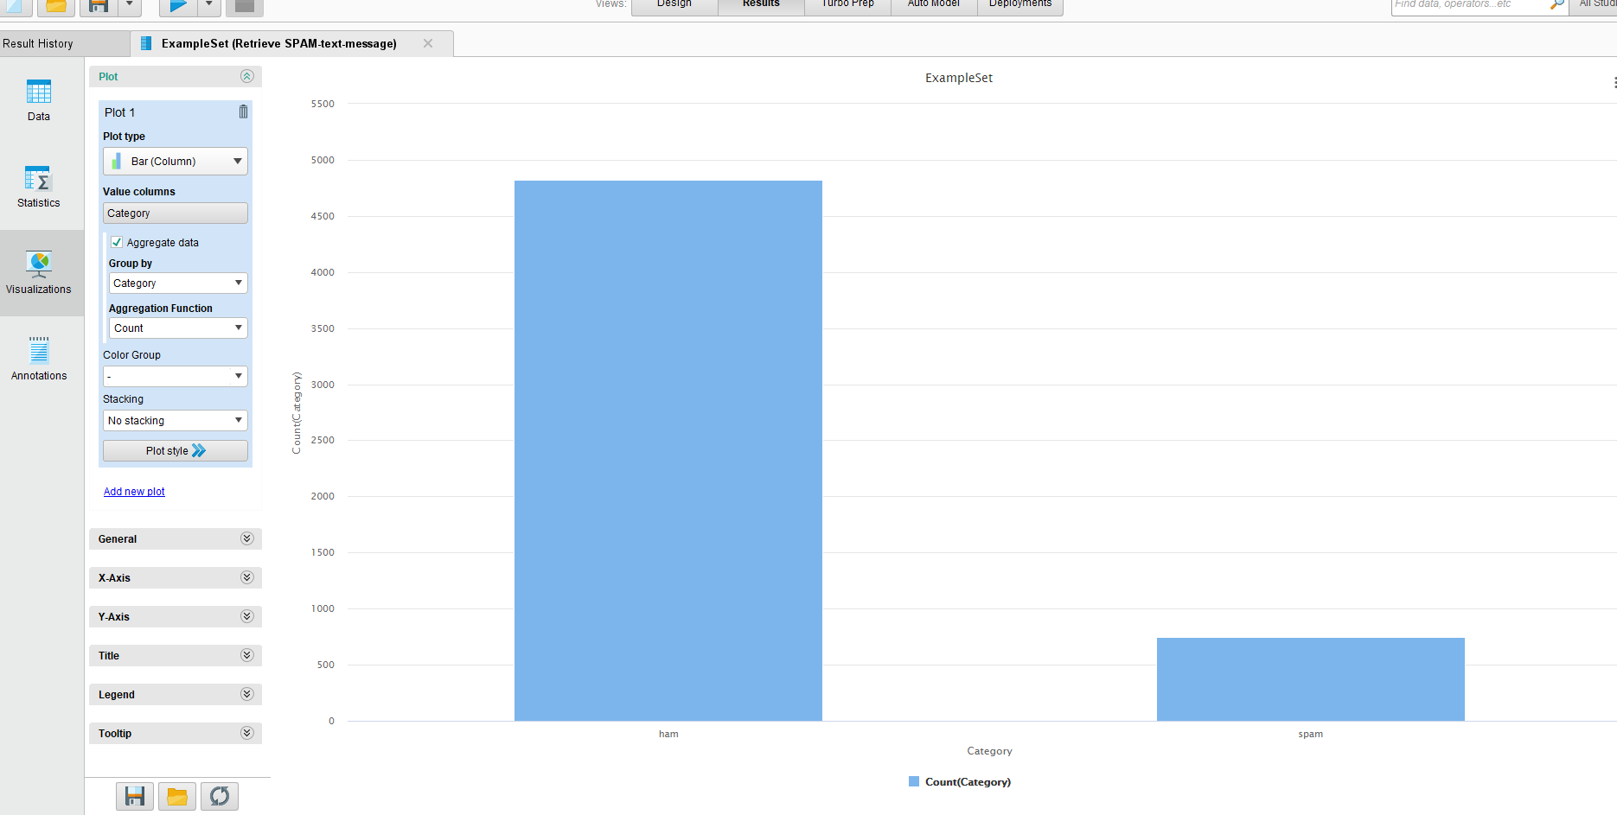
EDA and Text Visualization
Dataset Overview

Slide 10
EDA and Text Visualization
how is imbalance in the dataset handled?
Evaluation Metrics:
Use of metrics like Precision, Recall, instead of accuracy to better capture the model's performance, especially for the minority class (spam).
Confusion Matrix can also be analyzed to assess false positives and false negatives.
Ensemble Methods:
Using ensemble methods like Random Forest or Boosting can help improve the model's ability to handle class imbalance by combining predictions from multiple models, which can improve detection of minority class examples.
By using these strategies, we can mitigate the effect of class imbalance and improve the model’s ability to identify "spam" messages accurately.

Slide 11
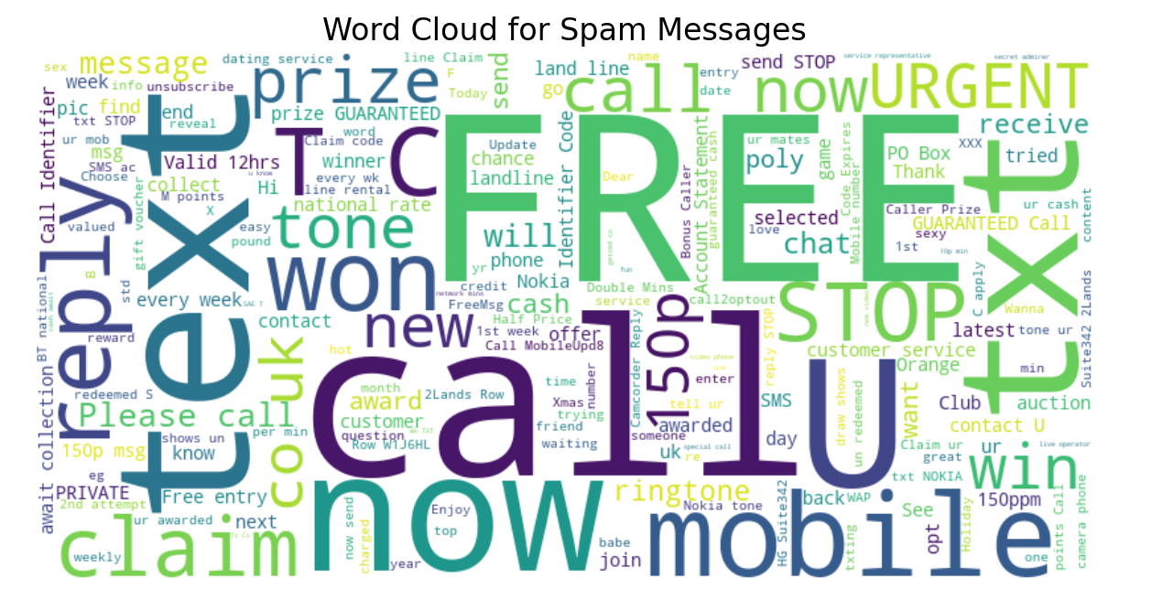
EDA and Text Visualization
Generate Word Cloud for Spam messages and Provide appropriate insights on word cloud and why is it important?

Slide 12
EDA and Text Visualization
Insights from the Word Cloud:
"FREE" and "WIN": Spammers often use enticing words like "FREE" and "WIN" to capture attention and lure recipients.
Urgency Triggers: Words like "NOW" and "URGENT" create a sense of immediacy, encouraging impulsive actions.
Action-Oriented Terms: Frequent use of "CALL," "REPLY," and "TEXT" suggests spam messages often require direct engagement.
Financial Incentives: Words like "PRIZE," "CASH," and "CLAIM" indicate a focus on false reward schemes.
Medium-Specific Terms: Words such as "MOBILE" and "SMS" highlight the spam's focus on text communication.

Slide 13
EDA and Text Visualization
Opt-Out Instructions: Terms like "STOP" appear to feign compliance with opt-out regulations, sometimes used deceptively.
Monetary References: Inclusion of amounts like "150p" and "redeem" hints at low-value financial scams.
Keywords for Targeting: Frequent use of brand names or specific services may indicate spammers target known companies.
Psychological Manipulation: Spammers exploit emotions like excitement and urgency to compel actions.
Instructions for Engagement: Spammers include actionable steps to prompt recipient responses.
Importance:
This analysis is crucial for identifying spam patterns and improving automated detection systems, such as spam filters, to protect users from phishing, fraud, and malicious campaigns.

Slide 14
Text Analysis - how is it important?
Provide appropriate details on which technique is used to find the sentiment scores
The sentiment analysis of spam and ham messages typically shows that spam texts tend to have negative or mixed sentiment due to their manipulative nature, while ham texts are generally neutral or positive.
Techniques like sentlwordnet are commonly used to calculate sentiment scores. It assigns three sentiment scores—positive, negative, and objective—to synsets in WordNet. This makes it a powerful tool for analyzing the sentiment of words, phrases, or text documents.

Slide 15
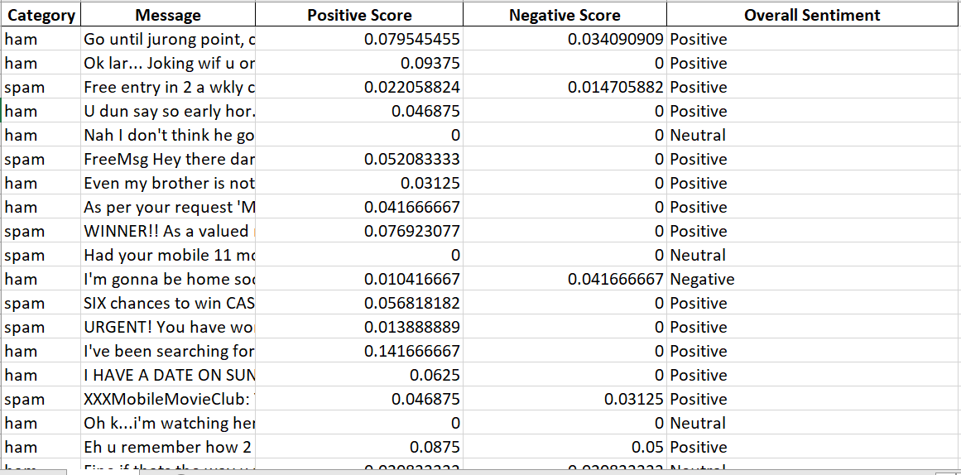
Text Analysis - how is it important?
Provide appropriate details on which technique is used to find the sentiment scores

Slide 16
Text Analysis - how is it important?
TF-IDF is a technique used to evaluate the importance of words in a document relative to the entire corpus. It assigns higher weights to terms that are frequent in a document but rare across all documents.
In spam messages, words like "free," "offer," and "urgent" tend to have higher TF-IDF scores, helping to distinguish spam from ham.
Using TF-IDF allows us to highlight key features that are unique to spam, aiding in the classification task and improving model accuracy. It helps filter out common terms, focusing on the most important words for classification.

Slide 17
Model Performance Summary – Decision Tree
Here’s the performance data presented in a tabular format:
Confusion Matrix:
This table provides a clear view of the model's performance metrics and confusion matrix.
Metric | Value
Accuracy | 94.39%
Weighted Mean Recall | 84.47%
Weighted Mean Precision | 90.20%
True/Predicted | Ham | Spam
Ham | 3,784 | 174
Spam | 76 | 424

Slide 18
Model Performance Summary – Decision Tree
Accuracy: 94.39% — The model performs well overall, correctly classifying most messages.
Weighted Mean Recall: 84.47% — Good recall, but there’s room for improvement in detecting both ham and spam messages, especially spam.
Weighted Mean Precision: 90.20% — High precision, indicating that most predicted ham and spam messages are correct.
Confusion Matrix Insights:
True Ham: 3,784, True Spam: 424
False Positives (Ham as Spam): 174, False Negatives (Spam as Ham): 76
The model excels at identifying ham messages but struggles to detect spam (with a recall of 57.72%).
Recommendations:
Improve Spam Recall: Focus on enhancing spam detection by refining feature engineering and experimenting with different algorithms.
Balance Classes: Address class imbalance to better detect spam.
Overall, while the model performs well in ham classification, improving spam recall should be prioritized to reduce false negatives and enhance security.

Slide 19
Model Performance Summary – Decision Tree After Pruning
Confusion Matrix:
Metric | Value
Accuracy | 94.19%
Weighted Mean Recall | 83.86%
Weighted Mean Precision | 89.84%
True/Predicted | Ham | Spam
Ham | 3,782 | 181
Spam | 78 | 417
Insights:
Ham Detection: Strong performance in identifying ham messages with high precision and recall.
Spam Detection: Good precision (89.84%) but recall (57.34%) could be improved, as some spam messages are still misclassified.
Recommendation: Focus on improving spam recall by fine-tuning features and experimenting with different models, while balancing pruning for efficiency.

Slide 20
Model Performance Summary – Decision Tree Before and After Pruning
Metric | Before Pruning | After Pruning
Accuracy | 94.39% | 94.19%
True Ham (Predicted Ham) | 3784 | 3782
True Spam (Predicted Spam) | 424 | 417
False Positives (Ham as Spam) | 174 | 181
False Negatives (Spam as Ham) | 76 | 78
Weighted Mean Recall | 84.47% | 83.86%
Weighted Mean Precision | 90.20% | 89.84%

Slide 21
Model Performance Summary – Decision Tree Before and After Pruning
Insights:
Accuracy: The accuracy slightly dropped after pruning (94.39% to 94.19%).
Recall: The recall for spam slightly decreased after pruning, from 84.47% to 83.86%. This is indicative of a minor trade-off to reduce false positives.
Precision: Precision for spam also decreased slightly after pruning, from 90.20% to 89.84%.
False Positives and False Negatives:
There was a slight increase in false positives (ham predicted as spam) and false negatives (spam predicted as ham), suggesting the model became more conservative in identifying spam but at the cost of precision and recall.
In conclusion, pruning slightly impacted the model's ability to recall spam messages but improved the model’s precision for spam classification. The trade-off may be beneficial depending on the business requirements for minimizing false positives or false negatives.

Slide 22
Model Performance Summary – Random Forest
Metric | Value
Accuracy | 87.71%
Weighted Mean Recall | 54.18%
Weighted Mean Precision | 93.78%
Confusion Matrix:
True/Predicted | Ham | Spam
Ham | 3,860 | 548
Spam | 0 | 50
Insights:
Ham Classification: The model classifies ham messages with perfect recall (100%) but at the cost of misclassifying 548 spam messages as ham.
Spam Classification: While precision for spam is 100%, recall is significantly low at 8.36%, indicating a high number of false negatives for spam.
Overall Accuracy: The model achieves an accuracy of 87.71%, driven largely by its strong performance on the ham class

Slide 23
Model Performance Summary – Random Forest After Pruning
Metric | Value
Confusion Matrix:
Accuracy | 86.59%
True/Predicted | Ham | Spam
Ham | 3,860 | 598
Spam | 0 | 0
Weighted Mean Recall | 50.00%
Weighted Mean Precision | 43.29%
Insights:
Ham Classification: The model correctly identifies all ham messages but misclassifies 598 spam messages as ham.
Spam Classification: Fails entirely to identify any spam messages (precision and recall for spam are 0%).
Overall Accuracy: While the accuracy is 86.59%, it is skewed by the overwhelming number of correctly classified ham messages, with no success in detecting spam.
Recommendations:
Improve Spam Detection: Focus on addressing the model's inability to detect spam messages. Consider techniques like class rebalancing.
Feature Engineering: Extract additional features or explore spam-specific patterns to improve the model
Model Selection: Evaluate alternative algorithms or ensemble techniques to enhance spam detection.

Slide 24
Model Performance Summary – Random Forest Comparison
Metric | Before Pruning | After Pruning
Accuracy | 87.71% | 86.59%
Weighted Recall | 54.18% | 50.00%
Weighted Precision | 93.78% | 43.29%
Confusion Matrix Comparison:
True/Predicted | Ham (Before) | Spam (Before) | Ham (After) | Spam (After)
Ham | 3,860 | 548 | 3,860 | 598
Spam | 0 | 50 | 0 | 0
Conclusion:
Pruning has negatively impacted the model’s performance, particularly its ability to detect spam. While pruning can simplify and improve efficiency, further optimization or alternative pruning strategies are needed to retain spam classification capability.

Slide 25
Model Performance Summary – Optimized parameters Decision Tree
Confusion Matrix:
Metric | Value
Accuracy | 94.89%
Weighted Recall | 98.53%
Weighted Precision | 94.51%
True/Predicted | Ham | Spam
Ham | 3,854 | 222
Spam | 6 | 376
Key Insights:
Accuracy: Increased to 94.89%, showing a significant improvement over the previous models.
Ham Classification: The model effectively identifies ham messages with high precision and recall.
Spam Classification: While the model misclassifies 222 spam messages as ham, it correctly detects 376 spam messages. The recall for spam is 98.53%, indicating strong detection of spam.
Optimized Parameters: The decision tree's use of information gain and a maximum depth of 12 has enhanced the model's ability to distinguish between ham and spam effectively.

Slide 26
Overall Summary:Choosing & commenting on best model
Conclusion: Best Model Selection
After evaluating the model performance with different configurations, the optimized Decision Tree with information gain and a maximum depth of 12 emerges as the best model.
Accuracy: The optimized Decision Tree achieved the highest accuracy at 94.89%, significantly outperforming the other models.
Spam Detection: It shows strong spam recall (98.53%) and precision (94.51%), effectively identifying the majority of spam messages while minimizing false positives.
Model Simplicity and Efficiency: The Decision Tree’s simplicity, with a maximum depth of 12, ensures efficient performance without overfitting.
While the Random Forest models performed well, especially in precision, the optimized Decision Tree offers a balanced trade-off between accuracy, recall, and precision, making it the most suitable choice for the spam classification task.

Slide 27
Overall Summary: Insights & Recommendations
Current Performance:
Accuracy: 94.89%
Spam Recall: 98.53%
Misclassified Spam as Ham: 222 messages
Key Insights:
Strong performance in spam detection, but some spam messages are misclassified as ham.
Potential for improvement in reducing false negatives (missed spam).

Slide 28
Overall Summary: Insights & Recommendations
Actionable Recommendations:
Enhance Feature Engineering: Incorporate NLP for semantic analysis, add metadata (e.g., links, punctuation).
Model Tuning: Use hyperparameter optimization and explore ensemble models (Random Forest, Gradient Boosting).
Address False Negatives: Implement cost-sensitive learning and active learning to retrain on misclassified spam.
Post-Processing Layer: Add rule-based filters to catch missed spam.
Ongoing Monitoring: Regularly track performance, use user feedback for model refinements.

Slide 29
Overall Summary: Insights & Recommendations
Improve Dataset Quality: Expand training set with diverse spam samples and apply data augmentation.
User Feedback Integration: Allow users to report spam, helping to refine the system.
Long-Term Strategy:
Implement a multi-tier spam detection system combining ML, rule-based filters, and human review for enhanced accuracy.

Slide 30
APPENDIX

Slide 31
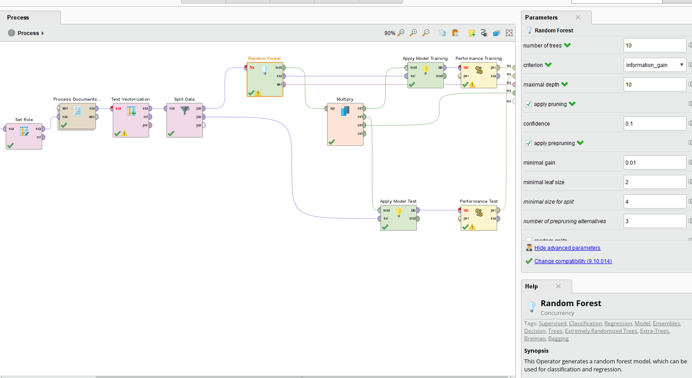
Random Forest model
Please mention any other pointers (if needed)

Slide 32
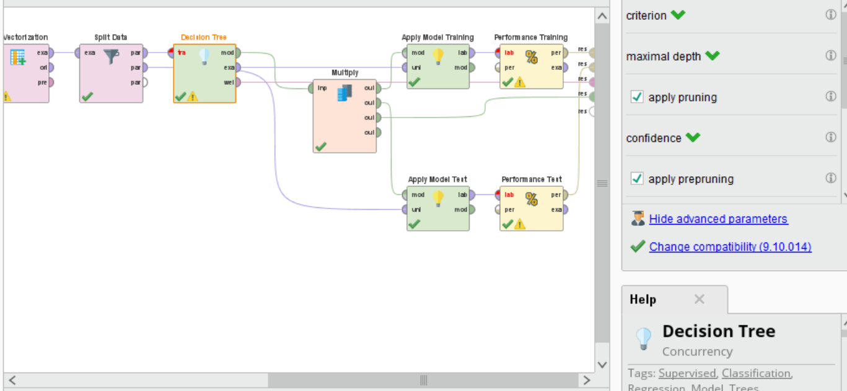
Decision Tree Pruned
Please mention any other pointers (if needed)

Slide 33
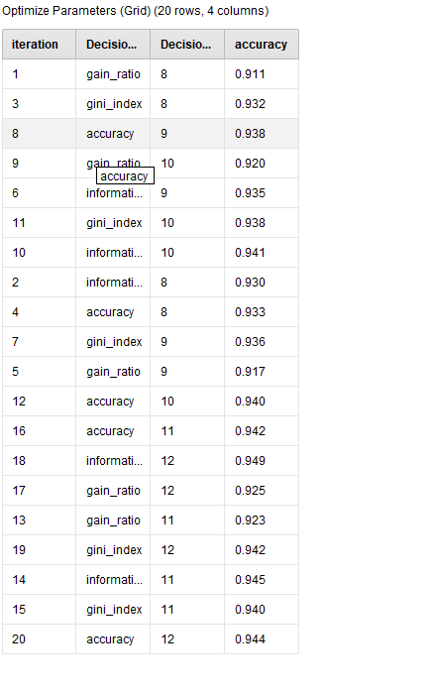
Optimize Parameters Grid

