Slide 1


TEAM 18
Packet Delay Visualization Using Wireshark Logs

Slide 2


Over_view
Team Members
Jaya Suriya S
2023503012 (CT)
Keerthivarman S D
2023503014 (CT)
Parthiban M
2023503301 (CT)
Mani Kandan S
2023503310 (CT)
Mentor
Haritha Priyadharshini E

Slide 3
Introduction
  Modern networks handle vast volumes of data across multiple paths, devices, and services. Network latency, or the delay experienced in packet transmission, directly affects the quality of user experience, particularly in real time applications like video calls, VoIP, and gaming.
  While tools like Wireshark provide access to raw packet data, they lack intuitive delay visualization mechanisms.
  This project introduces a system that captures network traffic using Wireshark, extracts timestamp-based delay information, and visualizes packet delay over time using Python. It aims to assist engineers in identifying sources of delay spikes and improving network configuration.

Slide 4
Problem Statement
Limitations of Existing Tools
  Focus mainly on protocol-level data (headers, packet counts, etc.).
  Do not provide high-level delay analytics or easy-to-read trends.
Current Issue
  Packet delay analysis often requires manual inspection of Wireshark logs.
  Process is time-consuming, error-prone, and lacks clarity.
The Gap
  No simple method to visualize network delays and round-trip times (RTT) effectively.
  Engineers struggle to identify delay spikes and bottlenecks quickly.

Slide 5





Our Aim and Goals
Goal # 1
Capture real-time network traffic using Wireshark.
To analyze and visualize packet delays and round-trip times (RTT) from Wireshark logs.
Goal # 2
Extract and calculate delays for TCP, ICMP, and HTTP protocols.
Goal # 3
Visualize delay trends and RTT patterns using Python libraries.
Goal # 4
Identify bottlenecks and unusual delay spikes in the network.

Slide 6
Phases:
PHASE 1 – DATA COLLECTION
PHASE 2 – DATA PROCESSING
PHASE 3 – VISUALIZATION
PHASE 4 – INTERPRETATION
  Wireshark captures traffic (.pcap)
  Focus on TCP, ICMP, HTTP
  Python (Scapy, Pandas)
  Extract timestamps
  Calculate Delay & RTT
  Matplotlib, Seaborn, Plotly (optional)
  Trends: spikes, avg RTT, anomalies
  Analyze under different loads
  Detect bottlenecks
  Suggest performance improvements

Slide 7
Literature Review
  Arvind et al. - Introduced network traffic virtualization; focused on integrating Wireshark with Google Maps for user-friendly monitoring.
  Gingade et al. (2023) - Enhanced real-time visualization for IoT networks, highlighting scalability to enterprise settings.
  Upadhyay et al. - Conducted protocol-specific deep dive (SMTP, IMAP, POP3); exposed vulnerabilities in email systems.
  Streeter - Practical reference for packet capture troubleshooting, bridging academic research and system admin needs.
  Tan et al. (2019) - Developed delay models for high-speed networks; provided theoretical foundation for latency-sensitive applications (5G, cloud).

Slide 8
What Has Been Achieved So Far
Sudha Arvind, S. Arvind, Vamshi Kumar Silveri, Govardhan Potey, Parameshwar Nunavath, Ranadheep Podishetty
“Network Traffic Virtualization Using Wireshark and Google Maps”
Topic: Network Traffic Visualization
Swara S. Gingade, Nagashree B., Rishika Mohan V., Mohana
“Real-Time Network Traffic Analysis and Visualization using Wireshark and Google Maps” (ICIMIA 2023)
Topic: Real-Time Network Traffic Monitoring
Devendra Upadhyay, Vineet Bhatia, Sumati Sidharth
“An in-Depth Analysis of Email Protocols Traffic Using Wireshark”
Topic: Protocol-Specific Analysis (Email Protocols)
Adam Streeter
“Adam's Guide To Packet Capture Analysis Using Wireshark”
Topic: Practical Guide / Troubleshooting
W. Tan, Z. Zhao, R. Bettati
“Transmission Delay Analysis in High-Speed Networks” (IEEE Transactions on Communications, 2019)
Topic: Delay Modeling in High-Speed Networks

Slide 9
Gaps & Research Opportunities
Scalability Limitations
  Most existing works (Arvind et al., Gingade et al.) tested on small-to-medium datasets.
  No validation on ISP-scale traffic or cloud-scale distributed systems.

Slide 10
Expected Outcomes
Scope Of Work
  Graphical insights into packet delay and round-trip times.
  Detection of delay spikes and bottlenecks in the network.
  Support for evaluating performance in real-time applications (gaming, streaming, cloud services).
  Actionable insights to improve network reliability and speed
Our Expected Result and Limitations
Boundaries /Limitations
  Focus is only on TCP, ICMP, and HTTP protocols.
  Visualization limited to delay and RTT trends (not full protocol analysis).
  No hardware implementation – purely software-based approach.
  Real-time monitoring is limited by Wireshark’s capture capability.

Slide 11

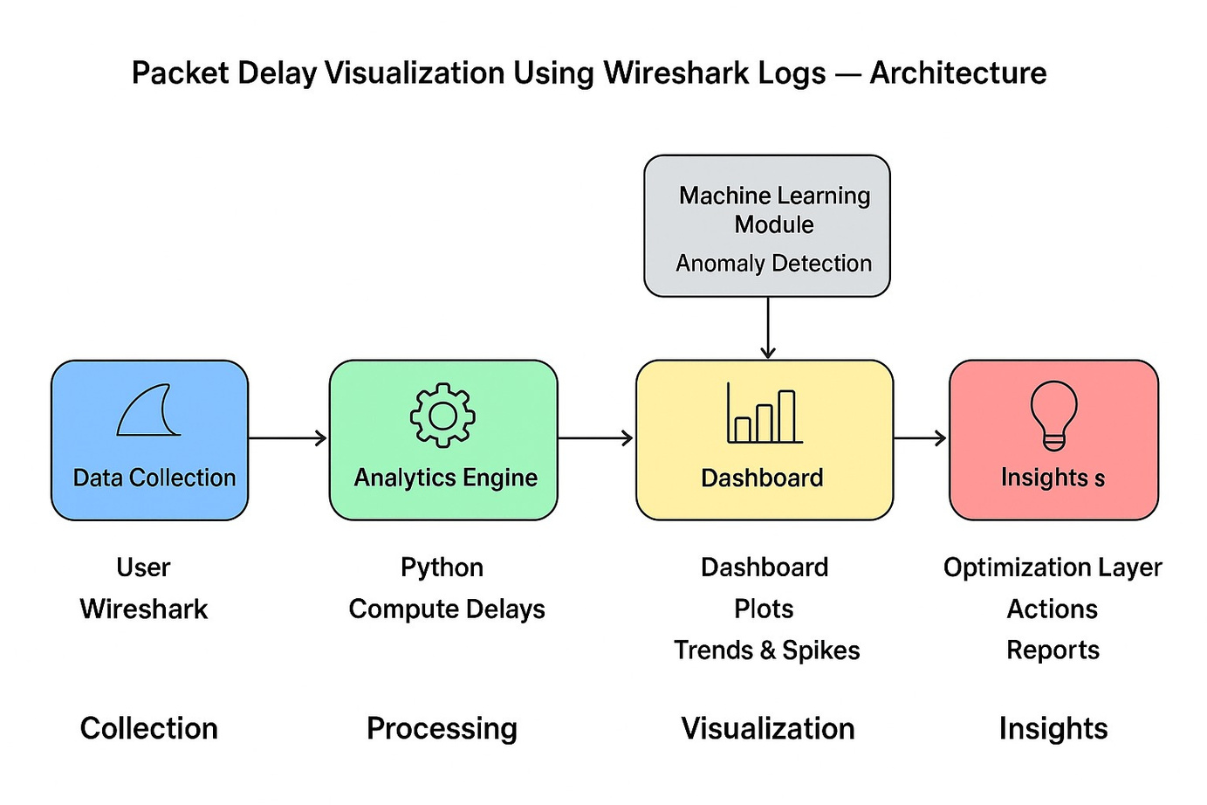
Architecture Diagram
  Wireshark captures network traffic (.pcap files).
  Python (Scapy, Pandas) extracts timestamps and calculates delays/RTT.
  Matplotlib/Seaborn generates delay visualization graphs. That should be displayed in the dashboard.
Back to Agenda

Slide 12
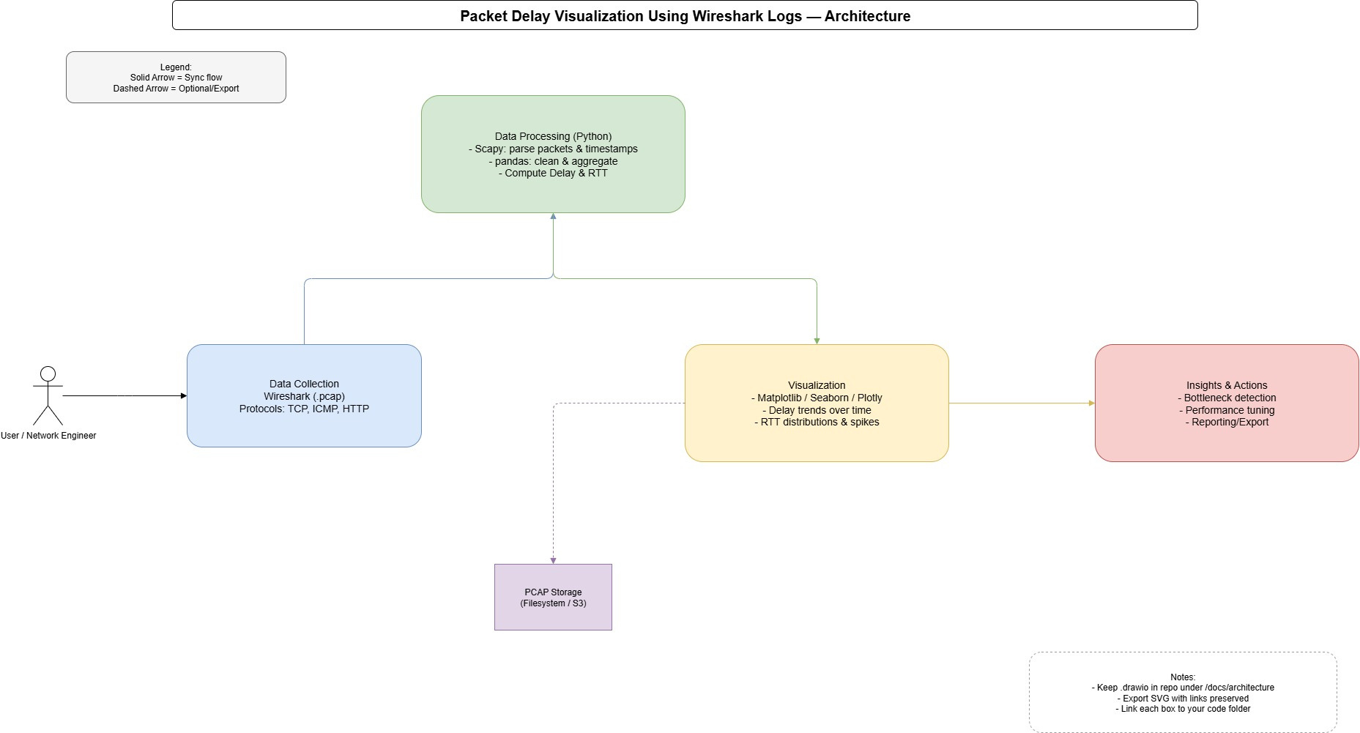

Slide 13
Work Plan
July
Aug
Sept
Oct
  Literature review & project setup.
Data collection (Wireshark captures) and initial processing scripts
Visualization of delay and RTT trends, testing under different conditions
Analysis, interpretation of results, final documentation & presentation

Slide 14
References
[1] Sudha Arvind; S. Arvind; Vamshi Kumar Silveri; Govardhan Potey; Parameshwar Nunavath; Ranadheep Podishetty, ” Network Traffic Virtualization Using Wireshark and Google Maps”
[2] Swara S Gingade; Nagashree B; Rishika Mohan V; Mohana, “Real Time Network Traffic Analysis and Visualization using Wireshark and Google Maps” presented at 2023 3rd International Conference on Innovative Mechanisms for Industry Applications (ICIMIA)DOI: 10.1109/ICIMIA60377.202321-23 Dec. 2023
[3] Devendra Upadhyay; Vineet Bhatia; Sumati Sidharth, “An in-Depth Analysis of Email Protocols Traffic Using Wireshark”

Slide 15
References
[4] Adam Streeter, “ Adam's Guide To Packet Capture Analysis Using Wireshark “
[5] Tan; W.Zhao; R.Bettati, “ Transmission delay analysis in high-speed networks. IEEE Transactions on Communications, 67(8), 5504-5513.” https://doi.org/10.1109/TCOMM.2019.2912029 (2019)

