Slide 1
ROTARY UNION ENABLING THROUGH COOLANT FOR CNC MACHINE – An extra attachment
Its an rotary union enabling through coolant system for cost reduction in a CNC

Slide 2
CONTENTS
Project Description
Engineering Concept and Calculations
3D Data / Photo / Demo Video
Applications in Real World
Advanced Technology Used
Certificates / Accolades

Slide 3
PROJECT DESCRIPTION
Design fabrication and performance appraisal of rotatory union holder setup for through hole drilling operation in CNC milling machine
To study the through hole drilling operation constrains and their performance for higher investment inbuilt CNC machine.
The main objective of the proposed work was low investment cost non in-built rotatory union holder unit was developed and incorporated in the normal CNC machine.
In which initial investment cost and maintenance was reduced than highly invested integrated inbuilt unit CNC machine.
Modular design of rotatory union holder proto model was developed by using 3D printer and evaluate the product.
The fabricated holder was adopted normal CNC machine and performance was measured. In this incident surface quality of work material and tool life was improved. In performance vise No deviation was observed than highly invested integrated inbuilt unit CNC drilling machine.
The main unique of this union holder setup was easy handling, low cost, maintenance free, easily adjust coolant flow speed, pressure based on material to be drill.

Slide 4
ENGINEERING CONCEPTS AND CALCULATION
Since it is coming under vertical milling machine and coolant flow involved in it we use the earth’s gravitational force principle.
Law of inertia
Law of momemtum

Slide 5
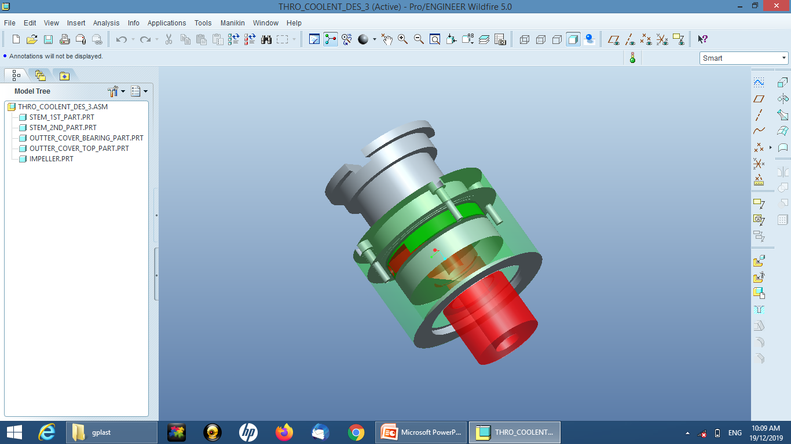
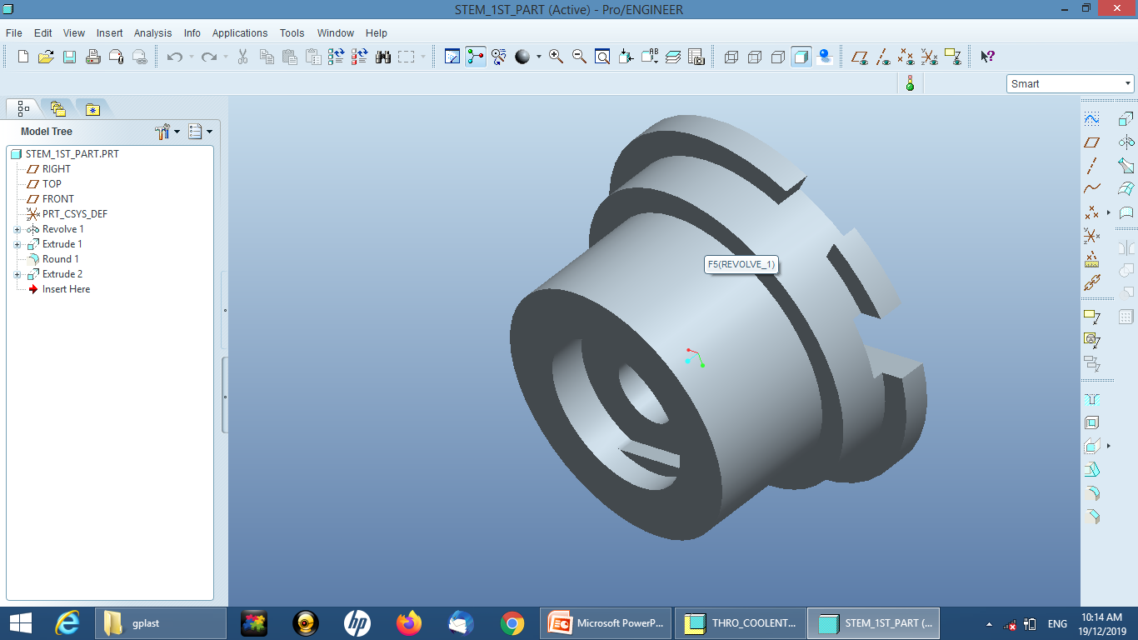

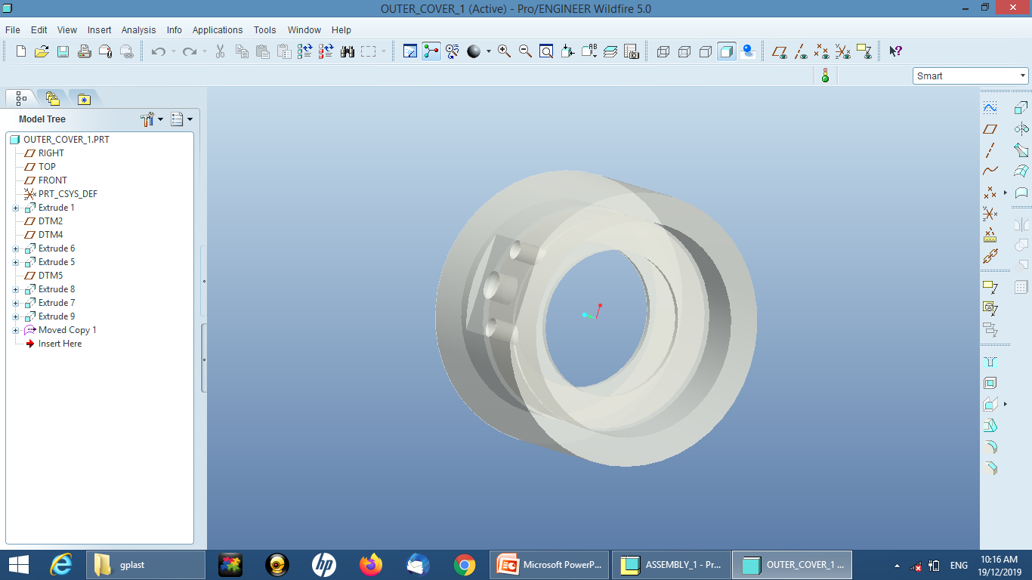
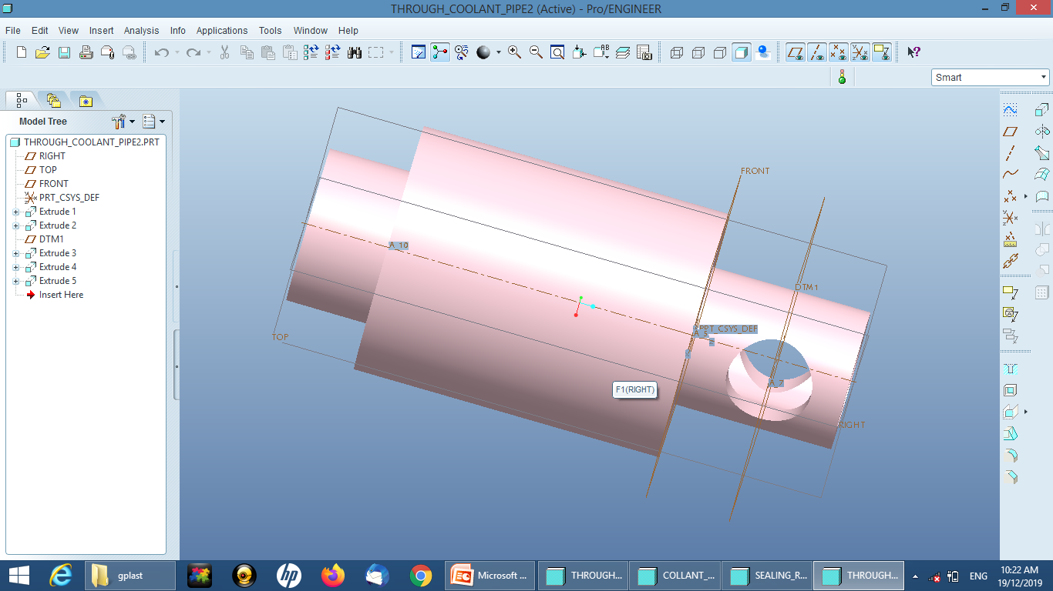
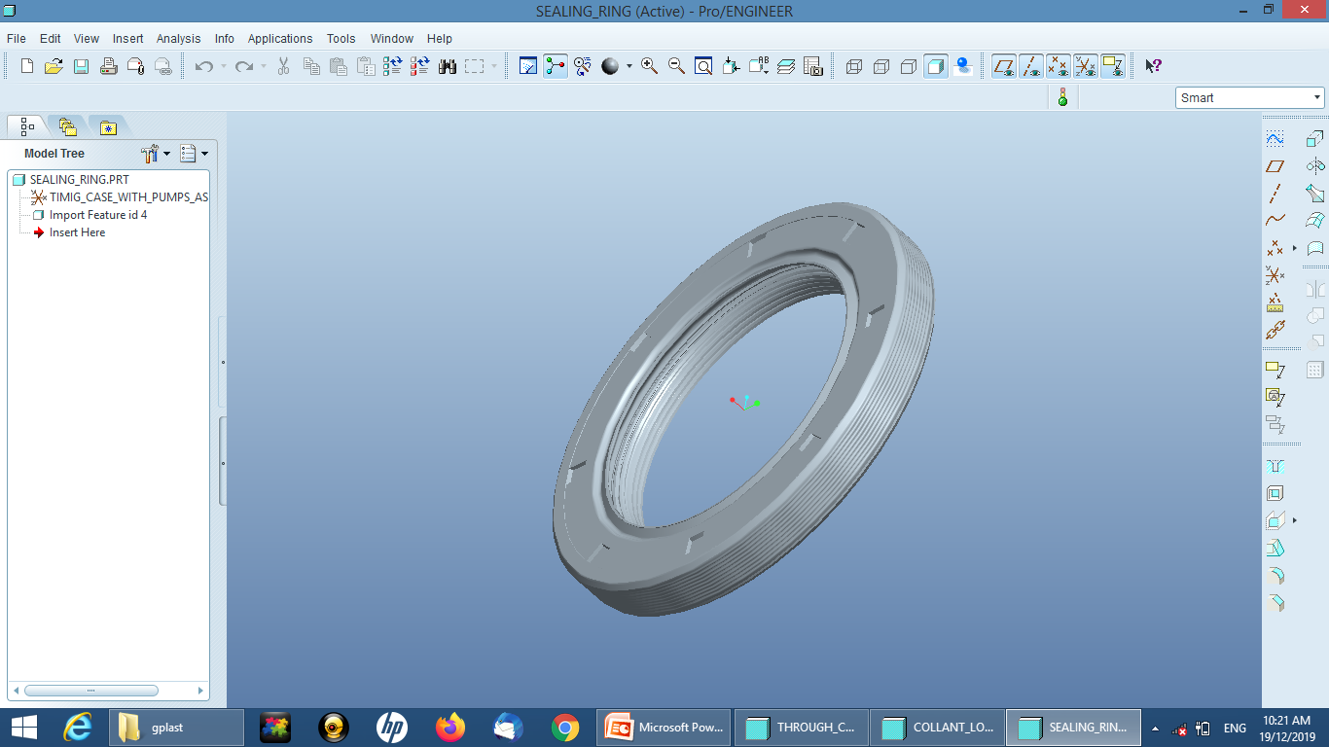
3D photo / Demo video

Slide 6
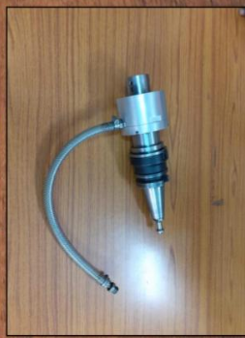
APPLICATIONS IN REAL WORLD
To provide a economical solution instead of investing a large amount in buying inbuild through spindle coolant machine.
In India lot of small and medium scale industries developing required application components through hole machining operations.
By adopting newly developed rotatory union holder setup supports small and medium scale industries with very low investment cost.
Our extra attachment eliminates the maintenance cost, increase tool life, suitable for all the materials, high quality and performance.

Slide 7
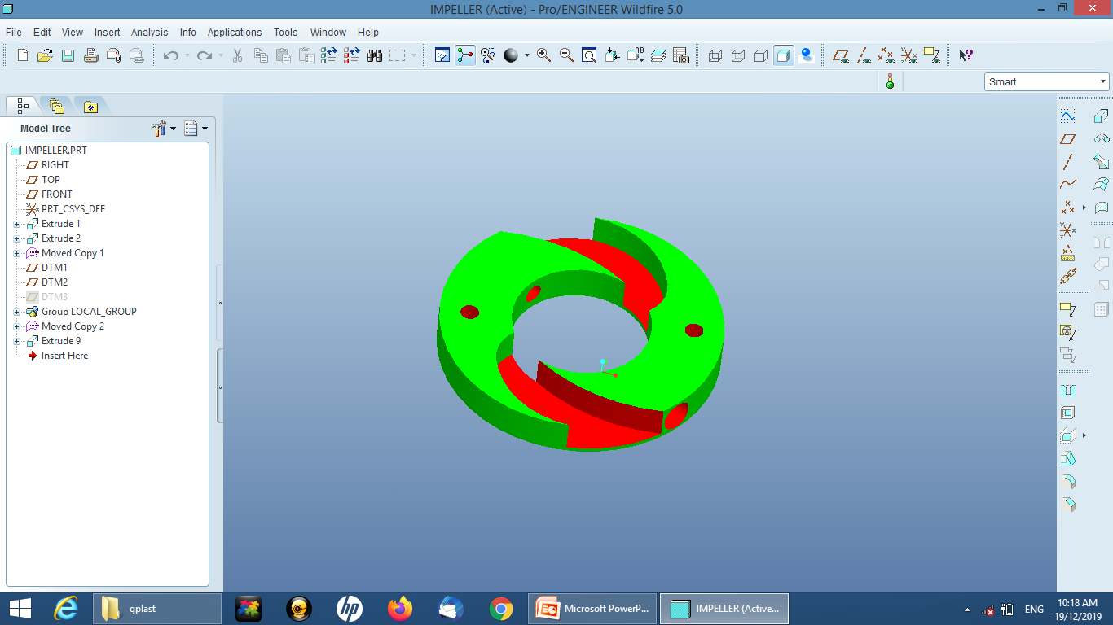
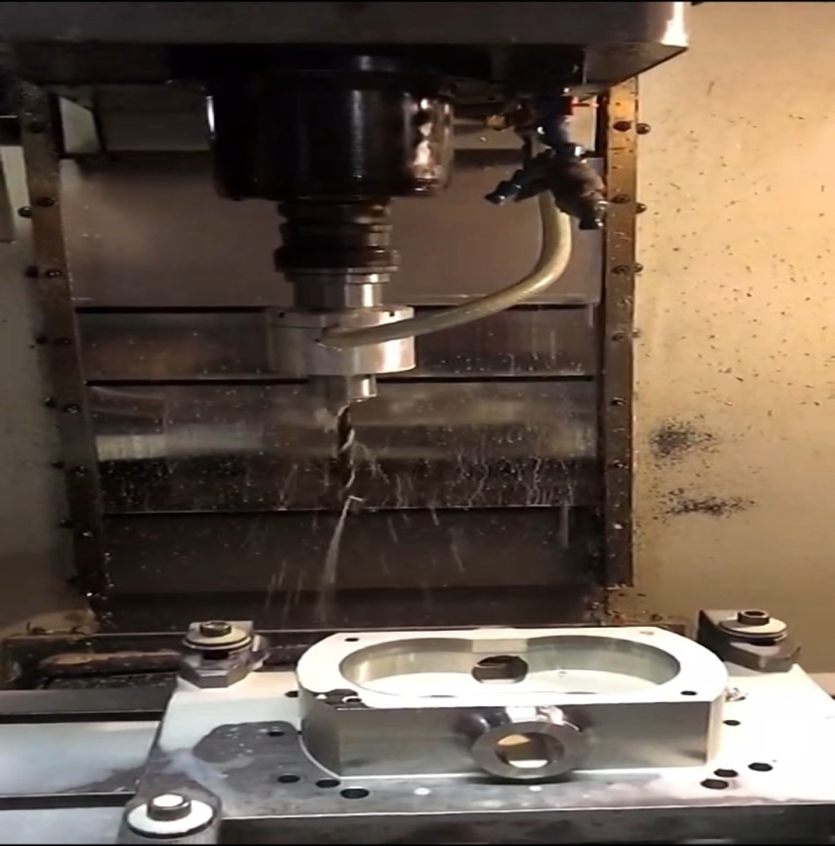
ADVANCED TECHNOLOGY USED
Creo (design & analysis): rotatory union holder setup.
3 D Printing: to develop proto model and impeller
Modern materials used to fabricate.
Elimination of functional errors.
High precession performance was obtained in normal machine.

