Slide 1
REVERSAL DISTANCE PROBLEM
Marasani Jayasurya
AM.EN.U4AIE20048

Slide 2
Objective
The objective of this project is to find the reversal distance when Gene rearranges to form another gene.
In this project we have discussed what is reversal distance problem and its approach for finding the reversal distance.
Also discussed the other approaches for which has the lower time complexity when compares to the naïve approaches.

Slide 3

Introduction
Reversal distance problem is a complex process to determine the relationship between two genomes of two different species.
Given two permutation genomes we need to find the shortest sequence of reversals to transform one into another.
The shortest sequence can be found by using sorting by reversals method and based on different sorting arrangements we need to take smallest possible reversals as the distance of the reversals.
There are many algorithms, but the basic algorithm approach is Greedy Algorithm where it sorts the genome by best possible way.
Then using sorting by reversals will reduce so many steps to compute the shortest distance.

Slide 4
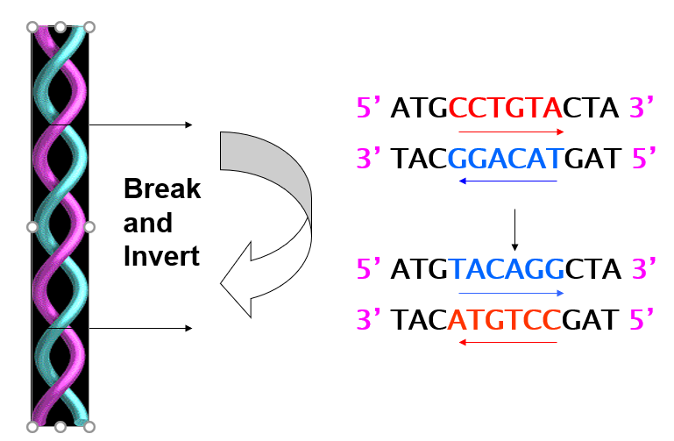
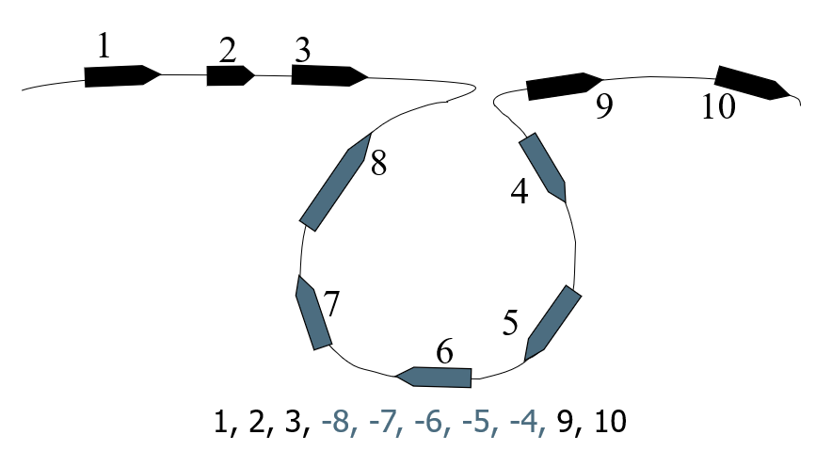
Pre-Requisites
Reversals is an operation that takes any subsequence in a sequence , reverses the subsequence’s order, then reinserts the subsequence back into the same position.
For example,
A = 1, 2, 3, 4, 5, 6, 7, 8, 9
A’s reversal = 1, 2, 4, 3, 5, 6, 7, 8, 9

Slide 5
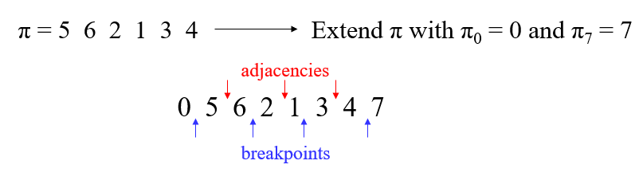
Pre-Requisites
A breakpoint of a permutation π is a pair of adjacent positions [i, i + 1] such that π_{i} and π_{i+1} are consecutively decreasing or increasing. A strip of π is a maximal run of consecutively increasing(decreasing) elements.
A pair of consecutive elements π_{i} and π_{i+1}, 0 ≤ i ≤ n, is called an adjacency.

Slide 6
Reversal Distance Problem
Goal: Given two permutations, find the shortest series of reversals that transforms one into another
Input: Permutations p and s
Output: A series of reversals r₁,…r_{t} transforming p into s, such that t is minimum
t - reversal distance between p and s
d(p, s) - smallest possible value of t, given p and s

Slide 7

Greedy Algorithm: An Example
Doing so, π can be sorted
1 2 3 6 4 5
1 2 3 4 6 5
1 2 3 4 5 6
Number of steps to sort permutation of length n is at most (n – 1)

Slide 8
Greedy Algorithm: Pseudocode
SimpleReversalSort(p)
for i ← 1 to n – 1
j ← position of element i in p (i.e., p_{j} = i)
if j ≠i
p ← p * r(i, j)
output p
if p is the identity permutation
return

Slide 9
Example
+1 -7 +6 -10 +9 -8 +2 -11 -3 +5 +4
+1 -2 +8 -9 +10 -6 +7 -11 -3 +5 +4
+1 +2 +8 -9 +10 -6 +7 -11 -3 +5 +4
+1 +2 +3 +11 -7 +6 -10 +9 -8 +5 +4
+1 +2 +3 -4 -5 +8 -9 +10 -6 +7 -11
+1 +2 +3 +4 -5 +8 -9 +10 -6 +7 -11
+1 +2 +3 +4 +5 +8 -9 +10 -6 +7 -11
+1 +2 +3 +4 +5 +6 -10 +9 -8 +7 -11
+1 +2 +3 +4 +5 +6 -7 +8 -9 +10 -11
+1 +2 +3 +4 +5 +6 +7 +8 -9 +10 -11
+1 +2 +3 +4 +5 +6 +7 +8 +9 +10 -11
+1 +2 +3 +4 +5 +6 +7 +8 +9 +10 +11

Slide 10
Analyzing SimpleReversalSort
SimpleReversalSort does not guarantee the smallest number of reversals and takes five steps on π = 6 1 2 3 4 5 :
Step 1: 1 6 2 3 4 5
Step 2: 1 2 6 3 4 5
Step 3: 1 2 3 6 4 5
Step 4: 1 2 3 4 6 5
Step 5: 1 2 3 4 5 6

Slide 11
Analyzing SimpleReversalSort
But it can be sorted in two steps:
π = 6 1 2 3 4 5
Step 1: 5 4 3 2 1 6
Step 2: 1 2 3 4 5 6
So, SimpleReversalSort(π) is not optimal
Optimal algorithms are unknown for many problems; approximation algorithms are used

Slide 12
Improved Reversal Sort Using Breakpoint
ImprovedBreakpointReversalSort(π)
while b(π) > 0
if π has a decreasing strip
Among all possible reversals, choose reversal ρ
that minimizes b(π • ρ)
else
Choose a reversal ρ that flips an increasing strip in π
π ← π • ρ
output π
return

Slide 13
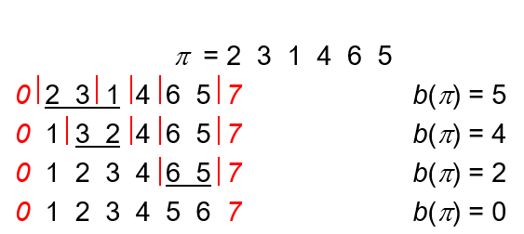
Example

Slide 14

Results

Slide 15
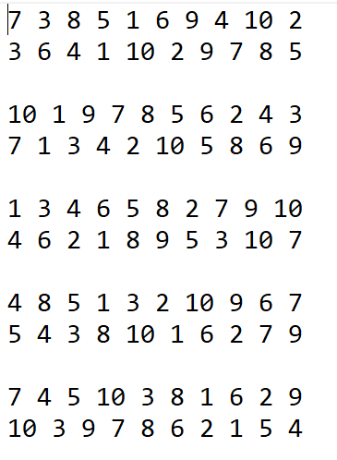
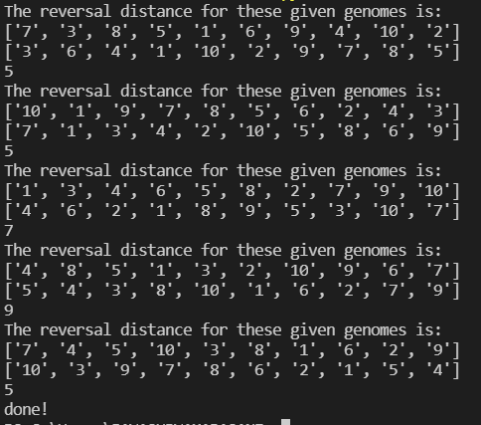
Dataset
Output

Slide 16
Conclusion
The Reversal Distance Problem gives the relationship between two different species and also helps us to know about their common ancestors. Even though the time complexity of this problem is very high when we used the Naïve approaches, but it gives an idea on the species relationship approximately but when the we use the improved algorithms it reduces the time complexity and gives better result when compares to the Naïve approaches.

Slide 17

Thank You

