Slide 1

Use of Suffix Array in Genome Assembly
GROUP NO: 6
Name Roll No
Abhinandhu A : AM.EN.U4AIE20002
Hariprasad S : AM.EN.U4AIE20035
M Mahadev : AM.EN.U4AIE20045
Marasani Jayasurya : AM.EN.U4AIE20048

Slide 2
Objectives
To find the use of suffix array where it could be used for as a tool for genome assembly.
To explore the applications of suffix array
To know the how the suffix array is useful in genome assembly.
Scope
Suffix arrays can be used in constructing string graphs, which are used in genome assembling.
Suffix array plays an essential part in pattern searching, finding longest common repeated string, palindromic substrings etc.
Suffix arrays are mostly used instead of suffix trees where space complexity is main concern.

Slide 3
Literature Review
Suffix Arrays and Genome Assembly
Peter F. StadlerGuilherme P. Telles, Cristina D. A. Ciferri
This paper contains a detailed explanation of suffix array and its application in genome assembly.
The main advantage of the proposed algorithm is that no string comparison is done.
Then, beyond the characters comparison avoiding, once constructed the generalized enhanced suffix array construct for R, all reads in R can be removed from the main memory.
Searching Gapped Palindromes Using Inverted Suffix Array
Shivika Gupta; Rajesh Prasad; Sunita Yadav
In this paper,they have developed an efficient algorithms to detect two different classes of gapped palindromes: long armed and length constrained in a biological sequences by using inverted suffix array.
The algorithms perform the computation in O(n) time.
Also determined palindromic weights (number and size of gapped palindromes) in the input biological string.

Slide 4
Background Of the study
Genome assembly refers to the process of putting nucleotide sequence into the correct order The term genome is a collective reference to all the DNA molecules in the cell of an organism.
A suffix array is an array of all suffixes of a given string in a sorted way. It is a data structure used in searching algorithms,, full text indices, data compression algorithms, and the field of bibliometrics
Inverse suffix array : For each position in a string, the inverse suffix array has its index in the string's suffix array.

Slide 5
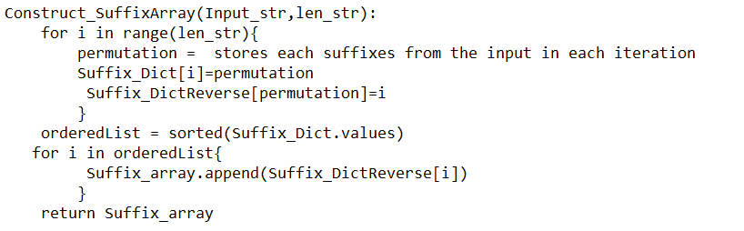
Cont ..
Suffix array and its algorithm
A suffix array can be developed by doing a DFS traversal of the suffix tree. Indeed Suffix tree and suffix array both can be developed from one another in linear time. A straightforward strategy to develop a suffix array is to make a variety of all postfixes ,then store it in an array and afterward sort the array

Slide 6
Research Design : Methods and
Algorithm

Slide 7
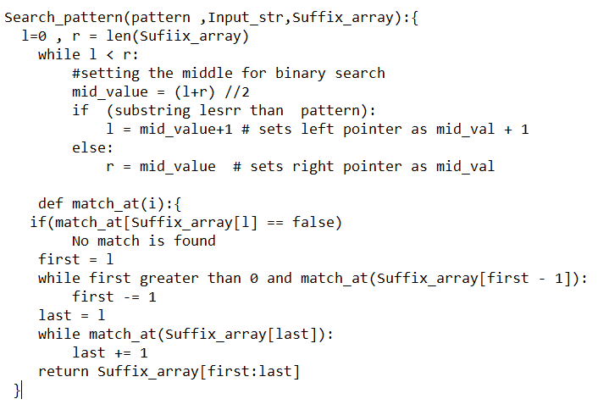
Pattern matching
To search a given pattern in a text, we first preprocess the text and constructs a suffixarray of the text. Since the suffixes are sorted during suffix array construction ,Binary Search can be used to search the subsequence.

Slide 8
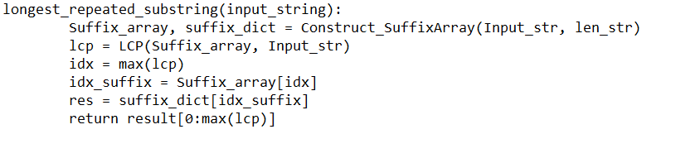
2) Finding the longest repeated substring
The basic idea is to find the longest repeated substring in one string. For example, the longest repeated substring in “ABRACADABRA” is “ABRA.”
The brute force method requires O(n²) time and lot’s of space. By using suffix array and LCP(Longest common prefix) array improvement can be made in the naive approach.

Slide 9
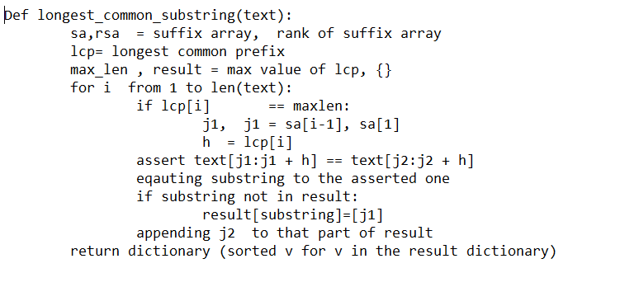
3) Longest Common Substring
The longest common substring problem is to find the longest string that is a substring of two or more strings.
A longest common substring of a collection of strings is a common substring (i.e., a shared substring) of maximum length. For example, "GTA" is a longest common substring of "ACGTACGT" and "AACCGTATA".

Slide 10
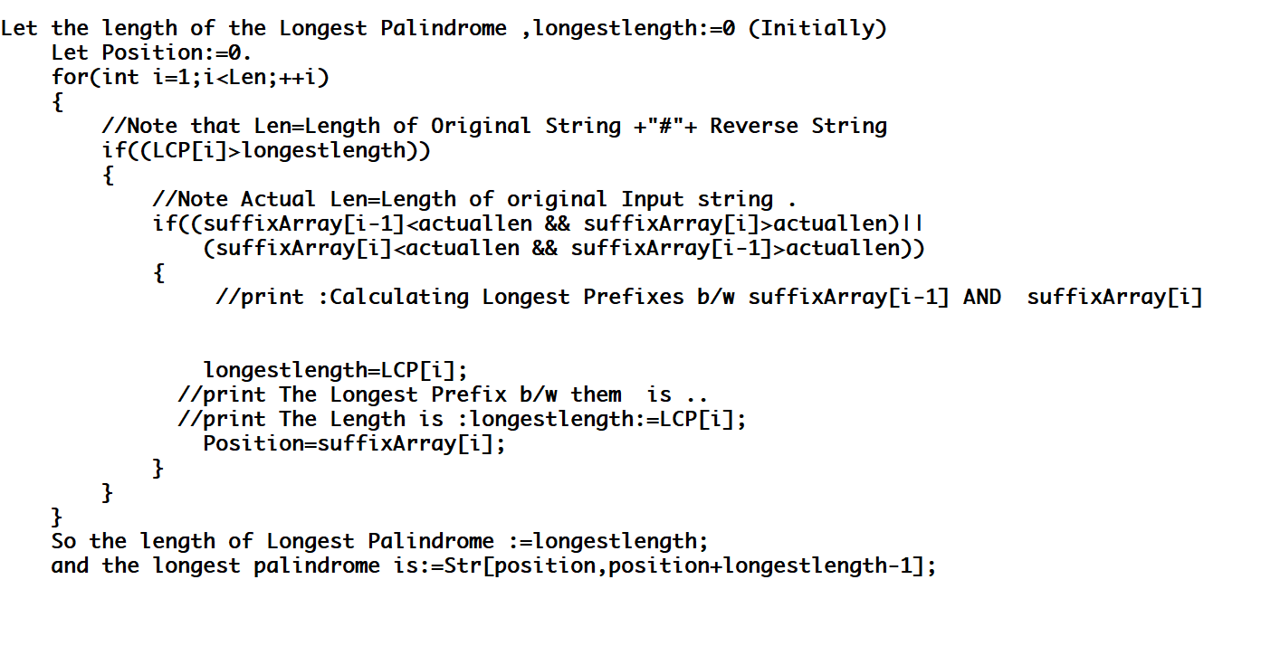
4) Finding Longest Palindromic Substring
Given a string, for finding longest palindromic substring using the algorithm mentioned below

Slide 11
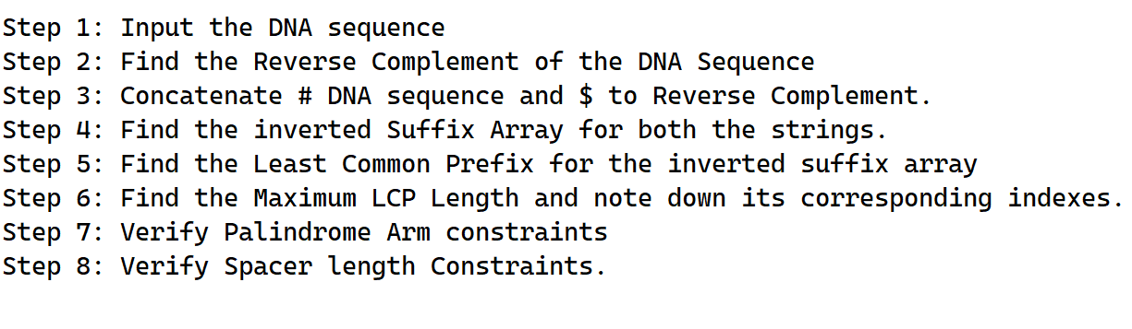
5) Palindrome Pattern Matching using Inverse Suffix Array
Proposed algorithm 1 :
ALGORITHM TO DETECT LONG ARMED GAPPED PALINDROMES

Slide 12
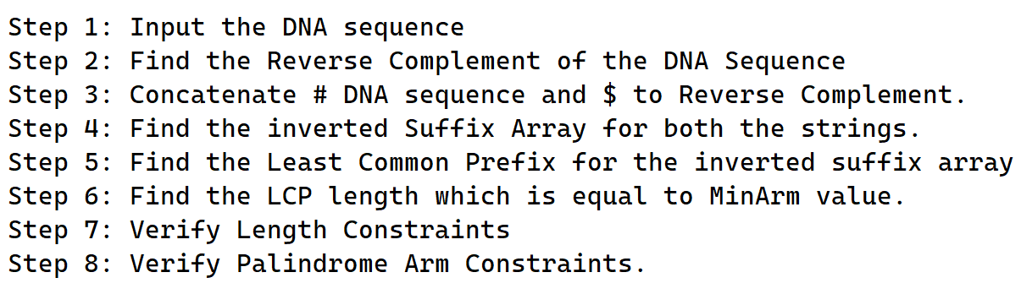
Proposed algorithm 2 :
ALGORITHM TO DETECT LENGTH CONSTRAINED GAPPED PALINDROMES

Slide 13
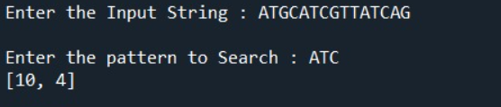


Results
Pattern matching
Finding the longest repeated substring
Longest Common Substring

Slide 14
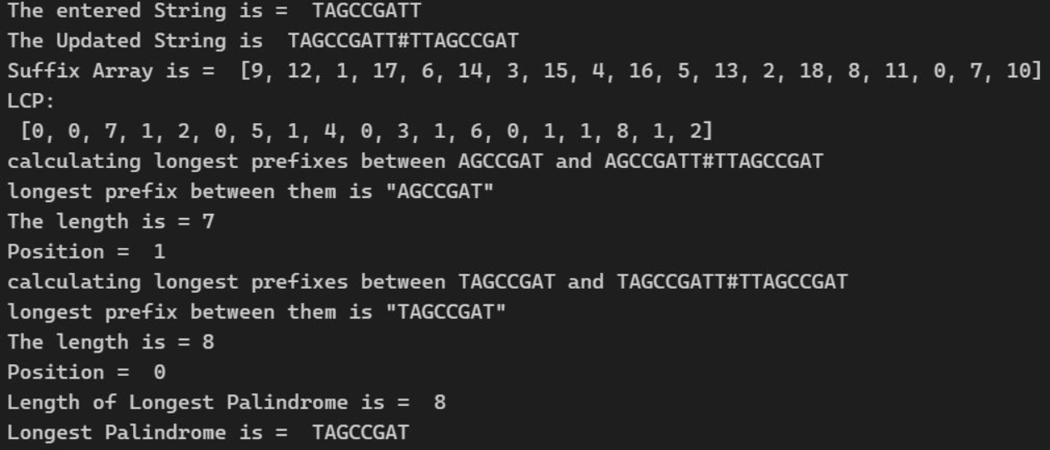
Results
Finding Longest Palindromic Substring

Slide 15
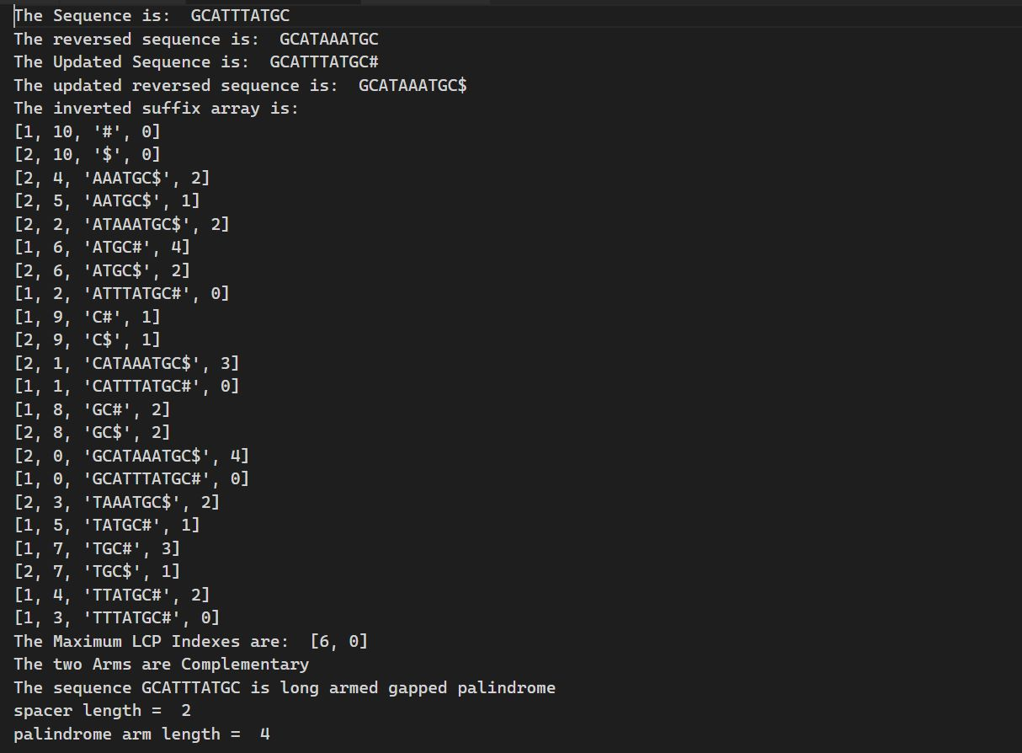
Results
Long Armed
Gapped Palindrome

Slide 16
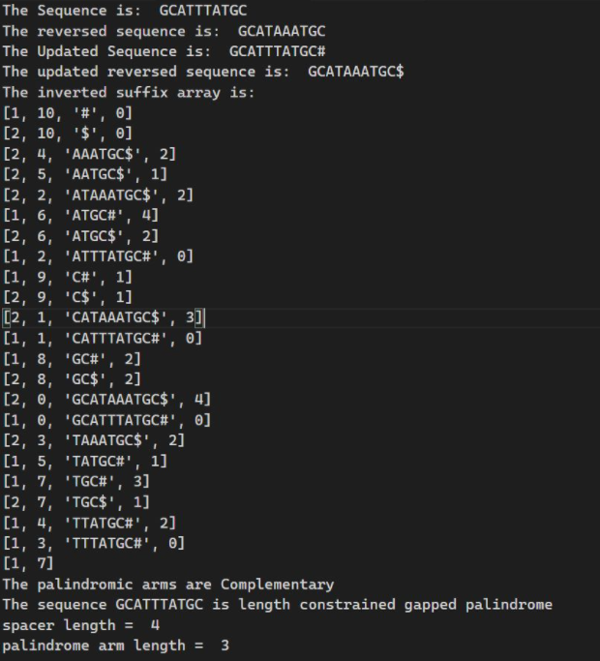
Results
Length Constrained
Gapped Palindrome

Slide 17
Discussion
The Applications of suffix array can be used to find Pattern Matching, to find longest repeated substring, to find longest common substring and longest palindromic substring in Genome sequencing or Genome assembly
Suffix Arrays are better than Suffix trees where suffix arrays consume less space and can be executed faster when compared to Suffix Trees.
Inverted Suffix Arrays can be used in finding long armed gapped palindromes and length constrained gapped palindromes where these palindromes are very essential in genome assembly
Palindrome structures in sequence show a major role in determining parameters of gene activities or further developments in cells.

Slide 18
Conclusion
In this paper, an emphasis is given on the use of suffix arrays in various streams of bioinformatics.
Various uses with the corresponding algorithm are mentioned.The applications mentioned are pattern searching, finding the longest repeated substring, finding the longest common substring, finding the longest palindrome in a string, Palindrome Pattern matching using inverted suffix array.
We have presented an algorithm to detect length constrained version of gapped palindromes in DNA sequences by using inverted suffix array and longest common prefix techniques.

Slide 19
Reference
https://stackoverflow.com/questions/7043778/longest-palindrome-in-a-string-using-suffix-tree
https://louisabraham.github.io/notebooks/suffix_arrays.html
https://www.youtube.com/watch?v=53VIWj8ksyI
https://www.youtube.com/watch?v=OptoHwC3D-Y
S. Gupta, R. Prasad and S. Yadav, "Searching Gapped Palindromes Using Inverted Suffix Array," 2015 IEEE International Conference on Computational Intelligence & Communication Technology, 2015, pp. 186-191, doi: 10.1109/CICT.2015.72.
S. Gupta, R. Prasad and S. Yadav, "Searching Gapped Palindromes in DNA Sequences using Dynamic Suffix Array," Indian Journal of Science and Technology, vol. 8, no. 23, pp. 1-9, 2015.

Slide 20
Thank You

