Slide 1
DIGITAL DESIGN & COMPUTER ARCHITECTURE
SMART WATER TANK
OVERFLOW PROTECTION
FULL
AND PUMP CONTROL SYSTEM
Design • Logic • Simulation in Logisim
LOW
TEAM MEMBERS
2620090006 | Sai Harsha
AUTO PUMP CONTROL
2620090013 | Kanduri Vishnu Preetham
2620090016 | Thumu Vilas
2620090023 | T. V. H. S. S. Jayasurya
SECTION: 9
FINAL PROJECT DEMONSTRATION

Slide 2
DDCA PROJECT / 02
Introduction & Objective
A digital-logic approach to safer, smarter water storage
HOW IT WORKS
THE PROBLEM
Water tanks can overflow when a pump is left running. Manual monitoring also wastes time and may lead to water and electricity loss.
FULL
OUR IDEA
LOW
Use level sensors as digital inputs and logic circuitry to control a pump indicator automatically.
OBJECTIVES
SENSORS
PUMP
•
Detect low-water and full-tank conditions
•
Turn the pump control output on/off logically
Sensor inputs → logic decision → pump output
•
Verify the design using a Logisim simulation

Slide 3
DDCA PROJECT / 03
Theory & Logic Circuit
Digital inputs represent water-level conditions
CONTROL LOGIC — CONCEPTUAL
INPUTS & OUTPUT
L — Low-level condition
1 = water is low
H — High-level / full sensor
1 = tank is full
P — Pump command
1 = pump ON
0 = pump OFF
LOW SENSOR
L
CONTROL
LATCH
PUMP
OUTPUT
FULL SENSOR
H
Set condition: low level detected • Reset condition: full tank detected
Design note: a real pump controller needs memory (latch/flip-flop) to keep the pump running between the low and full thresholds.
A latch provides the memory needed for automatic refill control; the exact Logisim implementation should match the circuit built by your team.

Slide 4
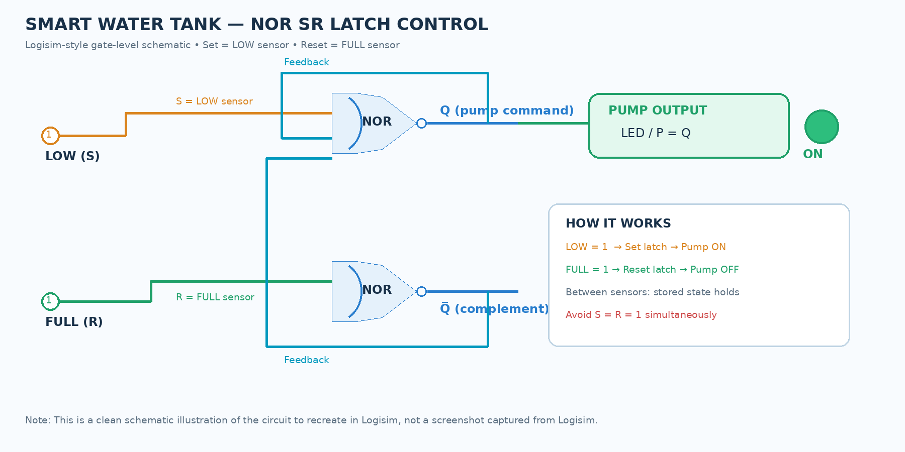
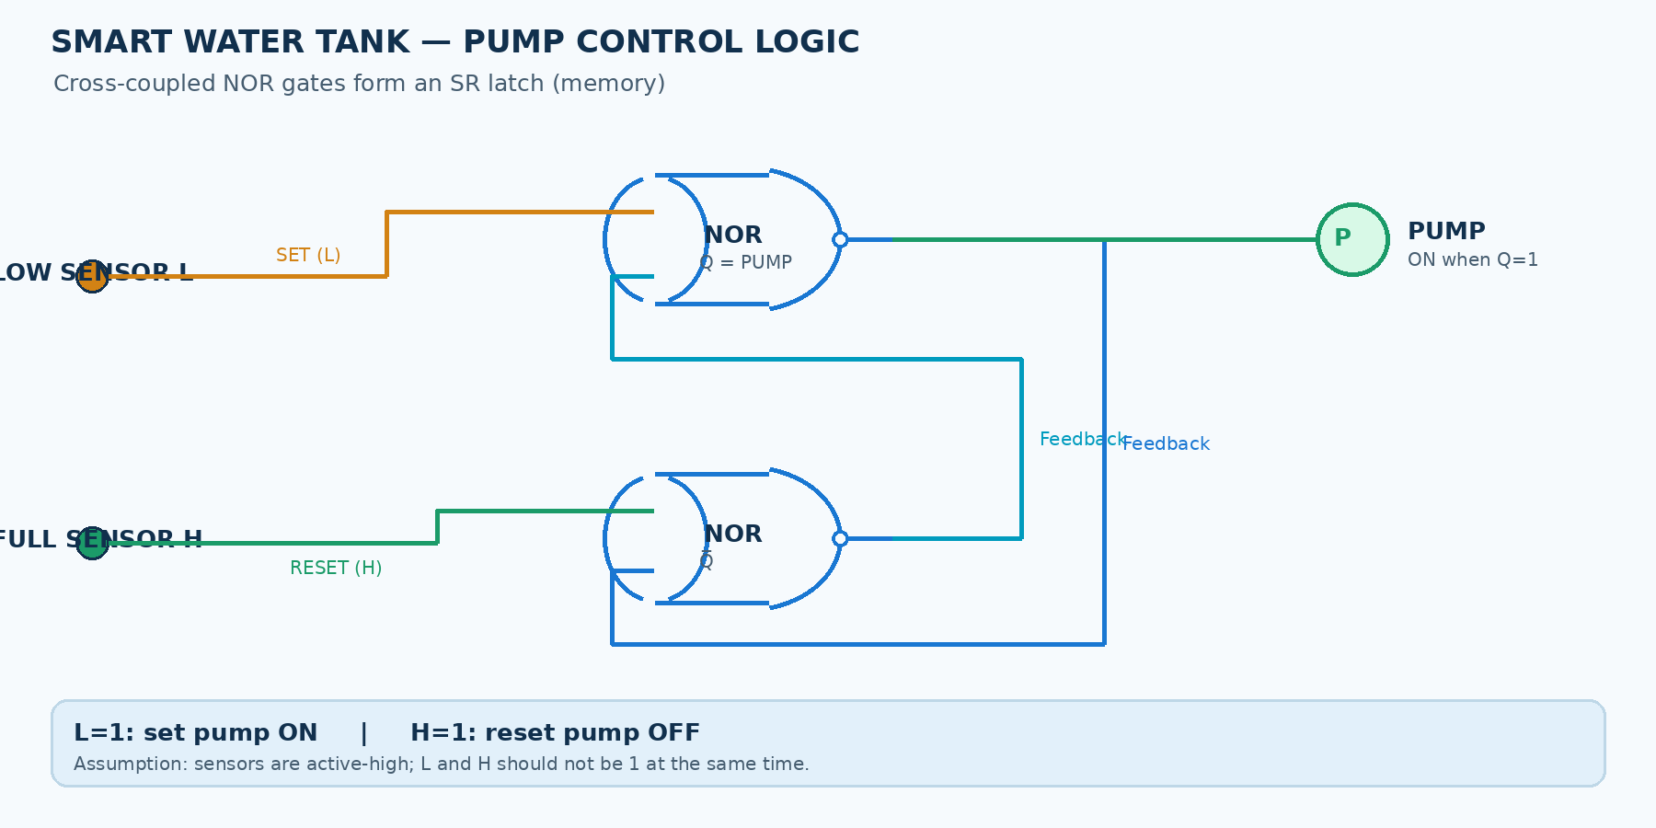
DDCA PROJECT / 04
Circuit Design in Logisim
Gate-level control using two cross-coupled NOR gates (SR latch)
In Logisim: place 2 NOR gates, 2 input pins (LOW and FULL), connect feedback wires, and attach an LED to Q.

Slide 5
DDCA PROJECT / 05
Simulation Results
Expected behavior for a latch-based refill controller
INPUT / EVENT
LOW SENSOR (L)
FULL SENSOR (H)
PUMP (P)
EXPECTED ACTION
Water below low mark
1
0
1
Pump starts
Water rising between sensors
0
0
1*
Pump keeps running
Tank reaches full mark
0
1
0
Pump stops
Normal level / no new event
0
0
0*
Pump remains off
*The output depends on the stored latch state when both sensors are 0. The memory element is what makes the system automatic.
Pump OFF / full reached
Pump ON / filling
Low-level trigger
This table describes the latch's stored-state behavior; the pump output between sensor thresholds depends on the previous state.

Slide 6
DDCA PROJECT / 06
Conclusion & Applications
From a logic design to a practical water-saving idea
OUTCOME
APPLICATIONS
FUTURE IMPROVEMENTS
•
Automatic pump start/stop logic
•
Homes and apartments
•
Add buzzer / overflow alarm
•
Reduces overflow risk
•
Overhead and storage tanks
•
Add dry-run protection
•
Demonstrates digital control
•
Schools, offices, small buildings
•
Use relay driver and real sensors
KEY TAKEAWAY
THANK YOU
Digital logic can make water management more reliable, efficient, and easier to monitor.

