Slide 1

CUSTOMER RETENTION
Presented by:
JAYASURYA E

Slide 2
Problem Statement
E-retail factors for customer activation and retention: A case study from Indian e-commerce customers
Customer satisfaction has emerged as one of the most important factors that guarantee the success of online store; it has been posited as a key stimulant of purchase, repurchase intentions and customer loyalty. A comprehensive review of the literature, theories and models have been carried out to propose the models for customer activation and customer retention. Five major factors that contributed to the success of an e-commerce store have been identified as: service quality, system quality, information quality, trust and net benefit. The research furthermore investigated the factors that influence the online customers repeat purchase intention. The combination of both utilitarian value and hedonistic values are needed to affect the repeat purchase intention (loyalty) positively. The data is collected from the Indian online shoppers. Results indicate the e-retail success factors, which are very much critical for customer satisfaction.

Slide 3
EDA(Exploratory Data Analysis)

Slide 4
Data Description
The dataset contains 269 records (rows) and 71 features (columns).
Here, we will provide a brief description of dataset features.
Since the number of features is large (71), we will attach the original
data description file to this study for more information about the dataset.
Now, we will mention the feature name with a short description of its
meaning.

Slide 5
Data frame Description:
The dataset contains the data of the e-commerce sector. On the basis of the data we have to predict the customer retention of the indian online shopping, the dataset contains the data like:
'Gender', 'Age', 'City', 'PinCode', 'Years', 'Times', 'Access', 'Device', 'ScSiMobDiv', 'OS', 'Browser', 'Channel', 'Reach', 'Explore', 'PayOpt', 'FreqAbad', 'Abandon', 'ContWeb', 'InfoRev', 'CompInfo', 'RelInfo', 'EaNav', 'LodProSp', 'UsFrInt', 'PayMeth', 'Trust', 'Empathy', 'GuarPriv', 'ResAvab', 'BenfDisc', 'Enjoyment', 'ConvFlex', 'RetRepPol', 'GaAcLoPr', 'DispQualinfo', 'SatShGoQual', 'NetBenf', 'SatExTru', 'WidVarProd', 'CompRelProdInfo', 'MontSav', 'ConvPat', 'SenAdv', 'ETSocStat', 'GratFavET', 'FulCerRol', 'ValMonSp', 'OnRetShop', 'EaUsWeb', 'VisAppWebLay', 'WiVaProdOff', 'CompRelProd', 'FaLoWebSp', 'RelWeb', 'QuComPur', 'AvaSevPayOpt', 'SpOrdDel', 'PrCusInfo', 'SecFinInfo', 'PerTrWor', 'PreAsMulCh', 'LoTiLogIn', 'LoTiDisGrPh', 'LaDecPr', 'LonPaLoTi', 'LimMoPayPr', 'LoDelPer', 'ChAppDes', 'FrqDist', 'WebEffBef', 'IndOnlRet'

Slide 6
Target Variable
Times(Retention): It’s continuous type of data, so the model approach is carried out for Regression analysis.
Regression:
It’s an analysis is used when you want to predict a continuous dependent variable from a number of independent variables.
Independent variables with more than two levels can also be used in regression analysis.

Slide 7
Visualization

Slide 8
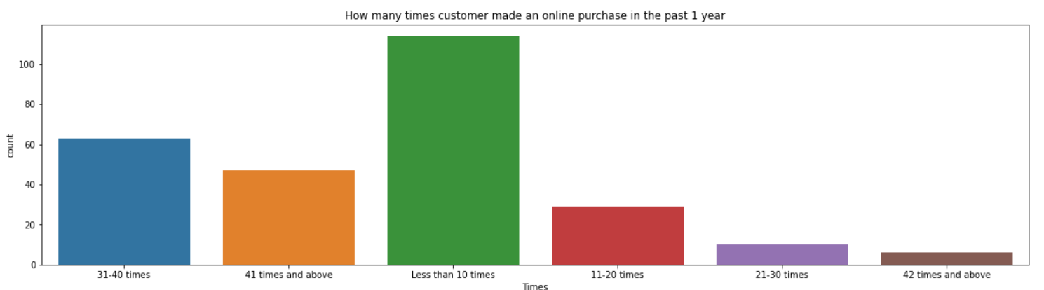
Target Variable (Times)

Slide 9
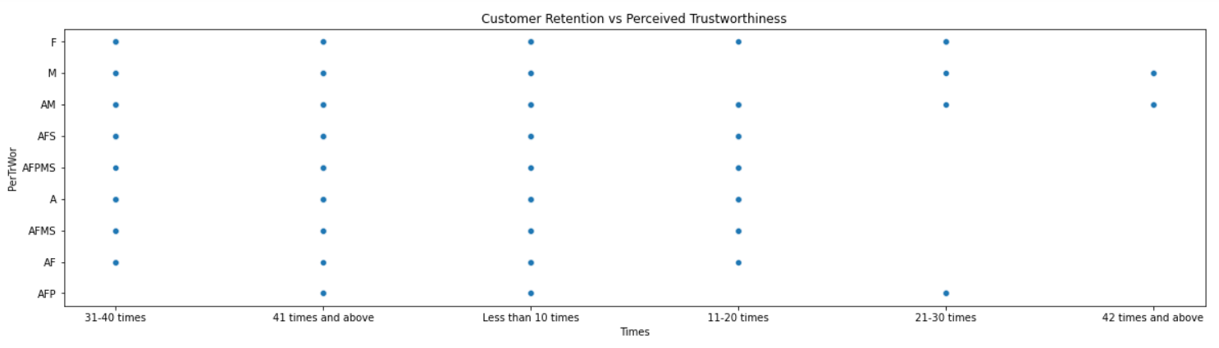
Scatter plot Distribution for Customer Retention(Target Variable) vs Perceived Trustworthiness

Slide 10
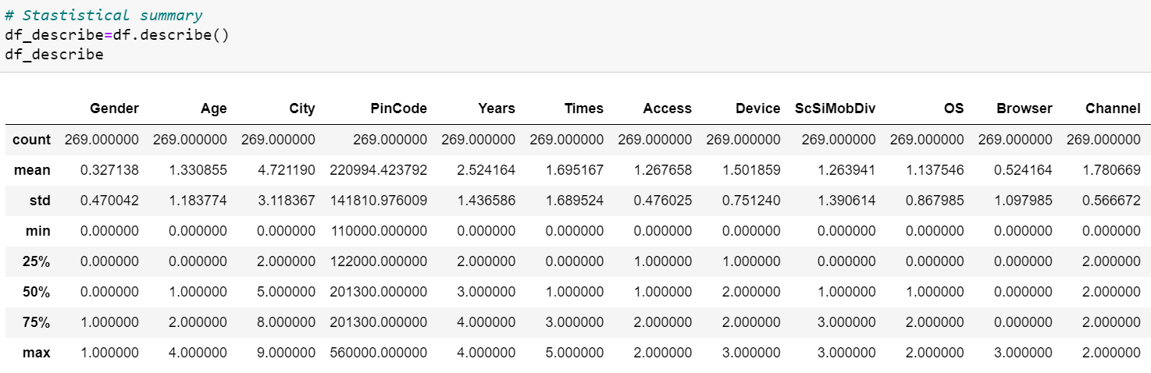
Data Pre-processing

Slide 11
Data Cleaning

Slide 12
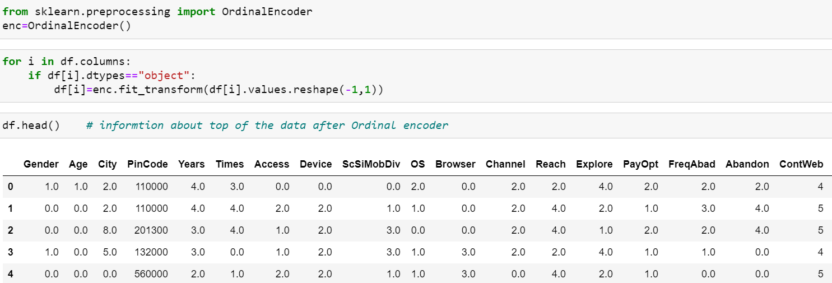
Encoding of Data Frame:
Since the dataset has a lot string values. We will use the ordinal encoding techniques to convert the string data to numerical one.

Slide 13
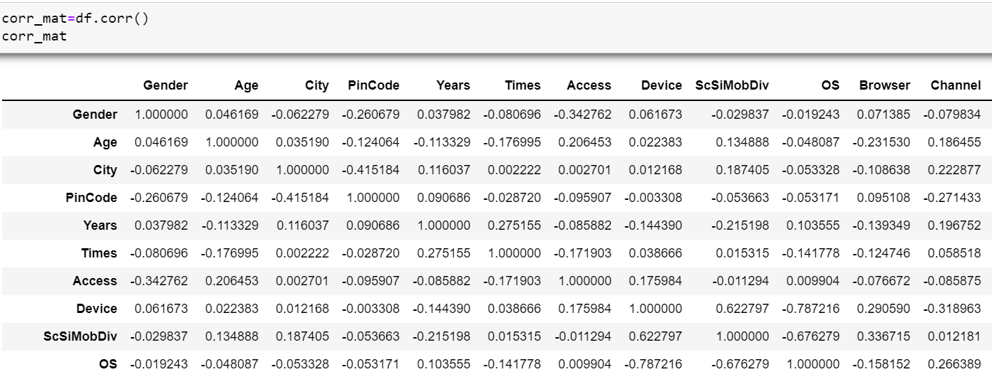
Correlation matrix:
A correlation matrix is simply a table which displays the correlation. The measure is best used in variables that demonstrate a linear relationship between each other. The fit of the data can be visually represented in a heatmap.

Slide 14
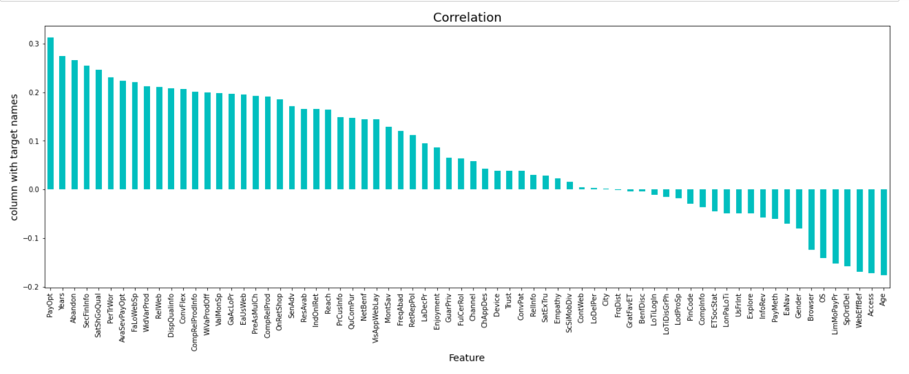
Checking the columns which are positively and negative correlated with the target columns:

Slide 15
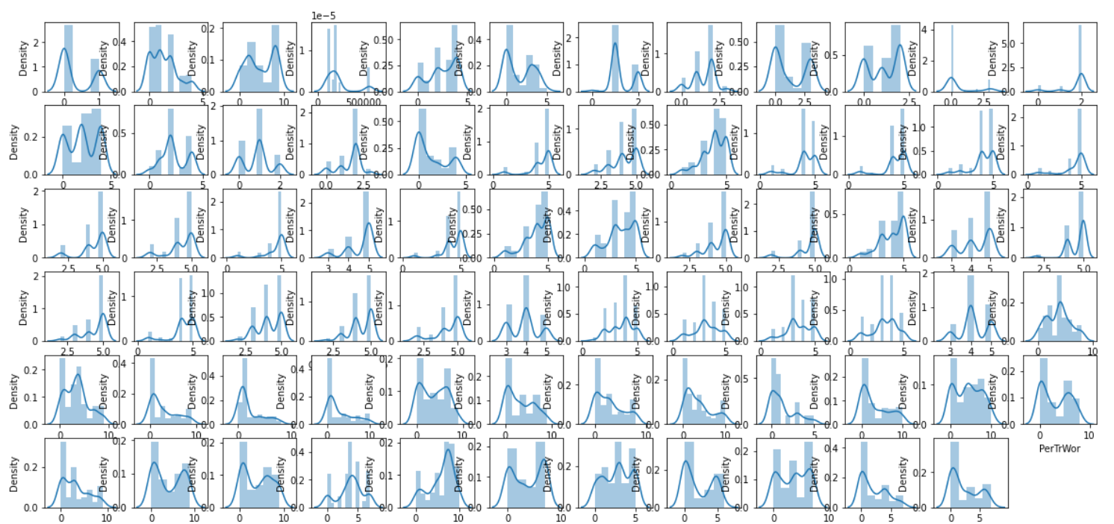
Checking the data distribution among all the columns.

Slide 16
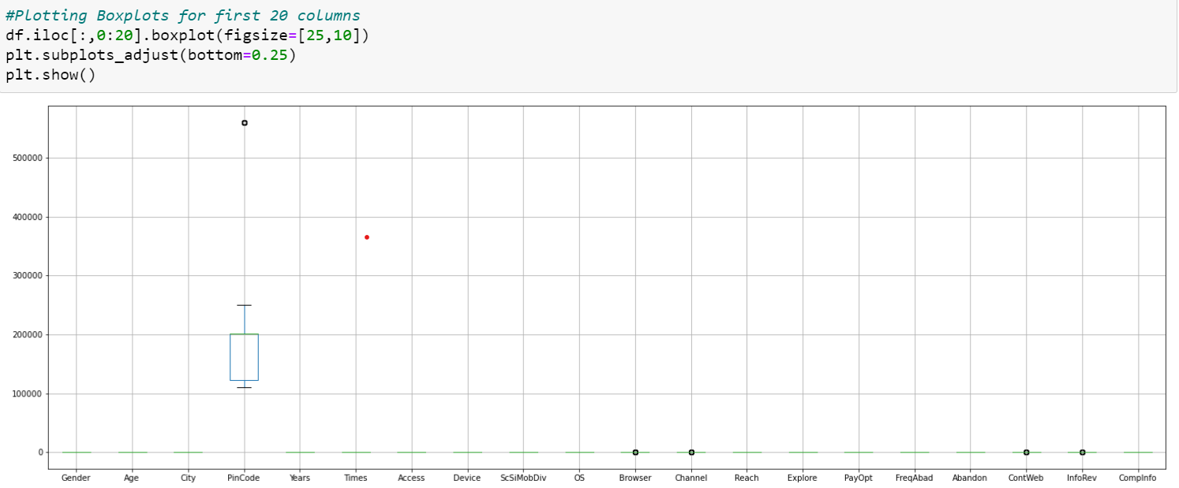
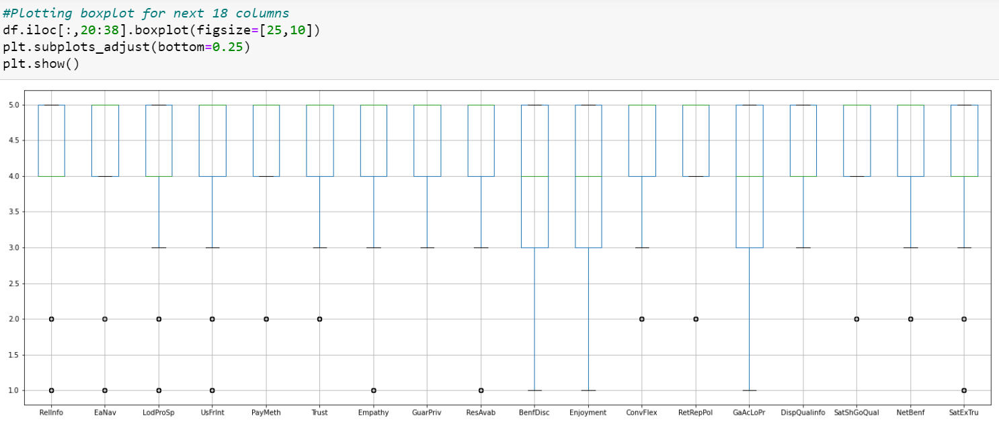
Outliers Check: There are 80 columns in dataset so it’s not possible to plot each and every column separately or plot all together. so, we will print in 4 steps:
First set
Second set

Slide 17
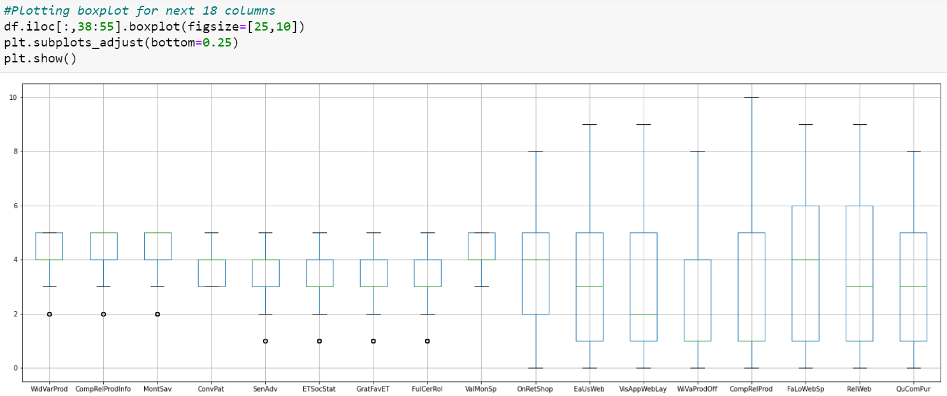
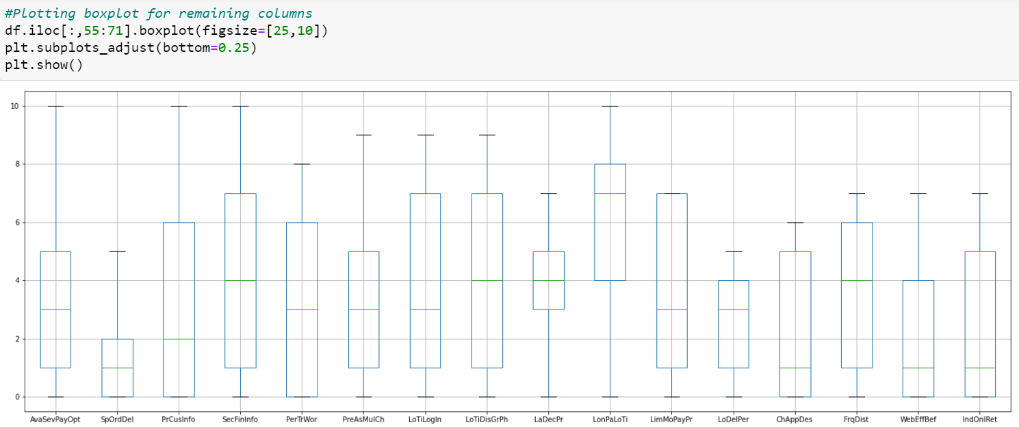
Remaining section of Outliers Check:
Third set
Fourth set

Slide 18
Removal of Outliers
Now let’s see outliers in few features so we consider z-score technique to remove the outliers.
Let us consider Z-score technique, it removes the outliers in the dataset.
Finally, the percentage of data loss in dataset is 25.65 due to larger number of outliers.

Slide 19
Checking Skewness: Now here, we are going to use Power transform function to handle skewness in dataset
Before handling Skewness
After handling Skewness
Columns Skewness | Columns Skewness
Gender 0.741028 | NetBenf -1.180598
Age 0.680987 | SatExTru -1.814791
City -0.105049 | WidVarProd -0.551863
PinCode 1.751959 | CompRelProdInfo -0.940104
Years -0.554705 | MontSav -1.247623
Times 0.286241 | ConvPat 0.115519
Access 0.630053 | SenAdv -0.337315
Device -0.485180 | ETSocStat -0.248103
ScSiMobDiv 0.349042 | GratFavET -0.360913
OS -0.270283 | FulCerRol -0.495053
Browser 1.710244 | ValMonSp -0.172501
Channel -2.469485 | OnRetShop 0.145462
Reach -0.041161 | EaUsWeb 0.508414
Explore 0.155075 | VisAppWebLay 0.813015
PayOpt 0.129735 | WiVaProdOff 1.186071
FreqAbad -0.867449 | CompRelProd 0.964100
Abandon 0.743052 | FaLoWebSp 0.106301
ContWeb -2.234127 | RelWeb 0.464836
InfoRev -0.801079 | QuComPur 0.606858
CompInfo -0.893446 | AvaSevPayOpt 0.781633
RelInfo -1.710957 | SpOrdDel 1.061243
EaNav -2.052560 | PrCusInfo 0.716860
LodProSp -1.467621 | SecFinInfo 0.073523
UsFrInt -2.015996 | PerTrWor 0.199441
PayMeth -1.581400 | PreAsMulCh 0.577166
Trust -1.261484 | LoTiLogIn 0.131096
Empathy -2.294982 | LoTiDisGrPh 0.167550
GuarPriv -1.355737 | LaDecPr -0.378929
ResAvab -2.104016 | LonPaLoTi -0.708594
BenfDisc -1.052475 | LimMoPayPr -0.086712
Enjoyment -0.565041 | LoDelPer -0.147702
ConvFlex -1.121619 | ChAppDes 0.354163
RetRepPol -2.243625 | FrqDist -0.100608
GaAcLoPr -0.853530 | WebEffBef 0.662084
DispQualinfo -0.555681 | IndOnlRet 0.583614
SatShGoQual -1.989886
Columns Skewness | Columns Skewness
Gender 0.741028 | NetBenf -0.622457
Age -0.024246 | SatExTru -0.469379
City -0.263529 | WidVarProd -0.205770
PinCode 0.000000 | CompRelProdInfo -0.317747
Years -0.371550 | MontSav -0.553624
Access 0.006801 | ConvPat -0.018599
Device -0.138222 | SenAdv -0.136339
ScSiMobDiv 0.165368 | ETSocStat -0.114445
OS -0.272132 | GratFavET -0.108012
Browser 1.533776 | FulCerRol -0.152034
Channel -2.029216 | ValMonSp -0.048997
Reach -0.208762 | OnRetShop -0.115650
Explore -0.055691 | EaUsWeb -0.084097
PayOpt -0.083889 | VisAppWebLay 0.006539
FreqAbad -0.192075 | WiVaProdOff 0.056626
Abandon 0.231205 | CompRelProd 0.042060
ContWeb -0.770947 | FaLoWebSp -0.203340
InfoRev -0.281012 | RelWeb -0.083203
CompInfo -0.235305 | QuComPur -0.064882
RelInfo -0.406237 | AvaSevPayOpt -0.025756
EaNav -0.588561 | SpOrdDel 0.130552
LodProSp -0.411050 | PrCusInfo 0.010433
UsFrInt -1.110510 | SecFinInfo -0.233972
PayMeth -0.647029 | PerTrWor -0.140989
Trust -0.495785 | PreAsMulCh -0.082562
Empathy -1.152407 | LoTiLogIn -0.169011
GuarPriv -0.848203 | LoTiDisGrPh -0.164309
ResAvab -0.539238 | LaDecPr -0.242822
BenfDisc -0.341753 | LonPaLoTi -0.406803
Enjoyment -0.242151 | LimMoPayPr -0.265289
ConvFlex -0.453152 | LoDelPer -0.226723
RetRepPol -1.132389 | ChAppDes -0.002355
GaAcLoPr -0.314912 | FrqDist -0.271126
DispQualinfo -0.297591 | WebEffBef 0.018153
SatShGoQual -0.676094 | IndOnlRet 0.006779

Slide 20
Model Building and Evaluation
These are modelling approach made to build an model :
Linear
Random Forest
Decision Tree
XGBoost
k-nearest neighbors (KNN)

Slide 21
Performance Metric
Model Building | R2 score | MAE | MSE | RMSE
Linear | 30.20 | 1.17 | 1.91 | 1.38
Random | 72.23 | 0.42 | 0.76 | 0.87
Decision | 77.94 | 0.21 | 0.60 | 0.77
XGBoost | 71.51 | 0.28 | 0.78 | 0.88
KNeighbors | 33.47 | 0.98 | 1.82 | 1.35
According to performance metric, the decision tree has higher R2 score, So this is our best model.

Slide 22
Comparison:
Performance Metric | Cross -Validation Score
30.20 | -1.72
72.23 | 77.91
77.94 | 75.97
71.51 | 76.12
33.47 | 42.58
Comparing the performance model and cross-validation score which has minimum difference is decision tree. so finally, this is our best model.

Slide 23
Hyper Parameter Tuning
The Hyper parameter tuning is carried out for Decision Tree Regressor model.
Because performance metric score is 77.94.

Slide 24
Hyper Parameter Tuning Performance
Decision Tree Regressor:
R2 Score : 88.23
Cross validation Score : 71.81

Slide 25
Best Model
Hyper parameter Tuning performance is carried out for Decision Tree Regressor:
Hyper parameter Tuning i.e.,R2 score = 88.23 and 71.81 respectively. Finally, Decision Tree best model for these dataset.

Slide 26
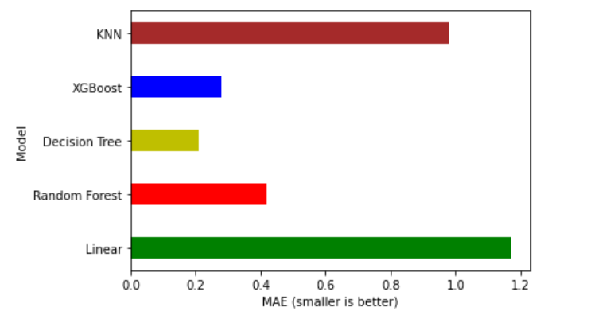
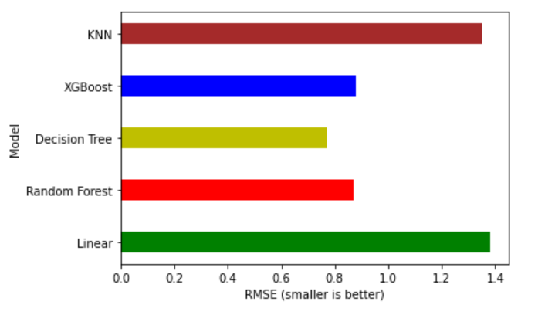
Performance Interpretation:
MAE (Mean Absolute Error)
RMSE (Root Mean Squared Error)

Slide 27
Feature Importance’s:
Some of the models we used provide the ability to see the importance of each feature in the dataset after fitting the model. We will look at the feature importance’s provided by both Random Forest and XGBoost models. We have 81 features in our data which is a big number, so we will take a look at the 15 most important features.

Slide 28
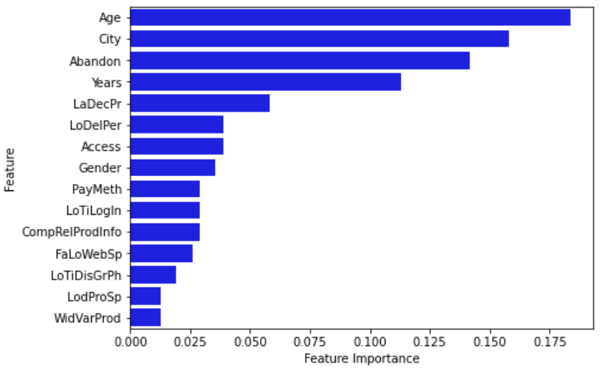
Feature Importance’s:

Slide 29
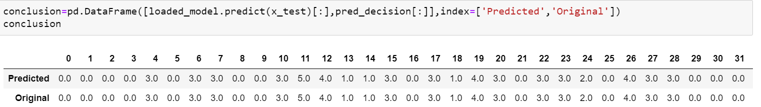
Conclusion:
In this paper, we built several regression models to predict the times of some customer retention given some of the customer retention features. We evaluated and compared each model to determine the one with highest performance. We also looked at how some models rank the features according to their importance. In this paper, we followed the data science process starting with getting the data, then cleaning and pre-processing the data, followed by exploring the data and building models, then evaluating the results.
As a recommendation, we advise to use this model (or a version of it trained with more recent data) by e-commerce sector who want to get an idea about customer. The model can be used also with datasets that covered areas provided that they contain the same features. We also suggest that people take into consideration the features that were deemed as most important as seen in the previous section; this might help them estimate the customer retention is better.

Slide 30
Thank you

