Slide 1

FLIGHT PRICE PREDICTION
Presented by:
JAYASURYA E

Slide 2
Problem Statement
Anyone who has booked a flight ticket knows how unexpectedly the prices vary. The cheapest
available ticket on a given flight gets more and less expensive over time. This usually happens as
an attempt to maximize revenue based on -
1. Time of purchase patterns (making sure last-minute purchases are expensive)
2. Keeping the flight as full as they want it (raising prices on a flight which is filling up in order
to reduce sales and hold back inventory for those expensive last-minute expensive
purchases)
So, you have to work on a project where you collect data of flight fares with other features and
work to make a model to predict fares of flights. This project contains three phase:
1.Data Collection
2.Data Analysis
3.Model Building
…Continued…

Slide 3
1.Data Collection:
You have to scrape at least 1500 rows of data. You can scrape more data as well, it’s up to you,
More the data better the model
In this section you have to scrape the data of flights from different websites (yatra.com,
skyscanner.com, official websites of airlines, etc). The number of columns for data doesn’t have
limit, it’s up to you and your creativity. Generally, these columns areairline name, date of journey,
source, destination, route, departure time, arrival time, duration, total stops and the target variable
price. You can make changes to it, you can add or you can remove some columns, it completely
depends on the website from which you are fetching the data.
2.Data Analysis:
After cleaning the data, you have to do some analysis on the data.
Do airfares change frequently? Do they move in small increments or in large jumps? Do they tend
to go up or down over time?
What is the best time to buy so that the consumer can save the most by taking the least risk?
Does price increase as we get near to departure date? Is Indigo cheaper than Jet Airways? Are
morning flights expensive?.
…Continued…

Slide 4
3.Model Building :
After collecting the data, you need to build a machine learning model. Before model building do
all data pre-processing steps. Try different models with different hyper parameters and select
the best model.
Follow the complete life cycle of data science. Include all the steps like
1. Data Cleaning
2. Exploratory Data Analysis
3. Data Pre-processing
4. Model Building
5. Model Evaluation
6. Selecting the best model

Slide 5
EDA(Exploratory Data Analysis)

Slide 6
Data Description
The dataset contains 10683 records (rows) and 11 features (columns).
Here, we will provide a brief description of dataset features. Since the
number of features is 11, we will attach the data description i.e.,
Airline, Date of Journey, Source, Destination, Route, Departure Time,
Arrival Time, Duration, Total Stops, Additional Info, Price.

Slide 7
Target Variable
Price(Ticket Price): It’s continuous type of data, so the model approach is carried out for Regression analysis.
Regression:
It’s an analysis is used when you want to predict a continuous dependent variable from a number of independent variables.
Independent variables with more than two levels can also be used in regression analysis.

Slide 8
Visualization

Slide 9
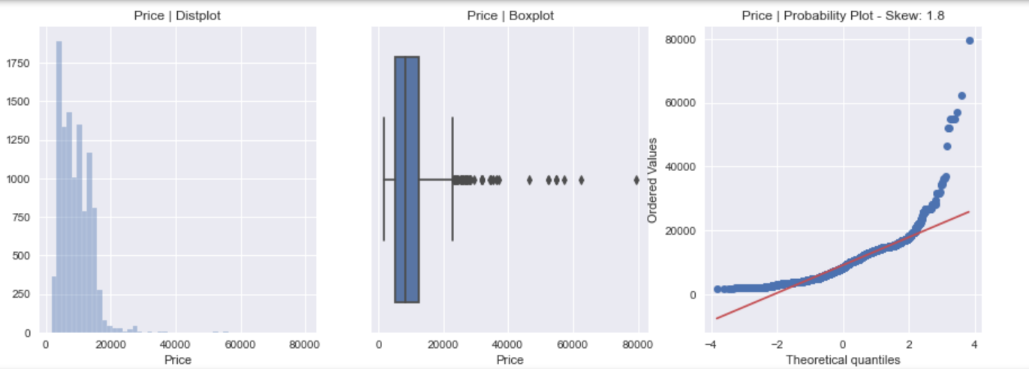
Target Variable (Price)

Slide 10
Data Pre-processing

Slide 11
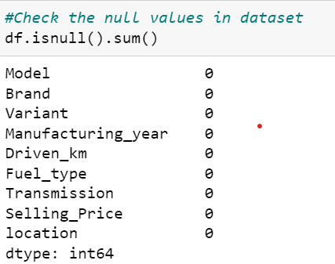

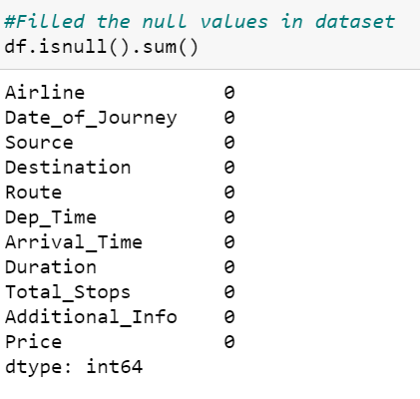
Null values in Dataset
Fill null values in Datasets
No Null values in Dataset
Dropped Features
Date of Journey
Route
Departure Time
Total Stops
Arrival Time
Duration

Slide 12
Data Cleaning

Slide 13
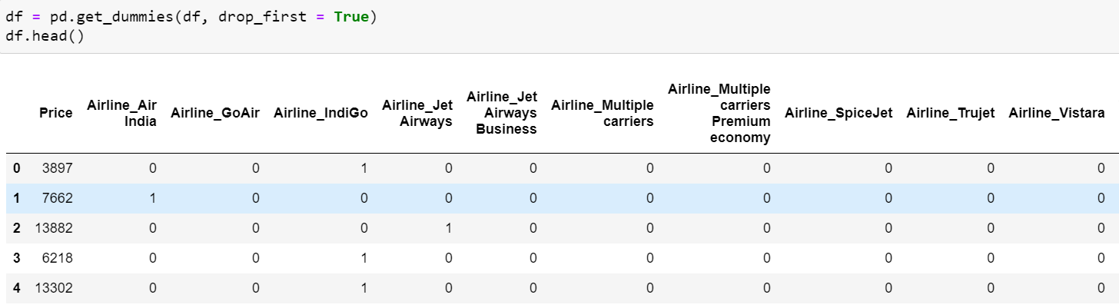
Encoding of Data Frame:
The Encoding Technique is used for this problem:
One hot encoding technique.
Now proceed with One hot encoding technique.
Now, let’s we can see all features is converted into numerical one after proceed with encoding technique.
This newly created data frame is used for machine learning algorithm. so, we create a new excel sheet to proceed with further steps.

Slide 14
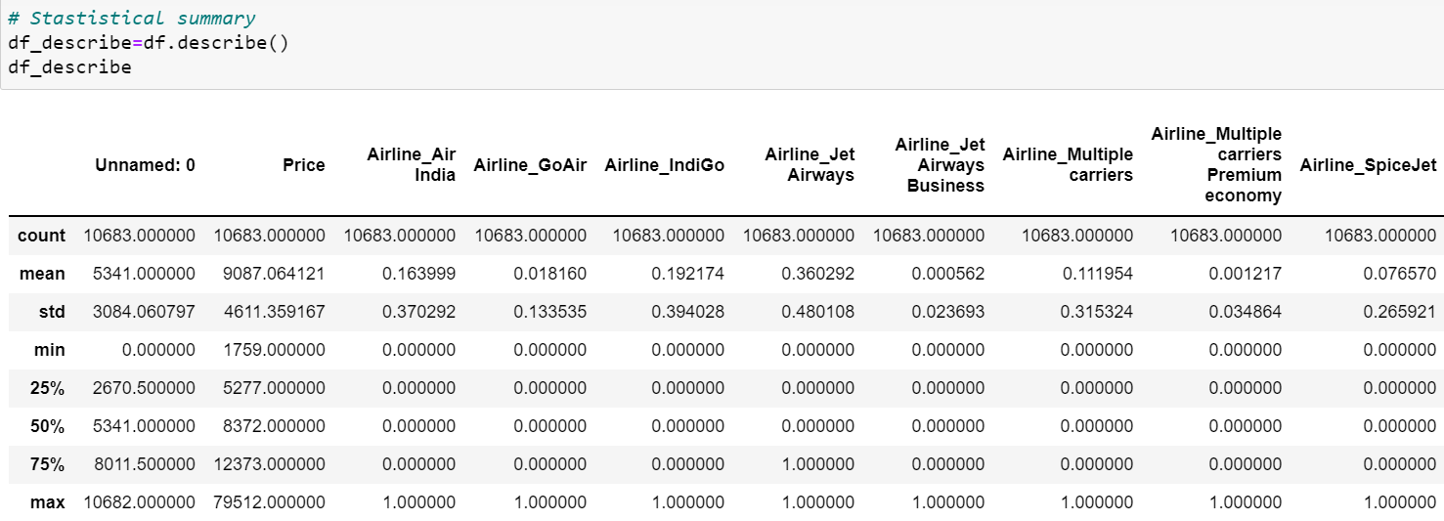
Statistical Summary
To see statistical information about the non-numerical columns in our dataset:

Slide 15
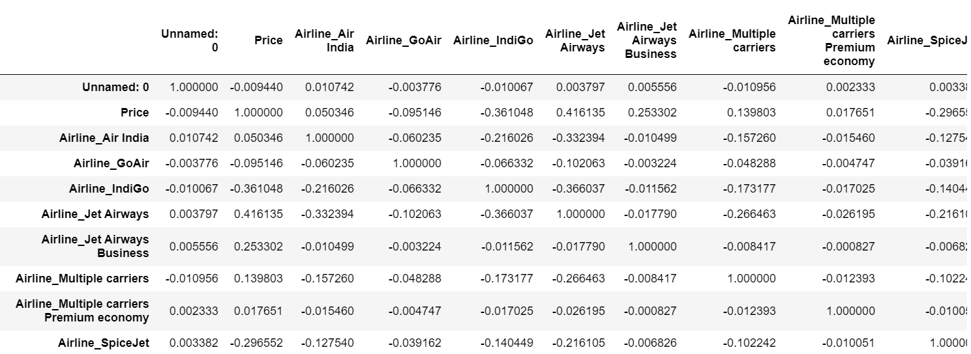
Correlation matrix:
A correlation matrix is simply a table which displays the correlation. The measure is best used in variables that demonstrate a linear relationship between each other. The fit of the data can be visually represented in a heatmap.

Slide 16
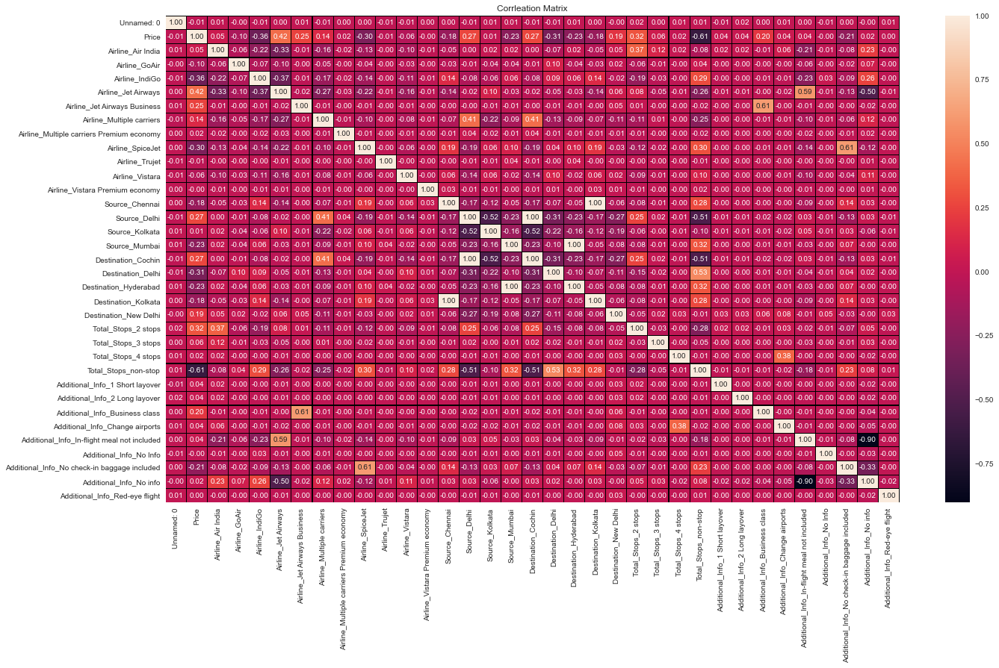

Slide 17
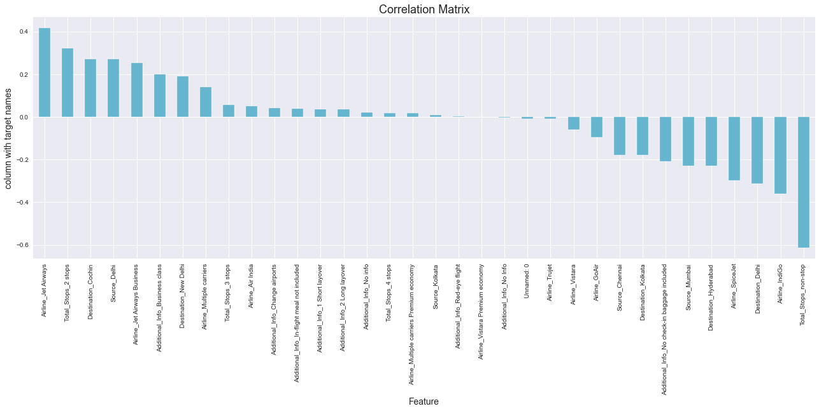
Checking the columns which are positively and negative correlated with the target columns:

Slide 18
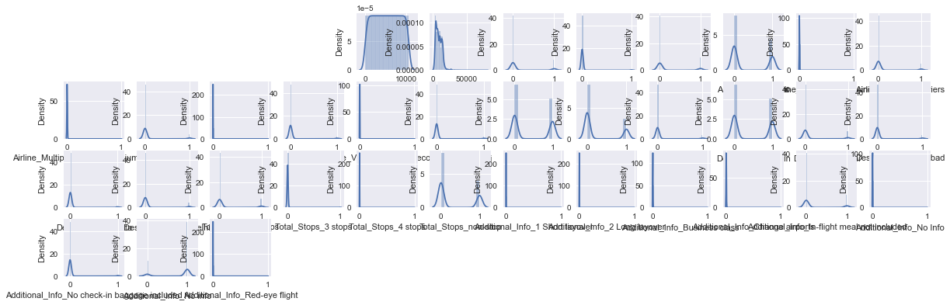
Checking the data distribution among all the columns.

Slide 19
Checking Skewness:
Columns Correlation
Price 1.812552
Airline_Air India 1.815130
Airline_GoAir 7.218042
Airline_IndiGo 1.562748
Airline_Jet Airways 0.582095
Airline_Jet Airways Business 42.166335
Airline_Multiple carriers 2.461716
Airline_Multiple carriers Premium economy 28.618184
Airline_SpiceJet 3.185227
Airline_Trujet 103.358599
Airline_Vistara 4.399442
Airline_Vistara Premium economy 59.657352
Source_Chennai 5.008333
Source_Delhi 0.304745
Source_Kolkata 1.043466
Source_Mumbai 3.521420
Destination_Cochin 0.304745
Destination_Delhi 2.362402
Destination_Hyderabad 3.521420
Destination_Kolkata 5.008333
Destination_New Delhi 2.925821
Total_Stops_2 stops 2.048256
Total_Stops_3 stops 15.312416
Total_Stops_4 stops 103.358599
Total_Stops_non-stop 0.738721
Additional_Info_1 Short layover 103.358599
Additional_Info_2 Long layover 103.358599
Additional_Info_Business class 51.657523
Additional_Info_Change airports 39.032952
Additional_Info_In-flight meal not included 1.618189
Additional_Info_No Info 59.657352
Additional_Info_No check-in baggage included 5.515777
Additional_Info_No info -1.360139
Additional_Info_Red-eye flight 103.358599
Now, let’s see features are categorical variable. So, it’s not necessary to handle skewness for these datasets.

Slide 20
Model Building and Evaluation
These are modelling approach made to build an model :
Linear
Random Forest
Decision Tree
XGBoost

Slide 21
Performance Metric
Model Building | R2 score | MAE | MSE | RMSE
Linear | 72.86 | 1719 | 5968432 | 2443
Random | 66.26 | 1735 | 7428244 | 2725
Decision | 51.01 | 2006 | 10774648 | 3282
XGBoost | 75.15 | 1558 | 5464293 | 2337
According to performance metric, the xgboost has higher R2 score, So this is our best model.

Slide 22
Comparison:
Performance Metric | Cross -Validation Score
72.86 | 67.23
66.26 | 60.70
51.01 | 45.17
75.15 | 65.70
Comparing the performance model and cross-validation score the minimum difference is for Random Forest. so finally, this is our best model.

Slide 23
Hyper Parameter Tuning
The Hyper parameter tuning is carried out for Random Forest Regressor model.
Because performance metric score is 66.26.

Slide 24
Hyper Parameter Tuning Performance
Random Forest Regressor:
R2 Score : 75.05
Cross validation Score : 68.31

Slide 25
Best Model
Hyper parameter Tuning performance is carried out for Random Forest Regressor:
Hyper parameter Tuning i.e.,R2 score and Cross validation score = 75.05% and 68.31% respectively. Finally, Random Forest is best model for these dataset.

Slide 26
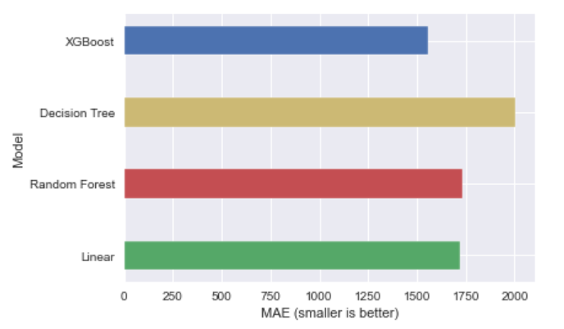
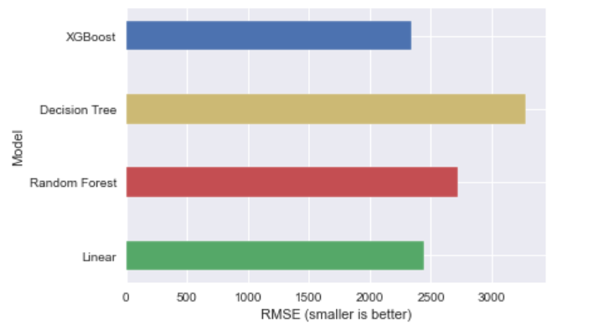
Performance Interpretation:
MAE (Mean Absolute Error)
RMSE (Root Mean Squared Error)

Slide 27
Feature Importance’s:
Some of the models we used provide the ability to see the importance of each feature in the dataset after fitting the model. We will look at the feature importance’s provided by Random Forest models. We have 32 features in our data which is a big number, so we will take a look at the 15 most important features.

Slide 28
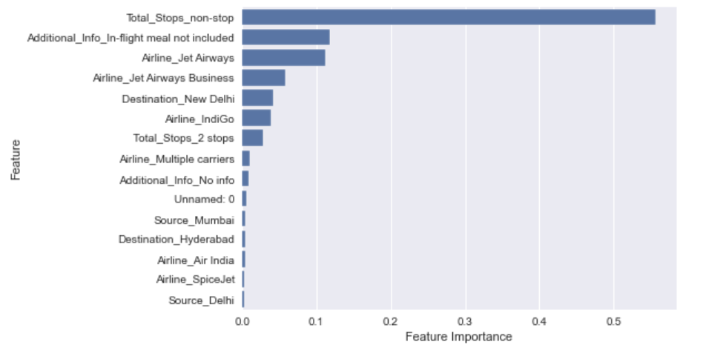
Feature Importance’s:
Notice here in feature importance of Random Forest, the total stops_non-stops feature plays a prominent role for target variable.

Slide 29
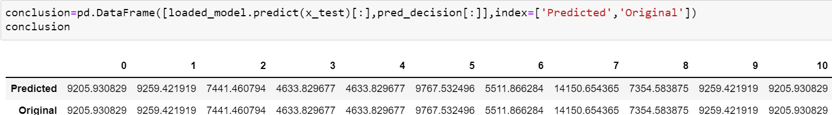
Conclusion:
In this paper, we built several regression models to predict the price of ticket by given some of the airline features. We evaluated and compared each model to determine the one with highest performance. We also looked at how some models rank the features according to their importance. In this paper, we followed the data science process starting from scrap of data, then cleaning and pre-processing the data, followed by exploring the data and building models, then evaluating the results.
As a recommendation, we advise to use this model (or a version of it trained with more recent data) by airline market who want to get an idea about ticket price. The model can be used also with datasets that covered areas provided that they contain the same features. We also suggest that people take into consideration the features that were deemed as most important as seen in the previous section; this might help them estimate the flight price is better.

Slide 30
Thank you

