Slide 1

Internship topic: Random Forest Classification
Week - 1
Submitted to:
Pooja Roy Choudhary
Karthik K
TuringMinds.ai
Bangalore
Submitted by:
Jayasurya B Jinaralkar
Data Science trainee
4694
TuringMinds.ai
Bangalore

Slide 2
Contents
Introduction
Working of Random Forest
Entropy Calculation
Gini impurity Calculation
Information gain calculation
References

Slide 3
Introduction
Root Node
The root node is the topmost decision node, which is where you have all of your data.
Leaf Node
A leaf node is a node that carries the classification or the decision.
Decision Node
A node that has two or more branches.
Entropy
It is a measure of randomness or unpredictability in the data set.
Information Gain
A measure of the decrease in the entropy after the data set is split is the information gain.
9Y/5N
Root Node
Outlook
Leaf Node
6Y/2N
3Y/3N
Sunny
Rainy
Fig: Decision Tree

Slide 4
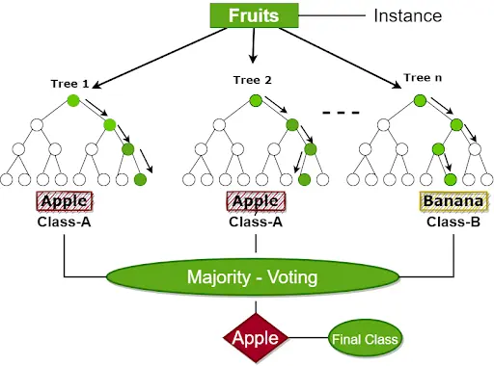
Working of Random Forest
Steps involved in Random Forest
Step 1: Select random samples from a given data or training set.
Step 2: This algorithm will construct a decision for every training data.
Step 3: Voting will take place by averaging the decision tree.
Step 4: Select the most voted prediction result as the final prediction result.
Fig: Random forest
Image Source: https://www.turing.com/kb/random-forest-algorithm

Slide 5
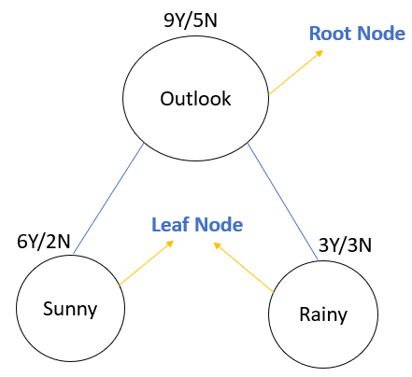
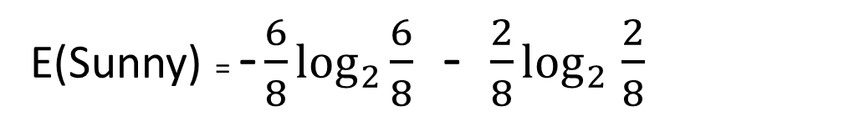
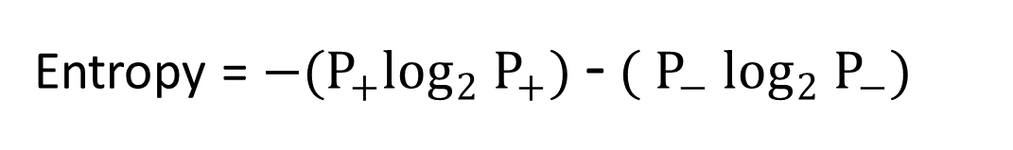
Entropy Calculation
Entropy = $−(P_{+}\log_{2}$ $P_{+})$ - $({ P}_{−}$ $\log_{2}$ $P_{−})$
E(Sunny) = - $\frac{6}{8}$ $\log_{2}$ $\frac{6}{8}$ - $\frac{2}{8}$ $\log_{2}$ $\frac{2}{8}$
E(Sunny) = 0.81

Slide 6
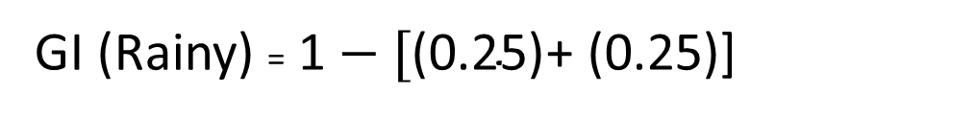
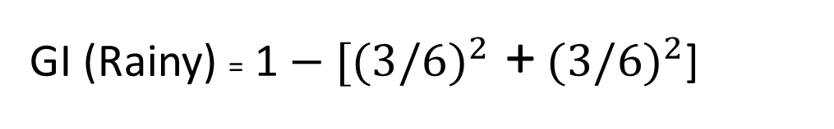
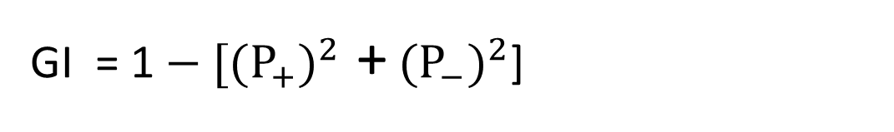
Gini Impurity
GI = 1$− [{(P_{+})}^{2}$ + ${(P_{−})}^{2}$]
GI (Rainy) = 1$− [{(3/6)}^{2}$ + ${(3/6)}^{2}$]
GI (Rainy) = 1$− \text{[}\text{(0.25)}$+ (0.25)]
GI (Rainy) = 0.5

Slide 7
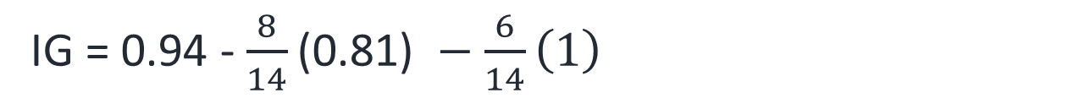
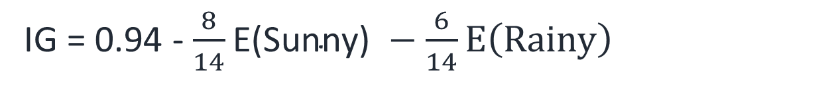

Information Gain
IG = E(R) - $Σ \frac{\left|s_{v}\right|}{\left|s\right|}∗E\left(s_{v}\right)$
IG = 0.94 - $\frac{8}{14}\text{E}\text{(}\text{Sunny}\text{)} −\frac{6}{14}E\left(Rainy\right)$
IG = 0.94 - $\frac{8}{14}\text{(}\text{0.81}\text{)} −\frac{6}{14}\left(1\right)$
IG = 0.05

Slide 8
References
https://www.youtube.com/watch?v=1IQOtJ4NI_0&list=RDLV1IQOtJ4NI_0&index=1
https://www.youtube.com/watch?v=5aIFgrrTqOw
https://www.youtube.com/watch?v=FuTRucXB9rA
https://www.turing.com/kb/random-forest-algorithm
https://www.simplilearn.com/tutorials/machine-learning-tutorial/random-forest-algorithm

