Slide 1

Internship topic: Random Forest Classification
Week - 8
Submitted to:
Pooja Roy Choudhary
Karthik K
TuringMinds.ai
Bangalore
Submitted by:
Jayasurya B Jinaralkar
Data Science trainee
4694
TuringMinds.ai
Bangalore

Slide 2
Contents
Introduction
Working of Random Forest
Entropy Calculation
Gini impurity Calculation
Information gain calculation
Model Building
Deployment
References

Slide 3
Introduction
Root Node
The root node is the topmost decision node, which is where you have all of your data.
Leaf Node
A leaf node is a node that carries the classification or the decision.
Decision Node
A node that has two or more branches.
Entropy
It is a measure of randomness or unpredictability in the data set.
Information Gain
A measure of the decrease in the entropy after the data set is split is the information gain.
9Y/5N
Root Node
Outlook
Leaf Node
6Y/2N
3Y/3N
Sunny
Rainy
Fig: Decision Tree

Slide 4
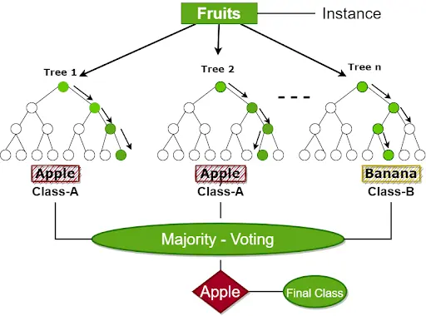
Working of Random Forest
Steps involved in Random Forest
Step 1: Select random samples from a given data or training set.
Step 2: This algorithm will construct a decision for every training data.
Step 3: Voting will take place by averaging the decision tree.
Step 4: Select the most voted prediction result as the final prediction result.
Fig: Random forest
Image Source: https://www.turing.com/kb/random-forest-algorithm

Slide 5
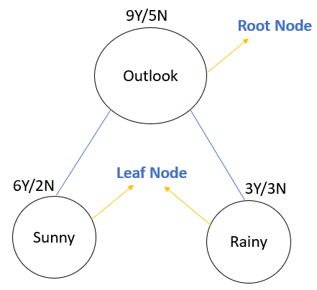
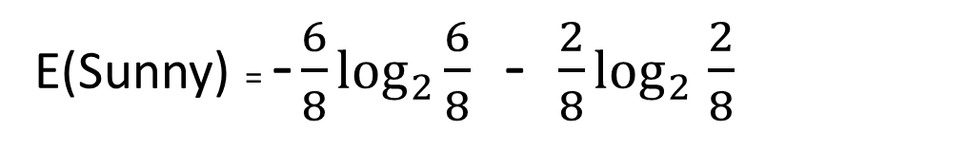
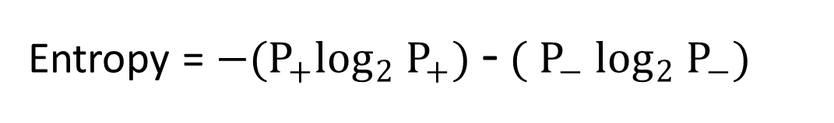
Entropy Calculation
Entropy = $−(P_{+}\log_{2}$ $P_{+})$ - $({ P}_{−}$ $\log_{2}$ $P_{−})$
E(Sunny) = - $\frac{6}{8}$ $\log_{2}$ $\frac{6}{8}$ - $\frac{2}{8}$ $\log_{2}$ $\frac{2}{8}$
E(Sunny) = 0.81

Slide 6
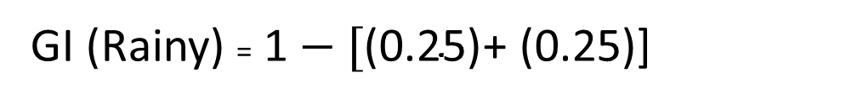
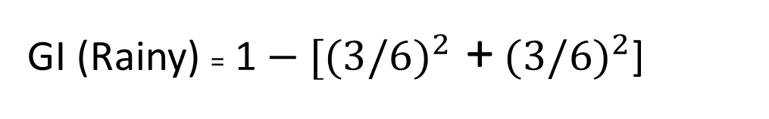
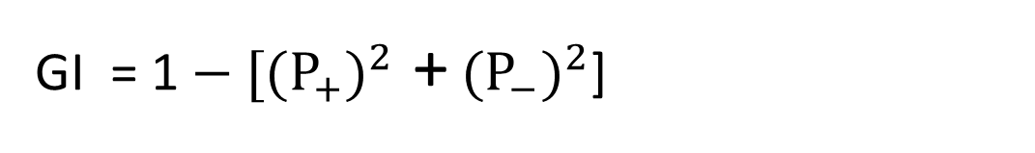
Gini Impurity
GI = 1$− [{(P_{+})}^{2}$ + ${(P_{−})}^{2}$]
GI (Rainy) = 1$− [{(3/6)}^{2}$ + ${(3/6)}^{2}$]
GI (Rainy) = 1$− \text{[}\text{(0.25)}$+ (0.25)]
GI (Rainy) = 0.5

Slide 7
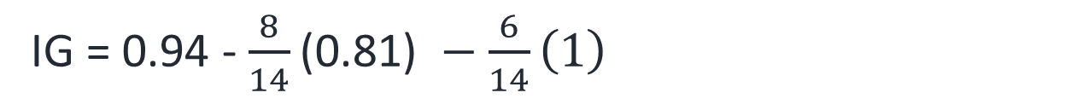
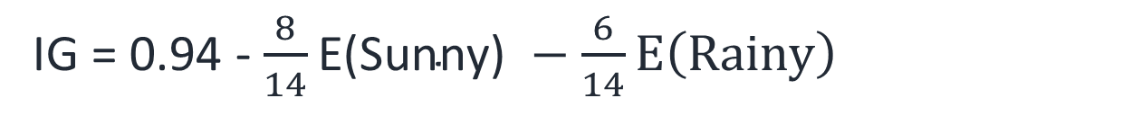
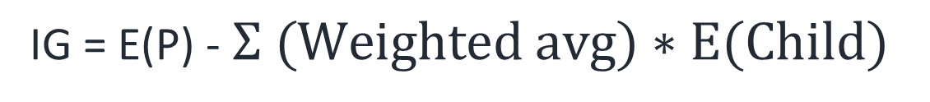
Information Gain
IG = E(P) - $Σ (Weighted avg)∗E(Child)$
IG = 0.94 - $\frac{8}{14}\text{E}\text{(}\text{Sunny}\text{)} −\frac{6}{14}E\left(Rainy\right)$
IG = 0.94 - $\frac{8}{14}\text{(}\text{0.81}\text{)} −\frac{6}{14}\left(1\right)$
IG = 0.05

Slide 8
Hyperparameters
Max Depth: This is the maximum number of children nodes that can grow out from decision tree until the tree is cut off.
Min Samples split: Minimum number of samples a node must possess before splitting.
Min Samples leaf: Minimum number of samples a leaf node must possess.
Max leaf nodes: Maximum number of leaf nodes a decision tree can have.
Max features: Maximum number of features that are taken into the account for splitting each node.

Slide 9
Advantages
Applications
Less Data Preparation
Easy to interpret
Versatility
More Accurate
Blood donors classification
Spam classification
Healthcare sector
Heart disease prediction
Image Classification
Disadvantages
Overfitting
Data resampling
Feature reduction
Unstable

Slide 10
Flow chart of Tasks
Week-1
Understanding of the algorithm
Week-2
Writing code from scratch
Week-3
Writing code from scratch
Week-4
Hyperparameter tuning
Week-5
Model building on Dataset-1
Week-6
Model building on Datasets
Week-7
Model building on Datasets
Week-8
Deployment

Slide 11
Churn data set
Problem Statement:
Maintaining current customers is very important as acquiring new customers is very expensive compared to maintaining current customers. So, to understand what rate the customers are leaving Churn is calculated. The target variable in the dataset is 'Churn'.
Features:
CustomerID, Gender, Senior Citizen, Partner, Dependents, Tenure, Phone Service, Multiple Lines, Internet Service, Online Security, Online Backup, Device Protection, Tech Support, Streaming TV, Streaming Movies, Contract, Paperless Billing, Payment Method, Monthly Charges, Total Charges, Churn

Slide 12
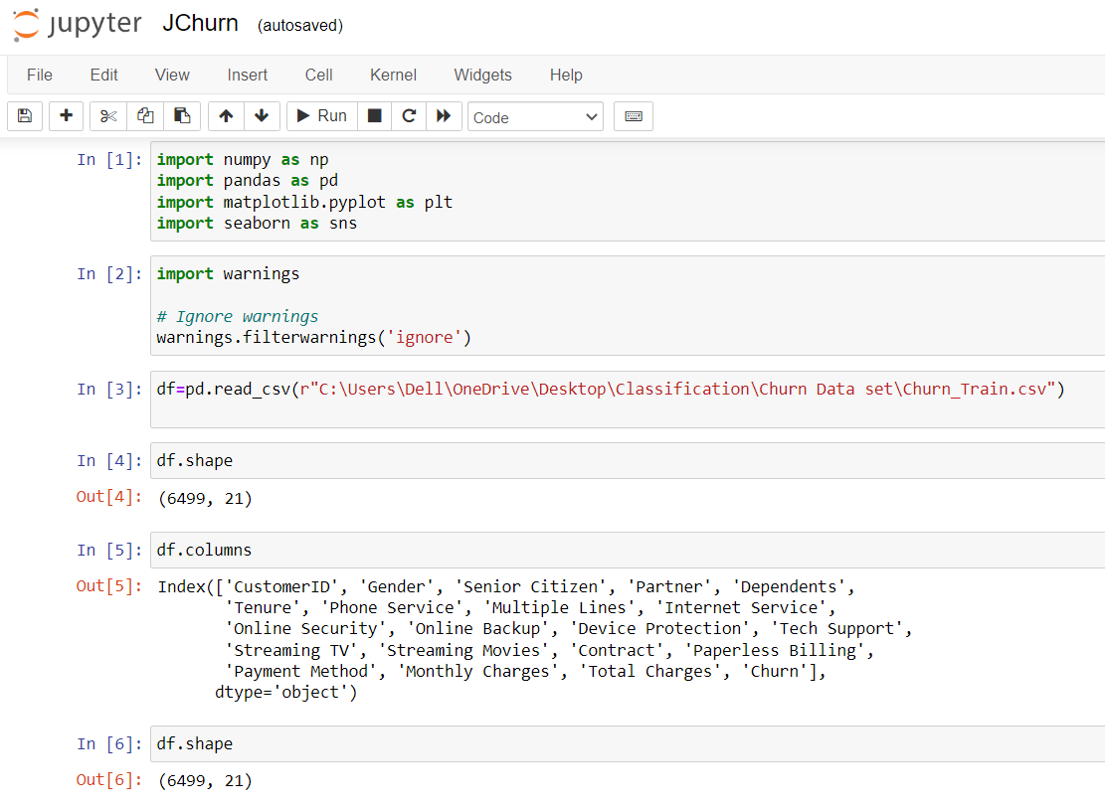
Importing libraries & reading dataset

Slide 13
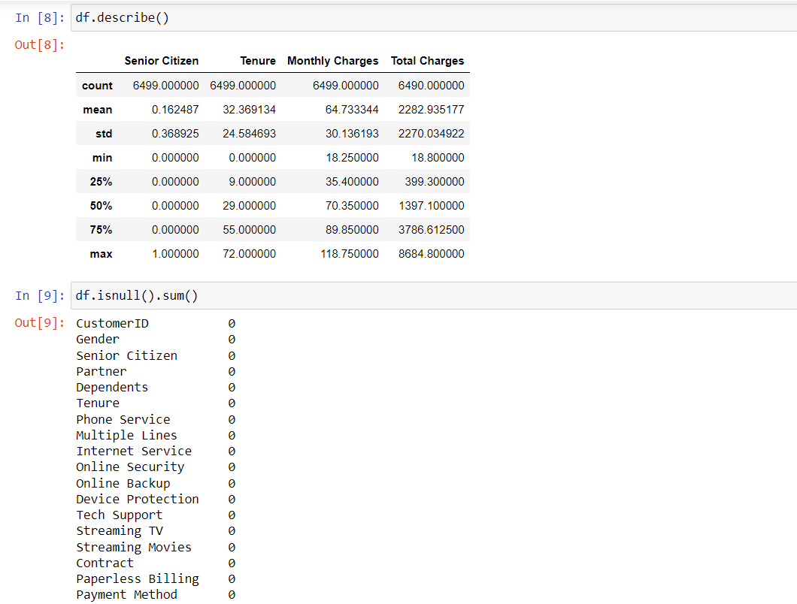
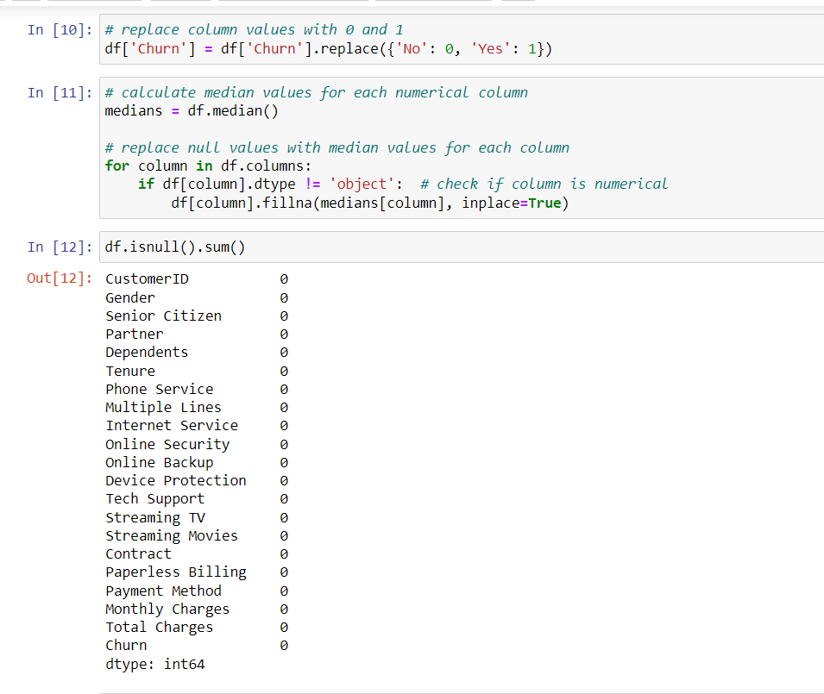
Exploratory data analysis

Slide 14
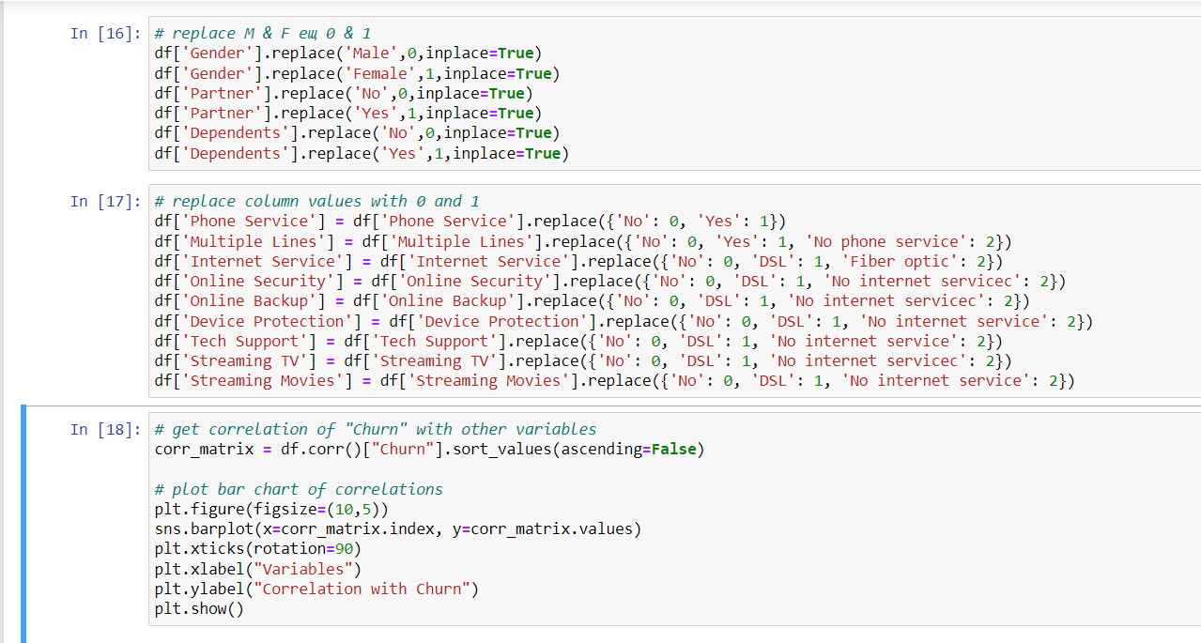
Exploratory data analysis

Slide 15
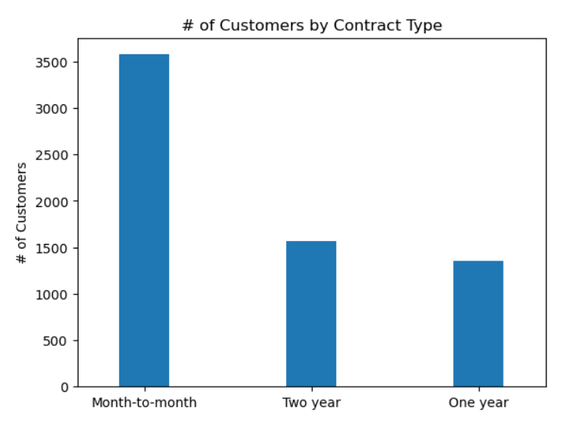
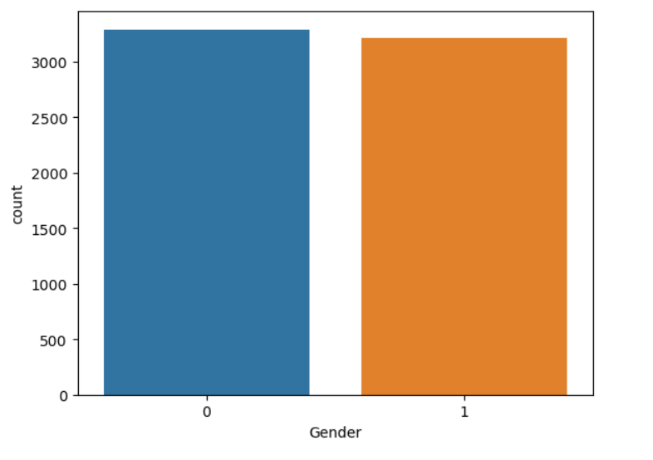
Data Visualizations

Slide 16
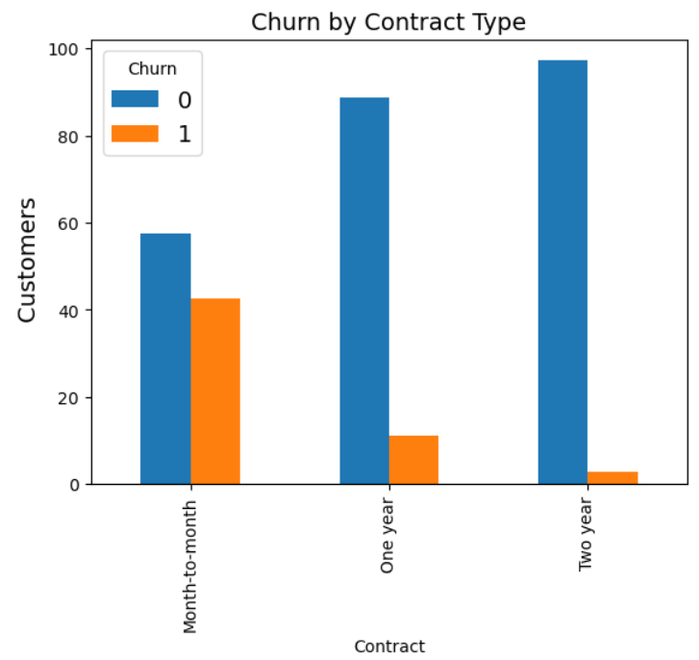
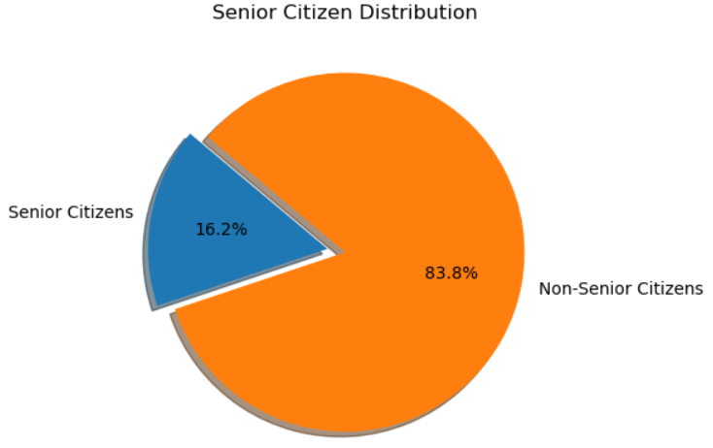
Data Visualizations

Slide 17
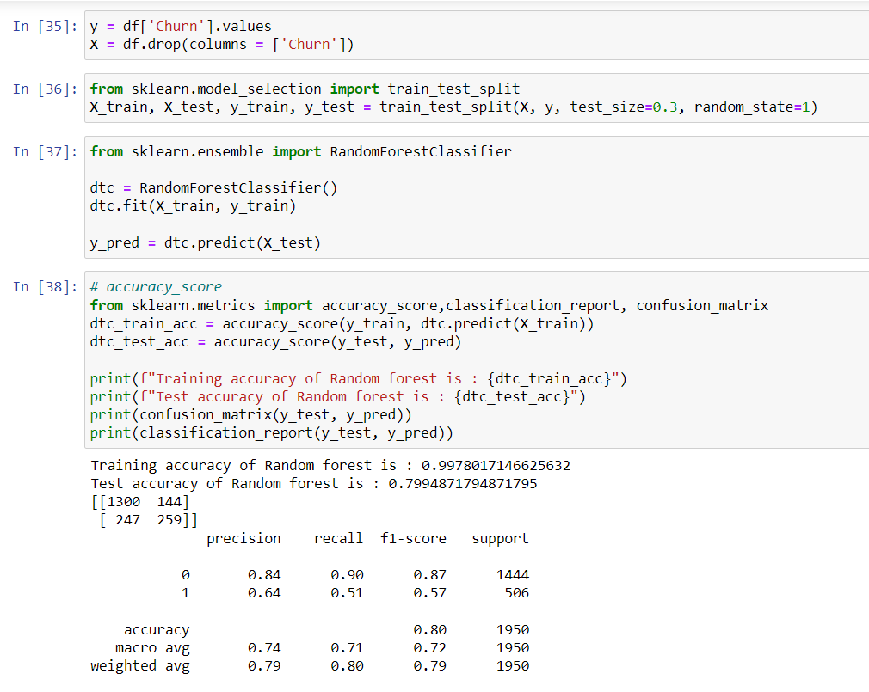
Model Building

Slide 18
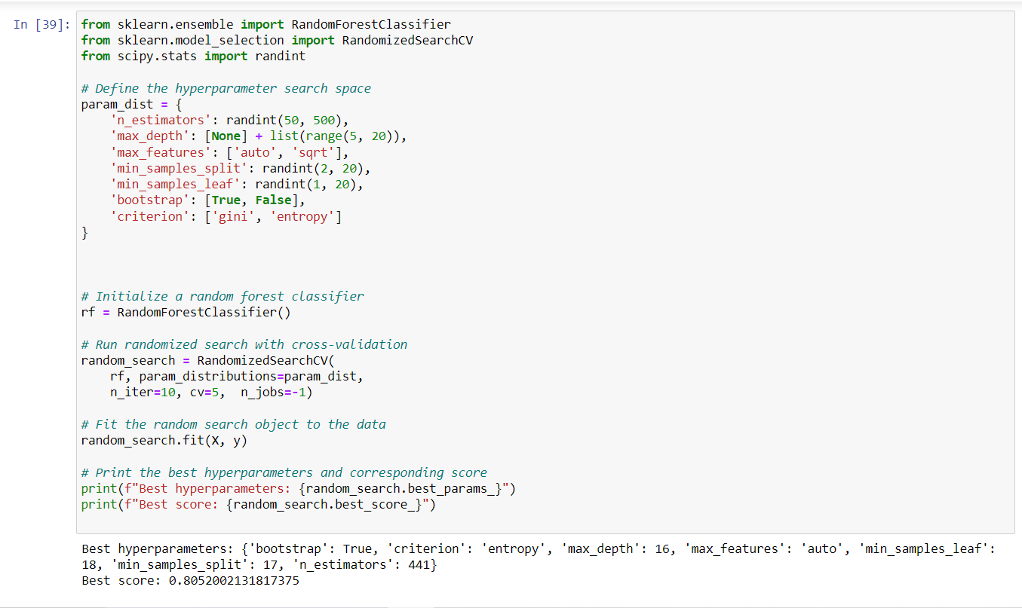
Hyperparameter Tuning

Slide 19
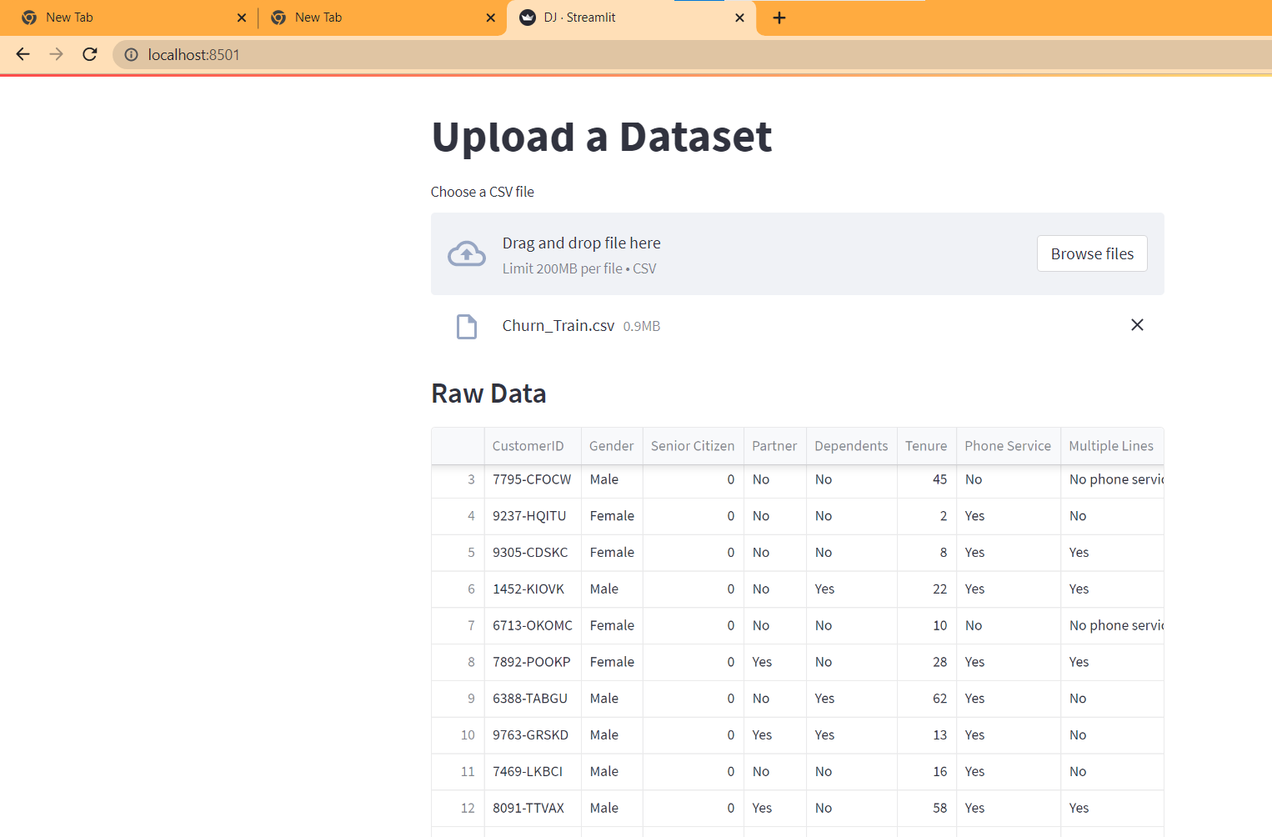
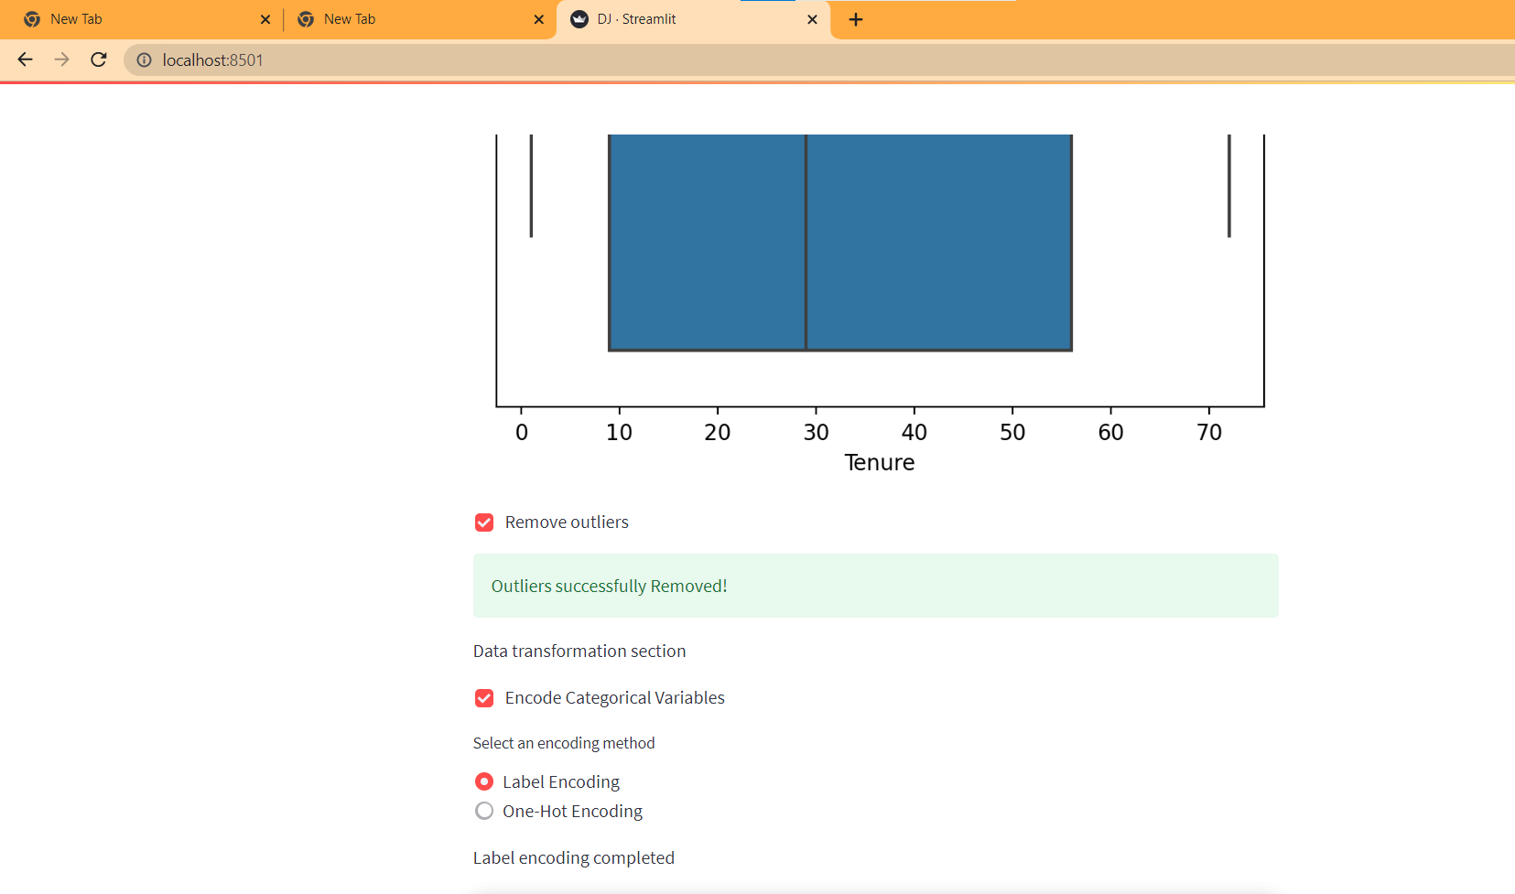
Model Deployment

Slide 20
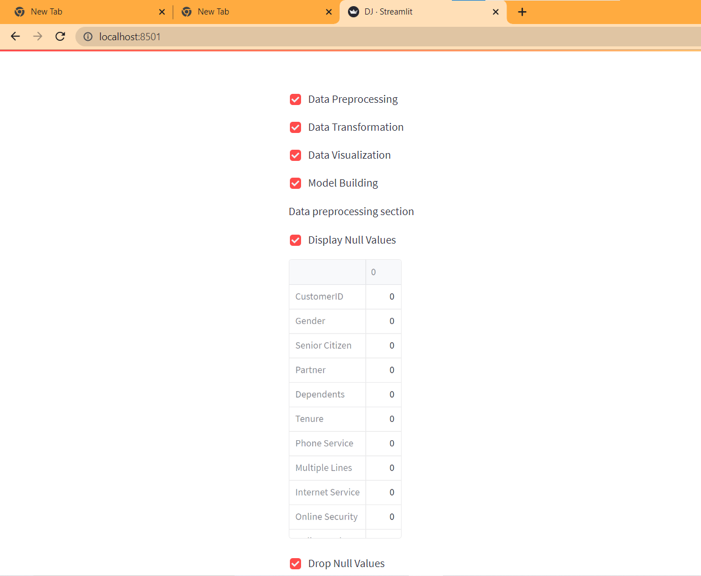
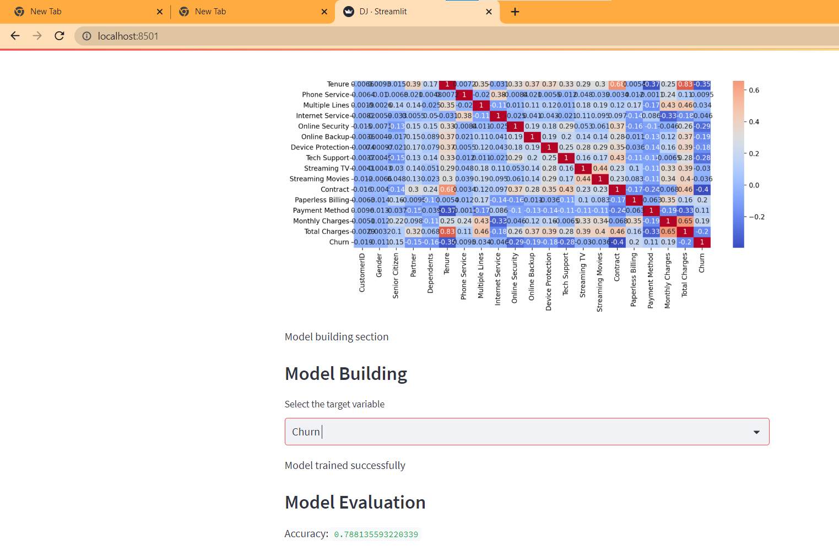
Model Deployment

Slide 21
References
https://www.youtube.com/watch?v=1IQOtJ4NI_0&list=RDLV1IQOtJ4NI_0&index=1
https://www.youtube.com/watch?v=5aIFgrrTqOw
https://www.youtube.com/watch?v=FuTRucXB9rA
https://www.turing.com/kb/random-forest-algorithm
https://www.simplilearn.com/tutorials/machine-learning-tutorial/random-forest-algorithm

