Slide 1
Evaluating the Effectiveness of Models(Logistic regression, SVM and Decision Tree) using the Three Level Moving Average strategy
Name: Jayasuryan Mutyala
Registration number: 210962009
Roll number : 5

Slide 2
Problem statement
Evaluating the effectiveness of the machine learning models (Logistic Regression, SVM and Decision Tree’s) based on profit/loss returns using Three Level Moving Average Strategy.

Slide 3
Project structure
Data Preprocessing Phase
Implementing Three Level Moving Average Strategy (Long, Short and Medium)
Identifying features and labels.
Data Visualization of the strategy.
Dimensionality Reduction through Principal Component Analysis (PCA)
Training the Logistic Regression, Support Vector Machine and Decision Tree models.
Computing the model’s profit/loss returns for the strategy.
Data Visualization of the results.
Evaluation of the models.

Slide 4
Three Level Moving Average
Moving Average(MA): Accounts for the average change of data over time. Used for keeping note on stock price trends.
Exponential Moving Average(EMA), is a type of moving average that places a greater weight and significance on the most recent data points
The strategy involves using multiple EMA’s (Short (SMA) usually the window is 5-20 days, Intermediate/Middle (MMA) usually the window is 50-200 days and Long (LMA) usually the window is 200-250 days) to calculate the trend following the indicator that reacts to price change.
The conditions for buy and selling stock is based on:
Buy: When SMA crosses above MMA and LMA indicating a positive uptrend.
Sell: When SMA crosses below MMA and LMA indicating a potential downtrend.
We are using a short-term strategy, so SMA has a 5 days window, MMA has a 23 days window and LMA has 53-days window.

Slide 5
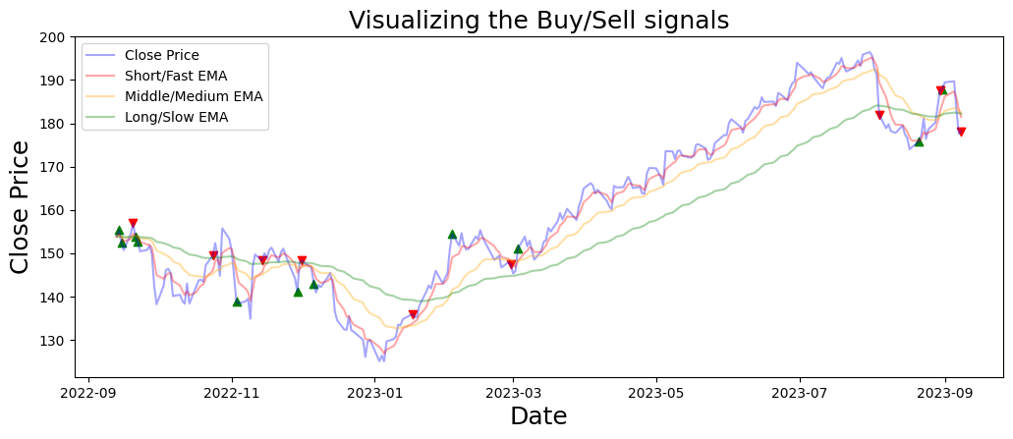
Visualizing the buy/sell signals
Buy:Green and Sell:Red

Slide 6
Dataset used
Financial timeseries stock data for APPLE(AAPL) from Yahoo Finance.
Close: Final price of the stock at the end of trading session.
One year of daily stock trading data is used 12/09/22 – 12/09/23
Features:[SMA,MMA,LMA]
Label: Signal(Buy(1), Sell(0))

Slide 7
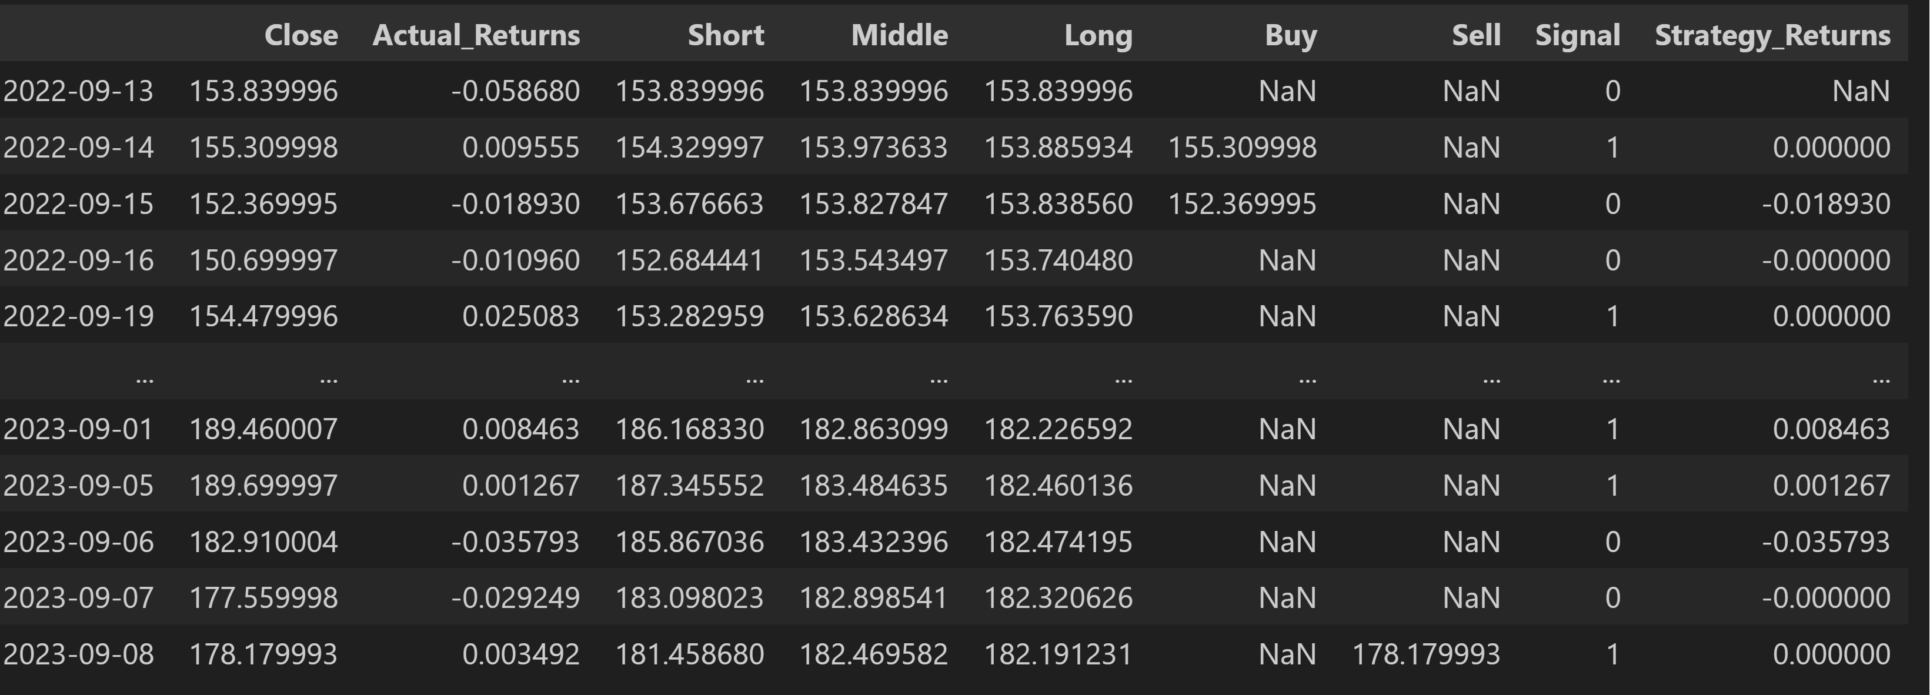
Data Preprocessing
Actual Returns: Determining profit(+)/loss (-) experienced by the trader over a specified period of time. Essentially, we compute the difference of current and original closing prices over the original closing price.
Strategy Returns: Determines overall profit or loss experienced by trader . Computed based on the product of actual returns and buy/sell signals.
Cumulative Returns: Total amount gained or lost by strategy over a specified period. It provide a cumulative view of the performance of an investment by considering capital appreciation (or depreciation).

Slide 8
Principal Component Analysis(PCA)
PCA converts the correlated features into linearly uncorrelated features known as Principal Components (PC).
Used for reducing feature dimensionality.
Principal Components (PC) generated by PCA are ordered based on the amount of variance they capture from the original dataset. PC1 captures the most variance, the PC2 the second most.
Filters out noise or less informative parts of the data.

Slide 9
Model Training
Dataset was split 0.7-0.3 for training and test sizes.
Objective: Predicting sell/buy signals with profit/loss returns
Models used are Logistic Regression, SVM and Decision Tree’s.
Visualize the cumulative returns and decision boundary plot for the models.

Slide 10
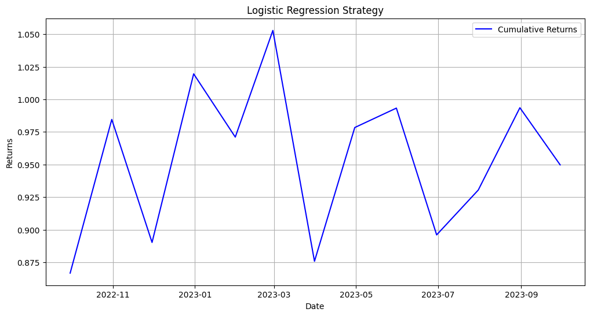
Logistic Regression
Cumulative Returns plot

Slide 11
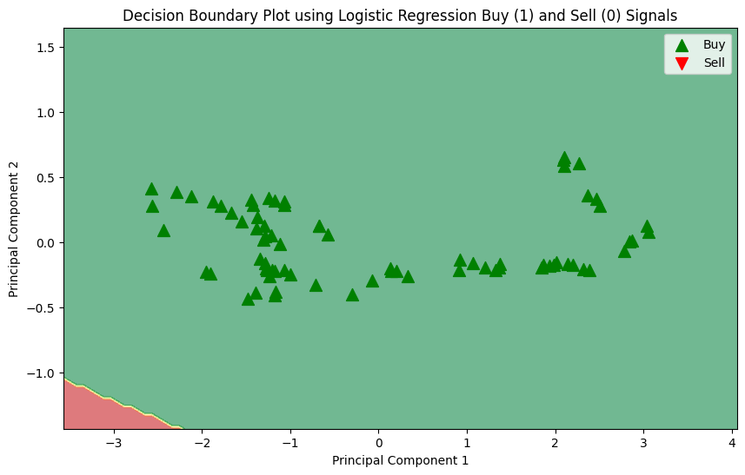
Decision Boundary Plot

Slide 12
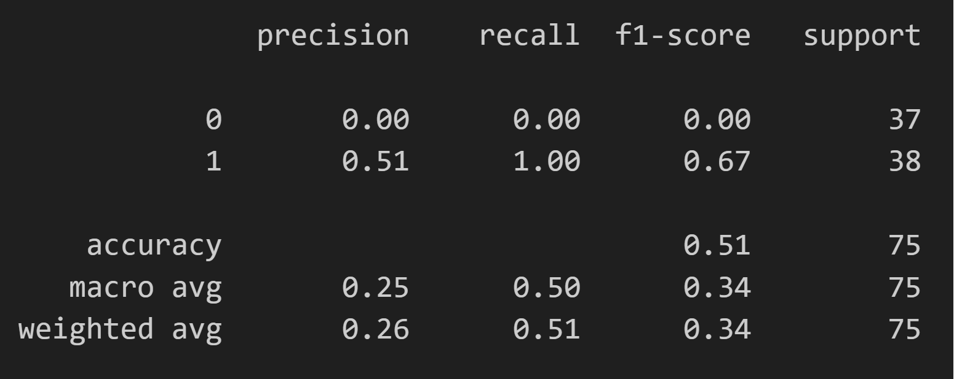
Evaluation

Slide 13
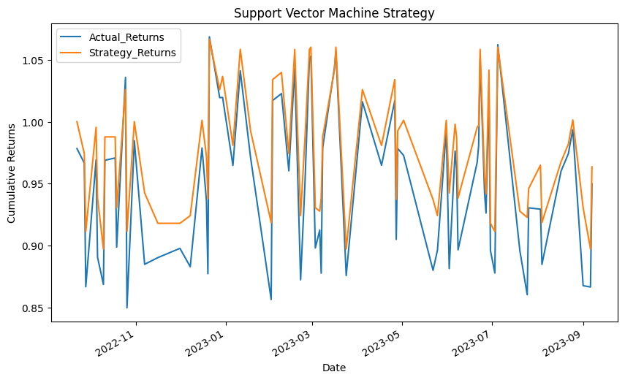
SVM
SVM cumulative returns

Slide 14
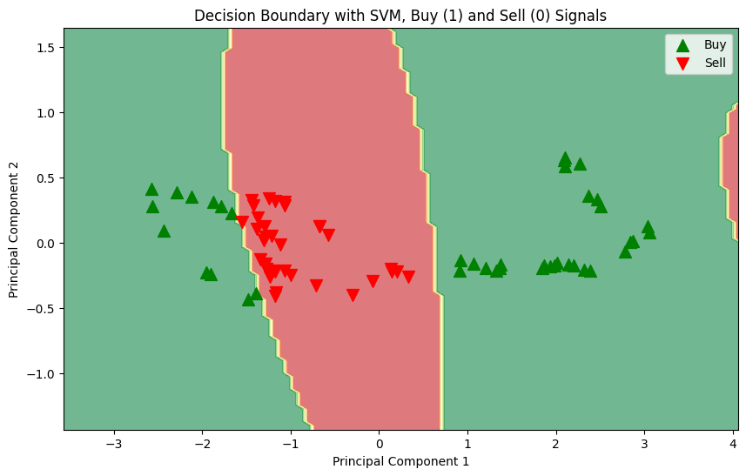
Decision Boundary Plot

Slide 15
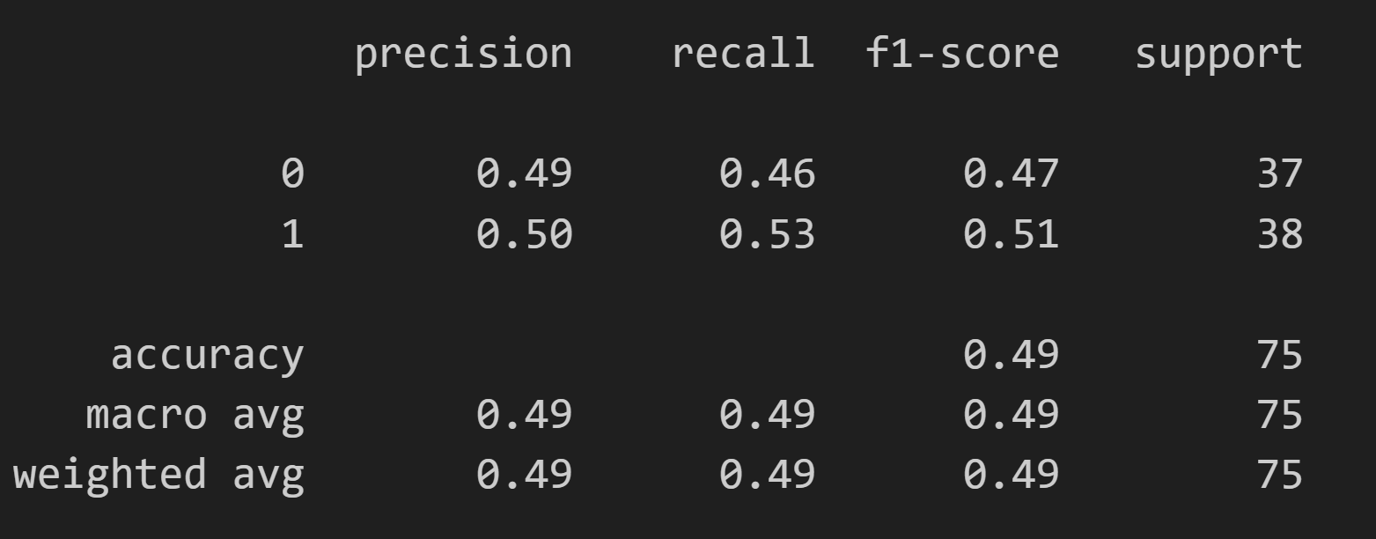
Evaluation

Slide 16
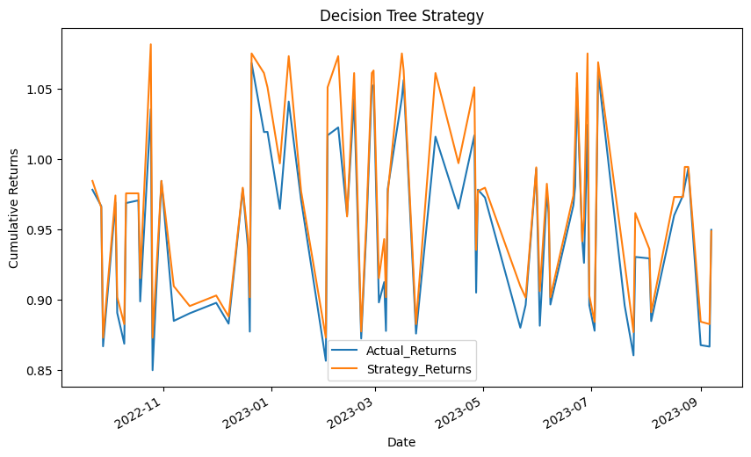
Decision Tree
Cumulative Returns plot

Slide 17
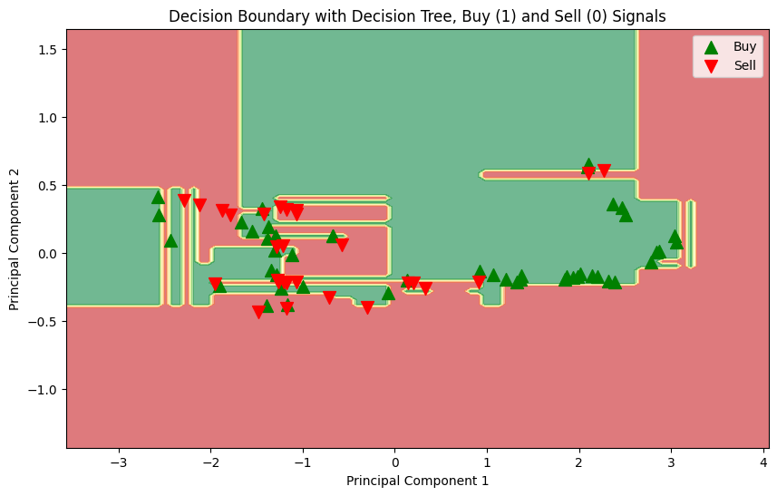
Decision Boundary Plot

Slide 18
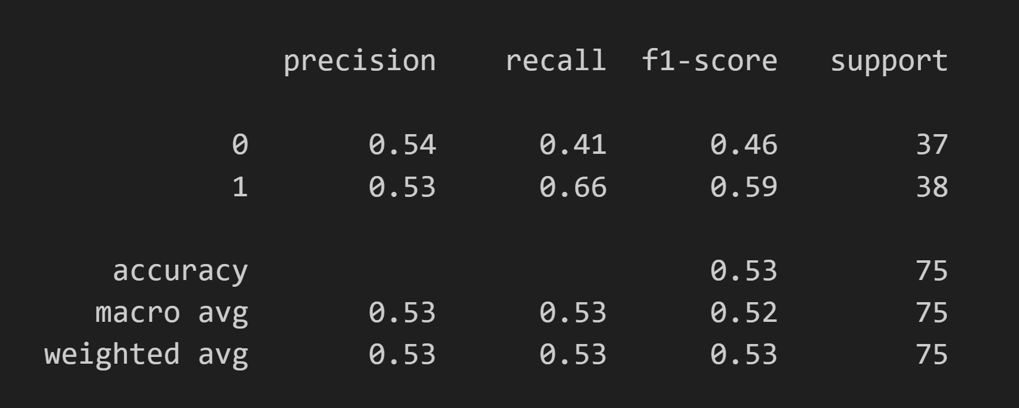
Evaluation

Slide 19
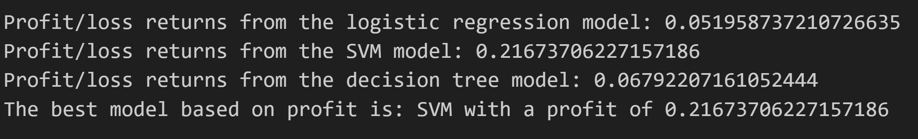
Hyperparameter tuning
Involves determination of the most optimal hyperparameters(controls learning process and model parameters).
Improvises the model's ability to capture market patterns and maximise profits.
Avoids overfitting
Increases model’s predictive accuracy and resulting better generation of signals.
SVM returns the highest profit after this process.

Slide 20
Conclusion
Logistic Regression model provide moderate accuracy but overfitted the decision boundary and struggled against complicated market patterns
SVM model was the most profitable according to research and after hyperparameter tuning, indicating potential reliability with its ability to form non-linear decision boundaries.
Decision Tree models returns the highest profit before hyperparameter tuning highlighting its ability non-linear relationships between features without the need for transformation. They are less sensitive to outliers.
Scope for improvement: LSTM (Long Short-Term Memory) networks have the potential to greatly improve stock market prediction due to their ability to capture complex, high-dimensional non-linear relationships and temporal patterns within financial time series data.
Using more technical indicators such as RSI(Relative Strength Index) that indicates when stocks are oversold and overbought.
Using stock data with hourly frequency.

