Slide 1
ECON
Mavericks

Slide 2
Introduction
What is Econometric Modeling?
Econometric Modelling brings mathematical and statistical methods to economic theory not only to estimate and test them, but also forecast trends, evaluate impact of policies or interventions.
What is our endeavour here?
Assess different factors of Labor market and its effect on Wage Earnings
Provide insights and policy implications
What dataset did we choose?
PUMS Data-set - Public Use Microdata Sample, provided by United States Census Bureau
Part of the decennial US census or the American Community Survey
Anonymised publicly available dataset
Offers diverse parameters from demographic to socioeconomic characteristics
Scope for analysis include: Wage inequality, occupational segmentation, workforce diversity and labor market dynamics
We choose State of California for our analysis, as it is the powerhouse of US Economic Growth engine, and is also home to a very diverse population mix
Notes:
Econometric modeling is a powerful tool that applies mathematical and statistical methods to economic theory, it not only allows us to estimate, and test these theories, it also aids in forecasting trends and evaluating the impact of policies or interventions.
Our endeavor here is to assess various factors within the labor market and their effects on wage earnings, providing valuable insights and policy implications.
To achieve this, we have selected the Public Use Microdata Sample dataset from the United States Census Bureau, which offers a wealth of anonymized demographic and socioeconomic information
We focus our study on the State of California, a key driver of US economic growth and a region characterized by significant diversity, we aim to explore the influence of race on wage earnings and investigate the intersectionality between race and English proficiency, examining how these factors collectively shape wage earnings in one of the highly competitive labor markets of the world

Slide 3
Research Question?
How does a person’s race affect their wage earnings?
How does the confluence of race and a person’s ability to speak english affect earnings?

Slide 4
Initial Data Analysis
We have extensively worked on Excel dataset and found variables which are most important to predict the earnings of a person. For example - Ability to Speak English, Age, Educational Attainment etc
Initially, we analysed data in Excel to understand each variable given in the data dictionary. We have excluded all Flag Variables - Weightage, Household related information, Identifiers and we have also excluded variables that are duplicate and detailed in nature.
We have performed correlation analysis in R to check the correlation between all the variables to make informed decision about variable selection in the Model. For Example - Nativity and Citizenship Status were highly correlated so we dropped Nativity
We have created dummy variables for categories wherever it was required.
We performed backtracking based on our initial models to further group the categorical variables. For Example - Pacific Islander, Native Hawaiian and American Indian Races categories were combined to form one categorical variable called “Other Races”

Slide 5
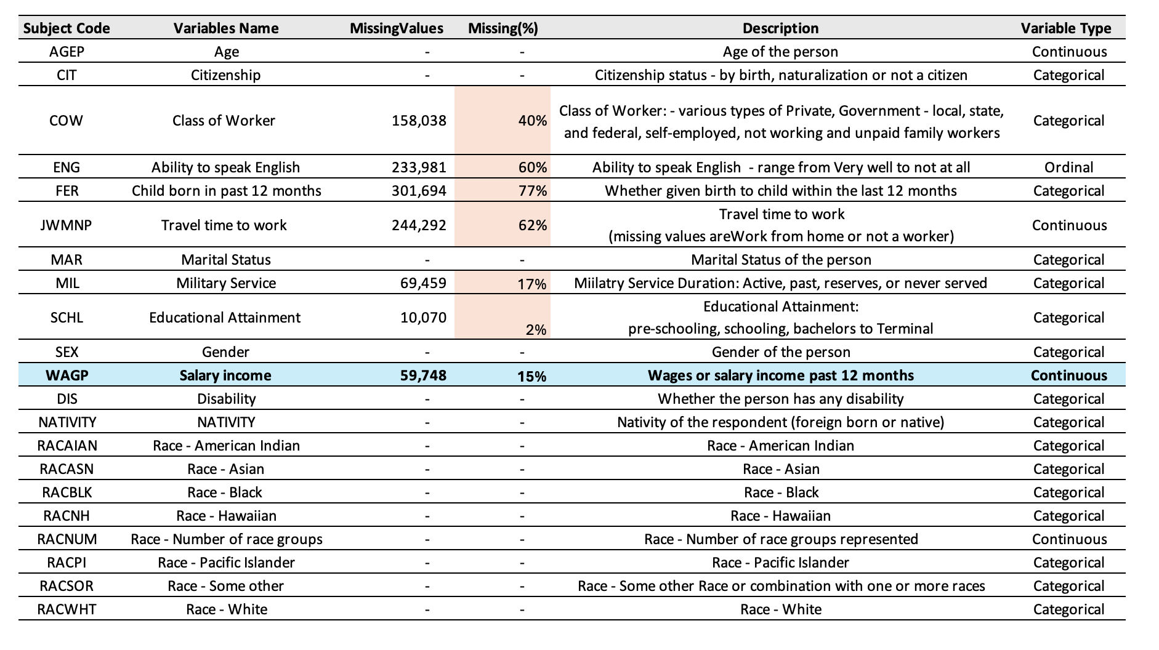
DESCRIPTIVE STATISTICS

Slide 6
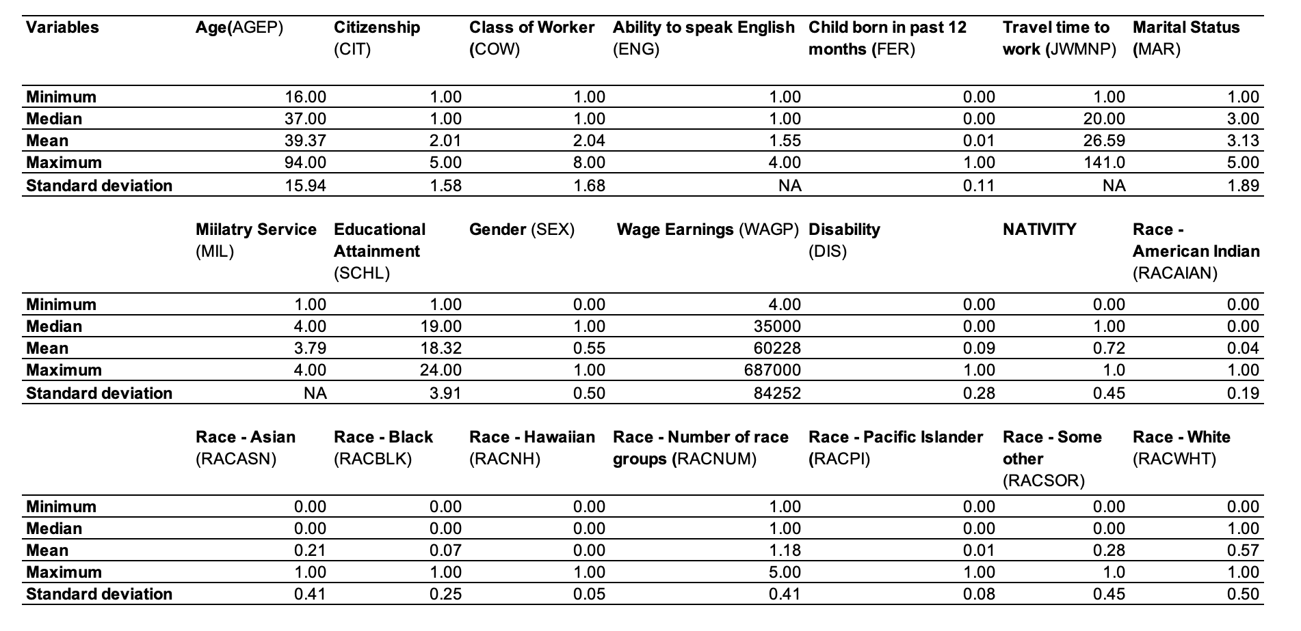
DESCRIPTIVE STATISTICS
Notes:
In Descriptive statistics we calculated min, max, mean and sd of chosen variables which provided insights of the variables and their relationships with each other. for instance age range, from 16 to 94, median age is 37, and mean age is 39.37, indicating a right-skewed distribution with the majority of individuals being younger, standard deviation of 15.94, suggesting considerable variability in age within the dataset. The maximum value of 8 suggests the presence of multiple categories of workers, which we further re-grouped in just 4 categories. Similarly for educational attainment with maximum of 24 categories, which were later combined in just 5 categories.

Slide 7
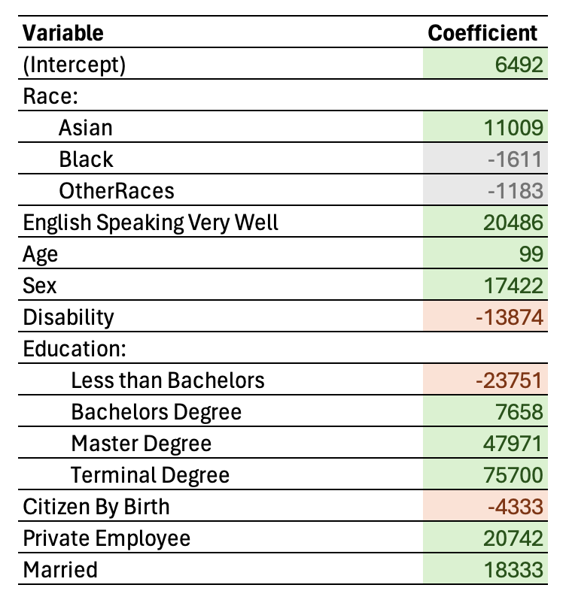
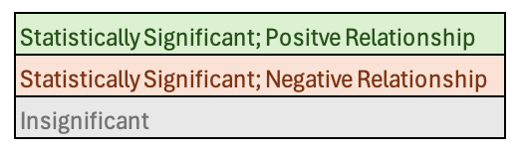
Model - Race & Wage Earnings relationship
Wage Earnings
=
β₀ + β₁ Asian + β₂ Black + β₃ Other Races +
β₄ English Speaking Very well +
β₅ Age + β₆ Sex + β₇ Disability +
β₈ Less than Bachelor's Degree + β₉ Bachelors Degree +
β₁₀ Master’s Degree + β₁₁Terminal Degree +
β₁₂ Citizen by birth + β₁₃ Private Employee +
β₁₄ Married

Slide 8
Interpreting the effects of Race on Wage Earnings
Statistically significant:
Holding other variables constant, Asian individuals have, on average, wage earnings that are $11,008 higher than the White individuals.
Having a very good level of English speaking is associated with an predicted increase in earnings of approximately $20,486 regardless of race or other factors.
A one year increase in age, on average, is associated with an increase in earnings of approximately $99 suggesting that earnings tend to increase with age.
Individuals with a disability might see their earnings reduce by an estimated $13,874 highlighting a disparity in income due to disability status.
Earning potential drops by about $23,751 for those without a bachelor's degree when compared to their counterparts with higher educational achievements.
Obtaining a bachelor's degree can lead to an earnings increase of roughly $7,658 showcasing the value of completing undergraduate studies.
Advancing to a master's degree level brings about a significant earnings boost, with an increase of nearly $47,970 reflecting the financial benefits of postgraduate education.

Slide 9
...Interpreting the effects of Race on Wage Earnings
Achieving a terminal degree positions individuals for an impressive earnings increase of about $75,700 underlining the premium placed on specialized higher education.
Citizen By birth is associated with a slight decrease in earnings, around $4,332 less, suggesting differences in income based on citizenship origins.
Employment in the private sector is financially advantageous, offering an increase in earnings of approximately $20,741 indicative of the sector's compensation trends.
Marriage is correlated with an earnings of about $18,333 pointing towards the economic advantages that can accompany marital status.
Black and other races are not statistically significant .
The r-square value of 0.2055 suggests that approximately 20.55% of the variance in the dependent variable can be explained by the independent variables in your model. The adjusted r-square value of 0.2054 is very close to the r square. value, which is adjusted for the number of predictors in the model.

Slide 10
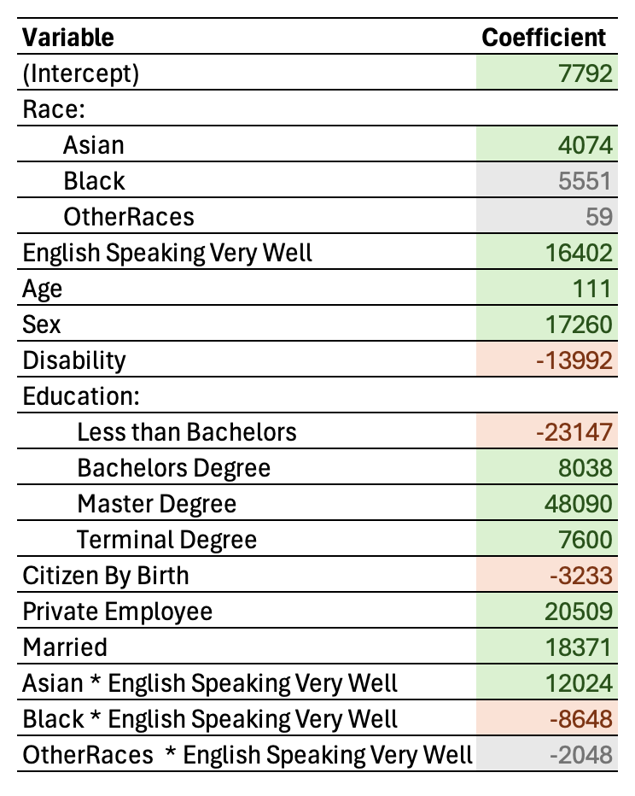
Model with interaction Terms
Wage earnings
=
β₀ + β₁ Asian + β₂ Black + β₃ Other Races +
β₄ English Speaking Very well +
β₅ Age + β₆ Sex + β₇ Disability +
β₈ Less than Bachelor's Degree + β₉ Bachelors Degree +
β₁₀ Master’s Degree + β₁₁Terminal Degree +
β₁₂ Citizen by birth + β₁₃ Private Employee + β₁₄ Married
+
β₁₅ Asian * English Speaking Very Well +
β₁₆ Black Asian * English Speaking Very Well +
β₁₇ Other Races * English Speaking Very Well

Slide 11
Interpretation of the model (continued)
The coefficient for "English Speaking Very Well" (ESVW) is 16402, indicating that individuals who speak English very well tend to have higher wage earnings compared to those who don't, holding other variables constant.
The coefficients for race represent the average difference in wage earnings between each racial group and the reference category (White) when other variables are held constant.
Asian individuals earn approximately 4074 more than White individuals on average (significant).
Black individuals earn approximately 5552 more than White individuals on average, but this difference is not statistically significant.
Other racial groups earn approximately 59 more than White individuals on average, but this difference is also not statistically significant.

Slide 12
…Interpretation
Interaction terms:
Interaction term: Captures the joint impact of two or more variables in a regression analysis
Significance: Determines if the relationship between variables differs when considered together.
Example: "Asian:English Speaking Very Well" in your results signifies the combined effect of Asian ethnicity and English-speaking proficiency on earnings.
Interaction Effects: The interaction terms show how the effect of English speaking ability on wage earnings varies across different racial groups.
For Asian individuals who speak English very well, their wage earnings increase by an additional 12023 compared to Asians who don't speak English very well (significant).
For Black individuals who speak English very well, their wage earnings decrease by 8648 compared to Blacks who don't speak English very well (significant)
For individuals from other racial groups who speak English very well, their wage earnings decrease by 2047 compared to those who don't, but this difference is not statistically significant.

Slide 13
..Interpretation
Overall Interpretation
Overall, proficiency in speaking English is associated with higher wage earnings across all racial groups.
The effect of English speaking ability on wage earnings differs among racial groups. For Asians, the effect is positive and significant, indicating a substantial wage premium for English proficiency. However, for Blacks, although speaking English very well is associated with higher wages, the magnitude is lower compared to the general effect of English proficiency, and it's statistically significant but negative. This suggests a complex relationship between English proficiency, race, and wage earnings.
For other racial groups, there is no significant effect of English proficiency on wage earnings, but the sample size or other factors may be influencing this result.
In summary, the model suggests that while English speaking ability generally leads to higher wage earnings, the relationship varies across different racial groups, indicating potential disparities that merit further investigation.

Slide 14
Key Insights & Recommendations
Key Insights
Race Impact - Asians higher earnings than Black & White
English Proficiency - Well Spoken English +ve influence on earnings especially for Asian & White
Education Level - Bachelors, Masters associate with high earnings
Recommendations
Policy Makers - Targeted programs, remove barriers for education
Employers - Encourage language training programmes

Slide 15
Implications & Future Research
Implications
Intersectionality : Race & Language proficient in economic outcomes
Diversity Policies: Need for Diversity and Inclusion policies
Future Research
Longitudinal: Track race, language & education influence over time
Industry Specific: Explore specific industries, targeted interventions
Policy Evaluations: Evaluate effectiveness of current policies for reducing disparities

Slide 16
Conclusion & Limitations
Conclusions
Combination of race, language proficiency, and education levels influence earnings over time.
Targeted policies and programs can lead to a more equitable and inclusive workforce, benefiting individuals and society.
Limitations
Data: Dataset may not fully capture diversity & complexity
Causality: Regression analysis shows associations but does not imply causation
Sample: May not be fully representative of the entire population, potentially leading to biases in the results.

Slide 17
Thank you!
Aditi - Ankit - Harsha - Saran - Jayathi - Pooja
Contributions:
Aditi - Data Exploration and Analysis
Ankit - Modeling and Insights
Harsha - Data preprocessing and Modeling
Saran - Modeling, R code, and Analysis
Jayathi - Post Processing and Interpretations
Pooja - Post Processing and Interpretations

