Slide 1
InPower Growth Strategy
Strategic Recommendations for Sustainable Competitive Advantage
Notes:
Good [morning/afternoon], everyone. Today we’ll be presenting our InPower Growth Strategy, which focuses on how InPower can build long-term, sustainable competitive advantage in the digital wellness and social empowerment space.
Our strategy is grounded in real revenue data, market trends, competitor analysis, and unit economics, and the goal was not just growth—but defensible, scalable, and ethical growth. Throughout this presentation, I’ll walk you through our strongest revenue driver, six strategic recommendations, and how these work together to build a durable business model.

Slide 2
Strategic Context
Understanding Our Strengths
Notes:
To build a strong strategy, we first had to understand what InPower already does well. InPower operates at the intersection of mental wellness, emotional intelligence, and digital community. Unlike traditional social platforms, InPower is purpose-driven. It combines:
Expert-led groups
AI-based emotional tools
Community-based learning
And peer support
This positioning allows InPower to compete not just with social apps, but also with wellness platforms, therapy marketplaces, and coaching services. That makes its strategic direction especially important—because it must defend value across multiple industries.

Slide 3
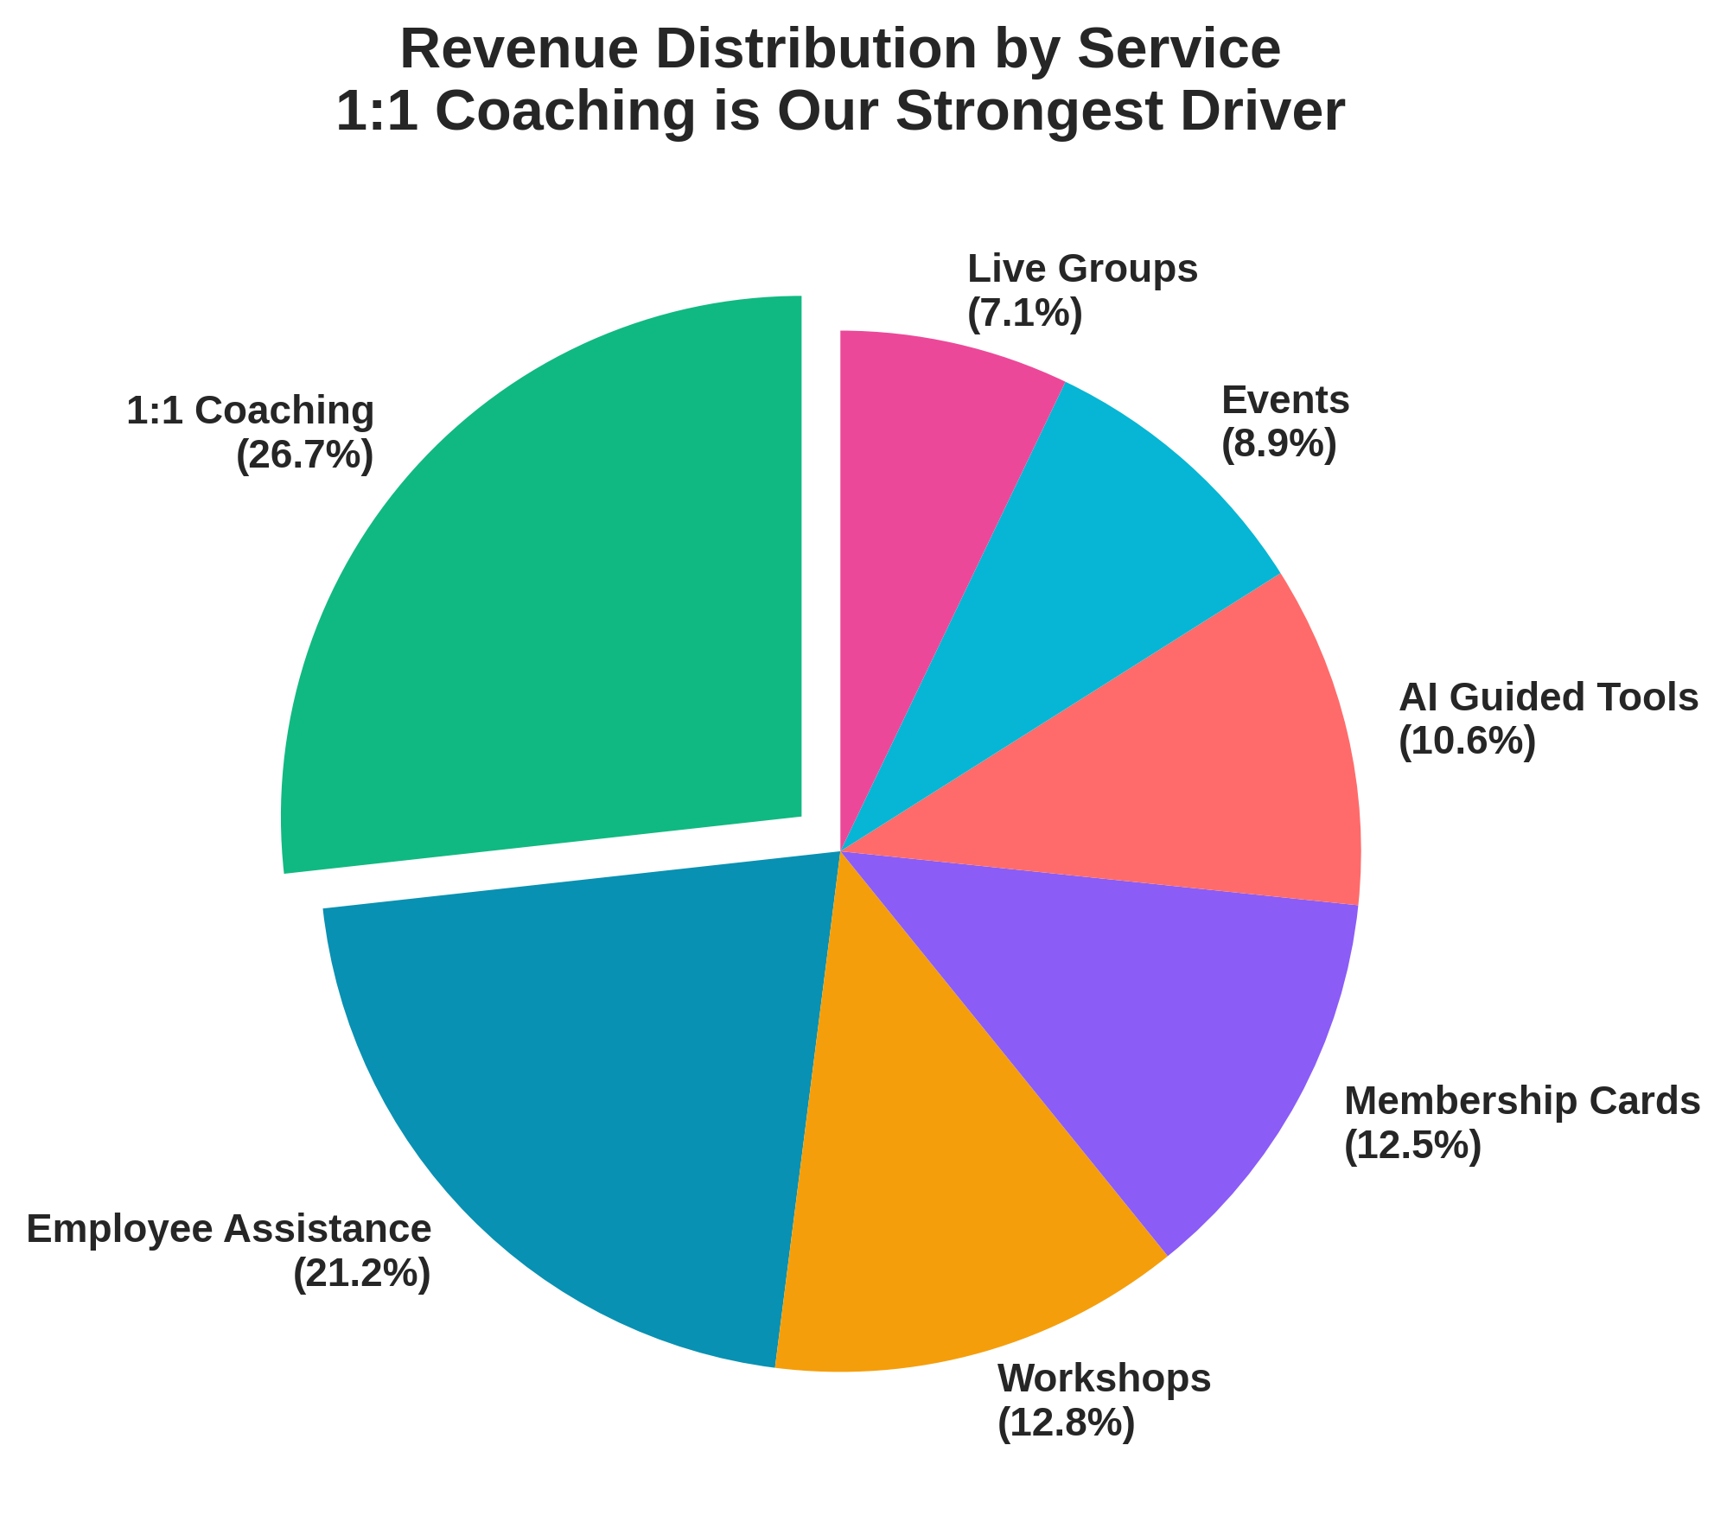
Our Revenue Mix: 1:1 Coaching Leads the Way
1:1 Coaching represents 26.7% of revenue - our strongest and most defensible service
Notes:
One of the most important insights from our revenue modeling is that 1:1 Coaching alone accounts for 26.7% of total revenue. This makes it the single largest and most important revenue stream in the business.
Why is this significant?
First, it is high-margin compared to digital-only tools. Second, it is relationship-based, which means users form long-term trust with therapists or coaches. Third, it is hard to replicate because quality therapists are not instantly scalable like software features.
This insight directly shapes our first and most important recommendation, which is building a competitive moat around this coaching service.

Slide 4
Six Strategic Recommendations
Building Multiple Competitive Advantages

Slide 5
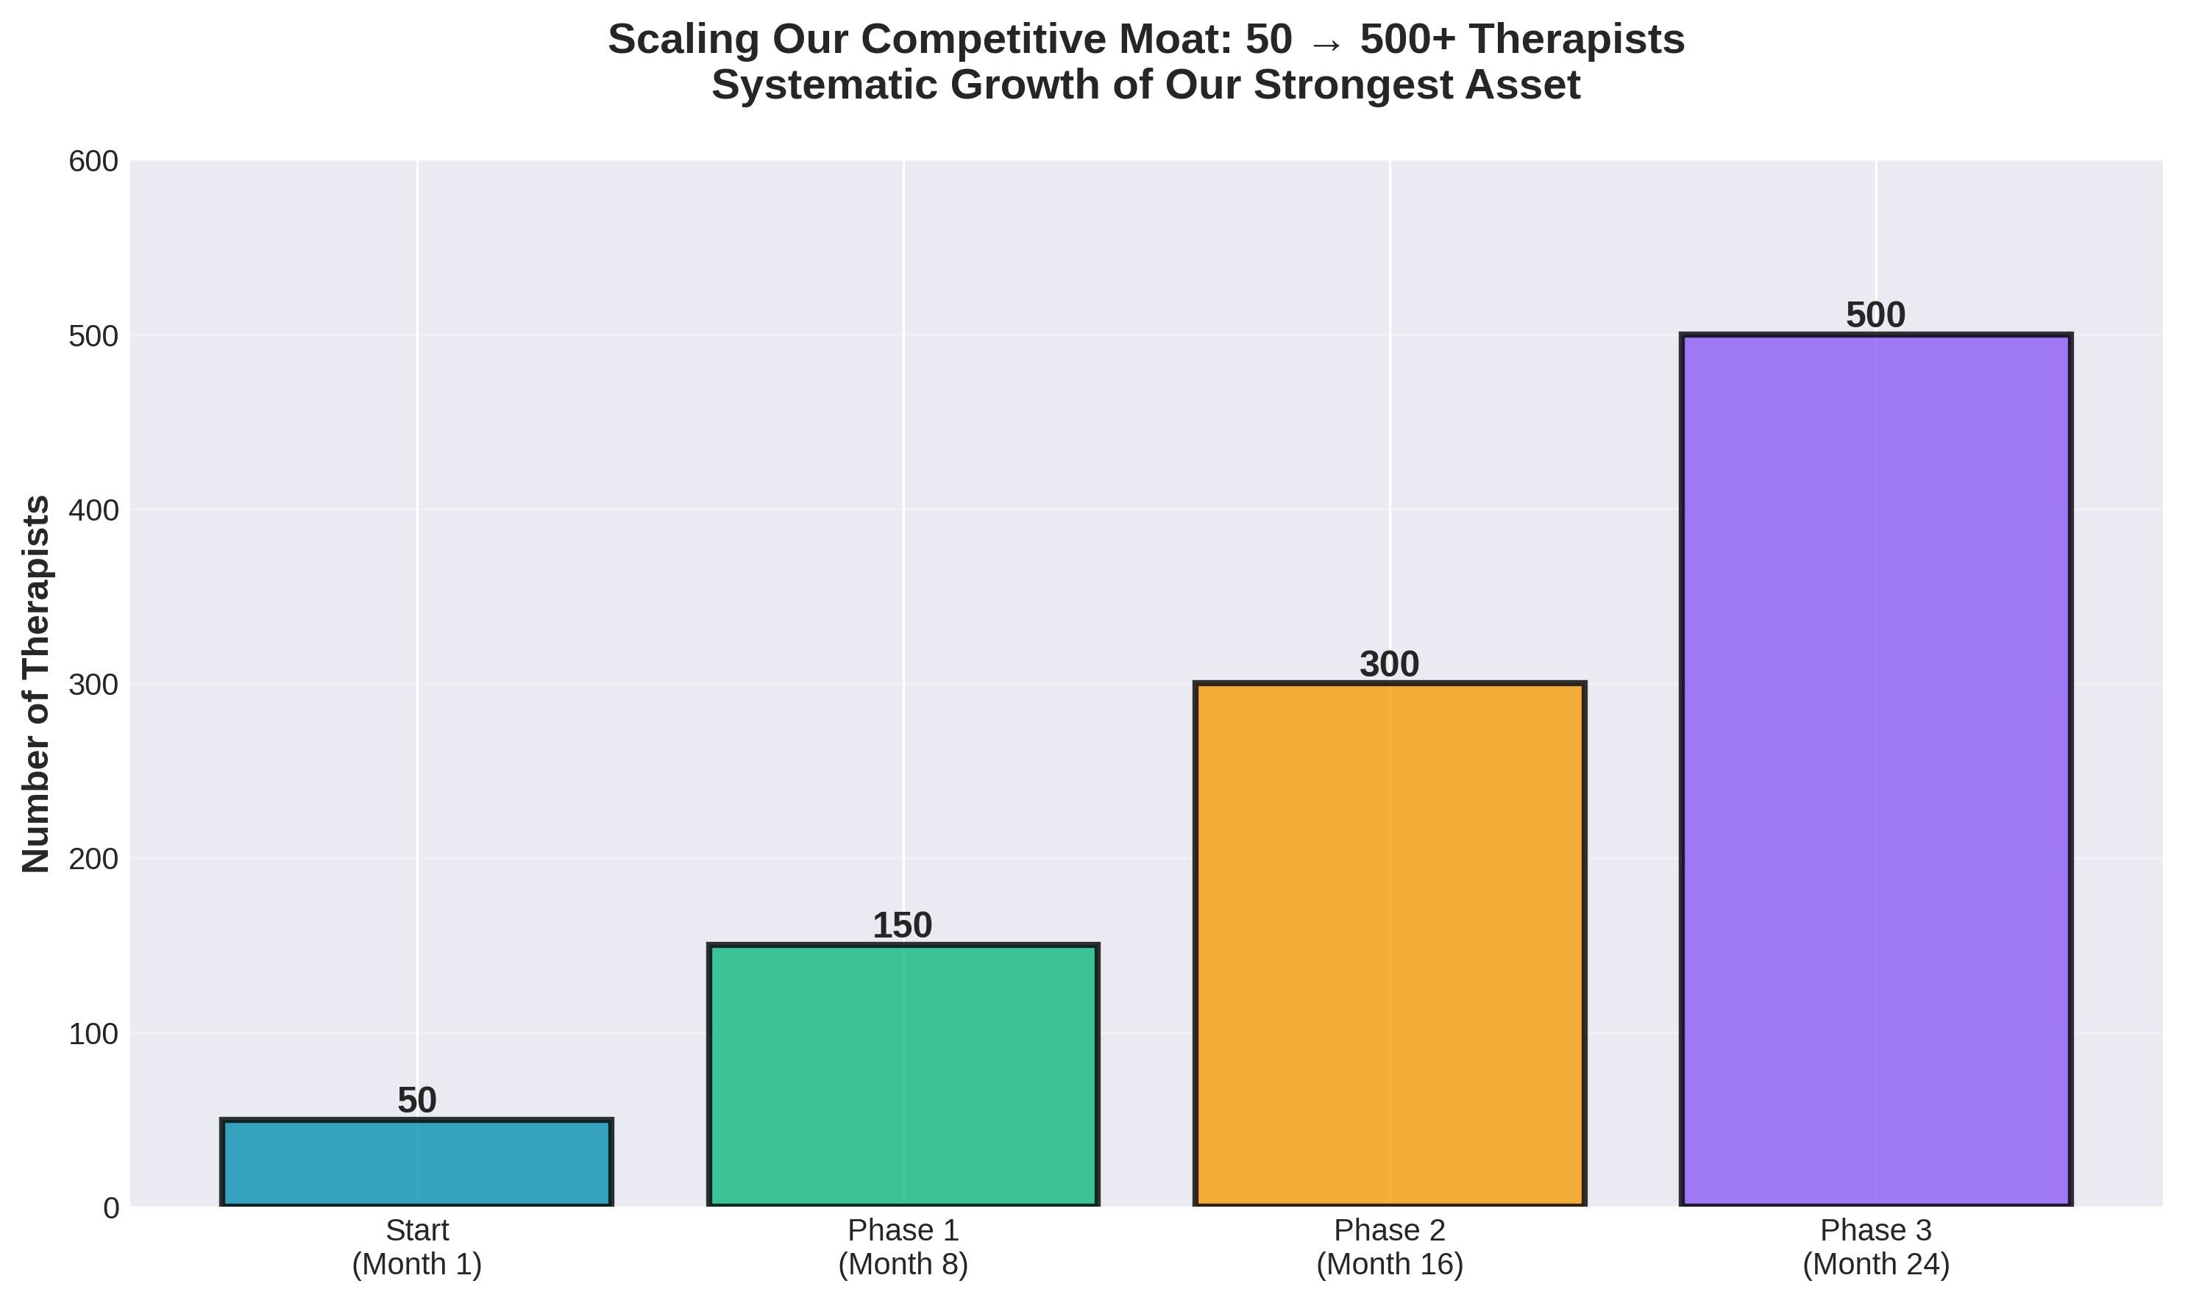
Recommendation #1: Scale Our Competitive Moat
✓ THE INSIGHT: 1:1 Coaching is our largest revenue driver (26.7%) with highest margins
✓ THE STRATEGY: Systematic therapist scaling from 50 to 500+ over 24 months
✓ THE APPROACH: Quality-first recruitment, retention programs, specialty matching
✓ WHY IT WINS: Therapist relationships create user lock-in competitors can't replicate
✓ THE OUTCOME: Sustainable competitive advantage through quality and trust
Notes:
Our first recommendation is to scale InPower’s strongest moat: 1:1 Coaching.
Right now, InPower’s coaching network is still relatively small. Our strategy proposes expanding it from approximately 50 therapists to over 500 therapists within 24 months. But this is not about rapid, careless hiring—it is about quality-first recruitment, focused on credentials, specialties, retention, and therapist satisfaction.
This creates three key advantages:
User lock-in – When users build personal relationships with therapists, they are far less likely to switch platforms.
High switching costs – Competing apps may offer meditation or AI tools, but they cannot replace trusted human relationships easily.
Brand trust – Therapist quality directly drives platform reputation.
The outcome here is not just growth—it’s a defensible market position built on trust, not just technology.

Slide 6
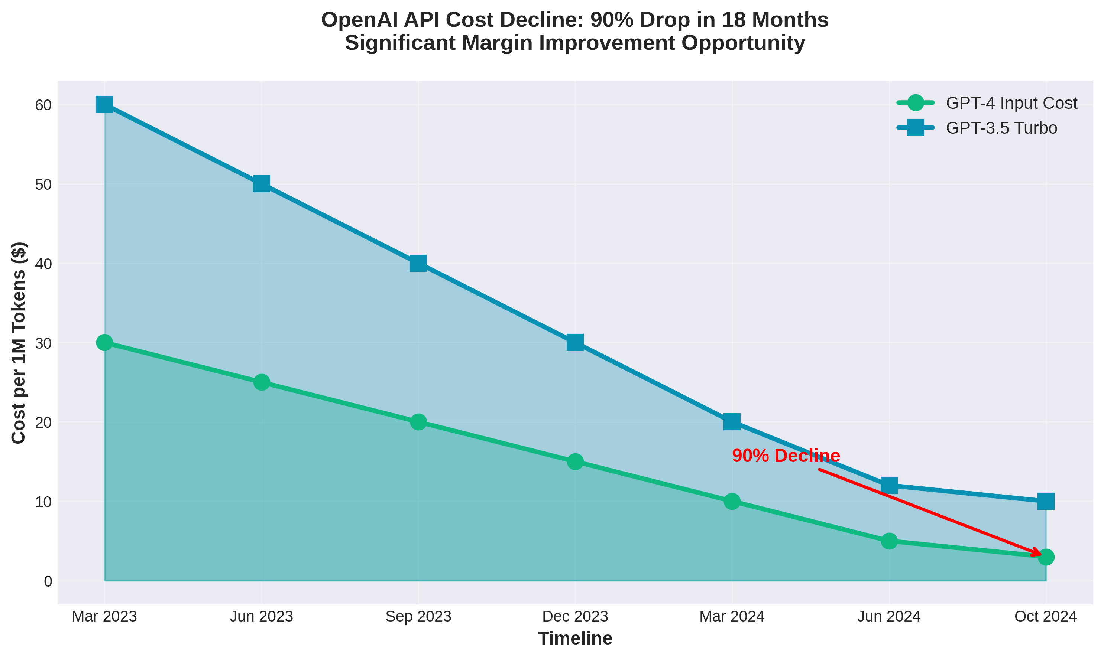
Recommendation #2: Leverage AI Cost Trends
✓ THE DATA: OpenAI API costs declined 90% in just 18 months
✓ THE TREND: Industry forecasts 15-25% annual declines continuing
✓ NVIDIA Blackwell: 25x cost-performance improvement announced
✓ THE OPPORTUNITY: Significant margin improvement on AI-guided tools
✓ THE STRATEGY: Reinvest 50% of savings into hiring more therapists
✓ SOURCES: OpenAI pricing, NVIDIA announcements, IDC industry reports
Notes:
Our second recommendation focuses on AI economics, which is one of the most powerful cost trends happening right now.
Over the past 18 months:
OpenAI API costs dropped nearly 90%
Industry forecasts project 15–25% annual AI cost decline
NVIDIA’s Blackwell chips showed a 25x improvement in cost performance
This is huge for InPower because AI powers:
Emotional support tools
Matching algorithms
Content moderation
Personalization features
Instead of treating these savings as profit alone, our recommendation is to reinvest 50% of those savings into expanding the therapist network. This creates a loop where:
Lower AI costs → Higher margins → More therapists → Better service → Higher retention → More revenue.
This transforms AI from a cost center into a growth accelerator.

Slide 7
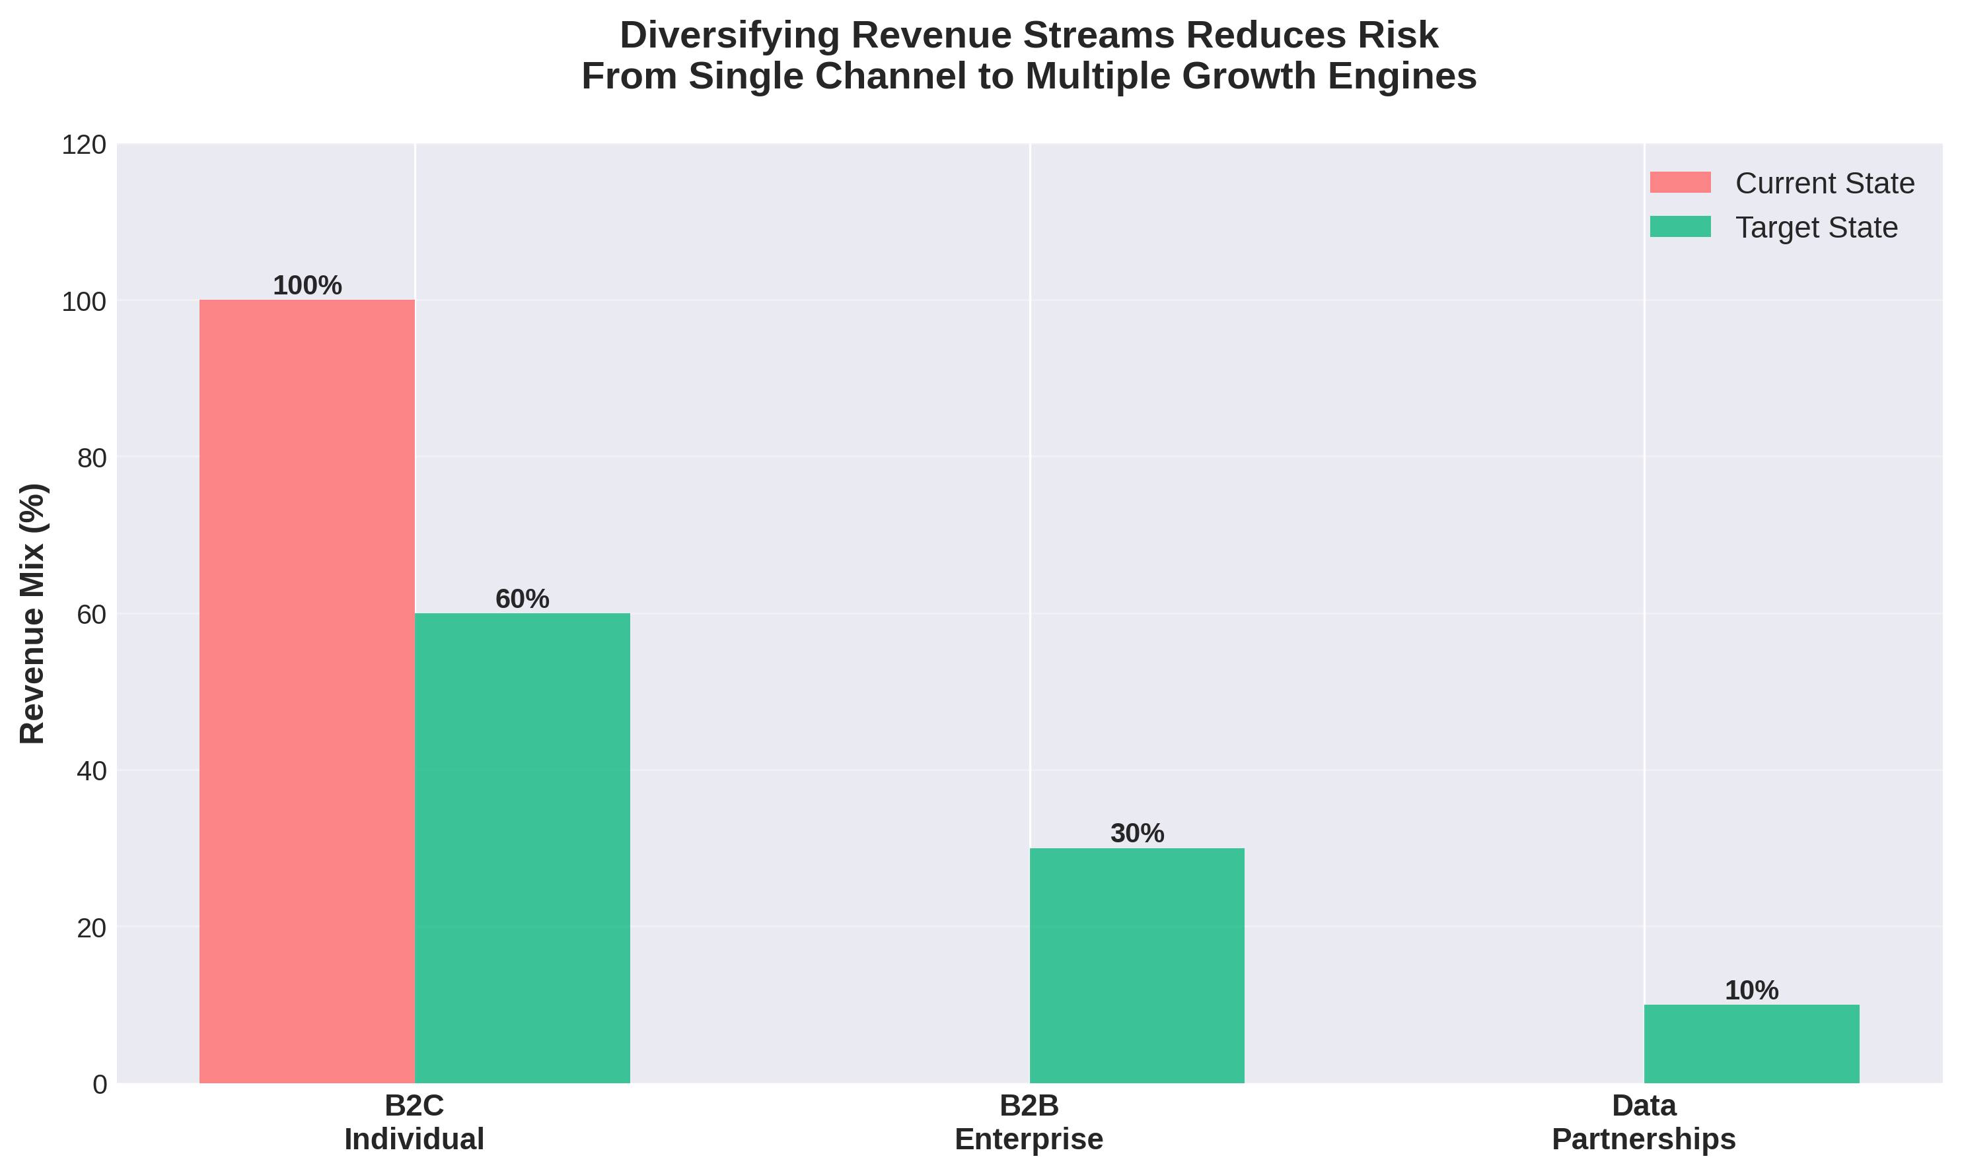
Recommendation #3: Launch B2B Enterprise Track
✓ THE PROVEN MODEL: Wisdo launched B2B2C, acquired by Talkspace
✓ B2C TRACK: Individual consumers, self-service, marketing-driven growth
✓ B2B TRACK: Corporate wellness, direct sales, multi-year contracts
✓ DIVERSIFICATION: Two independent revenue streams reduce dependency risk
✓ ENTERPRISE VALUE: Sticky contracts, predictable revenue, lower churn
✓ THE OUTCOME: Sustainable growth through multiple channels
Notes:
Our third major recommendation is to add a B2B enterprise revenue track alongside InPower’s existing B2C model.
This is based on the proven model used by Wisdo, which successfully pivoted into B2B and was later acquired by Talkspace. Under this approach:
B2C Track continues serving individuals through subscriptions, coaching, and digital tools.
B2B Track targets corporations offering wellness programs to employees through annual contracts.
Why this matters:
It diversifies revenue, reducing reliance on individual subscriptions.
It creates predictable, contract-based income.
It reduces churn, because enterprise contracts are multi-year.
This transforms InPower from a consumer-only app into a platform with enterprise-grade stability.

Slide 8
Recommendation #4: Ethical Data Partnership Program
✓ THE OPPORTUNITY: Anonymized mental health insights advance public research
✓ POTENTIAL PARTNERS: Universities, NIH, public health agencies, pharma R&D
✓ ETHICAL FRAMEWORK (Non-Negotiable):
• Opt-in consent only (never opt-out)
• Independent ethics review board oversight
• Full transparency in terms and reports
• Users maintain complete control
✓ TIMELINE: Infrastructure Year 1, Pilots Year 2, Scale Year 3
✓ IMPACT: Additional revenue stream + enhanced company valuation
Notes:
Our fourth recommendation is one of the most sensitive but also one of the most powerful: ethical data monetization.
InPower sits on uniquely valuable mental wellness, emotional growth, and behavior insight data. When anonymized properly, this data can support:
Universities
Public health research
Clinical trials
Pharmaceutical R&D
Government health agencies
However, this only works under non-negotiable ethical rules:
Opt-in consent only
Independent ethics review board
Full transparency
Complete user control
We propose:
Year 1: Infrastructure and policy framework
Year 2: Small pilot partnerships
Year 3: Scaled partnerships
This adds a high-value B2B revenue stream while strengthening InPower’s role as a social-impact organization, not just a profit-driven startup.

Slide 9
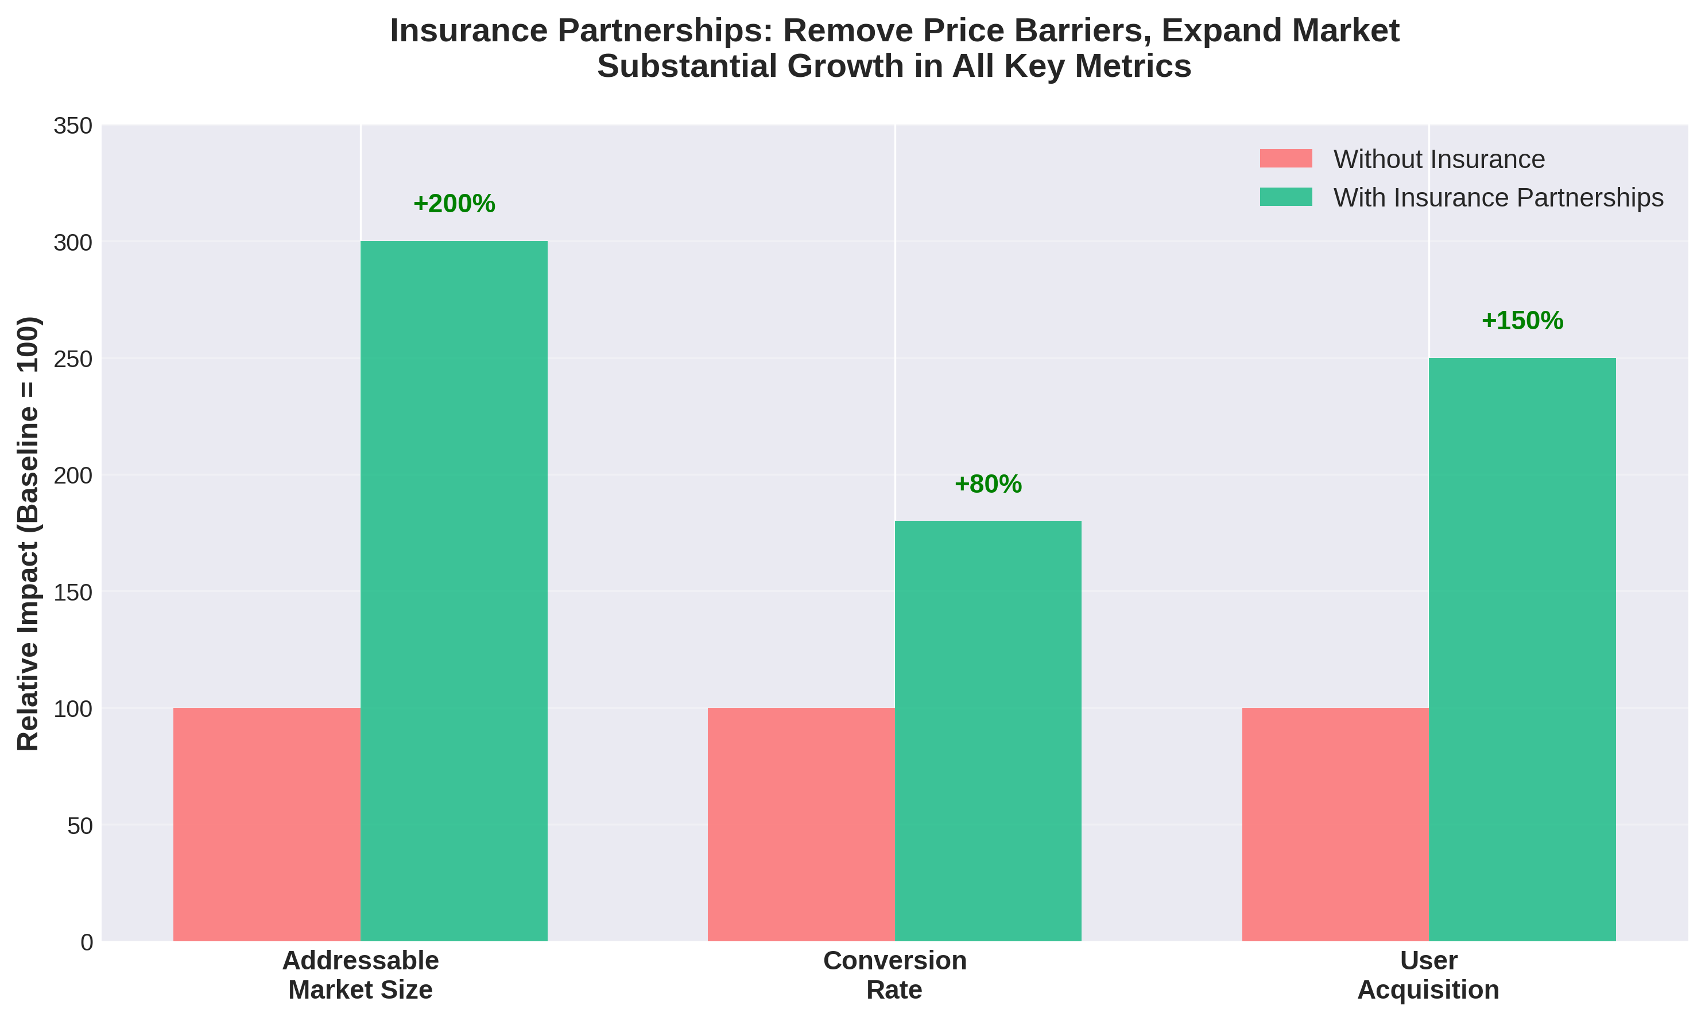
Recommendation #5: Remove Price Barriers via Insurance
✓ THE PROBLEM: Out-of-pocket costs limit access to mental health support
✓ THE SOLUTION: Partner with major insurers for 50-80% reimbursement
✓ TARGET PARTNERS: Sun Life, Manulife, Great-West Life (Canada focus)
✓ USER IMPACT: Effective cost drops significantly after reimbursement
✓ MARKET EXPANSION: Addressable market grows substantially
✓ CONVERSION BOOST: Higher conversion rates when cost barriers removed
✓ THE OUTCOME: Market expansion and increased accessibility
Notes:
Our fifth recommendation addresses one of the biggest barriers in mental health: affordability.
Right now, many users pay out-of-pocket for emotional support and coaching. We propose partnering with large insurers such as:
Sun Life
Manulife
Great-West Life
This allows 50–80% reimbursement for eligible therapy services. The impact is major:
Lower cost for users
Higher conversion rates
Expanded addressable market
Increased long-term user loyalty
This shifts InPower from a premium wellness platform to an accessible mental health infrastructure partner.

Slide 10
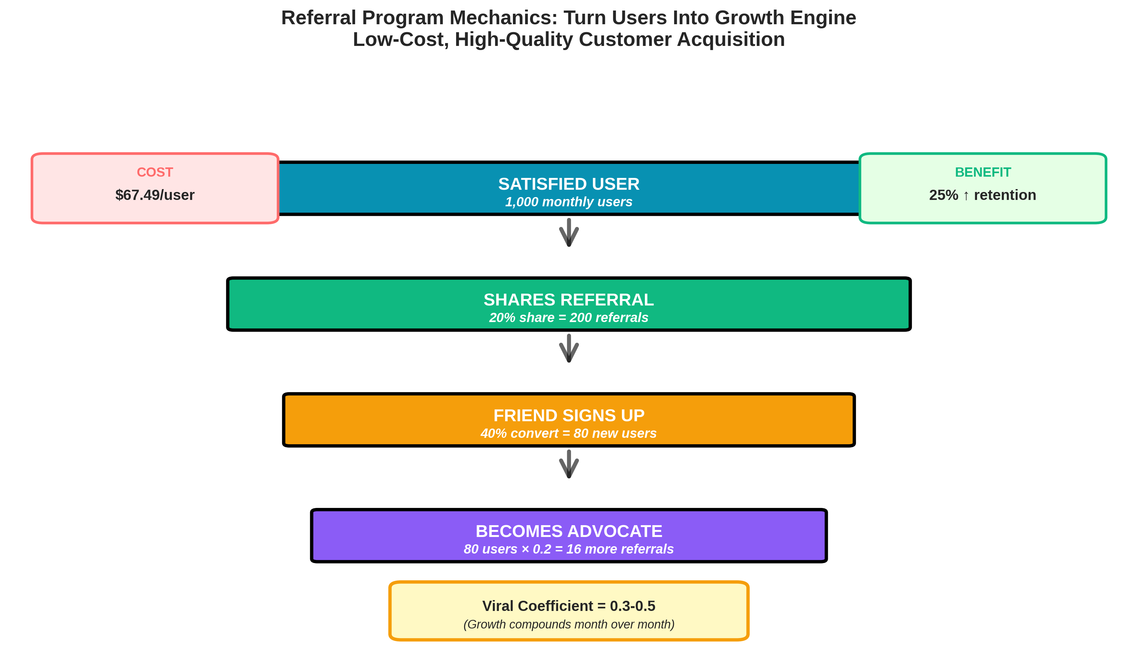
Recommendation #6: Build Viral Growth Engine
✓ THE INSIGHT: Mental health recommendations from trusted sources highly effective
✓ TRUST FACTOR: People trust peer referrals more than advertising
✓ THE MECHANICS: Reward referrers, reduce friction for new users
✓ ECONOMICS: Lower customer acquisition costs while maintaining quality
✓ RETENTION BONUS: Referred users demonstrate 25% higher retention rates
✓ THE GOAL: Create self-sustaining viral coefficient (Dropbox achieved 0.5)
✓ OUTCOME: Compounding growth through authentic word-of-mouth
Notes:
Our final recommendation is to build viral, referral-based growth.
Mental health products rely heavily on trust. People are far more likely to try a wellness platform if it is recommended by:
A friend
A family member
A therapist
We propose:
Rewarding referrers
Reducing onboarding friction
Tracking viral coefficient as a KPI
Research shows that referred users retain 25% longer than users acquired through ads. And companies like Dropbox used this same approach to fuel exponential growth.
This strategy lowers customer acquisition costs while boosting retention—an ideal combination for unit economics.

Slide 11
Implementation Strategy
Phased Approach with Checkpoint Validation

Slide 12
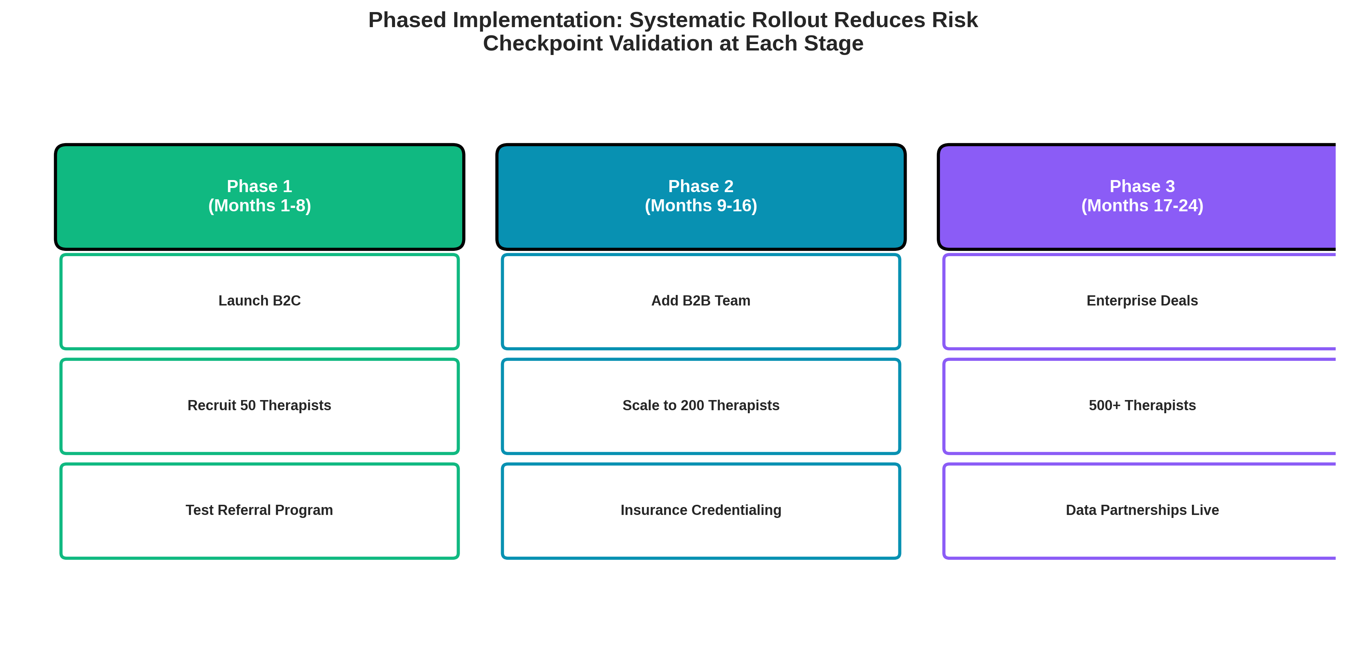
Three-Phase Implementation Over 24 Months
Systematic rollout with validation checkpoints at each phase transition
Notes:
These six strategies roll out across three structured phases:
Phase 1: Therapist recruitment, AI optimization, B2C refinement
Phase 2: B2B enterprise launch, insurance pilots
Phase 3: Ethical data partnerships and global scaling
Each phase includes performance checkpoints, ensuring that growth only continues if retention, margins, and satisfaction targets are being met.

Slide 13
Why This Strategy Wins
DEFENSIBLE MOAT
DIVERSIFIED REVENUE
PROVEN MODEL
✓ 500+ therapist network
✓ B2C individual
✓ Wisdo playbook
✓ Quality relationships
✓ B2B enterprise
✓ AI cost leverage
✓ User trust & loyalty
✓ Data partnerships
✓ Network effects
Combined Effect: Multiple reinforcing advantages create sustainable competitive position
Notes:
In summary, this strategy creates three powerful outcomes:
A defensible moat through therapist relationships
Diversified revenue through B2C, B2B, and data
Proven scalability by leveraging AI economics and referral growth
Together, these advantages reinforce one another and reduce risk from market shocks.

Slide 14
Critical Success Factors
✓ THERAPIST QUALITY: Competitive advantage depends on recruitment excellence
✓ USER EXPERIENCE: Seamless matching drives retention and satisfaction
✓ ETHICAL STANDARDS: Transparent data practices build long-term trust
✓ EXECUTION DISCIPLINE: Phased approach with clear milestones
✓ MARKET POSITIONING: Clear differentiation from competitors
✓ FINANCIAL PRUDENCE: Sustainable unit economics at every stage
Notes:
For this strategy to succeed, five factors must be executed with discipline:
Therapist quality
User experience
Ethical data practices
Financial discipline
Clear market positioning

Slide 15
Next Steps
1. Review and approve strategic recommendations
2. Prioritize Phase 1 initiatives for immediate action
3. Allocate resources for therapist recruitment program
4. Define success metrics and KPIs for each initiative
5. Establish governance structure for data ethics board
Notes:
Our immediate next steps are:
Approving Phase 1 initiatives
Allocating recruitment resources
Defining KPIs
Establishing data governance

