Slide 1
AMEX AI/ML Hackathon
Geek Goddess 2019
Powered by American Express
Title: Credit Card
Team Member: Jayathilaga Ramajayam
Analyst –Data analytics from Verizon
Team name: CG_TEAM_HKRZM

Slide 2

USE CASE:
Predict credit card approval by using customers information.

Slide 3
The bank needs ways to minimize the credit card approval.
It is where the role of Machine Learning and Data Science comes into play.
The tedious task can be dealt with Machine Learning by training the models with minimized errors.
Problem being solved

Slide 4
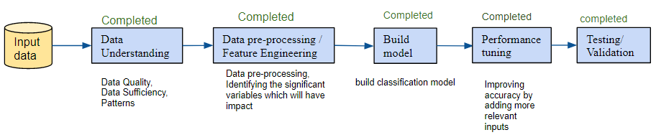
Technical architecture

Slide 5
Data Understanding
Train data: 590 records
Test data: 100 records
Number of features: 17
Continuous data: 7 Attributes
Discrete data: 10 Attributes
Univariate analysis and Bivariate analysis reports are recorded in Exploratory data analysis.docx
For more information about Exploratory data analysis: Please open Exploratory data analysis.docx file

Slide 6
Data Pre-processing / Feature Engineering
Data Pre-processing:
Removed fields with no variations (single value) and too much variations (phone numbers, sequential number like Key)
Some categorical fields had special characters like ‘?’,’+’,’-’ .
Cannot provide special characters as input to the model. Hence changed them to ‘no’, ‘yes’
Some fields had null values, they are transformed into ‘no’. Null cannot be given as input for model.
Feature Engineering:
For continuous variable Tree classifier and Recursive Feature Elimination is used to get Feature importance.
Years employed and income has more importance than other variables.
Relationship between categorical variables are tested using chi- squared test and the results are as follows,
Male and Drivers License fields have no relationship with Approved variable
Bank customer, married, education, ethnicity, prior default, employed, citizen have relationship with Approved variable.

Slide 7
Model Building
Since it is a binary classification problem, Inputs need to be provided in vectorized form.
Years employed and income are not changed, as it is already in continuous form.
married, education, ethnicity, prior default, employed, citizen are vectorized using one hot encoder
Input is merged as sparse matrix ( to save a significant amount of memory and speed up the processing of that data)
Following classification algorithms are tried,
Simple logistic regression, logistic regression with L2, multinomial Naïve Bayes, Support Vector Machine(SVM), random forest.(details in Exploratory data analysis.docx)
Logistic regression with L2 provided better results.(details in next slide)

Slide 8
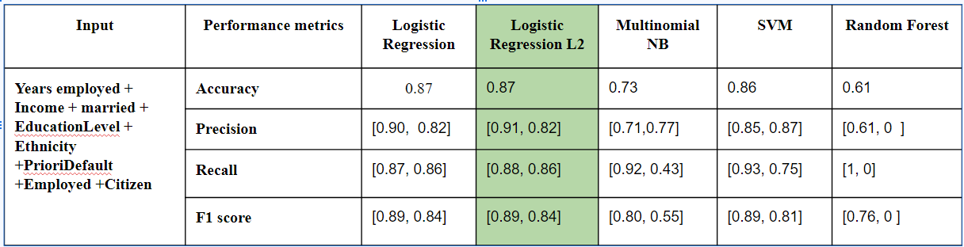
Performance Metrics
Performance metrics are calculated using sklearn packages,
Accuracy_score: (tp + tn) / (p + n)
Prescision_score: tp / (tp + fp)
Recall_score: tp / (tp + fn)
F1_score: 2 tp / (2 tp + fp + fn)

Slide 9
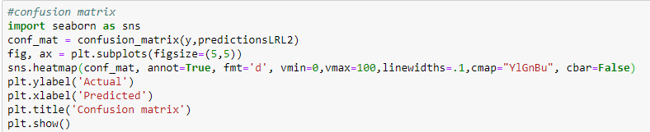
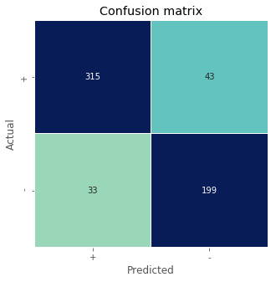
Confusion matrix
The number of correct and incorrect predictions are summarized with count values and broken down by each class. This is the key to the confusion matrix.
It gives us insight not only into the errors being made by a classifier but more importantly the types of errors that are being made.

Slide 10
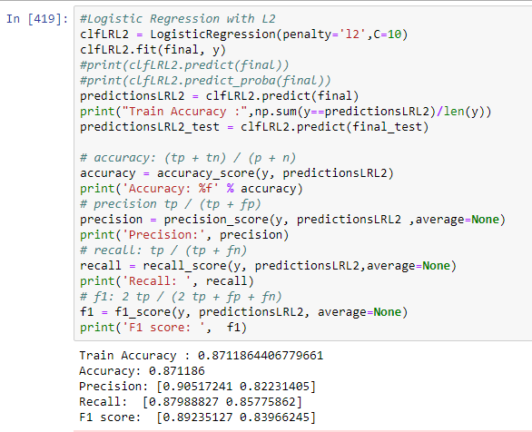
Prototype Demo(Video/Screenshots)

Slide 11
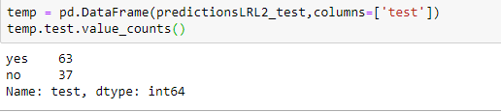
Test Data Results
Summary of the test data predicted using logistic regression with L2 model shows 75% as ‘+’ and 25% output as ‘-’
75
25

Slide 12


