Slide 1
Mr.Cooper
Round 2 for Machine Learning Team
Title: Multi-Class Text Classification
Jayathilaga Ramajayam
Data scientist

Slide 2
USE CASE:
Classification model that predicts the topic of the statement

Slide 3
Statement can be 1-4 sentences long.
Semantics or subject of the sentence is provided.
Create a classification model to predict the context.
Deploy the model using flask.
Problem being solved

Slide 4
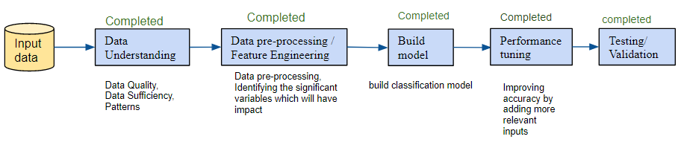
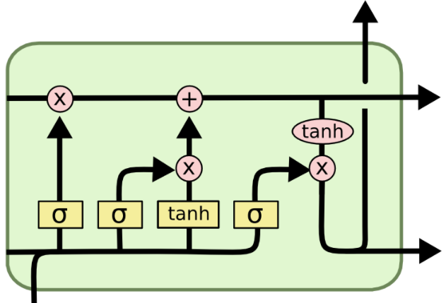



Technical architecture
LSTM

Slide 5
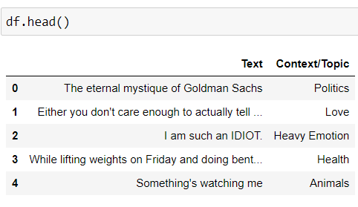
Data Understanding
Train data: 31386 records
Number of features: 2
input - String: Text
output - Categorical: Context/Topic
Exploratory data analysis :
Univariate analysis and Bivariate analysis is performed

Slide 6
Data Pre-processing / Feature Engineering
Data Pre-processing:
Textual data:
Convert to lowercase
Removed special characters/ punctuations – !,?,”,’
Removed numeric values
Removed stop words
Identify root word using Lemmatization
Generated tokens using keras Tokenizer
Filtered by pad_sequence using keras preprocessing
Categorical data:
Using pandas get_dummies convert Context/Data to one hot encoded form.

Slide 7
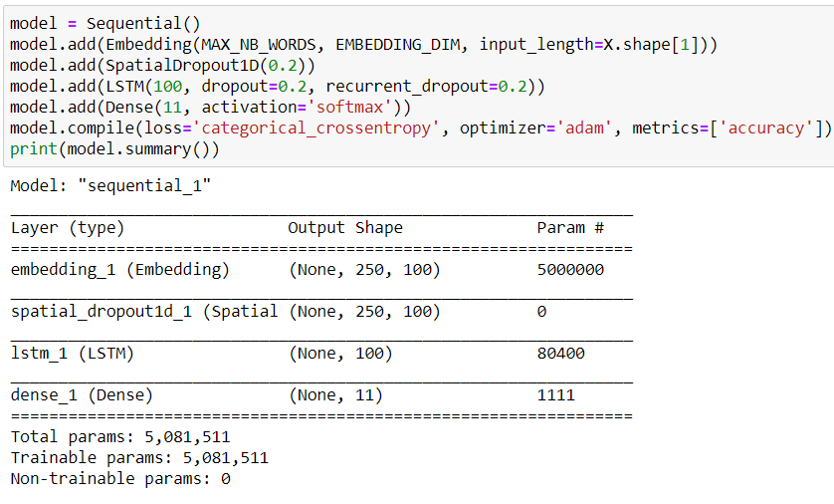
Model Building: Multi-class text classification using LSTM
Tried out Machine Learning models like Logistic Regression, SVM, Random forest.
Hence moved towards Deep learning model using LSTM.

Slide 8
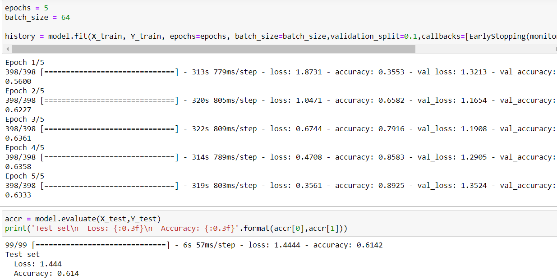
Model Demo(Screenshots)

Slide 9
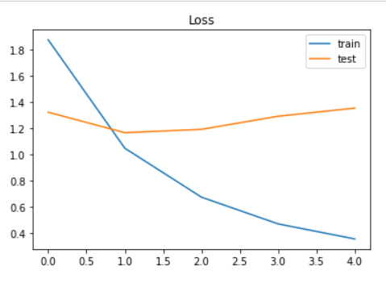
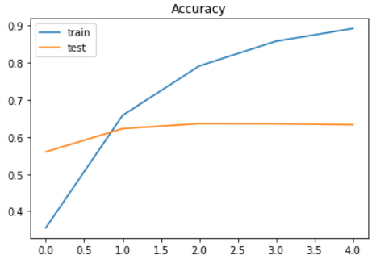
Model Validation
Summary of the output predicted.

Slide 10
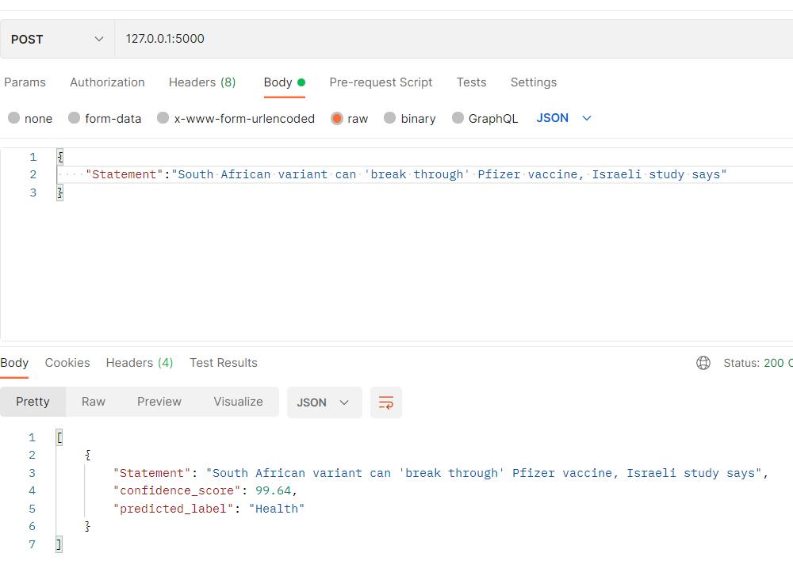
Flask API - Visualization
We can visualize output using Postman or swagger API

Slide 11


