Slide 1
The Sweet World of Chocolate
Exploring Varieties, Health Perks, and the Art of Creation

Slide 2
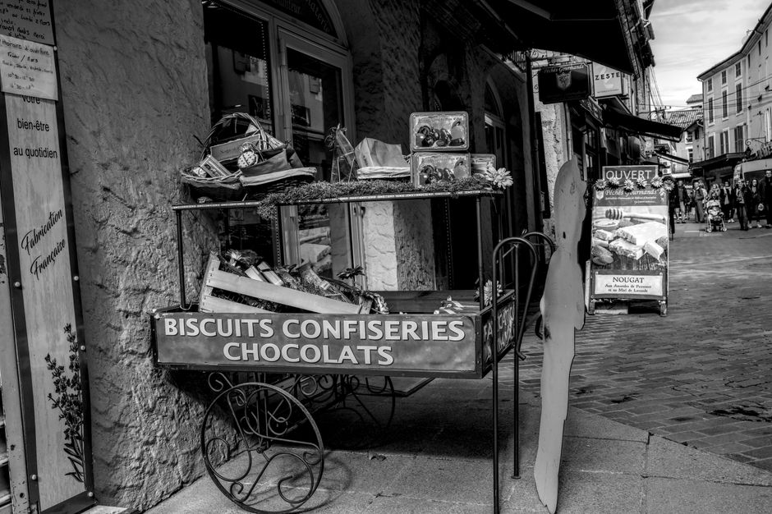
A Rich History: The Origins of Chocolate
Tracing the roots of chocolate from ancient civilizations to modern times.
• Chocolate has been cherished since ancient times, with roots tracing back to the Aztec and Mayan cultures.
• Initially consumed as a bitter beverage, chocolate was reserved for royalty and special ceremonies.
• European explorers introduced chocolate to Europe in the 16th century, transforming it into a sweet delicacy.
• The industrial revolution in the 19th century enabled mass production and popularized chocolate worldwide.

Slide 3
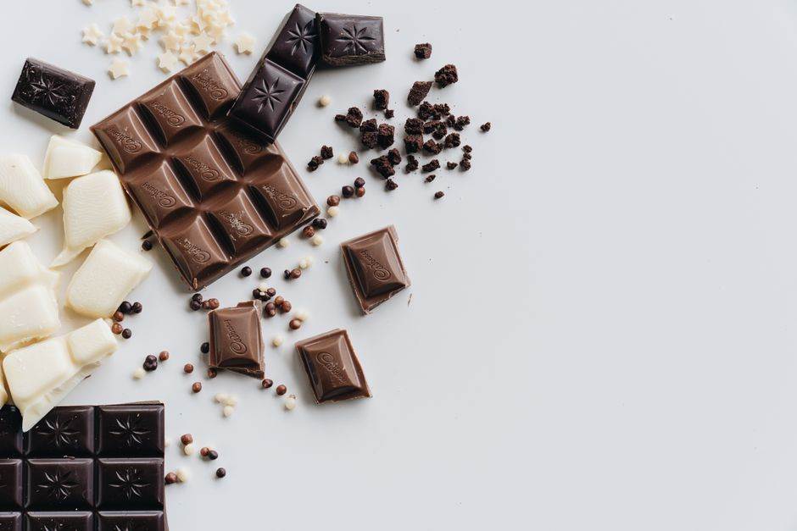
Types of Chocolate: From Dark to White
Exploring the diverse varieties and their unique characteristics.
• Dark chocolate contains high cocoa content, offering a rich and intense flavor profile.
• Milk chocolate is sweeter and creamier, with added milk solids and sugar.
• White chocolate lacks cocoa solids, offering a sweet taste with cocoa butter as its base.
• Ruby chocolate, a newer variety, is known for its natural pink color and berry-like flavor.

Slide 4
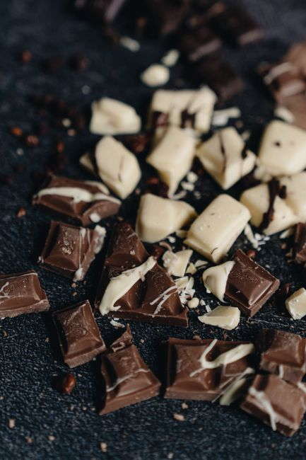
Dark vs Milk Chocolate
Comparing the characteristics and benefits of dark and milk chocolate.
• Dark chocolate is known for its high cocoa content and intense flavor, often containing less sugar.
• Milk chocolate is creamier and sweeter, with added milk solids that create a smoother texture.
• Dark chocolate is often touted for its health benefits, including high antioxidant levels.
• Milk chocolate is more popular among consumers due to its sweeter taste and creamy texture.

Slide 5
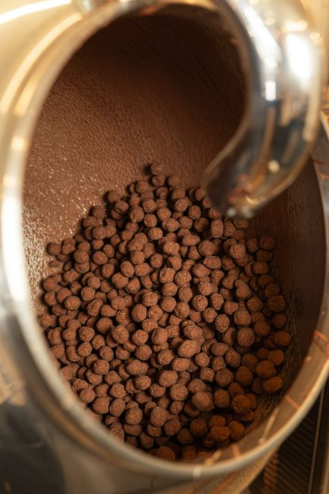
The Art of Chocolate Making
A step-by-step guide to how chocolate is crafted from bean to bar.
• The journey begins with the harvesting of cacao pods from tropical cacao trees.
• The beans are then fermented, dried, and roasted to develop their distinct chocolate flavor.
• Once roasted, the beans are cracked and winnowed to separate the nibs from the shells.
• The nibs are ground into a liquid called chocolate liquor, which forms the base of all chocolate.

Slide 6
From Chocolate Liquor to Finished Product
The final stages of chocolate production and creation of various products.
• Chocolate liquor can be further processed into cocoa solids and cocoa butter.
• Mixing precise amounts of cocoa solids, cocoa butter, and sugar creates different types of chocolate.
• Tempering is a crucial step that involves carefully cooling and reheating chocolate for a smooth finish.
• Molded into bars or shaped into confections, chocolate is finally packaged and ready for consumption.

Slide 7
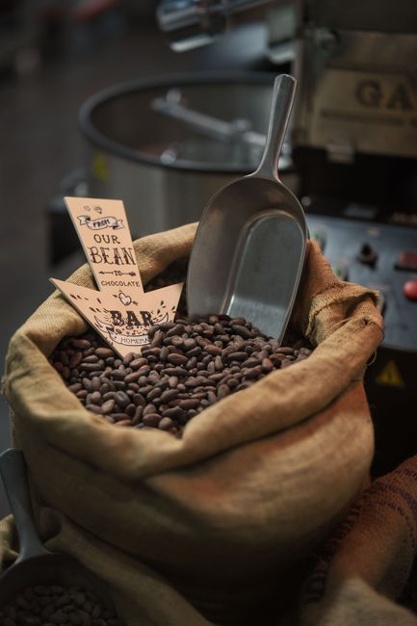
Ethical Considerations in Chocolate Production
Addressing sustainability and fair trade in the chocolate industry.
• Sustainable farming practices are vital to ensure the long-term health of cacao crops and ecosystems.
• Fair trade certification ensures that cacao farmers receive fair compensation for their labor.
• Companies are increasingly adopting eco-friendly packaging to reduce the environmental impact of chocolate.
• Supporting ethical chocolate brands helps promote better working conditions and community development.

Slide 8
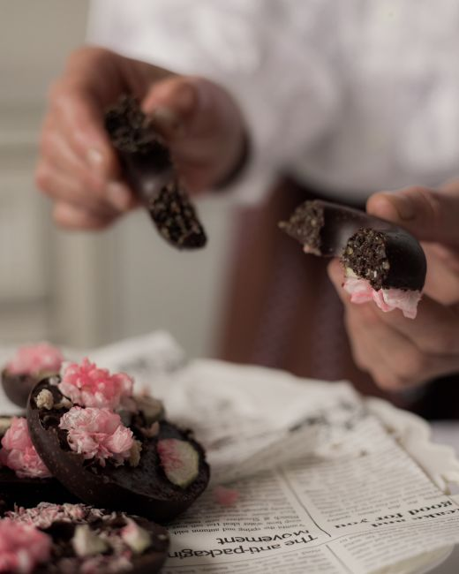
Innovations in Chocolate: New Flavors and Techniques
Exploring the latest trends and creative innovations in the chocolate industry.
• Artisan chocolatiers are experimenting with exotic flavors like lavender, sea salt, and chili pepper.
• Bean-to-bar producers emphasize craftsmanship and transparency in every stage of chocolate creation.
• 3D printing technology is being used to create intricate and novel chocolate designs.
• Vegan and dairy-free chocolate options are expanding, catering to a growing segment of consumers.

Slide 9
Conclusion: The Future of Chocolate
Reflecting on the enduring allure and evolving landscape of chocolate.
• Chocolate continues to captivate taste buds and imaginations across cultures and generations.
• Sustainability and innovation will shape the future of chocolate in an increasingly conscious market.
• As consumer preferences evolve, the chocolate industry must adapt to meet diverse dietary needs.
• The love for chocolate remains unwavering, promising a sweet future filled with endless possibilities.

