Slide 1
Fueling Growth: Strategic Budgeting for Marketing Success
Unlocking Opportunities through Smart Financial Planning

Slide 2

Introduction to the Marketing Budget
Overview of budget importance and strategic alignment.
• The marketing budget is a critical tool for aligning financial resources with strategic priorities.
• Understanding the budget helps the team focus on initiatives that maximize return on investment.
• Budgeting involves forecasting, tracking, and analyzing the financial aspects of marketing activities.
• A well-structured budget ensures that marketing efforts are both effective and efficient.

Slide 3

Previous Year's Budget Performance
Analyzing past performance to inform future budgeting decisions.
• Reviewing last year's budget performance helps identify successful strategies and areas for improvement.
• Key performance indicators (KPIs) were used to measure the effectiveness of budget allocations.
• Over or under-spending patterns can reveal insights about resource utilization and efficiency.
• Lessons learned from past experiences guide adjustments for more informed future planning.

Slide 4

Current Market Trends and Opportunities
Identifying trends that impact budget priorities.
• Current market trends can significantly influence the allocation of marketing resources.
• Emerging digital platforms offer new opportunities for reaching target audiences effectively.
• Shifts in consumer behavior necessitate adjustments in marketing strategies and budget focus.
• Staying ahead of competitors requires investment in innovative marketing tools and techniques.

Slide 5
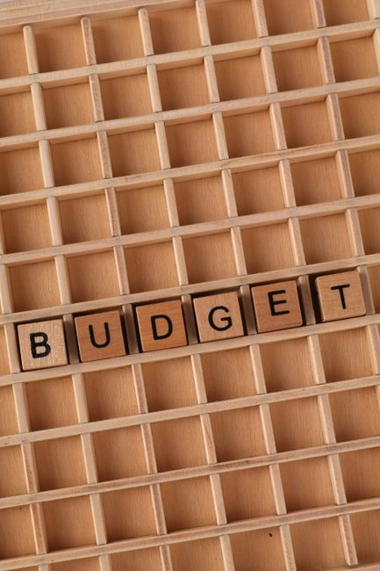
Budget Allocation by Channels
Strategic distribution of funds across marketing channels.
• Allocating the budget across various channels ensures a balanced approach to marketing outreach.
• Digital marketing channels often require a larger share due to their growing importance in engagement.
• Traditional media still plays a vital role, particularly in reaching certain demographics effectively.
• Regularly evaluating channel performance helps in optimizing budget allocations for maximum impact.

Slide 6

Investment in Technology and Tools
Enhancing capabilities with the right technology investments.
• Investing in advanced marketing tools can streamline operations and improve analytical capabilities.
• Automation technologies enable more efficient budget management and allocation processes.
• Data analytics tools provide deeper insights, leading to more informed budgetary decisions.
• Technology investments should align with strategic goals to ensure they support overall marketing objectives.

Slide 7

Risk Management and Contingency Planning
Preparing for uncertainties with strategic financial planning.
• A robust budget includes provisions for unforeseen challenges and opportunities in the market.
• Contingency funds allow for quick adaptation to changes without compromising strategic goals.
• Risk assessment involves identifying potential threats and devising strategies to mitigate them.
• Regularly updating risk management plans ensures preparedness for any financial disruptions.

Slide 8

Collaboration and Communication
Enhancing budget effectiveness through teamwork.
• Effective communication ensures all team members understand budget priorities and constraints.
• Collaborative planning fosters a sense of ownership and accountability among team members.
• Regular meetings help track progress and make necessary adjustments to the budget strategy.
• Sharing insights and feedback contributes to continuous improvement in budget management.

Slide 9

Future Projections and Strategic Goals
Aligning budget plans with long-term objectives.
• Future budget projections are based on current trends and historical performance data.
• Setting strategic goals ensures that budgeting supports the long-term vision of the organization.
• Regularly revisiting and revising projections helps in adapting to evolving business environments.
• Success metrics should be defined to measure progress towards achieving strategic financial objectives.

Slide 10

Conclusion and Call to Action
Summarizing key points and encouraging proactive engagement.
• Summarizing the budget strategy reinforces the importance of strategic financial planning in marketing.
• A call to action encourages team members to actively participate in budget implementation.
• Feedback loops should be established to continuously improve budget processes and outcomes.
• Empowering the team with the right resources and information fosters a culture of accountability.

