Slide 1
Indulge in the Art of Chocolatiering
Unveiling the Sweet Craftsmanship Behind Every Chocolate Creation

Slide 2
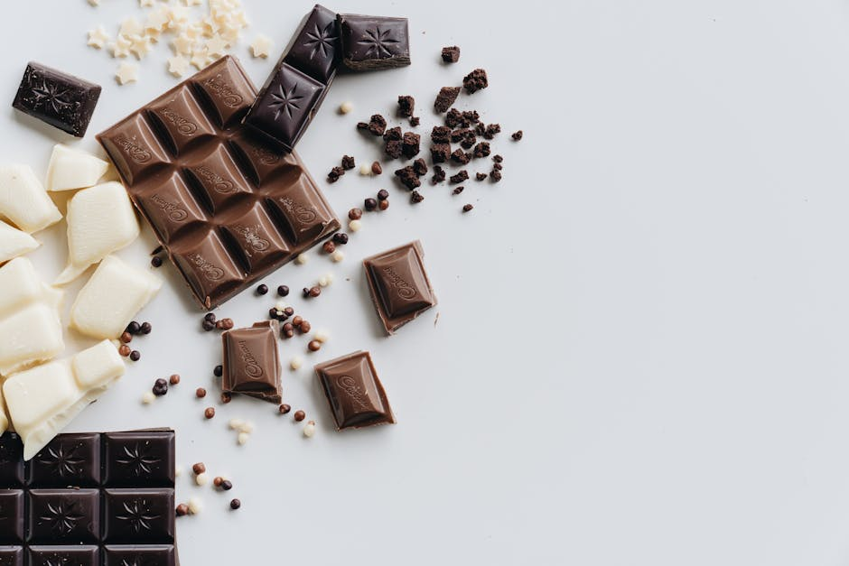
The Rich History of Chocolate
Exploring the Origins and Evolution of Chocolate Over the Centuries
• Chocolate dates back to ancient Mesoamerican cultures, such as the Maya and Aztecs, who revered cacao.
• The Spanish brought chocolate to Europe, transforming it into a luxurious drink for the elite.
• By the 19th century, innovations in chocolate processing made it accessible to a broader audience.
• Modern chocolate manufacturing techniques have evolved, yet traditional methods still hold significance.
• Understanding chocolate's history provides insight into its cultural and economic impact globally.

Slide 3
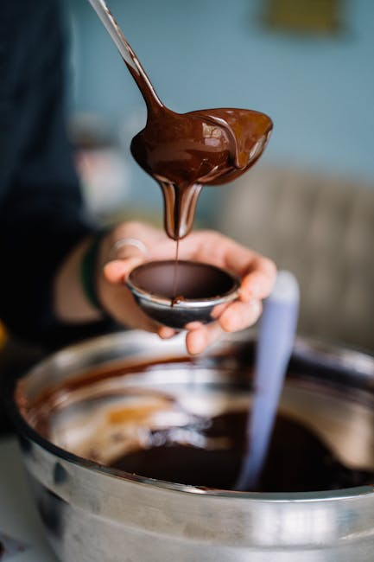
The Science of Chocolate Making
Delving into the Complex Processes Behind Crafting Chocolate
• Chocolate production begins with harvesting cacao pods and fermenting the beans to enhance flavor.
• Roasting cacao beans at precise temperatures is crucial for developing the characteristic chocolate taste.
• Grinding the roasted beans produces cocoa mass, which forms the base of all chocolate products.
• Conching refines the chocolate texture, improving its smoothness and flavor through extended mixing.
• Tempering involves controlled cooling and heating to stabilize chocolate, giving it a glossy finish.

Slide 4
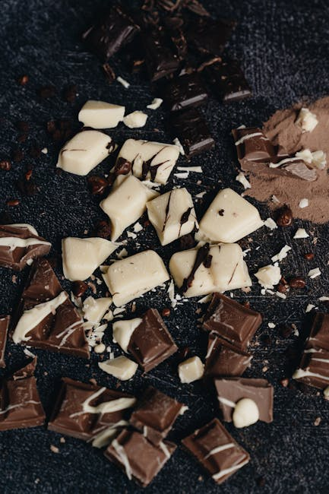
Exploring Chocolate Varieties
A Guide to Different Types of Chocolates and Their Unique Characteristics
• Dark chocolate, known for its high cocoa content, offers a rich, intense flavor profile.
• Milk chocolate blends cocoa with milk solids, creating a creamy and sweeter taste experience.
• White chocolate, devoid of cocoa solids, highlights cocoa butter combined with sugar and milk.
• Ruby chocolate, a recent innovation, is celebrated for its natural pink hue and fruity notes.
• Each chocolate type provides distinct culinary possibilities, catering to various taste preferences.

Slide 5
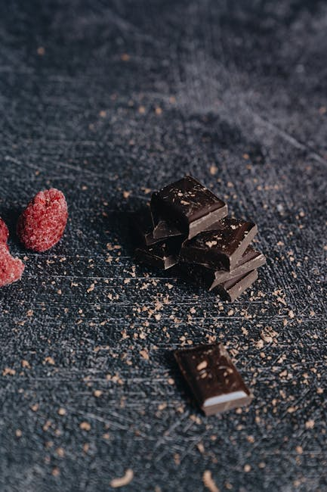
Flavor Pairing and Chocolate
Mastering the Art of Pairing Chocolate with Complementary Flavors
• Pairing chocolate with fruits, such as berries, enhances its natural sweetness and acidity balance.
• Nuts, like almonds and hazelnuts, add texture and a savory contrast to chocolate's creaminess.
• Spices, including cinnamon and chili, can intensify chocolate's complexity and depth of flavor.
• Cheese and chocolate combinations offer a surprising harmony of salty and sweet sensations.
• Experimenting with flavor pairings can elevate chocolate experiences, unlocking new dimensions of taste.

Slide 6

Chocolate and Health Benefits
Understanding the Potential Health Advantages of Consuming Chocolate in Moderation
• Dark chocolate is rich in antioxidants, which may help reduce inflammation and improve heart health.
• Consuming chocolate can stimulate endorphin production, potentially boosting mood and reducing stress.
• Flavonoids in chocolate are associated with improved brain function and cognitive performance.
• Moderate chocolate intake may lower blood pressure and improve blood flow, supporting cardiovascular health.
• Balancing chocolate consumption with a healthy diet is key to maximizing its potential benefits.

Slide 7
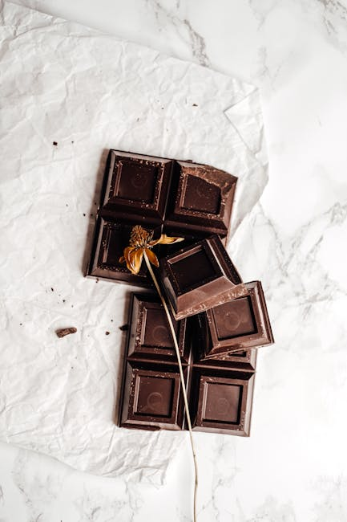
Ethical Chocolate Sourcing
Promoting Sustainable Practices in the Chocolate Industry
• Fair trade certifications ensure that cocoa farmers receive equitable wages and work in safe conditions.
• Sustainable farming practices help preserve biodiversity and reduce environmental impact in cacao cultivation.
• Consumers can support ethical chocolate by choosing brands committed to transparency and responsible sourcing.
• Addressing child labor issues is critical for promoting social justice within the chocolate supply chain.
• Informed choices can drive industry change, encouraging companies to adopt more ethical practices.

Slide 8
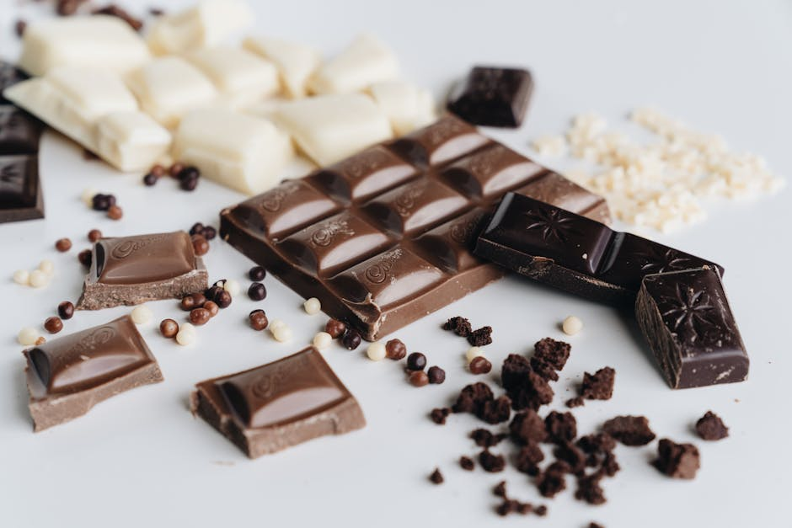
Innovations in Chocolate
Exploring Cutting-Edge Developments in Chocolate Production and Design
• 3D printing technology allows for the creation of intricate chocolate designs previously deemed impossible.
• Plant-based chocolate alternatives cater to growing demand for vegan and allergen-free confectionery options.
• Functional chocolates, infused with ingredients like probiotics, offer additional health benefits beyond indulgence.
• Artisanal chocolatiers are experimenting with unconventional ingredients, pushing boundaries of flavor and form.
• Technological advancements continue to shape the future of chocolate, blending tradition with innovation.

Slide 9
The Future of Chocolate
Anticipating Trends and Challenges Facing the Chocolate Industry
• Climate change poses significant challenges to cacao production, threatening the future chocolate supply.
• Advancements in sustainable practices are crucial for ensuring long-term viability of chocolate production.
• Consumer preferences are shifting towards more ethical, health-conscious, and environmentally friendly chocolate options.
• Innovations in flavor and texture will continue to shape consumer expectations and market trends.
• The chocolate industry must adapt to changing demands while preserving the art of traditional chocolatiering.

