Slide 1
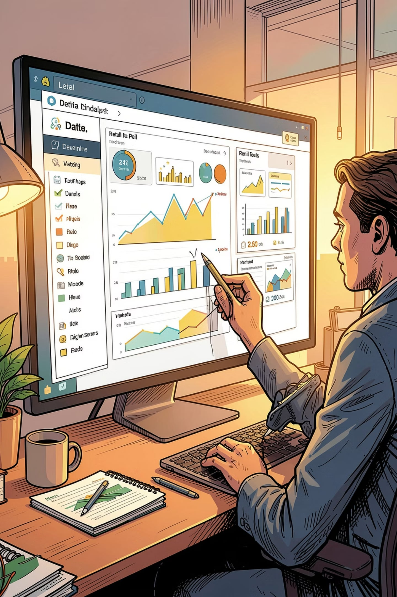
Customer Shopping Behavior Analysis
Transforming 3,900 retail transactions into actionable insights using Python, PostgreSQL, and Power BI to improve marketing, inventory, retention, and revenue.

Slide 2
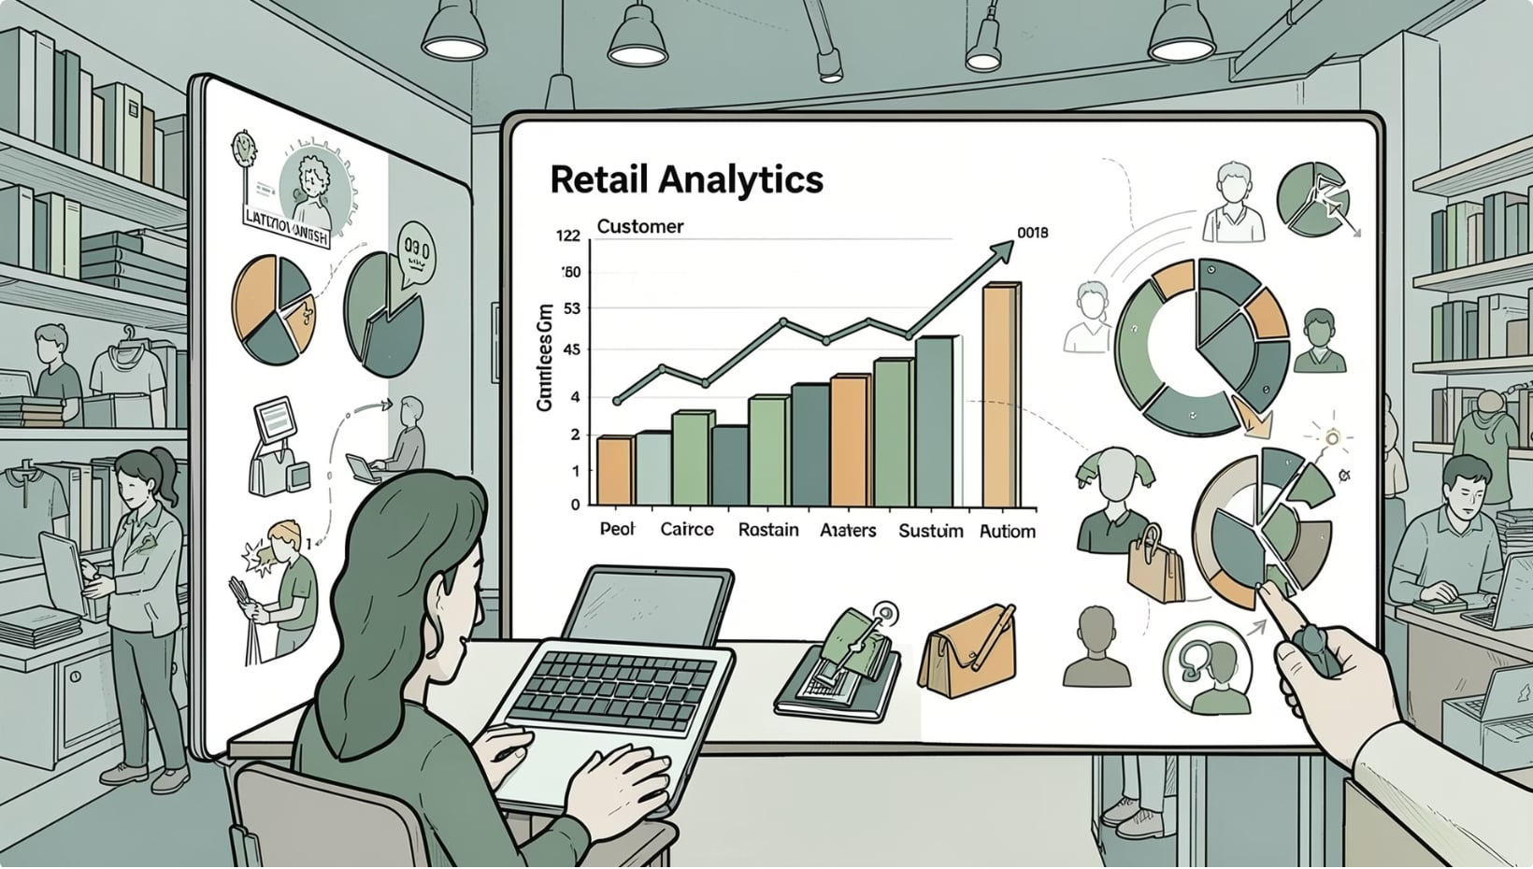
Project Overview
Analyze transactional purchase data to identify trends in demographics, purchasing patterns, product preferences, payment methods, and frequency. Deliver insights to optimize marketing, inventory, and customer retention.

Slide 3
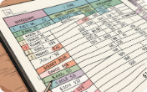
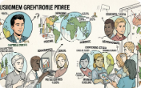
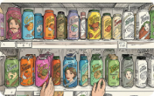
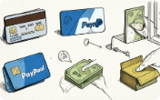
Dataset Summary
Dataset Basics
Customer Info
Product Info
Transaction Details
Customer Shopping Behavior — 3,900 rows × 18 columns.
ID, Age, Gender, Location.
Item, Category, Size, Color, Season.
Purchase Amount, Shipping, Payment, Discount, Promo, Subscription.

Slide 4

Data Quality & Structure
Total records: 3,900 • Total features: 18 • Missing: Review Rating (median imputed) • Duplicates: None
Numeric: Age, Purchase Amount, Review Rating, Previous Purchases
Categorical: remaining columns

Slide 5
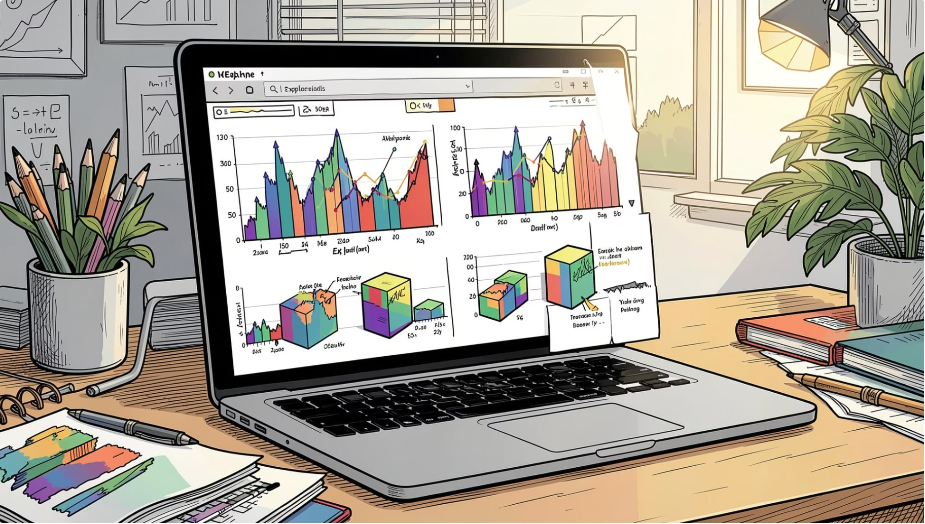
Exploratory Data Analysis (Python)
Loaded CSV into Pandas, inspected dimensions & dtypes, generated descriptive stats, and visualized distributions with Matplotlib & Seaborn. Addressed missing values and validated consistency.
Load & Inspect
Visuals
Cleaning
Read CSV, previewed rows/columns.
Distribution plots & correlations.
Missing ratings → median; no duplicates.

Slide 6
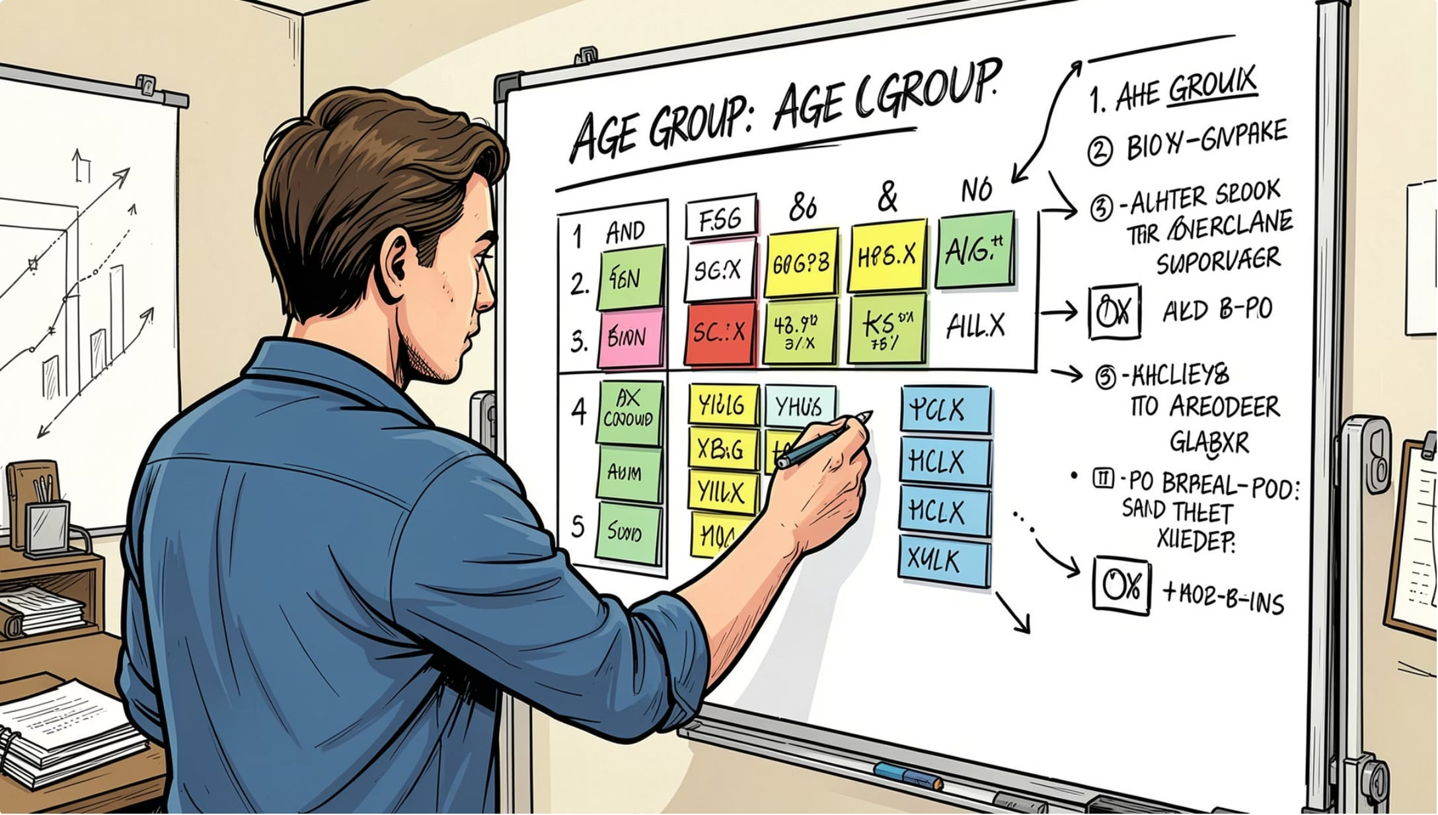



Feature Engineering
Age Groups
Binned continuous ages into categories for cohort analysis.
Standardization
Renamed columns to snake_case for consistency.
Encoding
Converted categorical variables for SQL and modeling.

Slide 7

Database Integration (PostgreSQL)
Connected Python to PostgreSQL via SQLAlchemy. Imported cleaned data and verified table creation to enable SQL-driven business analysis.
ETL: Pandas → SQL table
Schema validated for analytics

Slide 8
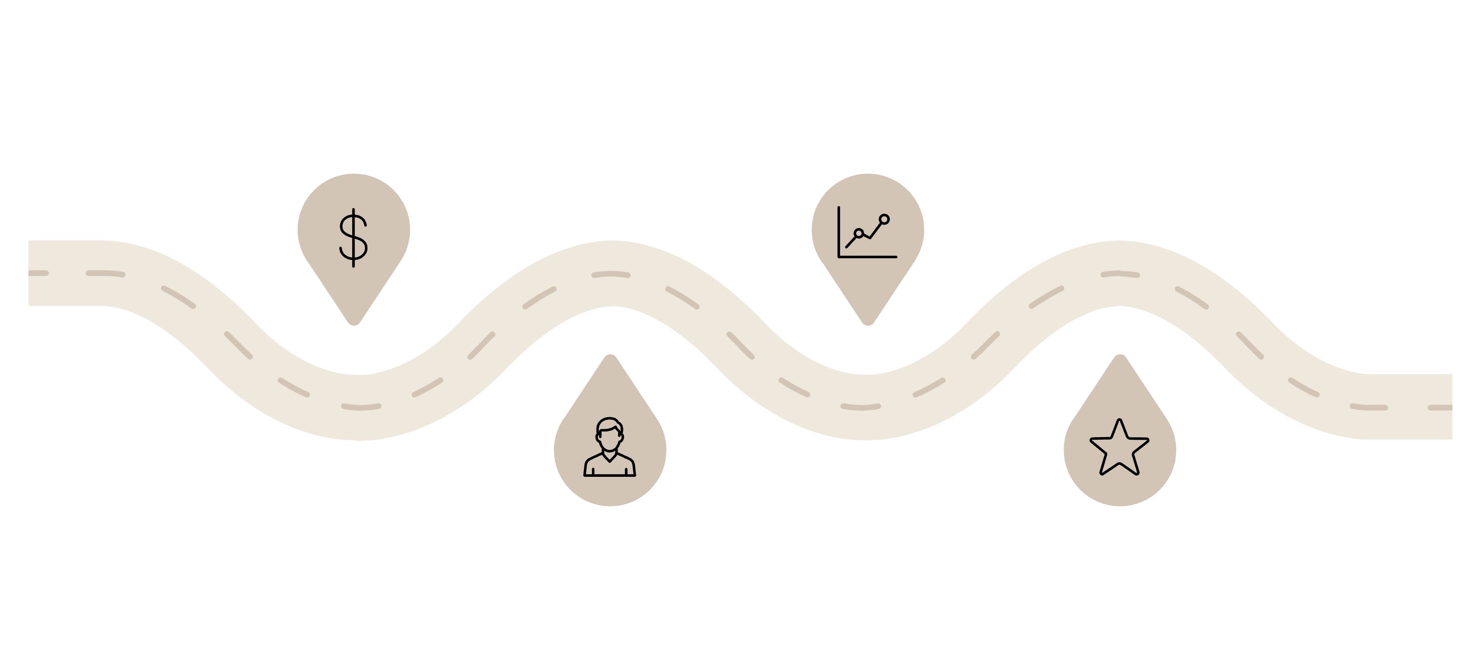
SQL Analyses Performed
Total Revenue
Avg Purchase
Revenue by product category
Average order by age group
By Gender
Top Products
Revenue split male vs female
Top 10 SKUs by revenue
Executed queries covering revenue, demographics, product performance, payment & shipping patterns, discounts, frequency, segmentation, and top customers.

Slide 9
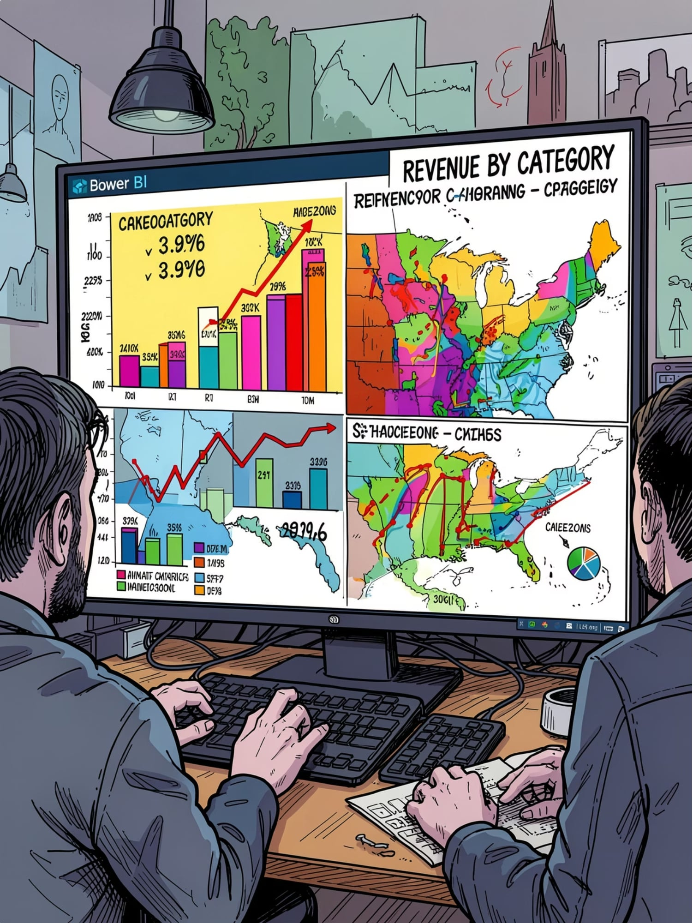
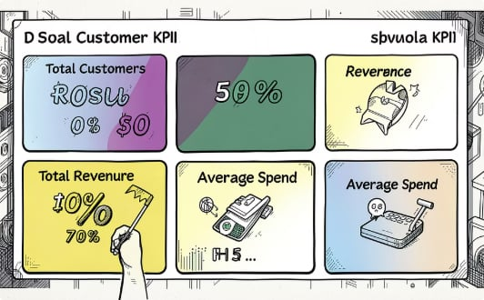
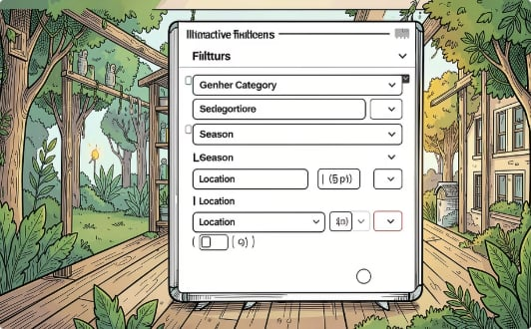
Power BI Dashboard
Interactive dashboard with KPIs and filters to explore customer behavior.
KPIs
Filters
Total Customers • Total Revenue • Avg Purchase • Avg Rating • Total Previous Purchases
Gender, Category, Season, Shipping, Subscription, Payment, Location

Slide 10


Business Recommendations
1
2
3
4
Increase Loyalty
Target High-Revenue Categories
Seasonal Marketing
Optimize Discounts
Personalized rewards for repeat customers with high previous purchases.
Launch targeted promotions during peak seasons.
Evaluate discount effectiveness to protect margins.
Expand inventory & promotions for top-performing categories.
5
6
7
8
Boost Subscriptions
Focus High-Value Customers
Enhance Experience
Optimize Shipping
Offer exclusive benefits to increase subscription adoption.
Improve products/services with low review ratings.
Promote cost-effective shipping options that maintain satisfaction.
Personalized recommendations and premium benefits for top spenders.

