Slide 1

Global Warming and Depletion of Natural Resources
Causes, Consequences, and Solutions
Jayatu Sarbadhikary
24/08/2024

Slide 2

Overview of the Topic:
Global warming and the depletion of natural resources are two critical environmental challenges we face today. These issues are interconnected and have profound implications for the health of our planet and the sustainability of human life.
This presentation will explore what these issues are, their causes, impacts, and potential solutions.
Contents:
Global Warming
Depletion of Natural Resources

Slide 3
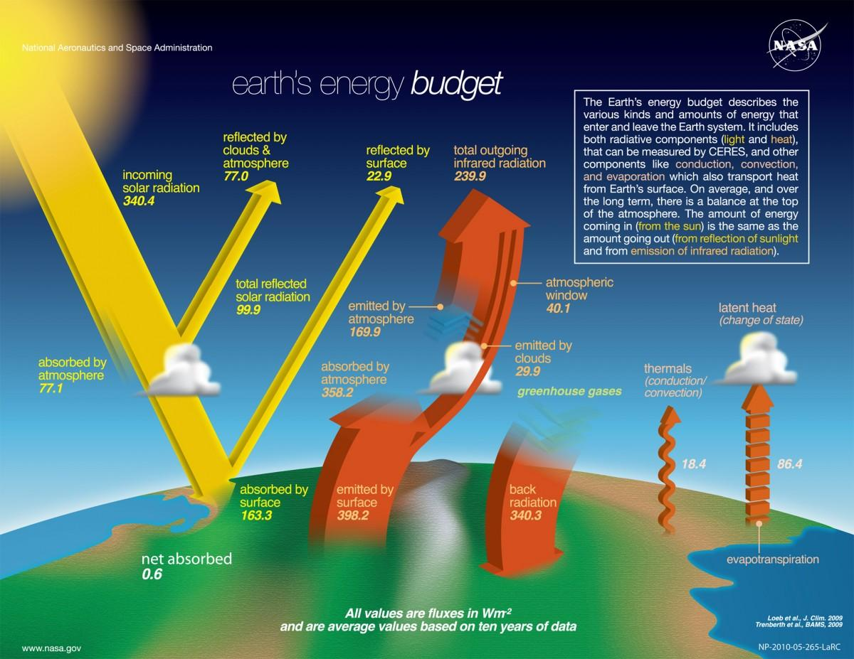
Engaging the audience
What is Global Warming?
Definition:
Global warming refers to the long-term rise in Earth's average surface temperature due to human activities, primarily the burning of fossil fuels, which increases greenhouse gas concentrations in the atmosphere.
The greenhouse effect traps heat in the atmosphere, leading to warmer global temperatures.

Slide 4
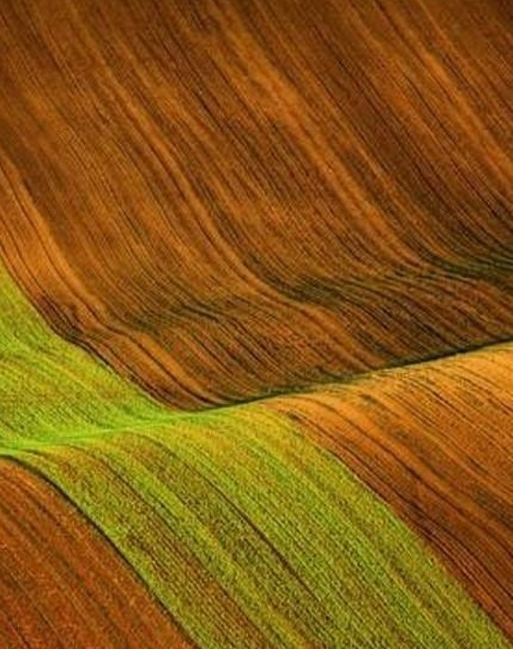
What is Depletion of Natural Resources?
Definition and Explanation:
Natural resource depletion refers to the consumption of resources faster than they can be replenished. This includes both renewable resources (like water, forests, and fish) and non-renewable resources (like fossil fuels and minerals).
Overuse and exploitation lead to scarcity, environmental degradation, and loss of biodiversity.

Slide 5
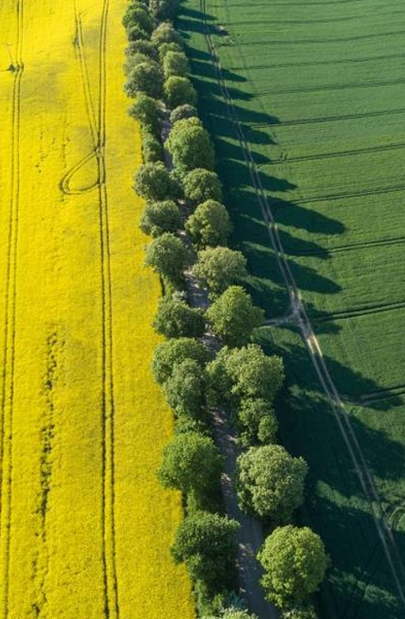
Relationship Between Global Warming and Resource Depletion:
Depleting forests and fossil fuel reserves contribute to increased carbon dioxide levels, a major greenhouse gas.
Mining, deforestation, and other resource extraction processes also release significant amounts of carbon dioxide and methane, further exacerbating global warming.
Overfishing and water pollution disrupt ecosystems, making them less resilient to climate change.

Slide 6

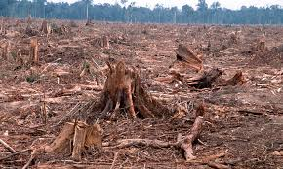
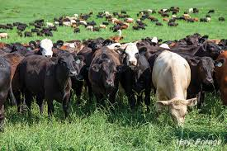
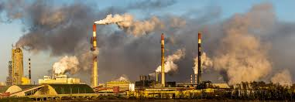
Causes of Global Warming
Greenhouse Gas Emissions: Primarily from burning fossil fuels for electricity, heat, and transportation.
Deforestation: Reduces the number of trees that absorb CO2, increasing atmospheric carbon levels.
Agriculture: Livestock farming produces methane, a potent greenhouse gas.
Industrial Activities: Manufacturing and chemical production release various pollutants into the atmosphere.

Slide 7

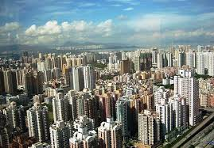
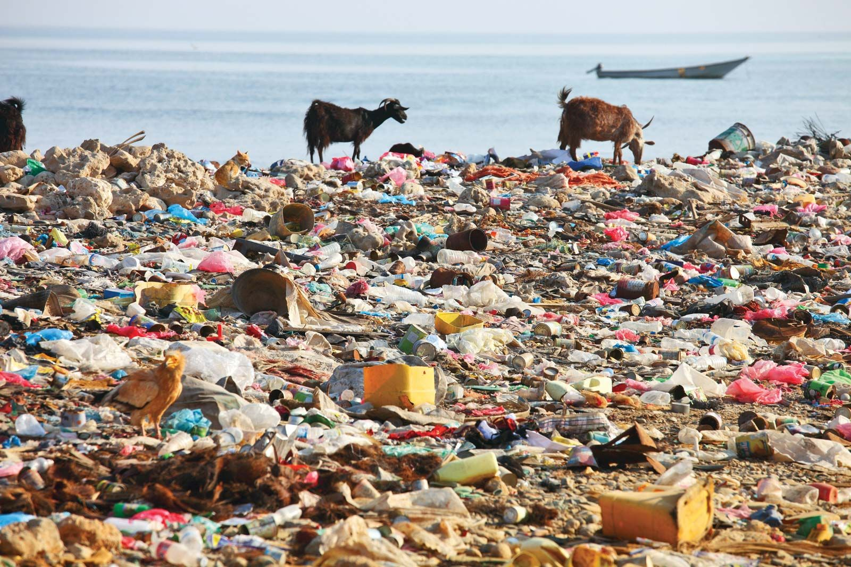
Causes of Resource Depletion
Overpopulation: More people lead to higher consumption rates of resources like water, food, and energy.
Economic Development: Increased industrialization and urbanization require more natural resources.
Over-exploitation: Practices like overfishing, deforestation, and mining exceed the rate at which nature can replenish resources.
Pollution: Contaminates soil, water, and air, making resources unusable and harming ecosystems.

Slide 8
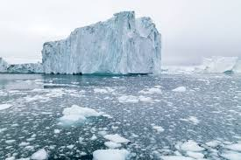
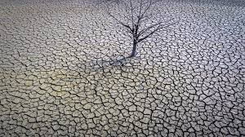
Effects of Global Warming:
Rising Temperatures: Leads to heatwaves and shifts in weather patterns.
Melting Ice Caps and Glaciers: Contributes to rising sea levels, threatening coastal regions.
Increased Frequency of Extreme Weather: Such as hurricanes, droughts, and floods.
Impact on Agriculture: Altered growing seasons and reduced crop yields.
Fig: Melting Glaciers and Ice Caps
Fig: Drought and Heatwaves

Slide 9
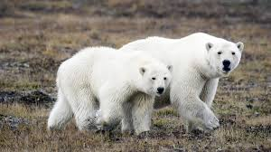
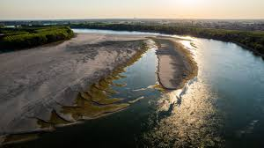
Effects of Resource Depletion:
Loss of Biodiversity: Extinction of species due to habitat destruction.
Water Shortages: Overuse of freshwater sources leading to scarcity.
Energy Crises: Diminishing fossil fuel reserves result in energy shortages
Food Insecurity: Overfishing and soil degradation lead to reduced food availability.
Fig: Polar bears outside their natural Habitats
Fig: World’s rivers are drying up

Slide 10
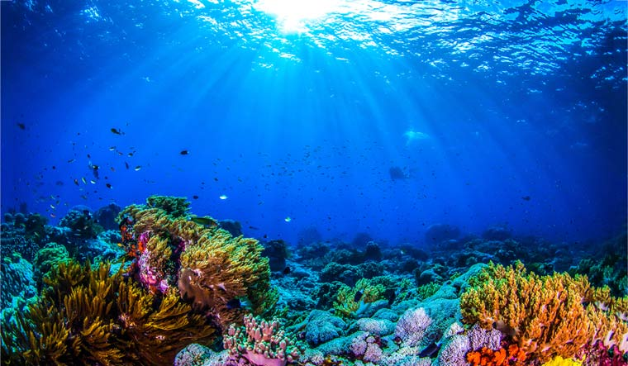
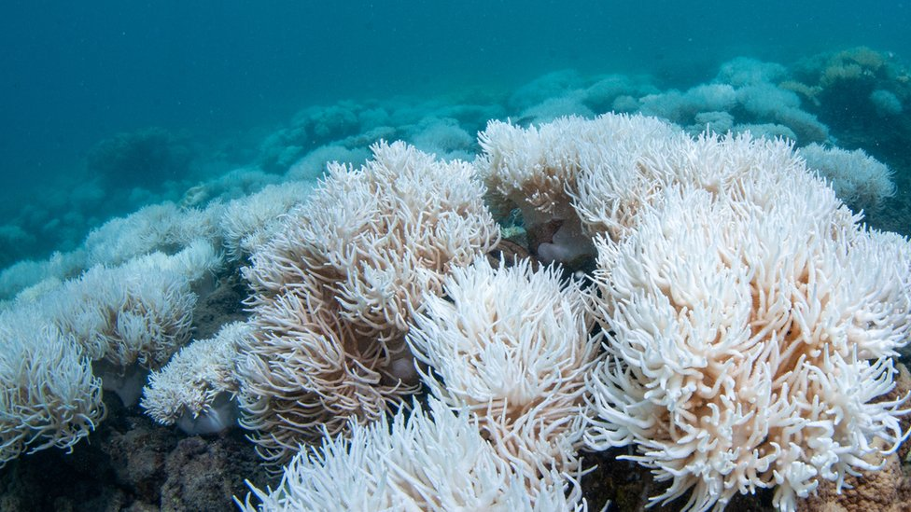
Global Warming Impact on Ecosystems:
Coral Reef Bleaching: Increased ocean temperatures cause coral to expel algae, losing their color and dying.
Wildlife Habitat Changes: Species migration patterns are altered, affecting food chains and ecosystems.
Disruption of Marine and Terrestrial Food Chains: Warmer temperatures and acidification impact species at all levels.
Fig: Great Barrier reefs before bleaching
(2013)
Fig: Great Barrier reefs after bleaching
(2018)
10

Slide 11

Solutions to Combat Global Warming:
Reduce Greenhouse Gas Emissions: Implement policies to cut emissions from industries and transportation.
Renewable Energy: Invest in solar, wind, and geothermal power.
Energy Efficiency: Promote energy-saving technologies and practices.
Reforestation: Plant trees to absorb CO2 and restore natural habitats.

Slide 12

Solutions to Resource Depletion:
Recycling and Reuse: Encourage recycling programs and reuse of materials.
Sustainable Agriculture: Practices that preserve soil health and water resources.
Water Conservation: Techniques like rainwater harvesting and efficient irrigation.
Regulation and Policy: Governments should enforce regulations on resource extraction and pollution.
12

Slide 13

Expected Outcomes and Deliverables:
What Can Be Achieved?
Climate Stabilization: Reduced global warming effects.
Biodiversity Preservation: Protection of endangered species and natural habitats.
Sustainable Development: Balance between economic growth and resource use.
Improved Quality of Life: Better health, cleaner environment, and stable economies.
13

Slide 14

Conclusion:
The issues of global warming and resource depletion are urgent and require collective action.
Governments, corporations, and individuals all have roles to play in implementing sustainable practices and reducing carbon footprints.
Awareness and education are key to driving change.

