Slide 1



Play_Store
View in Power BI
Last data refresh:
16/04/2025 09:03:22 UTC
Downloaded at:
24/03/2026 03:03:50 UTC

Slide 2
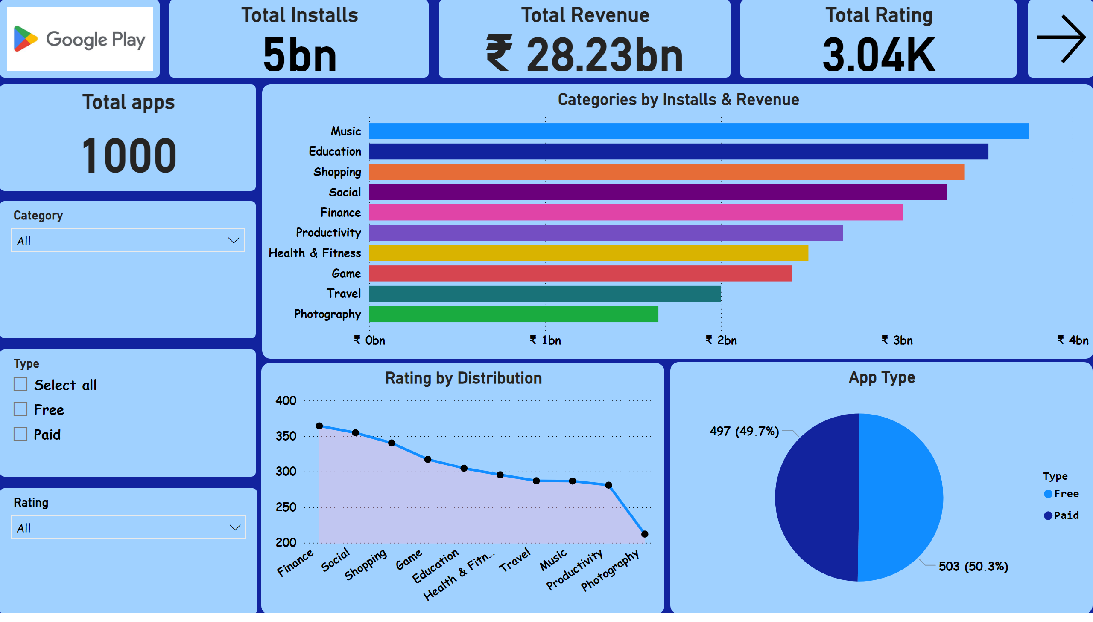
Executive Summary
Notes:
image
No alt text provided
Total apps
No alt text provided
Total Installs
No alt text provided
Total Revenue
No alt text provided
Total Rating
No alt text provided
Categories by Installs & Revenue
No alt text provided
Rating by Distribution
No alt text provided
App Type
No alt text provided
slicer
No alt text provided
slicer
No alt text provided
slicer
No alt text provided
actionButton
No alt text provided

Slide 3
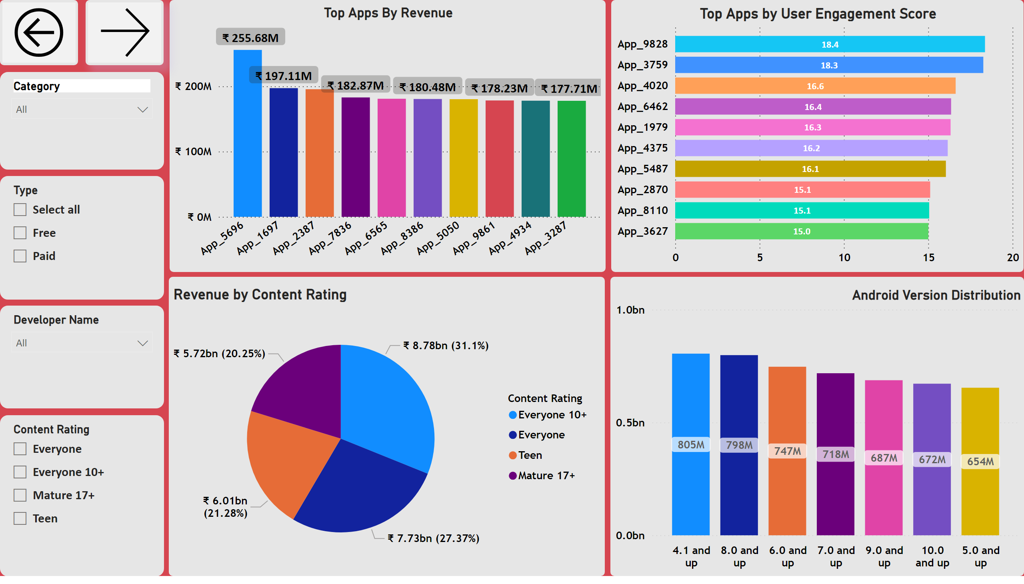
App Performance
Notes:
Top Apps By Revenue
No alt text provided
Top Apps by User Engagement Score
No alt text provided
Revenue by Content Rating
No alt text provided
Android Version Distribution
No alt text provided
actionButton
No alt text provided
actionButton
No alt text provided
slicer
No alt text provided
slicer
No alt text provided
slicer
No alt text provided
slicer
No alt text provided

Slide 4
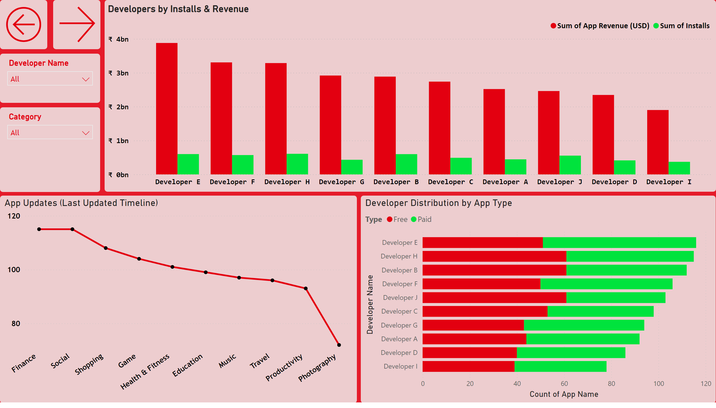
Developer Insights
Notes:
Developers by Installs & Revenue
No alt text provided
Developer Distribution by App Type
No alt text provided
App Updates (Last Updated Timeline)
No alt text provided
actionButton
No alt text provided
actionButton
No alt text provided
slicer
No alt text provided
slicer
No alt text provided

Slide 5
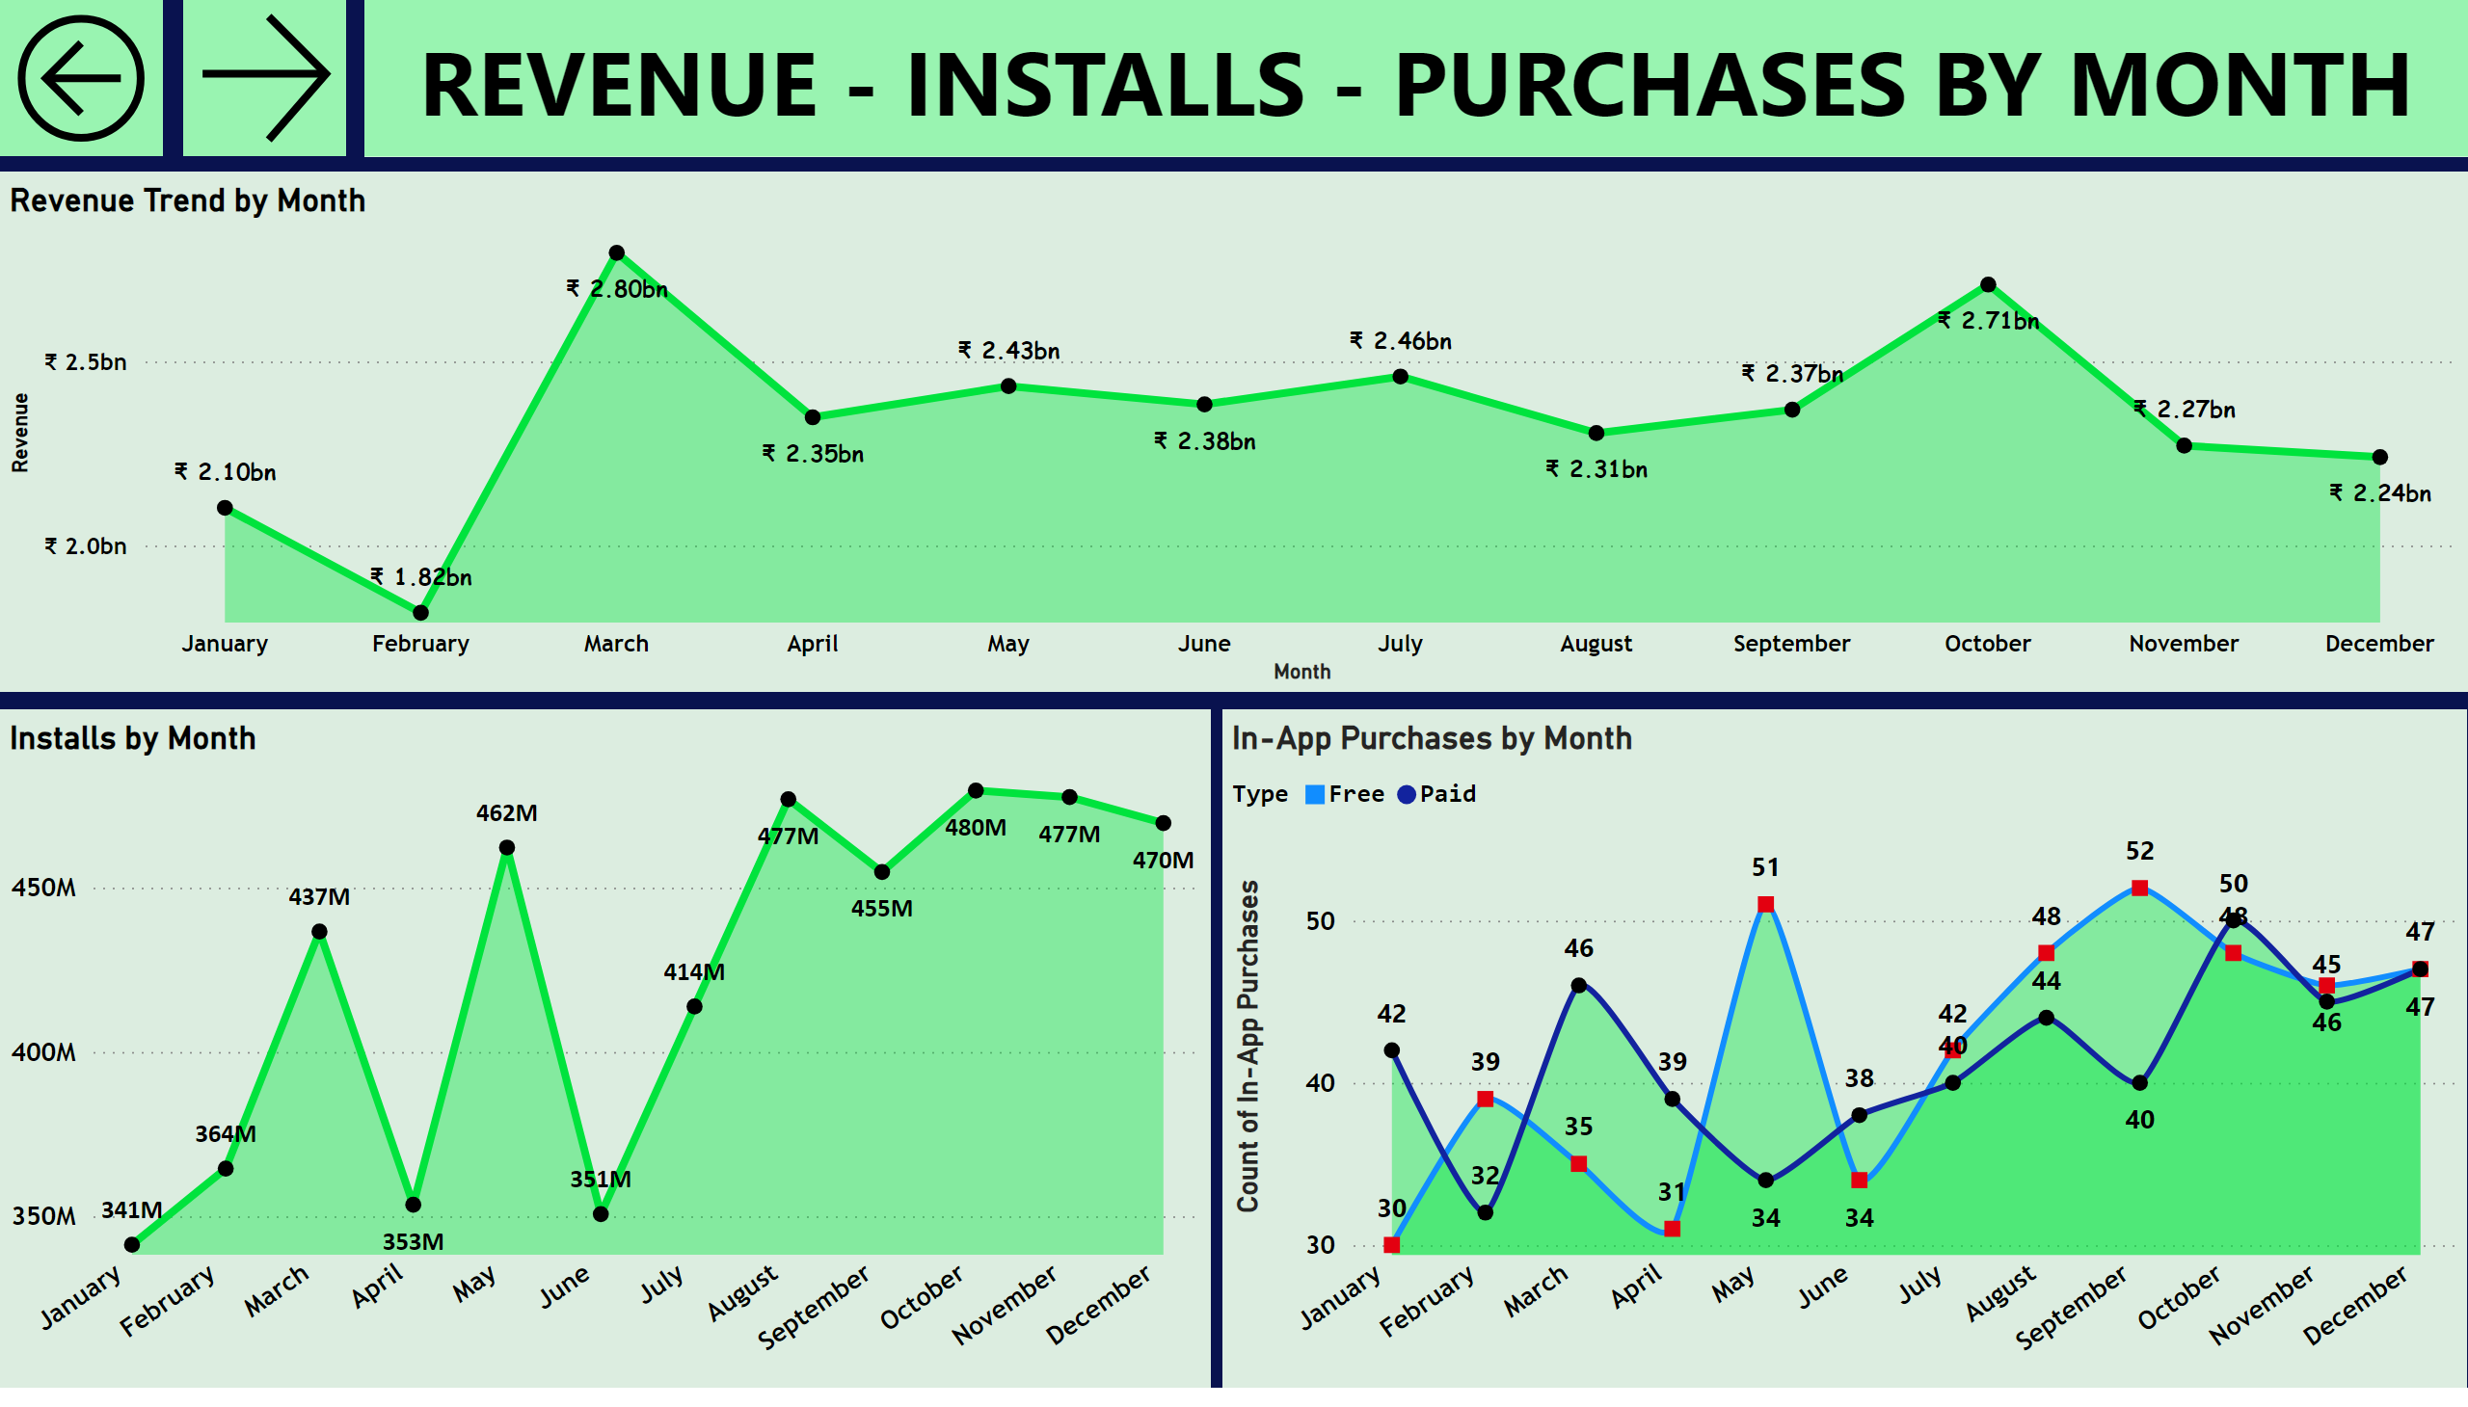
Advanced Analytics
Notes:
Revenue Trend by Month
No alt text provided
Installs by Month
No alt text provided
In-App Purchases by Month
No alt text provided
actionButton
No alt text provided
actionButton
No alt text provided
shape
No alt text provided

Slide 6
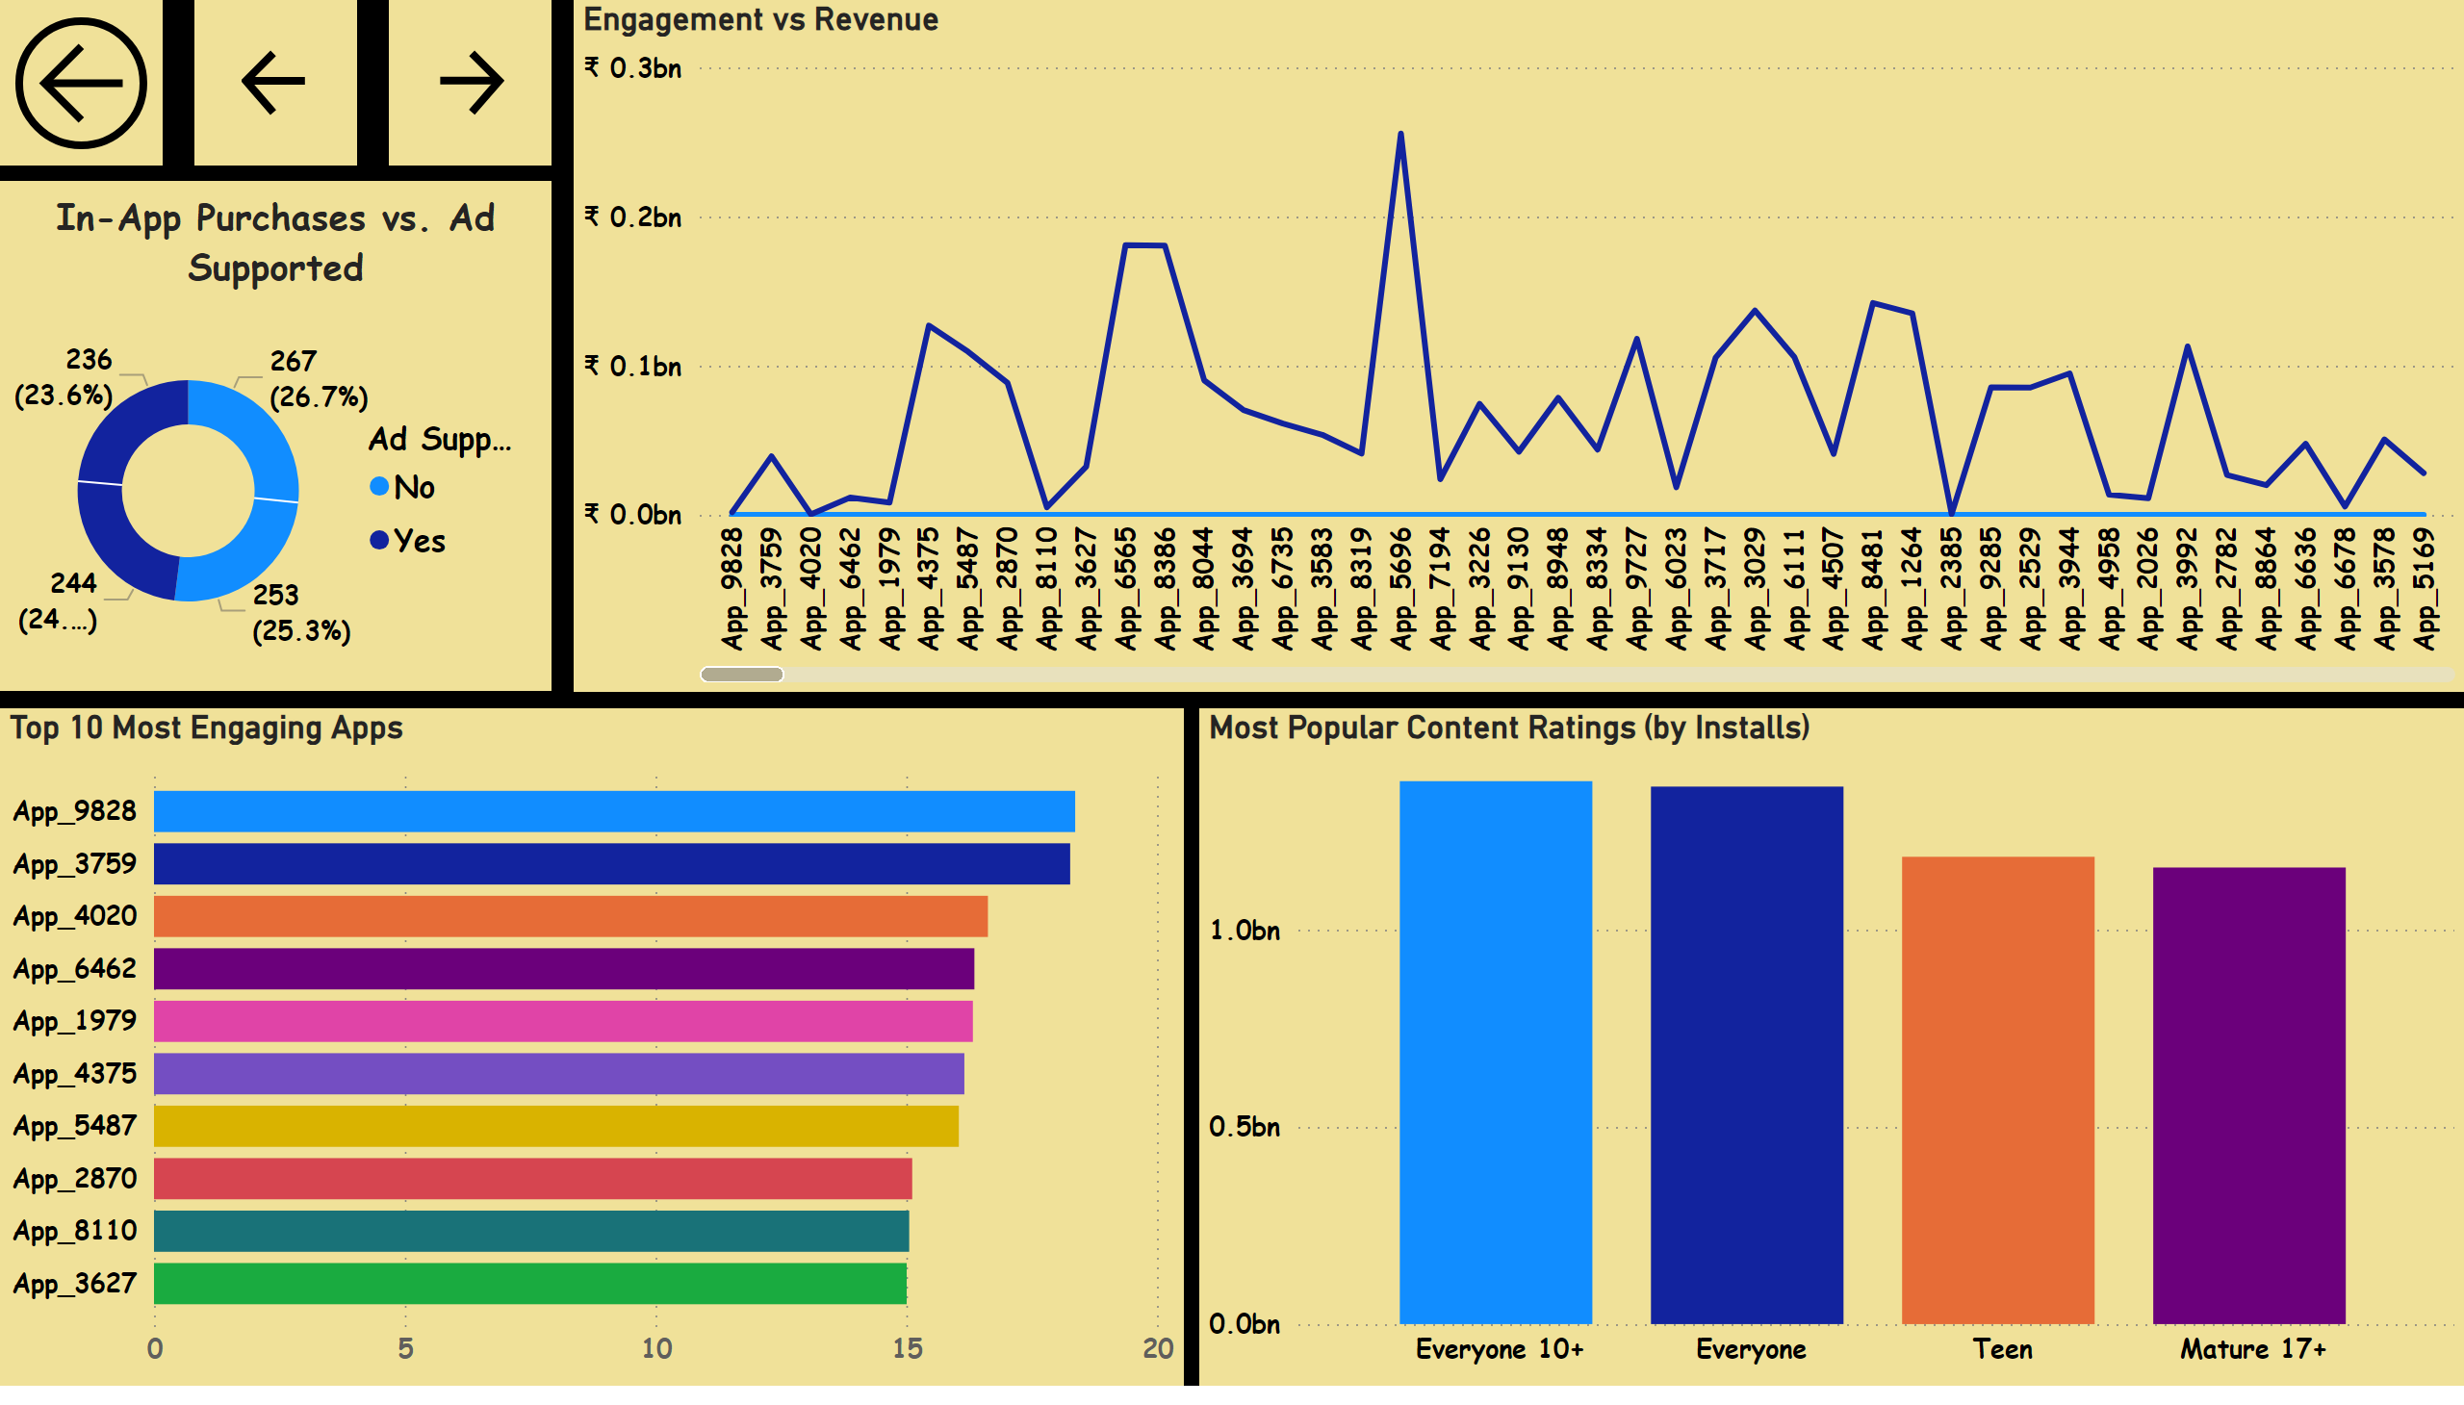
App Engagement & User Insights
Notes:
In-App Purchases vs. Ad Supported
No alt text provided
Most Popular Content Ratings (by Installs)
No alt text provided
Top 10 Most Engaging Apps
No alt text provided
Engagement vs Revenue
No alt text provided
actionButton
No alt text provided
actionButton
No alt text provided
actionButton
No alt text provided

Slide 7
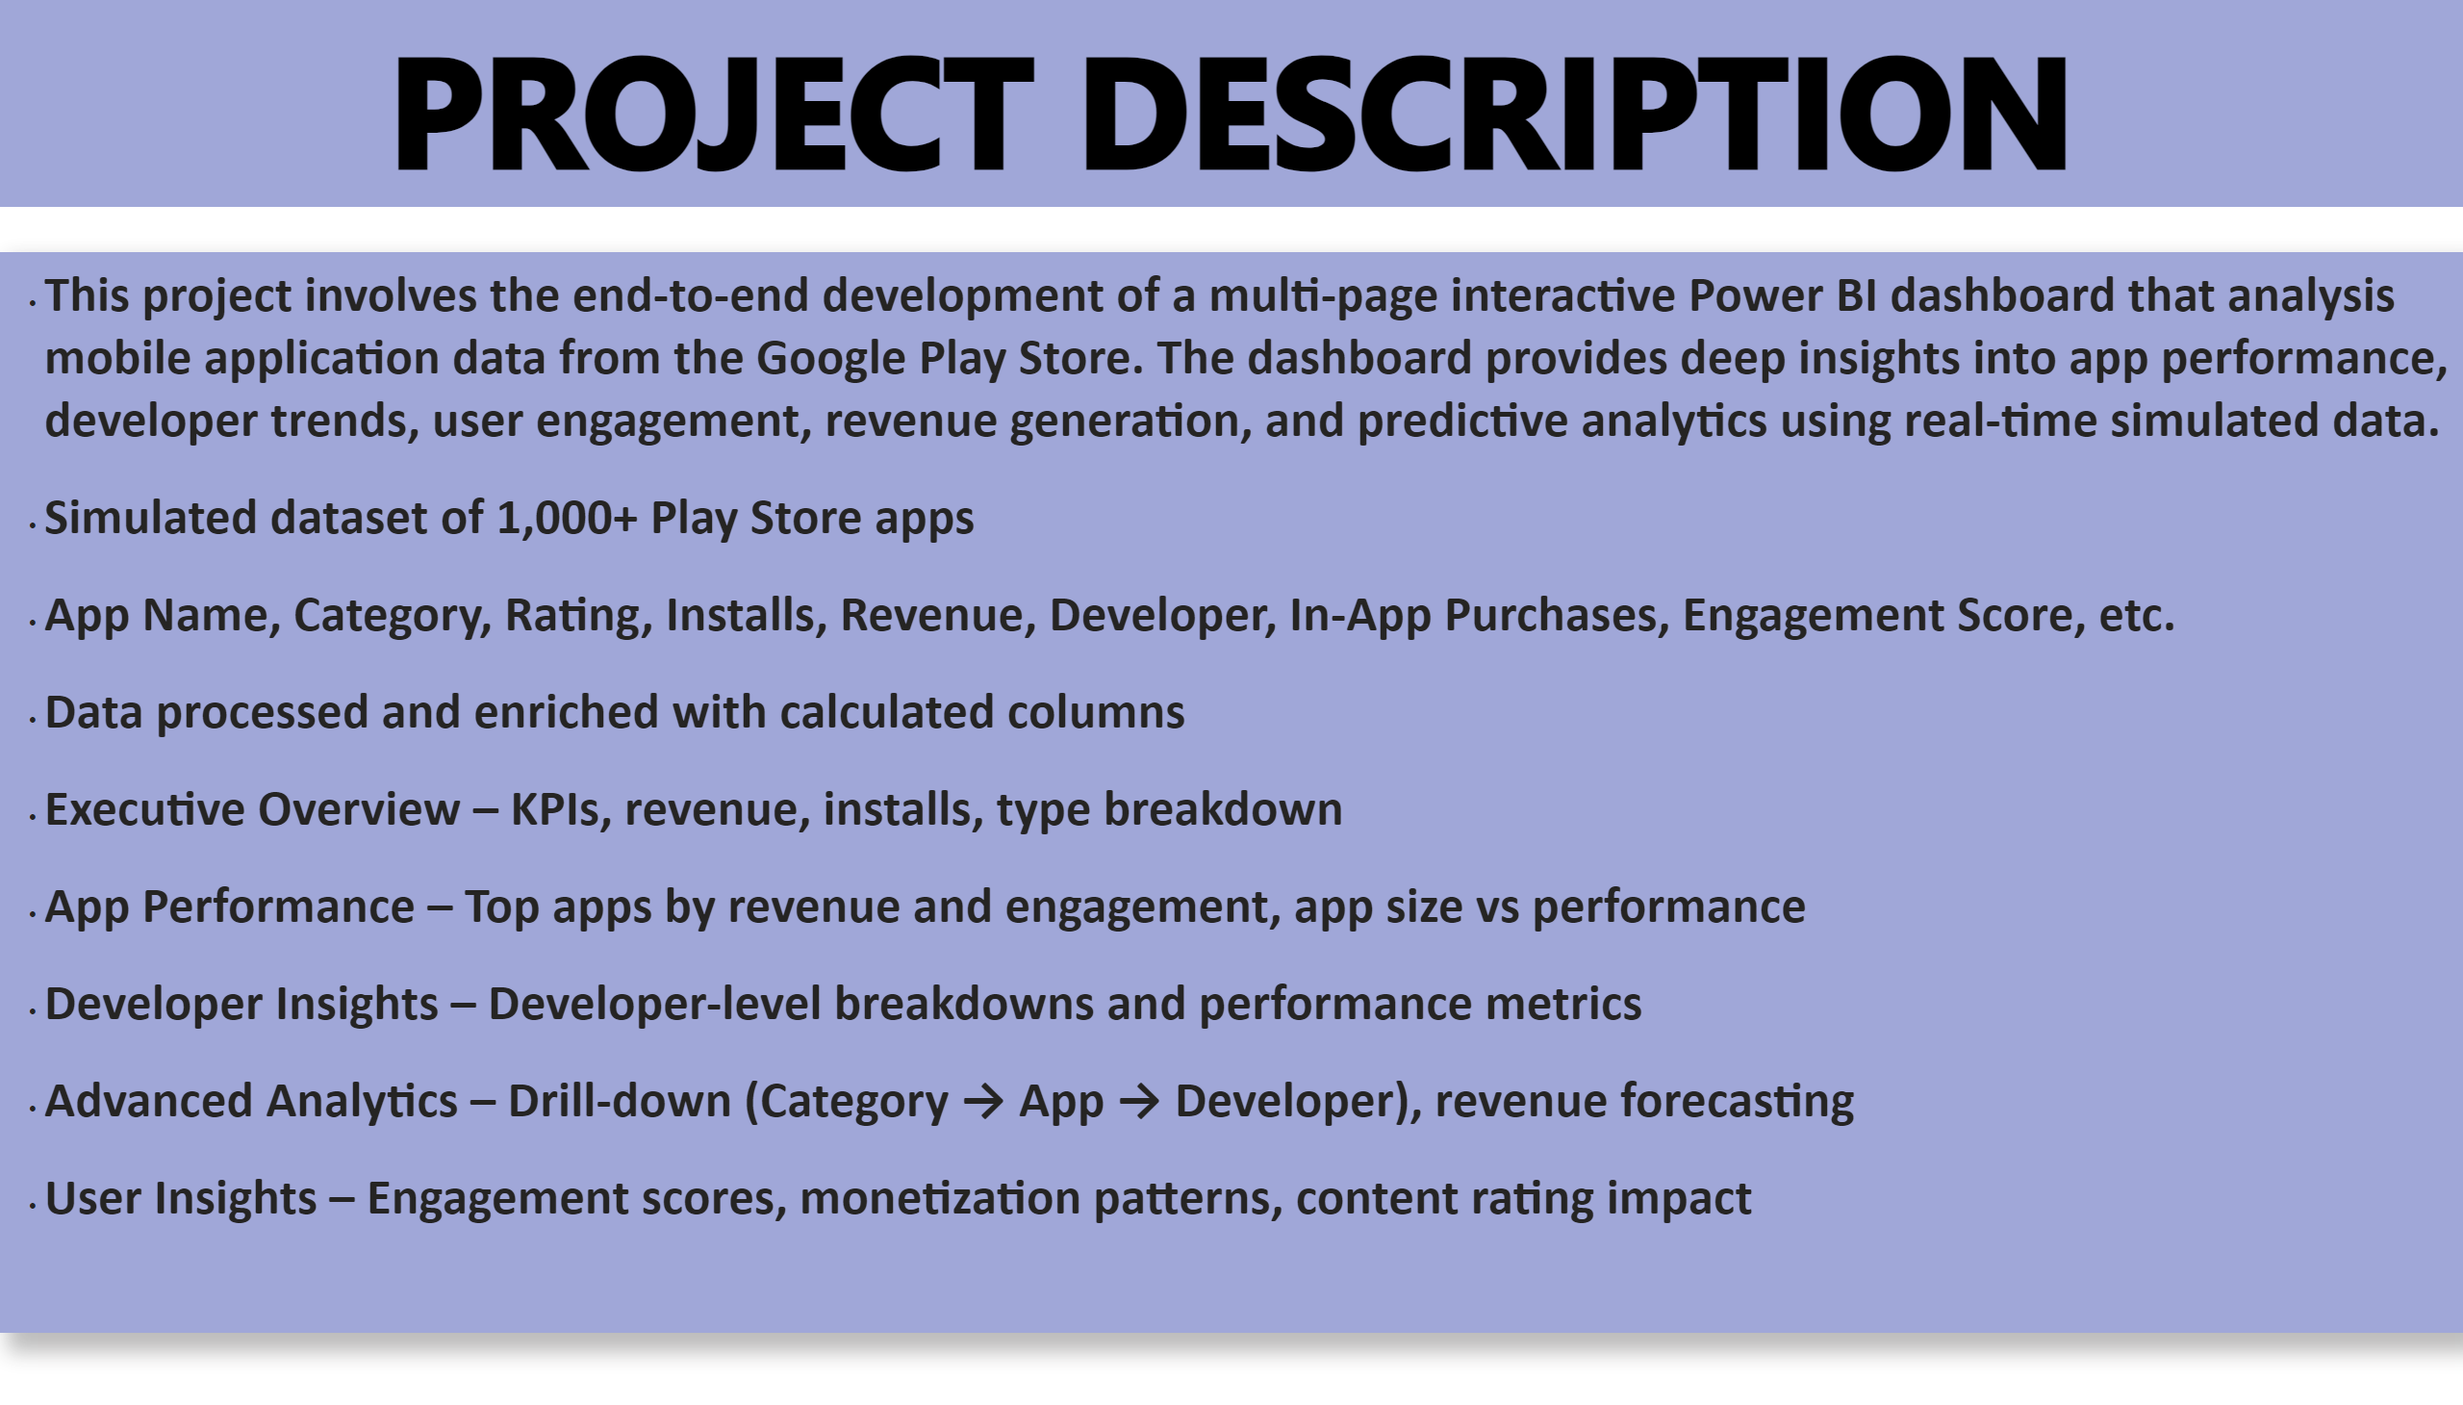
Project Description
Notes:
shape
No alt text provided
textbox
No alt text provided

