Slide 1

Who we are
My Accountant and I is an Audit and Accounting firm that specializes in financial accounting operations, auditing and reporting for Small and Medium Enterprises. Our professional experience spans over 10 years of helping businesses operate effectively through seamless, practical and comprehensible financial accounting.
We offer a wide range of professional accountancy services which include, Accounts Preparation, Bookkeeping, Tax Returns, Payroll, VAT and internal & external Auditing.
Our Mission is to help our clients grow their business by delivering quality professional accountancy services and providing them with timely and reliable reports that are of adequate standards, accurate and intelligible.
Our vision is to be the most trusted accounting and audit firm in our niche; by providing practical, impeccable and innovative services that not only contributes to our clients' success but also foster teaming relationships that positively impart all clients, stakeholders and the society at large.
At My Accountant and I utmost trust, accuracy and confidentiality are our non-negotiable values.
Our strength lies in demystifying the 'numbers' in our clients' businesses, enabling and guiding them in making the right business decisions. We know how important accurate numbers are to your business and we will help you get it right.
My Accountant and I... Know your numbers...Know your Business...Grow your Business.

Slide 2
The Founder
My Accountant and I is founded by Doris C. Ekeopara, CPA, ACCA, ICAN, CFA.
Doris Ekeopara is a seasoned chattered accountant with over 13 years of experience in financial accountancy and auditing. She is an Economics Graduate of Imo State University, a chattered member of Institute of Chartered Accountants Nigeria (ICAN), Association of Certified Chartered Accountants (ACCA) and CPA. She is an honest and greatly skilled professional with an eye for excellence, constantly leaving a trail of success in her career and professional endeavours.
She started her career at ABC in 2004 and has since then worked with several multinational and indigenous firms, including MTN, Glovescorp, Batula and Epac.
Doris founded XXX with a single goal. To be the eyes of businesses, through numbers. "You cannot be in control of a business if you don't know what is going on. With bad numbers or no numbers, a company is flying blind“.

Slide 3

Tax
When you minimize your tax liability, you maximize your income. In achieving results, we construct strategies and not just input figures.
From research to tax planning to preparation and filling for all types of business, we aim to reduce your tax liability while being fully compliant.
Our comprehensive tax administration services (including liaising with the various tax authorities) comprise
Procurement of Tax Certificates
Corporate Tax Computation & Administration,
Personal Income Tax (including PAYE) Administration,
Value Added Tax compliance and administration
Tax Audits.

Slide 4

Financial Advisory
We provide insight and advice at every stage of your business, collaborating with you to create and implement sustainable financial solutions tailored to your business.
From start-up to growth to succession, it is our aim to be a fundamental part of your financial management team by sharing our knowledge acquired over the years from helping clients run their business and organisation.
Investors, Financiers and buyers look to your financials when evaluating your business. Our advisory services in Investment management, Tax planning and Budget management will guide you through decisions with stakeholders.
Start-up assistance
Business entity selection
Financial forecast and projections
Cash flow and budgeting
Debt consulting
Profitability analysis
Business process controls and performance
Due diligence
Forensic accounting
Succession planning

Slide 5
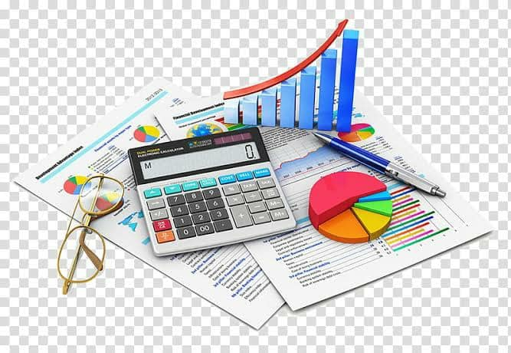
Accounts Preparation
Leave the numbers to us and let us be the accounting department for your business. Your business is your asset; we can help you manage it.
Using detailed or incomplete records made available to us we provide reliable and timely accounting information to enable you make well informed business decisions.
Accounting Solutions
Computation and preparation of periodic financial statements.
Basic accounting services such as bookkeeping.
Bank Reconciliation
Receivables and payables management
We use various accounting software in preparing financial records and statements.

Slide 6

Pay Roll
Having a good and reliable payroll system involves different functions that help you meet staff payment while keeping your business compliant with government regulations.
Comprehensive employee records
Computation of wages, salaries, bonuses and compensations
Computation and administration of taxes, insurance, and pensions.

Slide 7
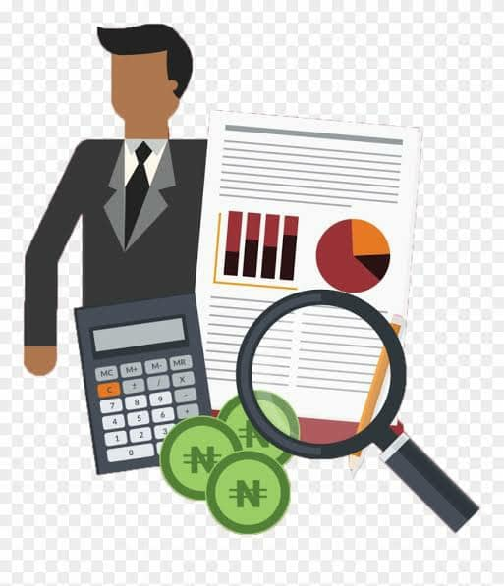
Audit
Auditing is a very complex process and auditors are a vital trust link in the financial reporting chain. We provide Non-statutory and Statutory audits in compliance with the requirements of the Companies and Allied Matters Act, and internationally accepted audit guidelines. All reports are done in International Financial Reporting Standards (IFRS) reporting environments and formats.

Slide 8
