Slide 1
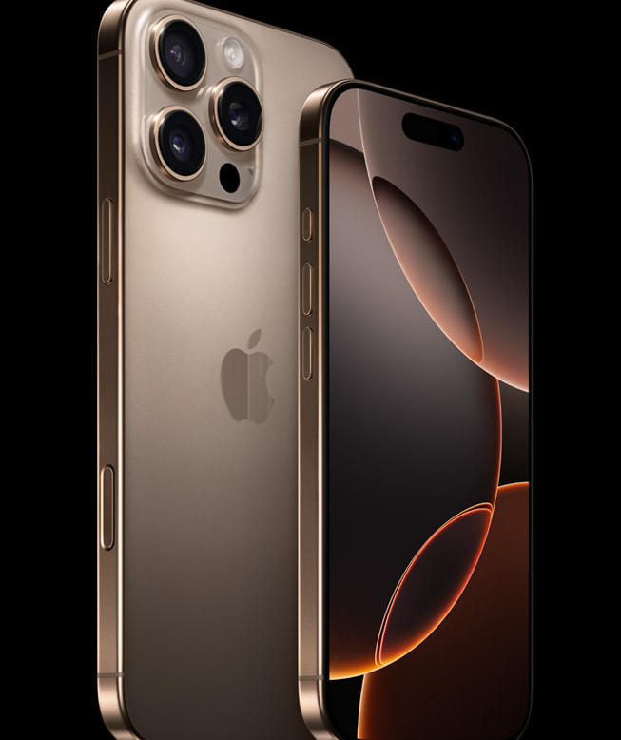
APPLE · SEPTEMBER 2024
iPhone 16 Pro
Built for Apple Intelligence.
Powered by A18 Pro.
The most advanced iPhone ever made.
Apple Intelligence
A18 Pro
Pro Camera
01 / 09
Notes:
Welcome. Today, we unveil the iPhone 16 Pro and iPhone 16 Pro Max — the most advanced iPhone ever made. Built from the ground up for Apple Intelligence, powered by the new A18 Pro chip, and featuring the most capable camera system we have ever put in a smartphone. This is not an incremental update. This is a leap.

Slide 2
PRODUCT POSITIONING
The Most Advanced iPhone Ever Made
"Powered by the faster, more efficient A18 Pro chip and built for Apple Intelligence, iPhone 16 Pro and iPhone 16 Pro Max are the most advanced iPhone models we've ever made."
— Greg Joswiak, SVP Worldwide Marketing
Apple
A18 Pro Chip
Pro Camera
Larger Displays
Battery Leap
Intelligence
02 / 09
Notes:
Let me set the stage. Greg Joswiak, Senior Vice President of Worldwide Marketing, said it best: these are the most advanced iPhone models we have ever made. What makes that claim real is the convergence of five forces — Apple Intelligence, the A18 Pro chip, a pro-grade camera system, the largest displays on any iPhone, and the biggest battery leap we have delivered. Every one of these alone would define a generation. Together, they redefine what a smartphone can do.

Slide 3
Built for Apple Intelligence
Generative models. Personal context. Privacy at the core.
Writing Tools
Siri, Reimagined
Privacy First
Rewrite, proofread, and summarize text systemwide across iOS.
Richer language understanding. New glowing edge-light design.
Private Cloud Compute flexes between on-device and server.
Adjust tone to be more friendly, concise, or professional. Clean up notes instantly. Available wherever you write.
Type when you type. Maintains context across requests. Extensive product knowledge about device features and settings.
Dedicated Apple silicon servers. End-to-end encryption. Data never stored or made accessible to Apple. Free software update.
03 / 09
Notes:
First, Apple Intelligence. This is personal intelligence — generative models that understand your context to deliver help that is genuinely relevant. Three pillars define the experience. Writing Tools let you rewrite, proofread, and summarize text systemwide. Siri is reimagined with richer language understanding, a beautiful new glowing design, and the ability to maintain context across requests. And privacy is foundational — Private Cloud Compute uses dedicated Apple silicon servers with end-to-end encryption. Your data is never stored or made accessible. Apple Intelligence arrives as a free software update.

Slide 4
A18 Pro. Unprecedented Efficiency.
Second-generation 3nm. Hardware ray tracing. Faster Neural Engine.
6-core
6-core
CPU
GPU
15% faster · 20% less power
Up to 20% faster graphics
16-core
2x
CPU
GPU
6-core
6-core
Neural Engine
Hardware Ray Tracing
Faster, more efficient
vs. previous gen — faster
NEURAL ENGINE
16-core
17%
more system memory bandwidth — highest ever in iPhone
ISP · MEDIA ENGINE
A18 PRO · 2ND-GEN 3NM
04 / 09
Notes:
Powering all of this is A18 Pro, built on second-generation three-nanometer technology. A six-core CPU delivers fifteen percent faster performance while using twenty percent less power. A six-core GPU is up to twenty percent faster. The sixteen-core Neural Engine is faster and more efficient than ever. Hardware-accelerated ray tracing is now up to two times faster. And with seventeen percent more memory bandwidth — the highest ever in iPhone — the entire system feels fluid and responsive under any load.

Slide 5
Larger Displays. Thinnest Borders Ever.
The biggest iPhone displays yet, wrapped in aerospace-grade titanium.
iPhone 16 Pro
SPEC COMPARISON
Pro Max
6.3"
6.9"
6.27" measured
Display Size
6.3"
6.9"
6.85" measured · largest ever
Super Retina XDR Always-On display ProMotion 120Hz Dynamic Island
Super Retina XDR Always-On display ProMotion 120Hz Dynamic Island
Panel
Super Retina
Super Retina
Refresh Rate
ProMotion
ProMotion
Always-On
✓
✓
128GB from $999
256GB from $1,199
Pro
Pro Max
Thinnest borders
on any Apple product
05 / 09
Notes:
Now, the displays. iPhone 16 Pro features a six-point-three-inch display, while iPhone 16 Pro Max boasts a six-point-nine-inch display — the largest ever on an iPhone. Both feature Super Retina XDR with Always-On and ProMotion. And the borders? They are the thinnest on any Apple product, wrapping these massive displays in aerospace-grade titanium. Whether you choose Pro or Pro Max, you are getting the most immersive viewing experience we have ever built.

Slide 6
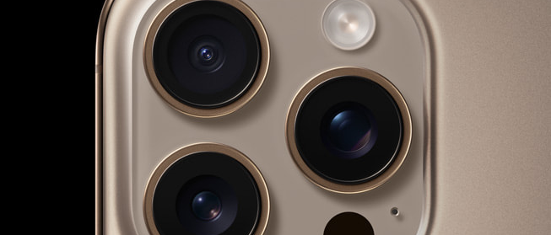
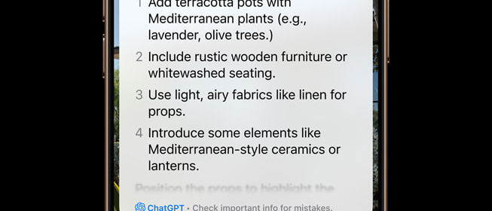
Camera Control. A New Way to Shoot.
Tactile hardware-software integration — click, press, slide — puts everything at your fingertip.
New capacitive sensor on iPhone 16 Pro
Visual Intelligence — click and hold to identify
Click
Light Press
Slide
Tactile switch launches camera, takes photo, starts recording.
High-precision force sensor — access zoom, exposure, depth of field on the fly.
Capacitive sensor — slide finger to adjust settings, compose the perfect shot.
Physical button — precise, responsive, silent
06 / 09
Notes:
Next, something entirely new: Camera Control. This is a tactile button that integrates a physical switch, a high-precision force sensor, and a capacitive slider. Click to launch the camera or take a photo. Light press to access zoom, exposure, and depth of field controls. Slide your finger to fine-tune settings and compose the shot. Coming this fall, a two-stage shutter locks focus and exposure independently. And coming later, Visual Intelligence lets you click and hold to identify objects, places, and restaurants — your gateway to third-party tools like Google and ChatGPT.

Slide 7

Pro Camera. Redefined.
48MP Fusion · 48MP Ultra Wide · 5x Telephoto · 4K120fps Dolby Vision
PRO CAMERA FEATURE
iPhone 16 Pro
Pro Max
Photography
48MP Fusion Camera
✓
✓
48MP Ultra Wide (autofocus)
✓
✓
5x Telephoto (120mm equiv.)
✓
✓
Photographic Styles (real-time)
✓
✓
Shot on iPhone 16 Pro — 48MP Fusion
48MP Fusion
Video & Audio
2x faster sensor readout
4K120fps Dolby Vision
✓
✓
4K120fps Dolby Vision
Studio Mics + Audio Mix
✓
✓
Cinema-quality color grading
Audio Mix
In-frame, studio, spatial modes
ProRes + Log video to external storage
Full pro workflow — record directly to USB-C SSDs
07 / 09
Notes:
The pro camera system needs no introduction — it is the world's favorite camera, and it just got significantly better. The forty-eight-megapixel Fusion camera reads two times faster with zero shutter lag. A new forty-eight-megapixel Ultra Wide with autofocus elevates macro photography. And for the first time, five-x Telephoto is available on both Pro models. On the video side, four-K at one-hundred-twenty frames per second in Dolby Vision delivers the highest resolution and frame rate ever on iPhone. Studio-quality mics with Audio Mix let you adjust sound post-capture. And ProRes recording with Log can go directly to external USB-C storage. This is a complete professional workflow in your pocket.

Slide 8
Stronger. Lighter. Greener.
Titanium design, Ceramic Shield, huge battery leap, and recycled materials.
Battery Leap
Titanium Design
Largest batteries yet in the Pro lineup. iPhone 16 Pro Max = best battery life on iPhone ever.
Aerospace-grade titanium. Strong, lightweight, premium finish.
New thermal architecture: 20% better sustained performance
Four finishes:
Black
Natural
White
Desert
Ceramic Shield
Environment
Latest generation Ceramic Shield.
25%+ recycled content
2x
tougher than glass on any other smartphone
100% recycled aluminum frame 100% recycled cobalt battery 95%+ recycled lithium — first for iPhone
Carbon neutral by 2030 · Plastic-free packaging
08 / 09
Notes:
Beyond performance, we have engineered these devices to be stronger, lighter, and greener. The Pro lineup features the largest batteries yet — iPhone 16 Pro Max has the best battery life of any iPhone ever. A new thermal architecture delivers twenty percent better sustained performance. The aerospace-grade titanium design comes in four stunning finishes. Ceramic Shield is back in its latest generation, twice as tough as any glass on competing smartphones. And on the environment: over twenty-five percent recycled content, one hundred percent recycled aluminum frame, one hundred percent recycled cobalt in the battery, and over ninety-five percent recycled lithium — a first for iPhone. We remain committed to being carbon neutral across our entire footprint by twenty-thirty.

Slide 9
PRICING & AVAILABILITY
Available September 20.
Pre-order Friday, September 13 at 5 a.m. PDT
iPhone 16 Pro
iPhone 16 Pro Max
$999
$1,199
or $41.62/mo
or $49.95/mo
128GB · 256GB · 512GB · 1TB
256GB · 512GB · 1TB
6.3" display
6.9" display — largest ever
FOUR FINISHES
Black Titanium
Natural Titanium
White Titanium
Desert Titanium
Trade-in: $180–$650 (iPhone 12+) · up to $1,000 with carrier offers
Pre-order Sept 13
09 / 09
Notes:
Finally, let us talk availability. iPhone 16 Pro starts at nine hundred ninety-nine dollars for one hundred twenty-eight gigabytes. iPhone 16 Pro Max starts at one thousand one hundred ninety-nine dollars for two hundred fifty-six gigabytes. Both are available in four finishes — Black Titanium, Natural Titanium, White Titanium, and the new Desert Titanium. Pre-orders begin Friday, September thirteenth at five a.m. Pacific. Availability begins Friday, September twentieth in over fifty-eight countries. Trade in your old device for one hundred eighty to six hundred fifty dollars in credit, or up to one thousand dollars with carrier offers. Apple Intelligence arrives as a free software update next month. Thank you.

