Slide 1
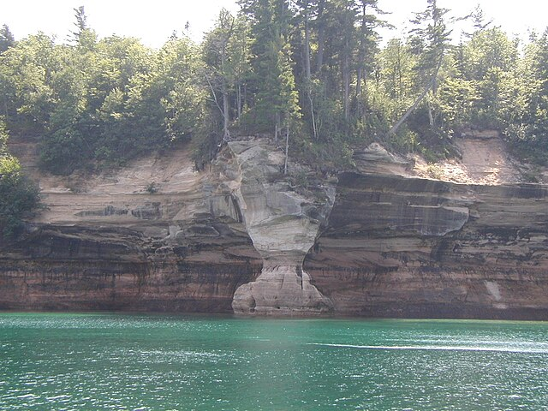
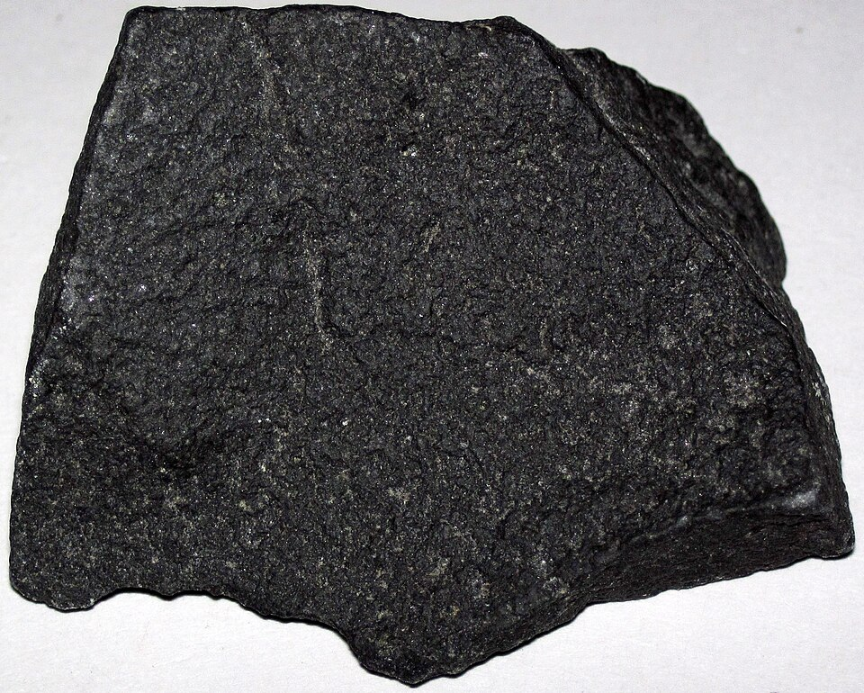
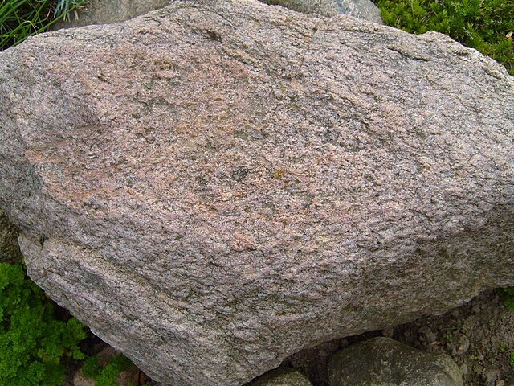
EARTH SCIENCE
Recognizing the Rock Cycle
A study of igneous, sedimentary, and metamorphic rocks
Observe texture, layering, and mineral patterns to classify rock types.
01

Slide 2
Recognize rock types by how they form
Compare origin clues: cooling from melt, layers of sediment, or transformation under heat and pressure.
Igneous
Sedimentary
Metamorphic
Forms when melted rock cools and solidifies, often from magma or lava.
Builds from layers of sand, silt, plant material, and animal remains compacted over time.
Starts as existing rock and changes underground under intense heat and pressure.
cooled melt
layered sediment
changed by pressure
02

Slide 3
The rock cycle shows how rock types transform
Rocks are created, transformed, and recycled through repeated geologic processes.
Sediments
small rock pieces
Weathering
& Erosion
Deposition
& Compaction
Igneous
melted rock cools
Sedimentary
layers compact
Heat &
Pressure
Cooling
Magma
melted rock
Metamorphic
heat + pressure
Melting
Each arrow names the process that changes one material into the next.
03

