Slide 1
Recognizing the Rock Cycle
Igneous
Sedimentary
Igneous, sedimentary, and metamorphic clues for classroom identification
Metamorphic
A study guide redesigned around formation process, texture, and evidence.

Slide 2
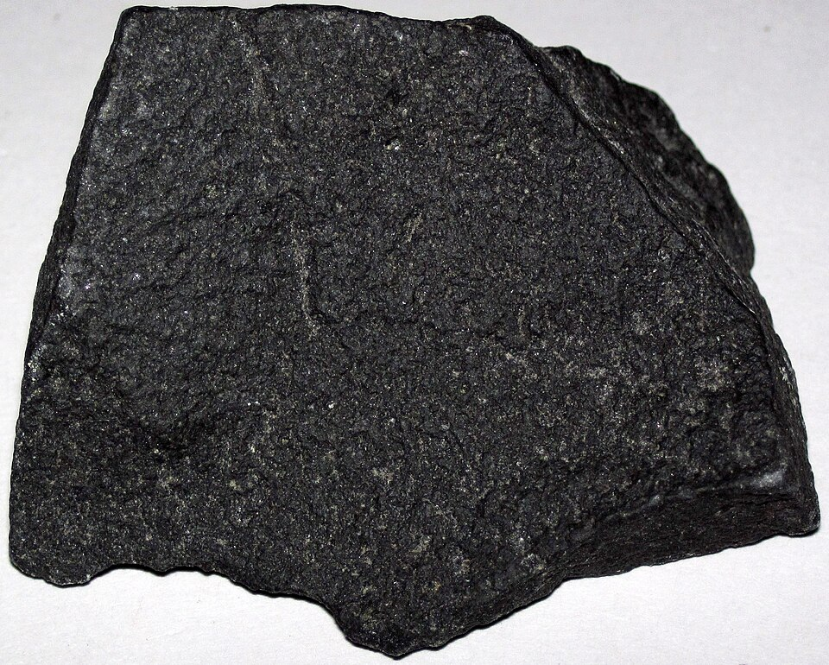
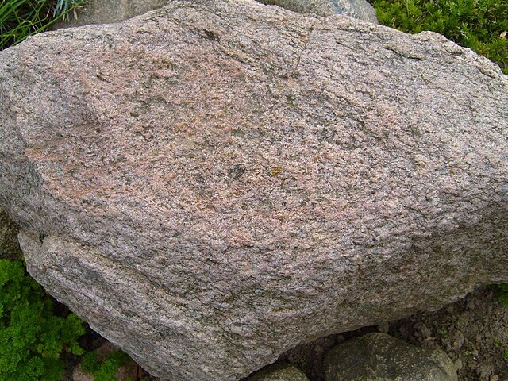
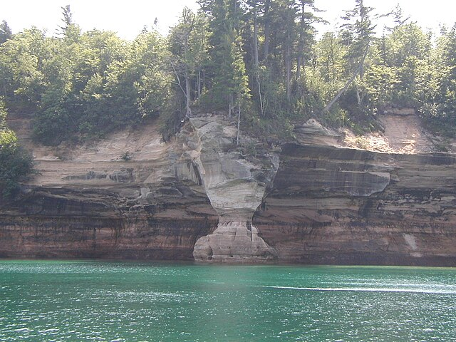
Three Rock Families
Igneous
Sedimentary
Metamorphic
Forms when magma or lava cools. Look for crystals, glassy texture, or gas bubbles.
Builds from layers of sediment, shells, or organic remains. Look for bedding and fossils.
Existing rock changed by heat and pressure. Look for bands, foliation, or recrystallized grains.
Formation clue
Formation clue
Formation clue

Slide 3
The Rock Cycle as a Process Map
Sedimentary
Igneous
Weathering + erosion
Heat + pressure
Metamorphic
Melting, cooling, crystallization
Rocks are not fixed categories. They move through a cycle as energy, pressure, water, and time reshape material.

