Slide 1
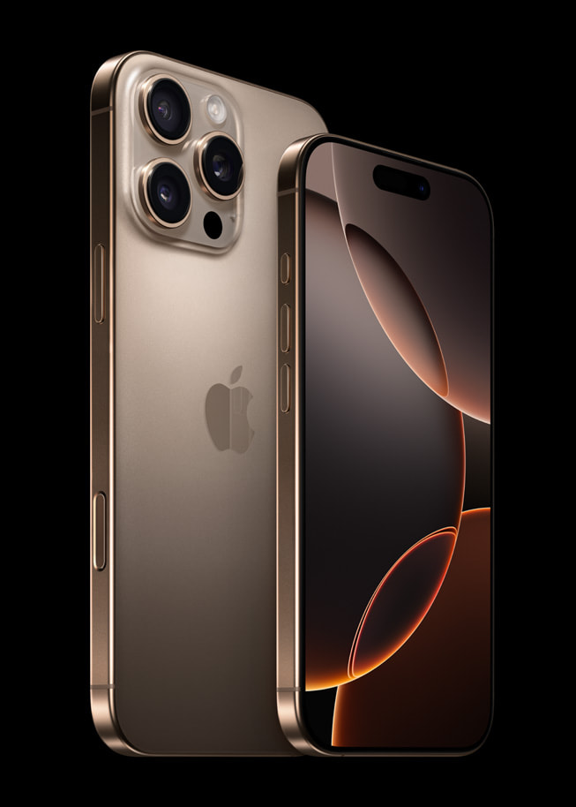
APPLE PRODUCT LAUNCH | SOURCE PDF ONLY
iPhone 16 Pro
and Pro Max
Built for Apple Intelligence and powered by A18 Pro.
Launch positioning
Apple frames the Pro lineup around intelligence,
pro camera capability, larger displays, and battery.
A18 Pro
Titanium finishes
Camera Control
Source image: Apple press release, Figure 1
01 / 09
Notes:
iPhone 16 Pro and iPhone 16 Pro Max are positioned around Apple Intelligence, A18 Pro, a more capable camera system, and premium titanium design. This deck stays inside the Apple source PDF and frames the story for consumer tech media, channel partners, and sales teams.

Slide 2
LAUNCH THESIS
02 / 09
16-core Neural Engine
Built for Apple Intelligence.
faster and more efficient for Apple Intelligence
Driven by A18 Pro.
The Pro story links personal intelligence and privacy architecture
with a chip platform built for on-device AI.
+17%
A18 Pro
GPU +20%
system memory bandwidth
2nd-generation
up to, 6-core graphics
3-nm chip
Apple Intelligence positioning
Generative models that understand
personal context
Useful, relevant assistance with privacy protections
extended through Private Cloud Compute.
CPU up to 15% faster
SOURCE CONSTRAINT
and up to 20% less power than the previous generation
First features arrive in beta next month
as a free software update.
Source: Apple press release PDF, Apple Intelligence and A18 Pro sections
Notes:
The launch thesis is that Apple Intelligence becomes more useful when it is paired with dedicated silicon and privacy architecture. The source highlights Apple-built generative models, Private Cloud Compute, and A18 Pro metrics including a faster Neural Engine, more memory bandwidth, faster GPU performance, and a more efficient CPU.

Slide 3
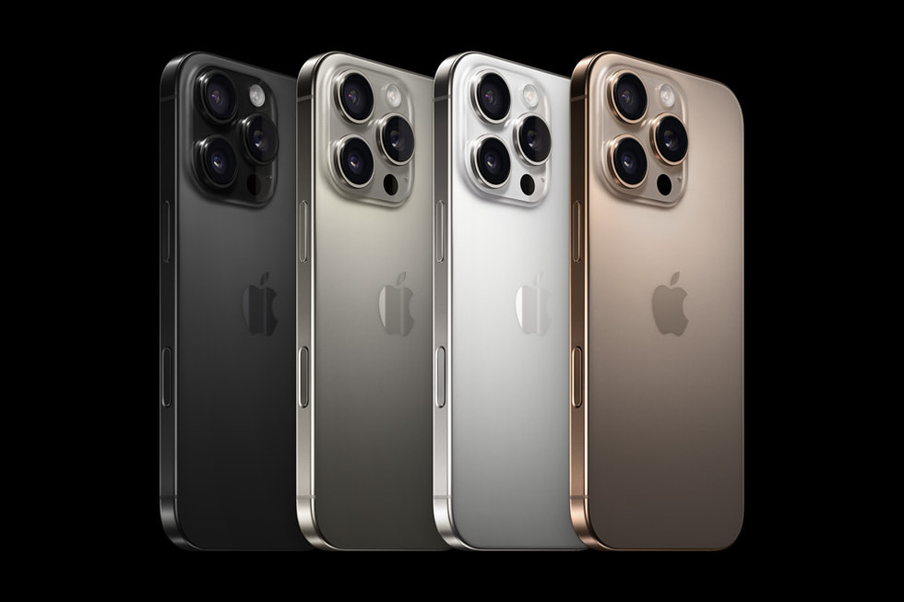
DESIGN, DISPLAY, DURABILITY
03 / 09
A larger Pro canvas in a titanium build.
Apple positions the line as a premium physical product: bigger displays, thinner borders,
more durable glass, and Pro finishes.
DISPLAY
SCREEN EDGE
6.3 / 6.9
Thinnest borders
inch Pro display sizes
on any Apple product
DURABILITY
BATTERY HEADLINE
2x tougher
Pro Max: best
Ceramic Shield vs.
iPhone battery
glass on any smartphone
life ever, per source
Source image: iPhone 16 Pro finishes from Apple press release
Finishes:
black, natural, white, and desert titanium
Source: Apple press release PDF, design and display sections
Notes:
The hardware story gives the Pro line a larger canvas and a stronger premium signal. Apple calls out the 6.3-inch and 6.9-inch displays, thinnest borders, titanium finishes, a tougher Ceramic Shield, and a battery headline that is strongest on iPhone 16 Pro Max.

Slide 4
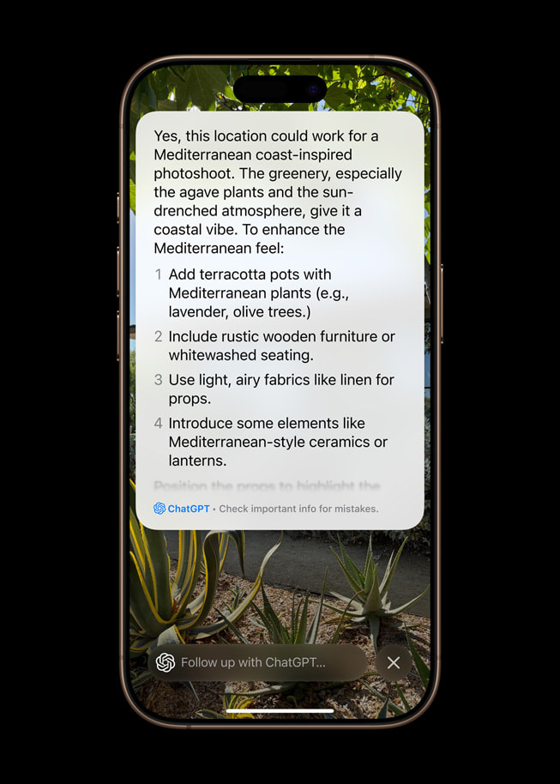
NEW INTERACTION MODEL
04 / 09
Camera Control
A dedicated way to launch the camera and capture media,
then adjust tools while staying in the shot.
Click
quickly launch camera, take photo, or start video
Press lightly
surface options like zoom, exposure, or depth of field
Slide
adjust the selected control while staying composed
COMING LATER THIS YEAR
Visual intelligence can help identify places,
events, or objects.
User-controlled third-party service access, per source.
Source: Apple press release PDF, Camera Control and visual intelligence sections
Notes:
Camera Control is the clearest interaction change in the launch narrative. It gives users a dedicated way to open the camera, capture media, surface controls such as zoom or exposure, and later connect to visual intelligence features under user control.

Slide 5
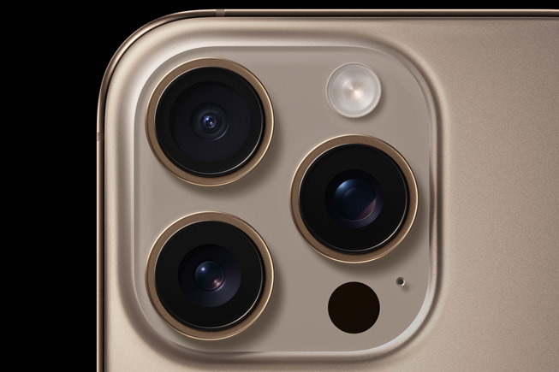


PRO CAMERA SYSTEM
05 / 09
From capture hardware to creator workflow.
The source ties the Pro lineup to higher-resolution photography, cinema-grade video,
and more flexible creative control.
Pro camera hardware
Creative capture
Pro video toolkit
48MP Fusion, 48MP Ultra Wide, and 5x Telephoto
Photographic Styles and macro-ready Ultra Wide
4K120 fps Dolby Vision and Spatial Audio capture
CAMERA CLAIMS FROM SOURCE
48MP Fusion | 48MP Ultra Wide | 5x Telephoto on both Pro models | studio-quality mics
Source: Apple press release PDF, pro camera system and video sections
Notes:
The camera section connects specifications to creator use cases. The source supports 48MP Fusion, 48MP Ultra Wide, 5x Telephoto on both Pro models, 4K120 fps Dolby Vision, studio-quality mics, Spatial Audio, and Photographic Styles.

Slide 6
PERFORMANCE + PRIVACY ARCHITECTURE
06 / 09
A18 Pro is the platform story behind Apple Intelligence.
The source pairs local silicon and generative models with server-side
Apple silicon for more complex requests.
NEURAL ENGINE
16-core
On-device
Private Cloud
when more capacity is needed
Compute
personal context
and fast local tasks
larger server-based models
MEMORY
running on Apple silicon
AI
+17%
bandwidth
CPU EFFICIENCY
WHAT SALES TEAMS CAN CLAIM
15% faster
Apple-built generative models, privacy safeguards, and A18 Pro
using 20% less power
performance gains are explicitly source-backed.
Source: Apple press release PDF, Apple Intelligence, Private Cloud Compute, A18 Pro sections
Notes:
A18 Pro is not only a speed claim; it is the platform behind the Apple Intelligence positioning. For more complex requests, the source describes Private Cloud Compute as server-based processing on Apple silicon, while simpler or more personal tasks can stay on device.

Slide 7
FEATURE COMPARISON TABLE
07 / 09
Two Pro models, one capability story.
Use this source-backed table for channel and sales enablement
without adding unsupported competitor claims.
ATTRIBUTE
iPhone 16 Pro
iPhone 16 Pro Max
Display
6.3-inch display
6.9-inch display
Starting price
$999 or $41.62 per month
$1,199 or $49.95 per month
Capacity
128GB, 256GB, 512GB, 1TB
256GB, 512GB, 1TB
Telephoto
5x Telephoto camera
5x Telephoto camera
Battery headline
Huge leap in battery life
Best battery life on iPhone ever
Finishes
black, natural, white, desert titanium
black, natural, white, desert titanium
Launch timing:
pre-order begins September 13; availability begins September 20 in first-wave markets.
Notes:
For sales and channel enablement, the comparison should stay clean and source-backed. The table compares the two Pro models on display size, starting price, capacity options, telephoto capability, battery headline, finishes, and launch timing without introducing unsupported competitor claims.

Slide 8
DESIGN + ENVIRONMENT
08 / 09
Premium design also carries
an environmental proof point.
Apple cites recycled materials, renewable electricity, and fiber-based
packaging in the iPhone 16 Pro launch source.
100%
100%
>95%
fiber
>25%
recycled aluminum
recycled cobalt
recycled lithium
based packaging
internal frame
in the battery
in the battery
recycled content
by weight, per source
APPLE 2030 CONTEXT
All Apple facilities, including data centers powering Apple Intelligence,
run on 100% renewable electricity.
Source: Apple press release PDF, environment section
Notes:
The environmental story supports the premium design message rather than replacing it. Apple cites recycled content by weight, recycled aluminum in the internal frame, recycled cobalt and lithium in the battery, fiber-based packaging, and renewable electricity across Apple facilities.

Slide 9
LAUNCH READINESS CTA
09 / 09
Lead with intelligence,
camera, and Pro design.
For launch teams, the clean pitch is source-backed: Apple Intelligence readiness,
A18 Pro, Camera Control, larger displays, and pro camera tools.
IPHONE 16 PRO
IPHONE 16 PRO MAX
$999
$1,199
or $41.62 per month
or $49.95 per month
LAUNCH WINDOW
ENABLEMENT FOCUS
Pre-order September 13; availability September 20.
Anchor demos around Camera Control, 4K120 Dolby Vision,
and Apple Intelligence availability constraints.
Source: Apple press release PDF, pricing and availability sections
Notes:
The closing message is practical for launch readiness. Lead with Apple Intelligence, Camera Control, pro camera workflows, larger displays, and source-backed pricing and availability: pre-orders begin September thirteenth, with availability beginning September twentieth in first-wave markets.

