Slide 1
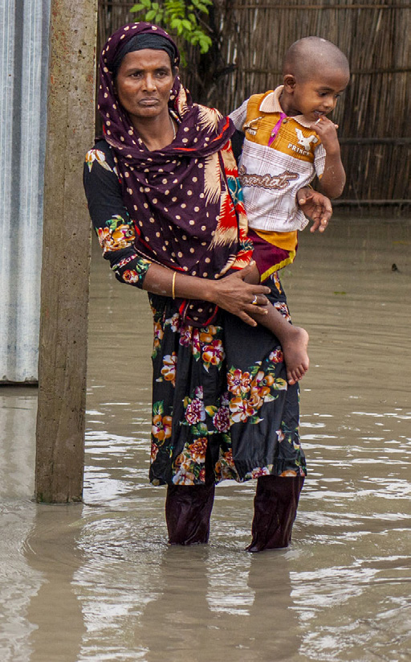
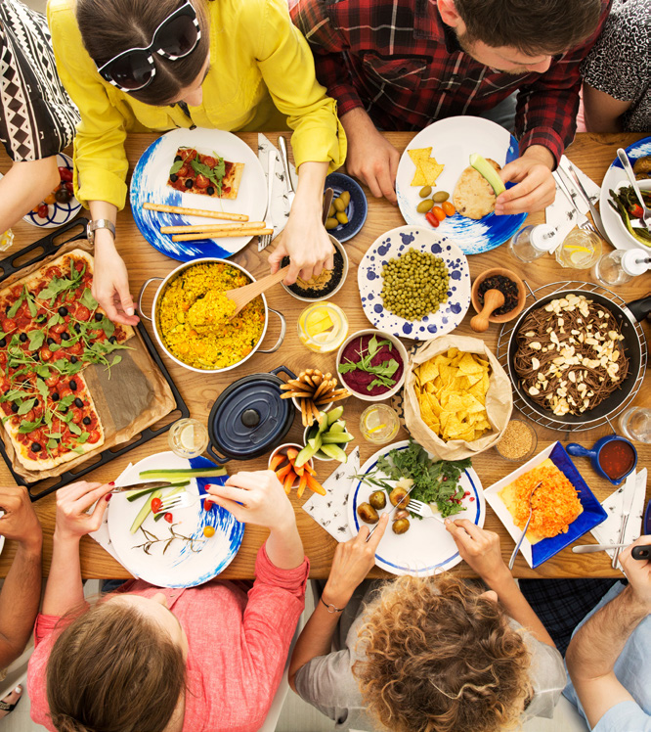
WORLD FOOD SAFETY DAY 2024
01 / 10
7 June 2024
Food safety:
prepare for the
unexpected
Campaign briefing for government, food business,
and NGO partners.
FAO / WHO communication toolkit
Campaign assets from source toolkit
Public-health tone, source-supported statistics, partner activation focus.
Notes:
This briefing is based on the FAO and WHO World Food Safety Day 2024 communication toolkit. The central theme is "Food safety: prepare for the unexpected." The audience for this deck is campaign partners who need to turn the toolkit into practical briefings, events, and communication activity.

Slide 2
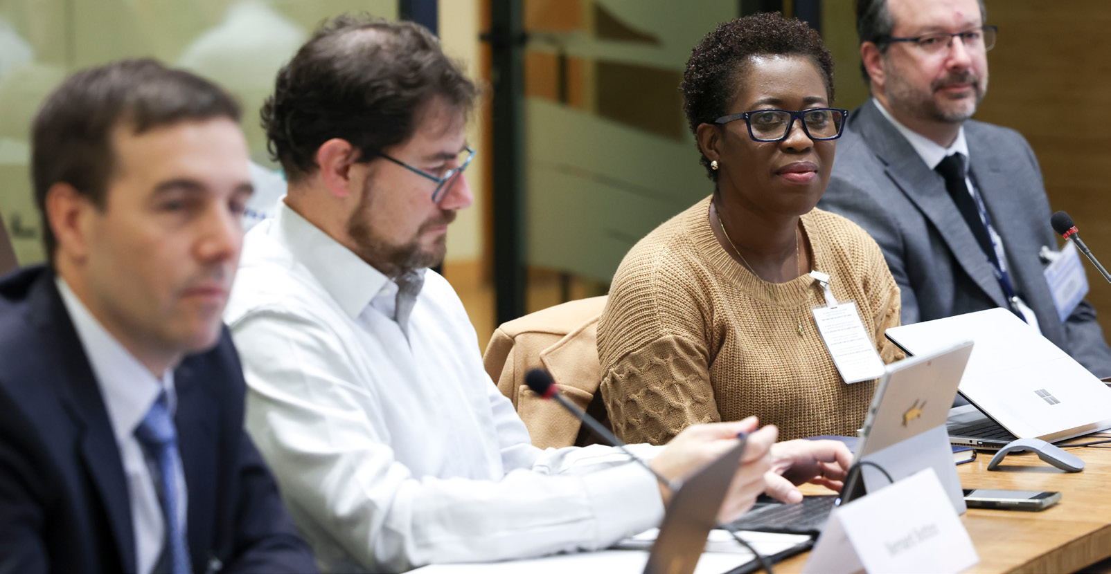
WHY TAKE ACTION?
02 / 10
Food safety emergencies affect health, learning, and work.
The toolkit frames foodborne illness as preventable when food safety
is prioritized along the chain.
600M+
420,000
people fall ill each year
deaths every year
after eating contaminated food.
from contaminated food.
Why the campaign matters
safe food enables health
people learn and work
food chains stay trusted
prevent illness
Source: World Food Safety Day 2024 communication toolkit, page 2.
Notes:
The toolkit grounds the campaign in preventable public-health harm. More than six hundred million people fall ill every year after eating contaminated food, and four hundred twenty thousand die. The campaign message is that safe food supports health, learning, work, and trust across the food chain.

Slide 3

THEME CONTEXT
03 / 10
Food safety hazards do not recognize borders.
The toolkit frames preparedness around local incidents that can become international emergencies.
Incident range named by the toolkit
Power outage
Food poisoning
Product recall
Imported outbreak
at home
local restaurant
contaminated
cross-border
Are you ready?
Preparedness focus:
avoid illness even when the unexpected intervenes.
Notes:
The 2024 theme focuses on situations where the unexpected intervenes. The toolkit names examples ranging from a power outage at home to food poisoning, product recalls, imported outbreaks, and natural disasters. The common point is that food safety hazards can move quickly across a connected supply chain.

Slide 4
TARGET AUDIENCES
04 / 10
The campaign asks every part of the food chain to prepare.
Partner briefings should keep stakeholder roles distinct and easy to activate.
Governments
Food businesses
Consumers
Partners
Prepare national
Maintain food safety
Know how to report
Translate toolkit
emergency response
management plans,
or respond to food
messages into local
plans and food control
recall procedures, and
safety incidents,
briefings, events,
systems.
consumer communication.
including at home.
and social posts.
Common frame:
food safety is a shared responsibility from producers to consumers.
Notes:
This page separates the audiences so partners can brief each group clearly. Governments focus on plans, surveillance, and communication. Food businesses focus on management plans and consumer communication. Consumers need to know how to report and respond, while partners translate the messages into local action.

Slide 5
STAKEHOLDER ACTION MATRIX
05 / 10
Preparedness roles by stakeholder group
Use this as the briefing table for partners adapting the toolkit locally.
Stakeholder
Preparedness actions
Partner briefing cue
Develop or update national emergency response plans.
Governments
Strengthen national food control systems and surveillance.
Plan, coordinate, inform
Improve communication with businesses and the public.
Improve food safety management plans.
Food businesses
Share lessons learned and act quickly during incidents.
Manage, trace, communicate
Improve communication with consumers.
Know how to report or respond to a food safety incident.
Consumers
Understand unexpected home risks and how to react.
Recognize, report, respond
Use trusted guidance during recalls or disruptions.
Source: World Food Safety Day 2024 communication toolkit, page 4.
Notes:
The stakeholder matrix is the working reference page for the briefing. It maps each group to actions from the toolkit and gives partners a short cue for how to present the role. The goal is clear division of responsibility without losing the shared campaign frame.

Slide 6
INFOSAN ROLE
06 / 10
Rapid exchange of information saves lives.
The FAO/WHO International Food Safety Authorities Network supports
information flow during food safety events.
What the toolkit says
189
2004
Authorities
INFOSAN
Food control
countries
launched
FAO/WHO network
INFOSAN facilitates rapid
exchange of information during
food safety events, enabling risk
management measures to prevent
illness and save lives.
Public info
Countries
Source: World Food Safety Day 2024 communication toolkit, page 4.
Notes:
INFOSAN is included because the toolkit uses it as the formal example of rapid information exchange. It is managed jointly by FAO and WHO and connects food safety authorities across one hundred eighty-nine countries. During food safety events, rapid exchange helps enable risk management measures that prevent illness and save lives.

Slide 7
CAMPAIGN MESSAGES
07 / 10
Message house for partner communications
Use consistent public-health messages across briefings, events, and social content.
Food safety: prepare for the unexpected
Preparedness is key
Information saves lives
Plans protect consumers
Everyone is a risk manager
National response
Fast, accurate sharing
Food producers,
Individuals, families,
plans and surveillance
among agencies,
importers, retailers,
communities, business,
systems help manage
labs, businesses, and
and distributors need
and governments all
food safety events.
partners supports action.
updated plans.
make risk choices.
Communication principle:
accurate, open, timely information maintains confidence in the food supply.
Notes:
This page turns the key messages into a message house that partners can reuse. The top line is the campaign theme, and the pillars cover preparedness, information exchange, management plans, and shared responsibility. The foundation is accurate, open, timely communication to maintain confidence in the food supply.

Slide 8
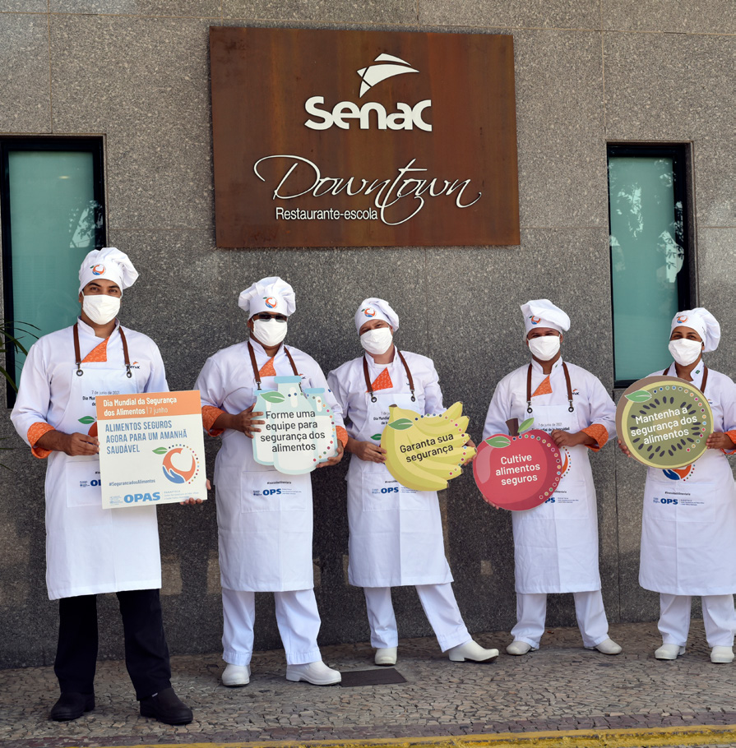
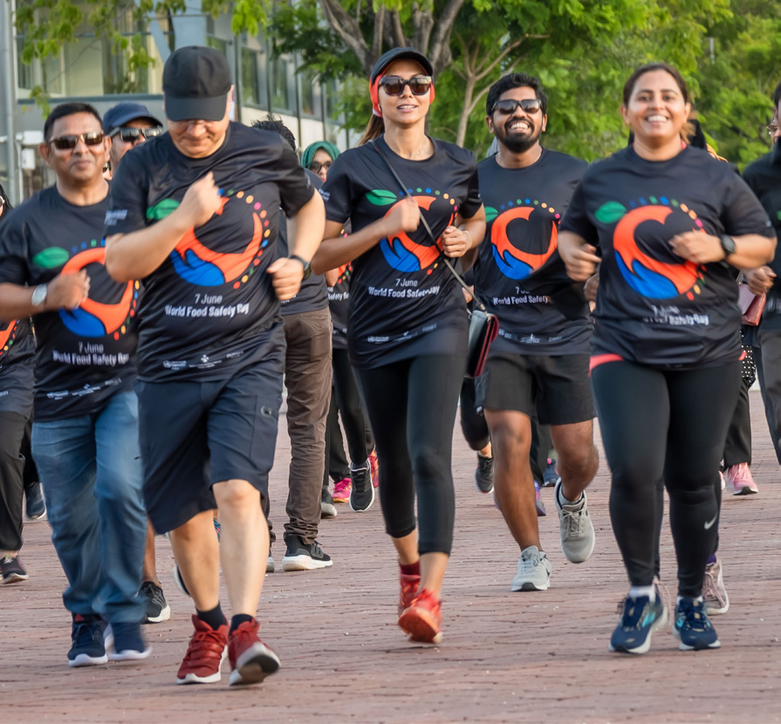
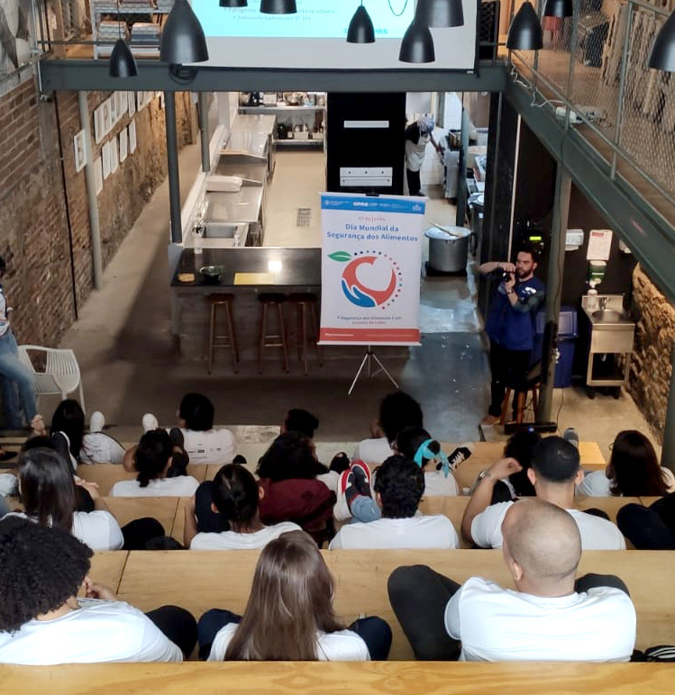

ACTIVATION IDEAS
08 / 10
Partners can activate through training, events, and official assets.
The toolkit suggests staff training, creative activities, and downloadable communication materials.
Train staff
Get creative
Use official materials
Reinforce food safety
Use competitions, exhibitions,
Poster, website, retrospective
management at work.
sports, videos, songs, or dances.
video, report, asset bank, Trello.
Source: World Food Safety Day 2024 communication toolkit, pages 7-9.
Notes:
The toolkit gives partners practical activation routes rather than only slogans. Staff training can reinforce management plans at work. Creative events can make the topic visible locally. Official posters, videos, reports, the asset bank, and the Trello board give partners ready-made material.

Slide 9
PARTNER ROLLOUT
09 / 10
Partner rollout plan around 7 June
A simple cadence turns toolkit assets into a campaign partners can execute.
Before
7 June
After
1
7
3
Brief stakeholders
Publish sample messages
Share photos and links
Localize messages
Run events or training
Document activities
Prepare asset links
Use #WorldFoodSafetyDay
Report outcomes to organizers
Toolkit asset references
Sample social frame
Website “How to participate”, retrospective video,
“Plan, prepare, act!” and “Food safety is everyone’s
2023 report, asset bank, and Trello board.
business” are source-supported partner messages.
Source: World Food Safety Day 2024 communication toolkit, pages 8-11.
Notes:
The rollout plan organizes activity before, during, and after World Food Safety Day. Before 7 June, partners brief stakeholders and prepare assets. On the day, they publish source-supported messages and run activities. Afterward, they document and share photos, links, and event news with organizers.

Slide 10
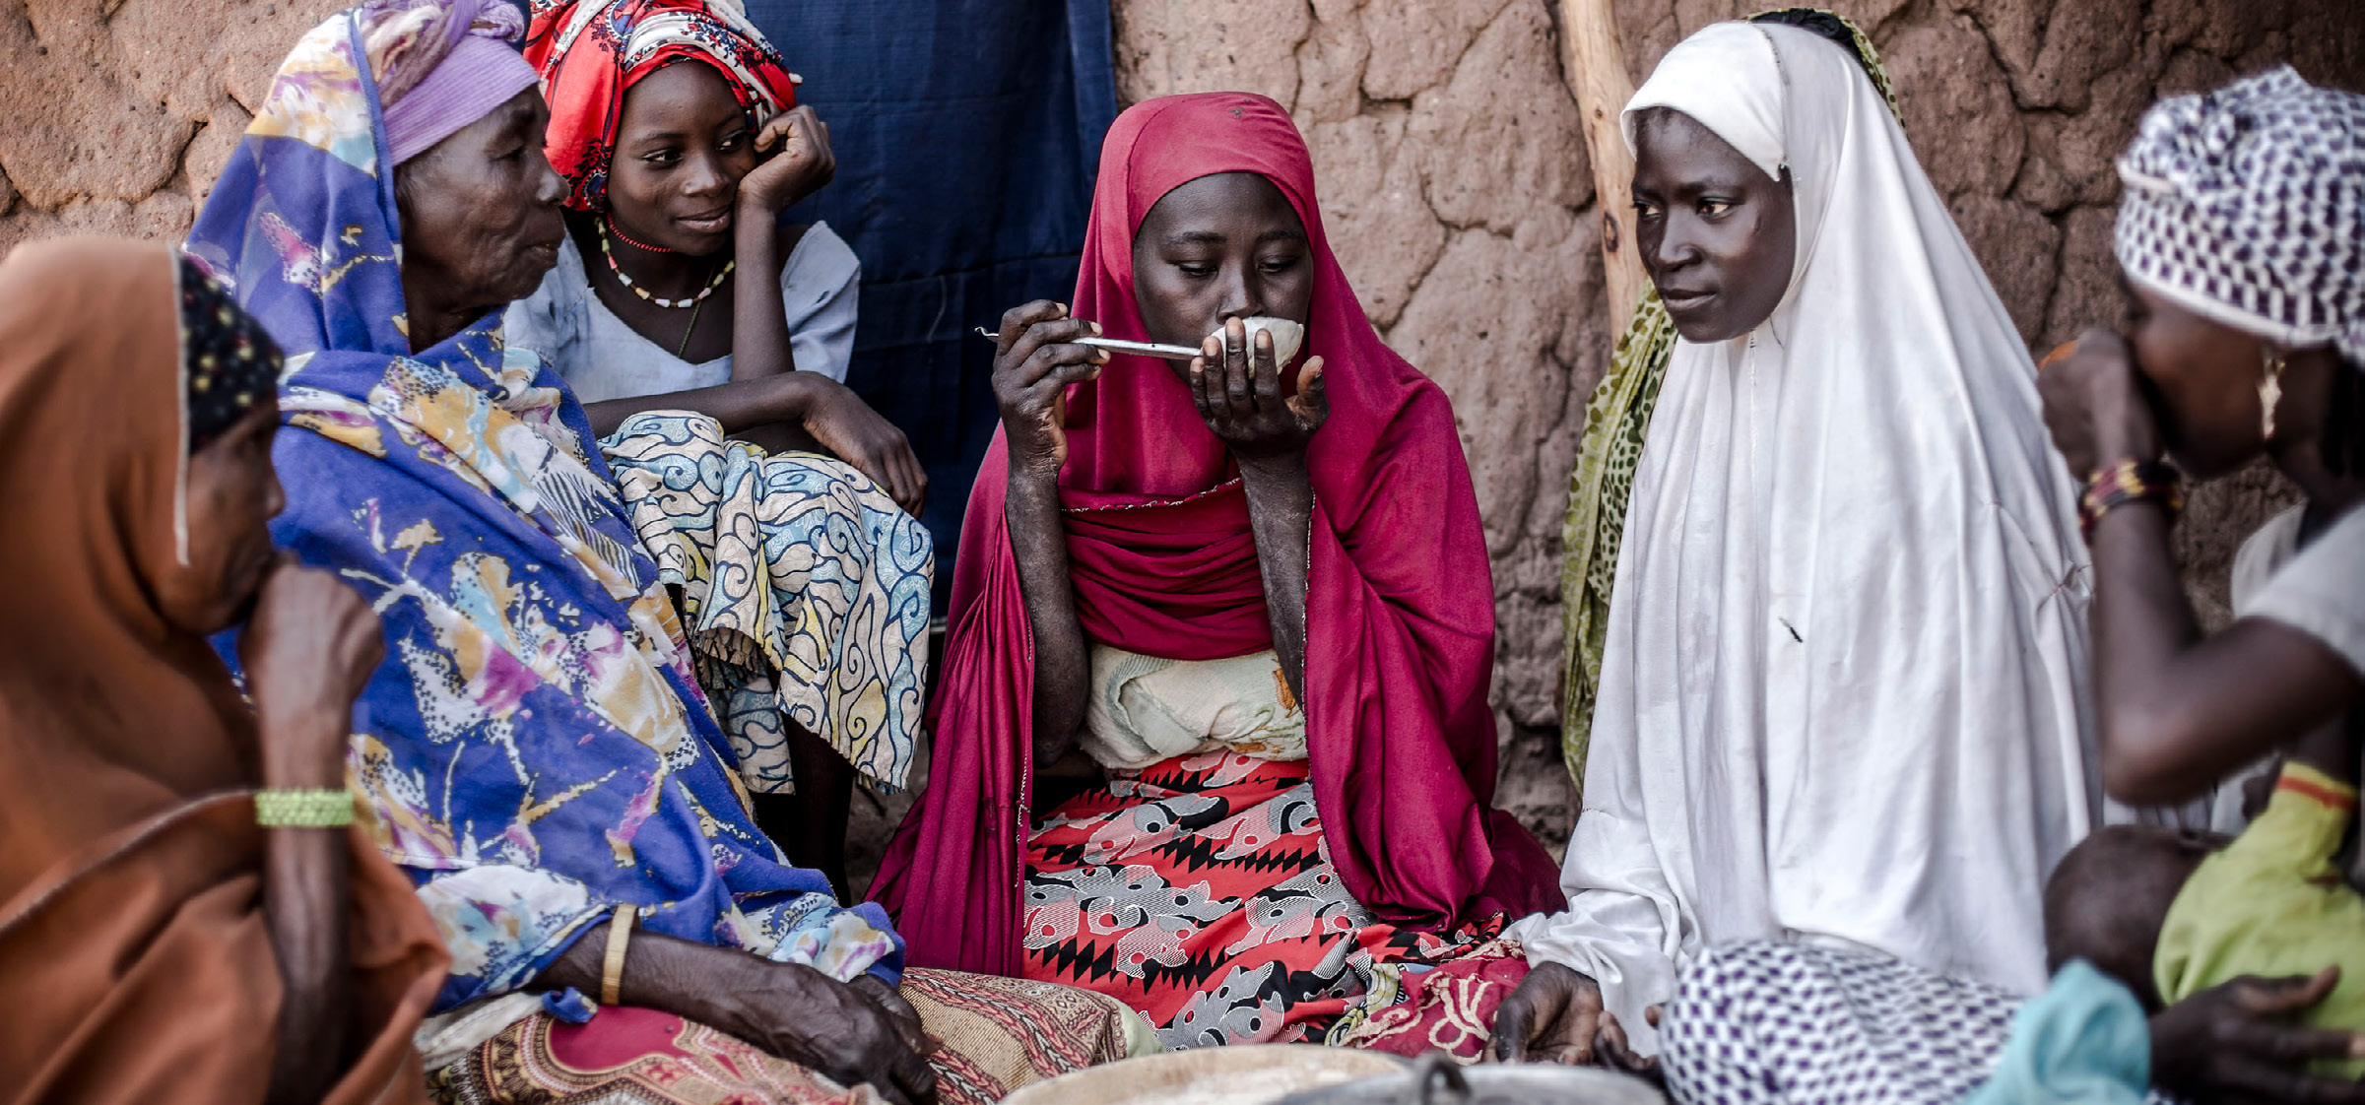
PARTNER CALL TO ACTION
10 / 10
Plan. Prepare. Act.
Use the toolkit to brief stakeholders, run local activations,
and share campaign evidence around
World Food Safety Day.
1
Confirm stakeholder briefing owners.
Organizer contact points
2
Localize toolkit messages and assets.
FAO: World-Food-Safety-Day@fao.org
3
Share event photos, video links, and news.
WHO: Foodsafety@who.int
Post event content tagging @FAOWHOCodex where relevant.
Campaign line:
Food safety is everyone’s business.
Notes:
The closing action is simple: plan, prepare, and act. Partners should confirm local owners, adapt the toolkit responsibly, share event evidence, and use the contact points provided in the toolkit. The final line returns to the campaign slogan: food safety is everyone’s business.

