Slide 1
RECOGNIZING
THE ROCK CYCLE
ROCKS
A Study of Igneous, Sedimentary, and Metamorphic Rocks
Explore how Earth's rocks form, transform, and recycle through the continuous processes of the rock cycle.
IGNEOUS
METAMORPHIC
SEDIMENTARY
Earth Science | Educational Resource

Slide 2
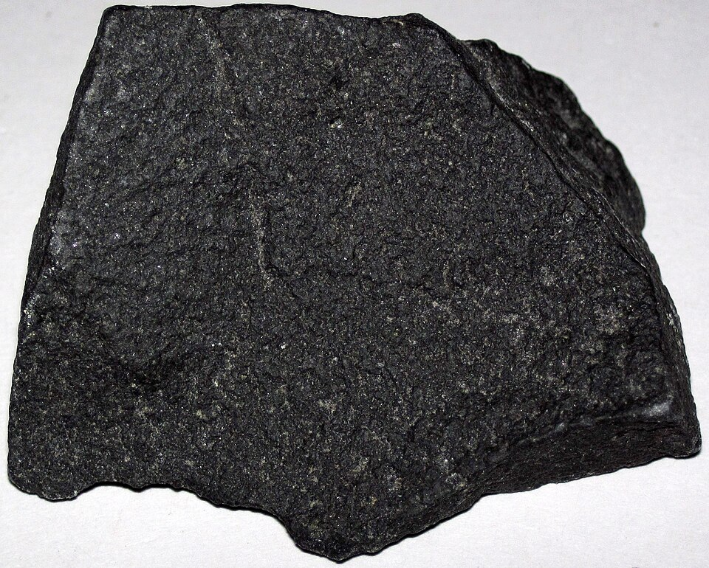
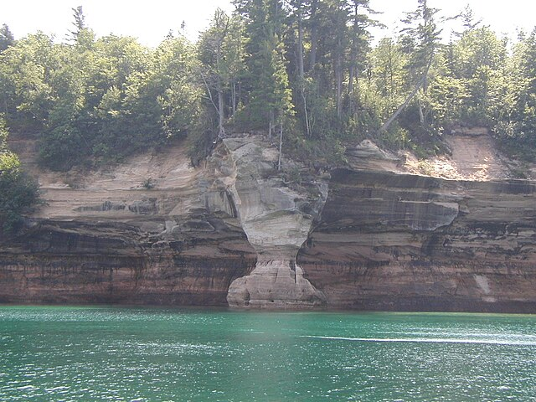
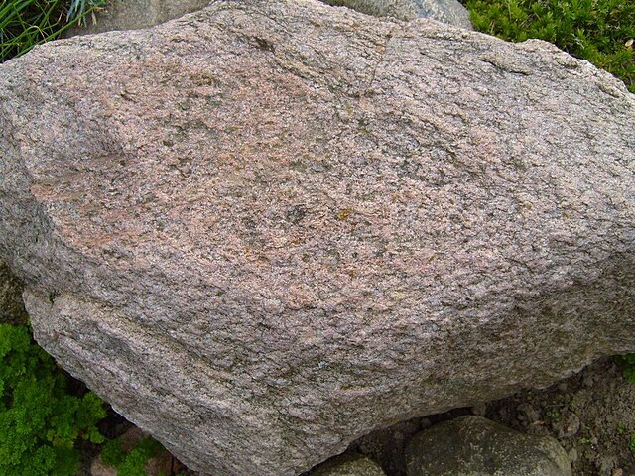
Three Types of Rocks
Igneous, Sedimentary, and Metamorphic — each formed through distinct geological processes
IGNEOUS
SEDIMENTARY
METAMORPHIC
Fire-formed
Layer-built
Heat-changed
Formed from the cooling and solidification of magma or lava deep inside the Earth.
Formed from compressed layers of sand, silt, dead plants, and animal skeletons over time.
Formed when existing rocks are transformed by extreme heat and pressure underground.
Common Examples:
Common Examples:
Common Examples:
Granite, Basalt, Obsidian, Pumice
Sandstone, Limestone, Shale, Coal
Marble, Slate, Quartzite, Gneiss
These definitions and examples should be memorized for the exam.

Slide 3
The Rock Cycle
MAGMA
Molten rock beneath surface
Cooling & Crystallization
IGNEOUS
Melting
A continuous process by which rocks are created, transformed, and recycled over geological time. Every rock on Earth can be traced through this cycle.
Heat & Pressure
Cooled from magma or lava
METAMORPHIC
Weathering & Erosion
Changed by heat & pressure
Heat & Pressure
SEDIMENT
SEDIMENTARY
Compaction & Cementation
Weathered & eroded particles
Compacted & cemented layers
Earth Science | Rock Cycle Diagram

