Slide 1
AI-based celebrity classification using CNN
Jaea Cho
CNIT 48300

Slide 2

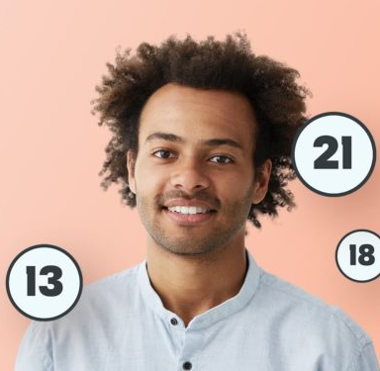
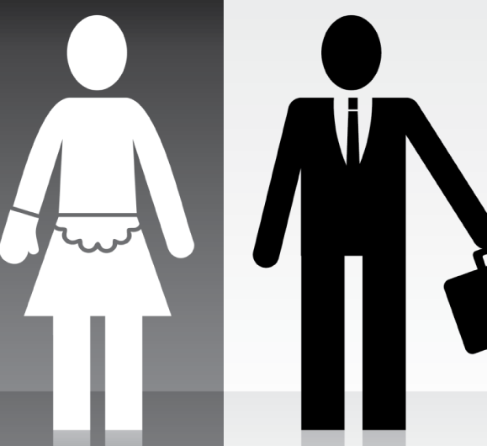
What can be determined from a person's face?
Emotions
Age
Gender

Slide 3

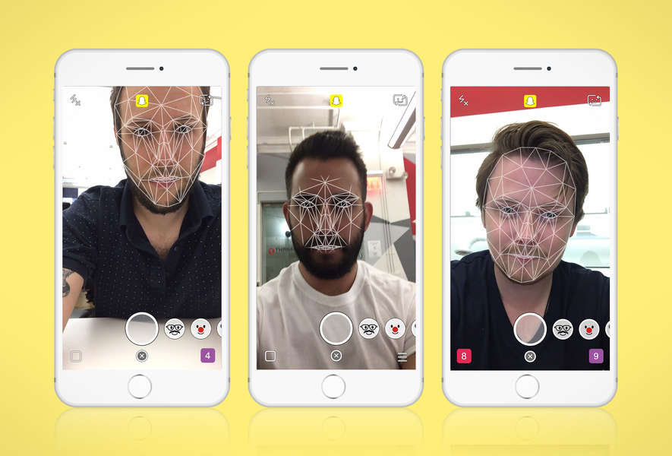
Where are Face Recognition used?
Notes:
Important, used a lot, errors

Slide 4
Research Plan
Crawling
Building Model
Solving overfitting
Evaluation
Notes:
Overfitting main objective

Slide 5
Why Celebrity face identification?
Mobile application
Crawling – use real world data
Advanced features:
Use pictures from one’s library to make a self lock system
Take a picture of random celebrity to know who he/she is
Simpler GPU using technique to identify similar looking celebrity

Slide 6
Methods
CNN Classification
Max Pooling
Drop Out
Crawling
Visualization

Slide 7

Gathering images for the image crawling
Directory is made and divded into two
Install image downloader library
Divide the subset into four classes

Slide 8
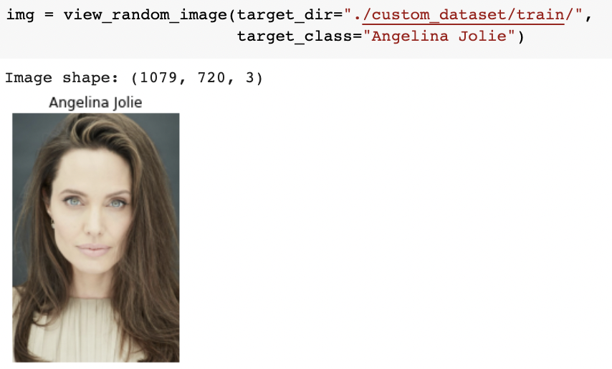
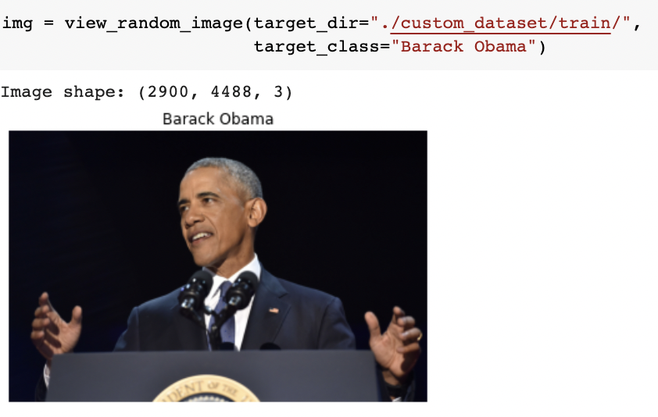
Confirming crawled data
Random function

Slide 9
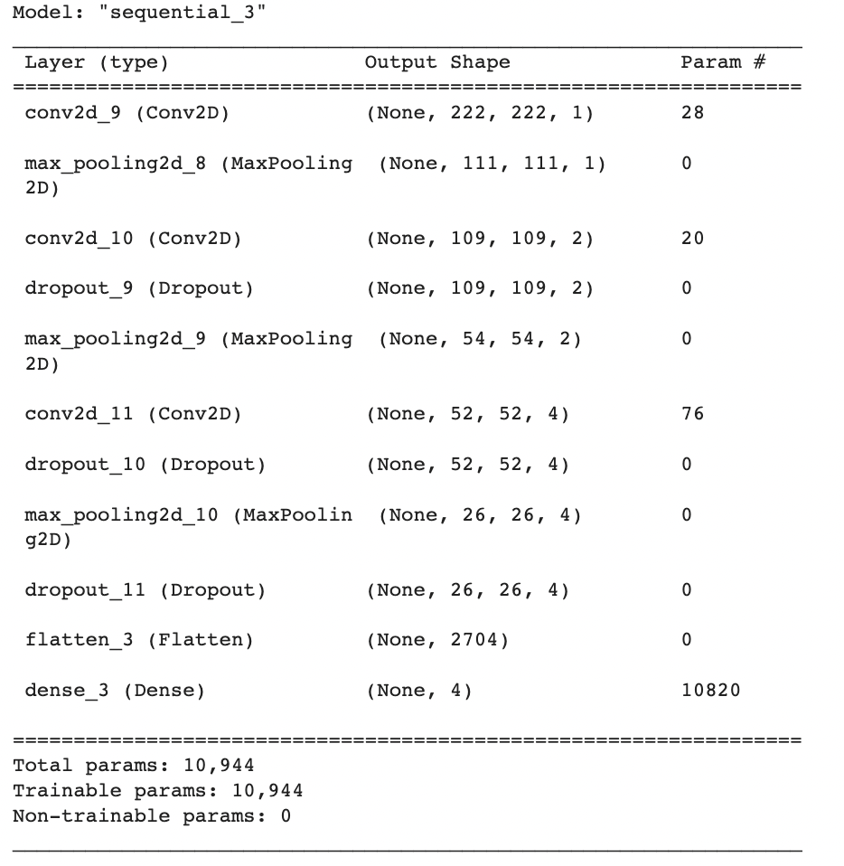
Model
Sequential
Convolutional layer with ’relu’ activation
Dense layer with ‘softmax’ activation
Adam Optimizer

Slide 10
What is overfitting
Learning the patterns in the training dataset too well and thus its ability to generalize to unseen data will be diminished
Increase of validation loss
Not useful in real-world

Slide 11
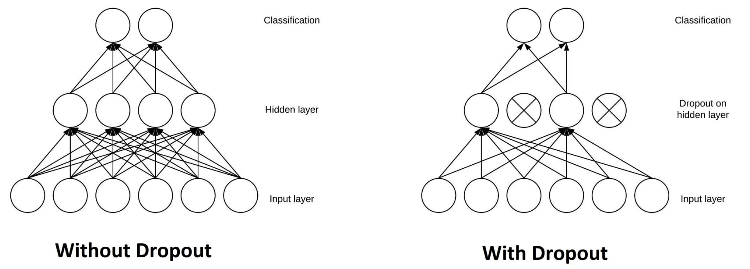
Overfitting resolutions
Maxpooling - reduces the dimensionality of images by reducing the number of pixels in the output from the previous convolutional layer
Data augumentation
Drop Out
Changing epochs
Changing dataset size

Slide 12
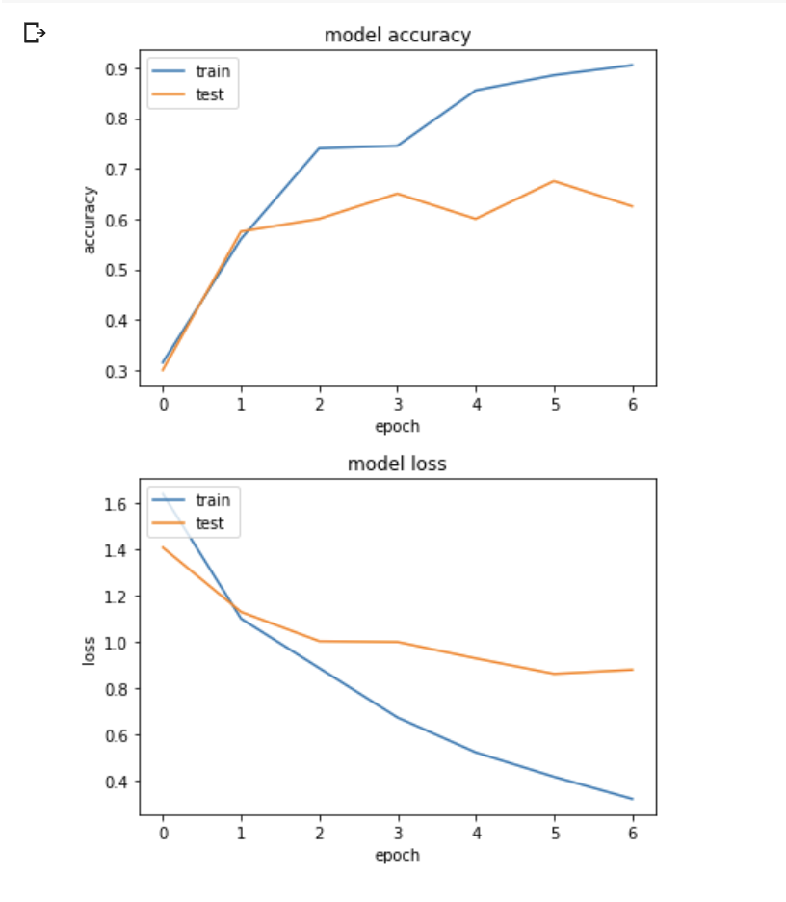
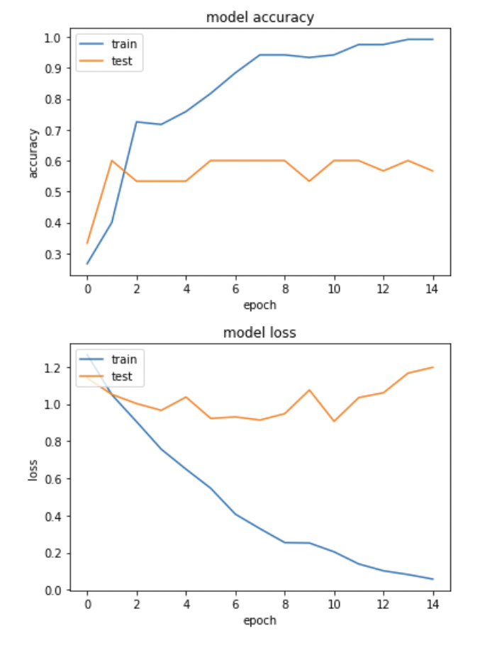
Data Augmentation Comparison
Notes:
Without augmentation(left), with augmentation(right)

Slide 13
Conclusion
Final model result
Visualization of accuracy and loss
Visualization of Model Prediction

Slide 14
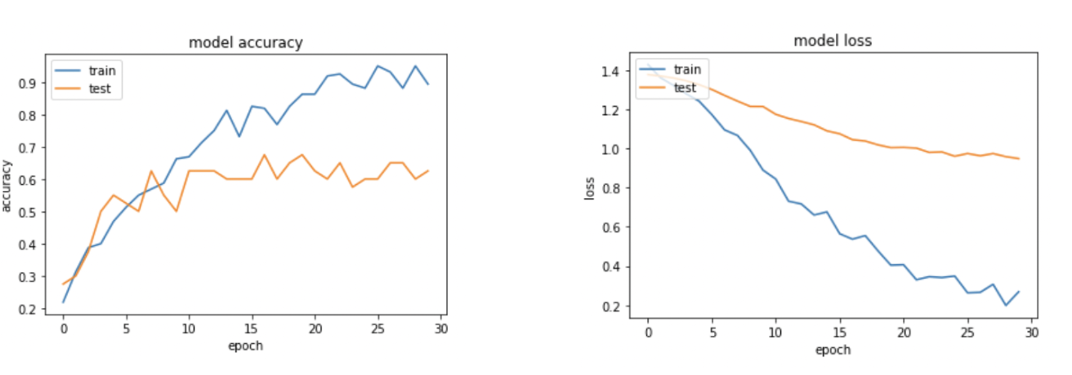
Visualization of accuracy and loss of the Model

Slide 15
Visualization
Image from internet not from the existing dataset
Decode the image into tensor
Resize and rescale
Add another dimension to axis 0
Use ‘pred_and_plot’function

Slide 16
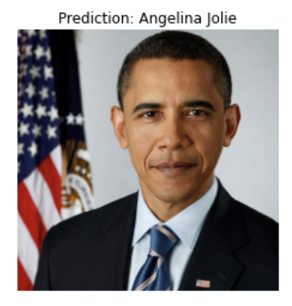
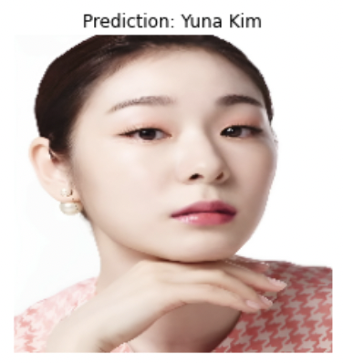
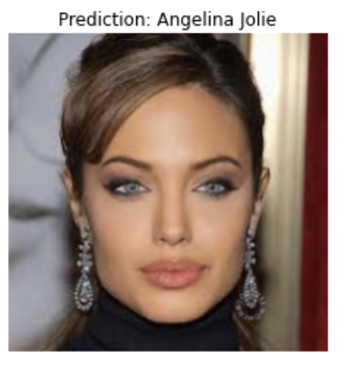
Visualization of Model Prediction

Slide 17
Future Studies
Different expected result for augmentation
Transfer learning

Slide 18
Thank you

