Slide 1
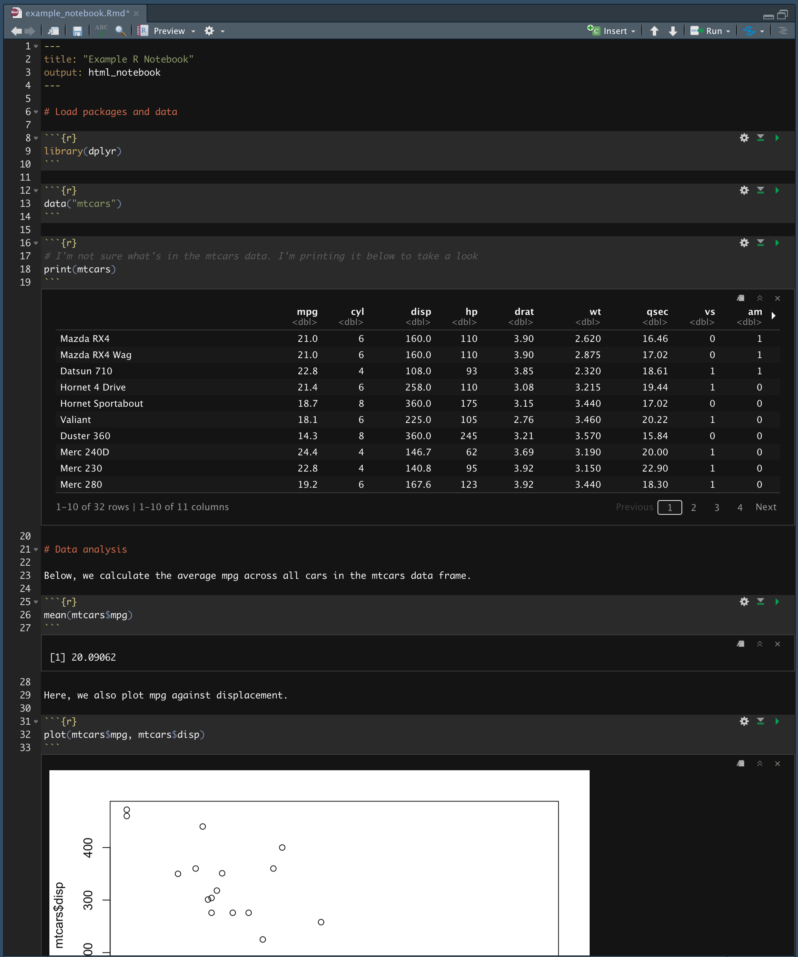
Notes:
example_r_markdown

Slide 2
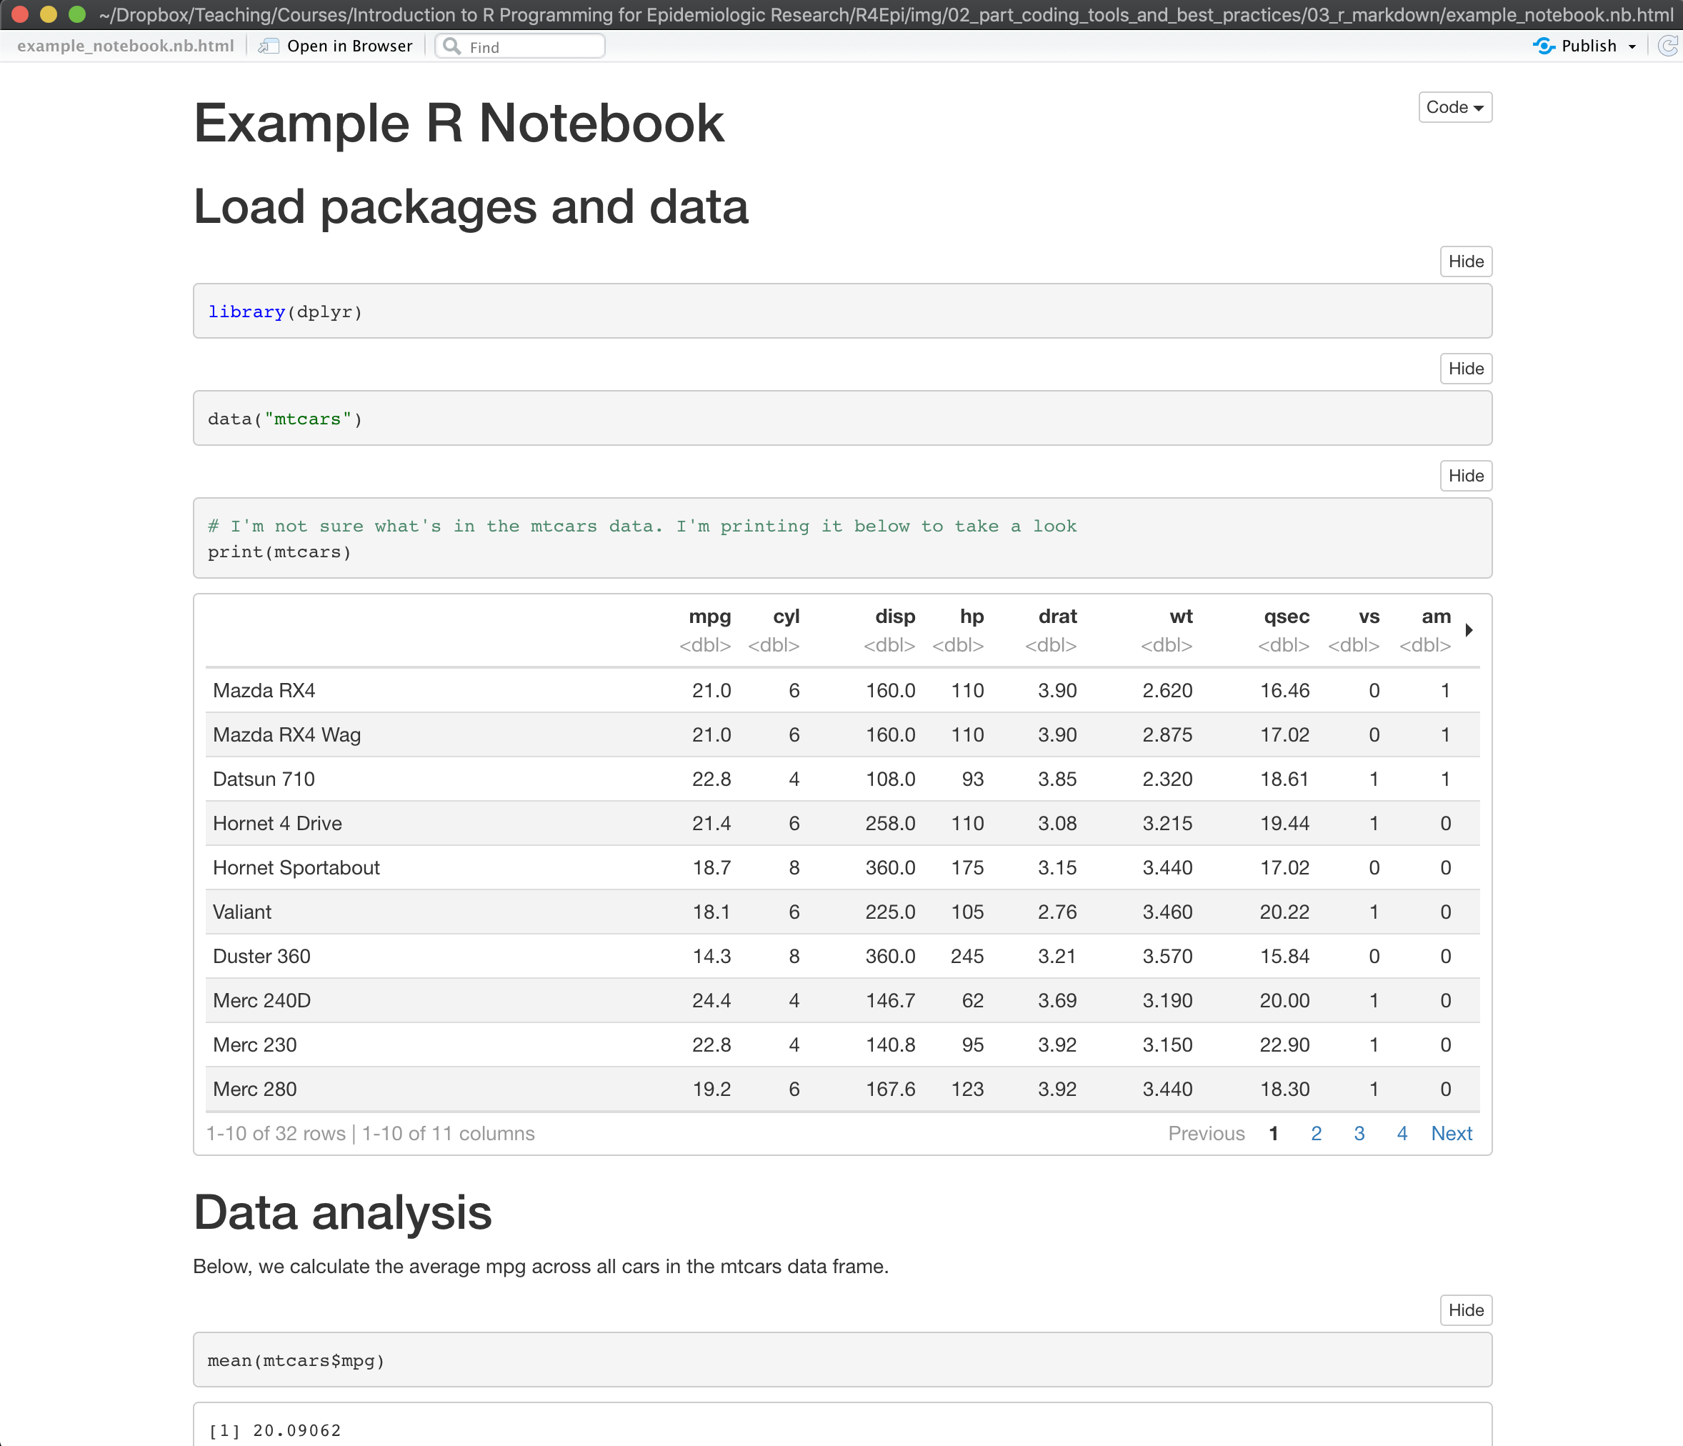
Notes:
rendered_preview

Slide 3
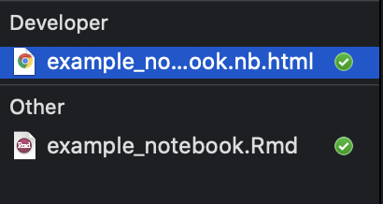
Notes:
markdown_files

Slide 4
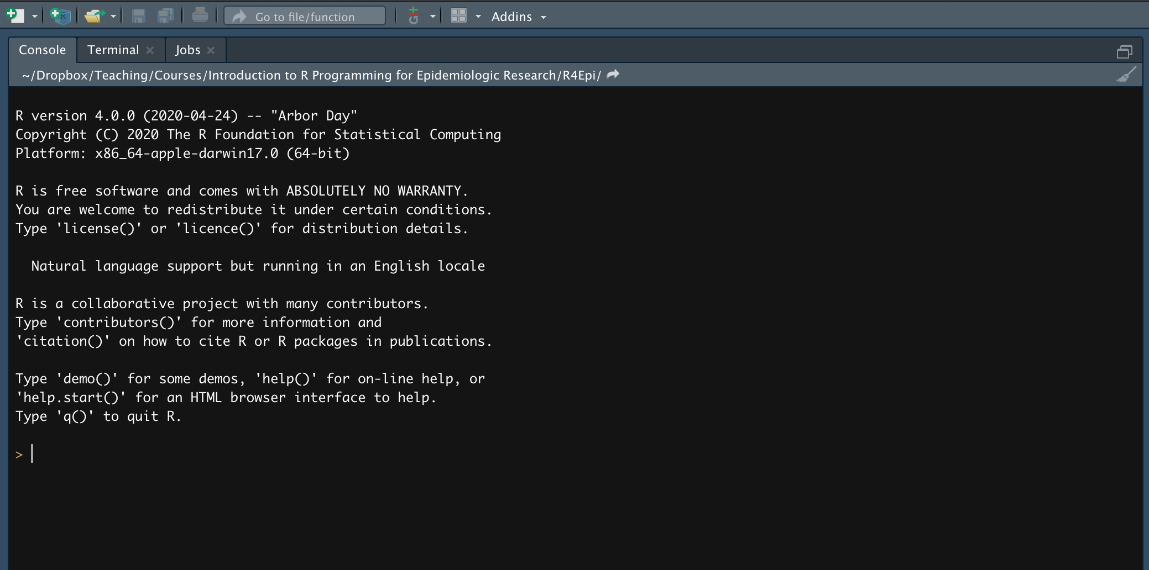
Notes:
new_r_markdown1

Slide 5
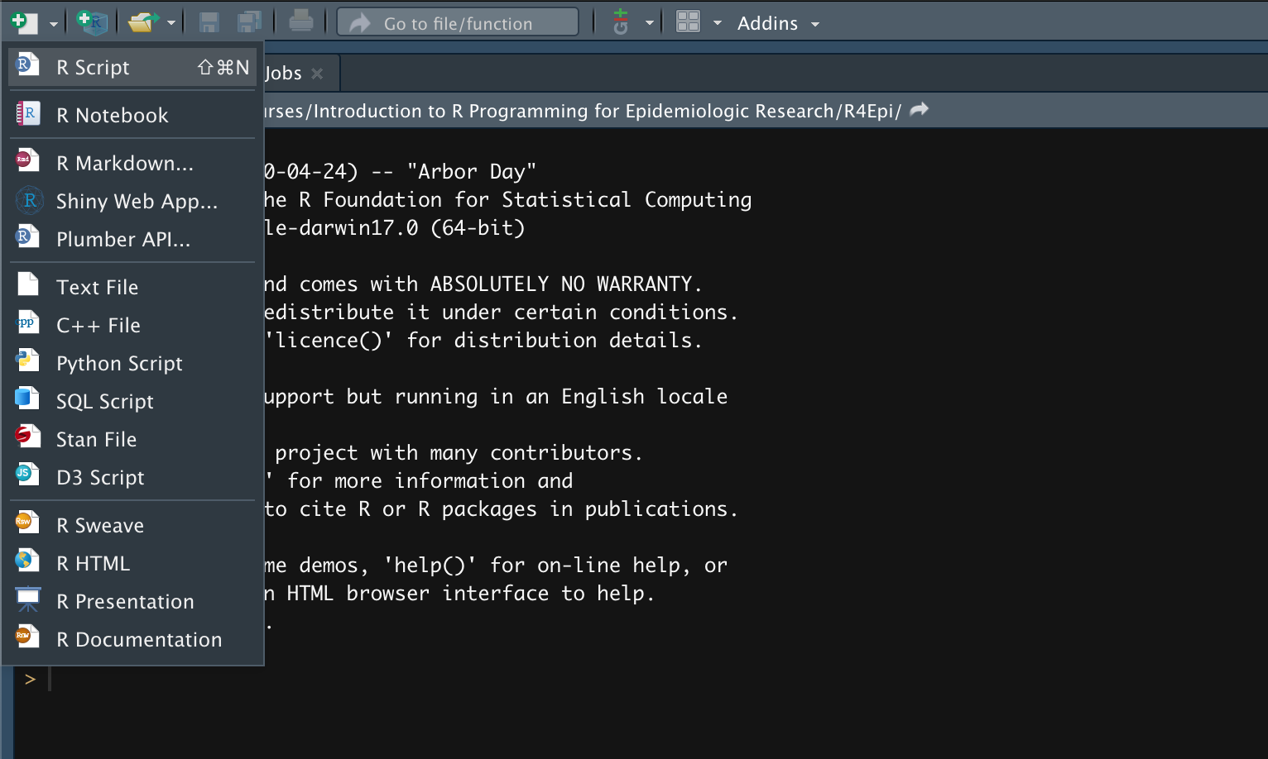
Notes:
new_r_markdown2

Slide 6
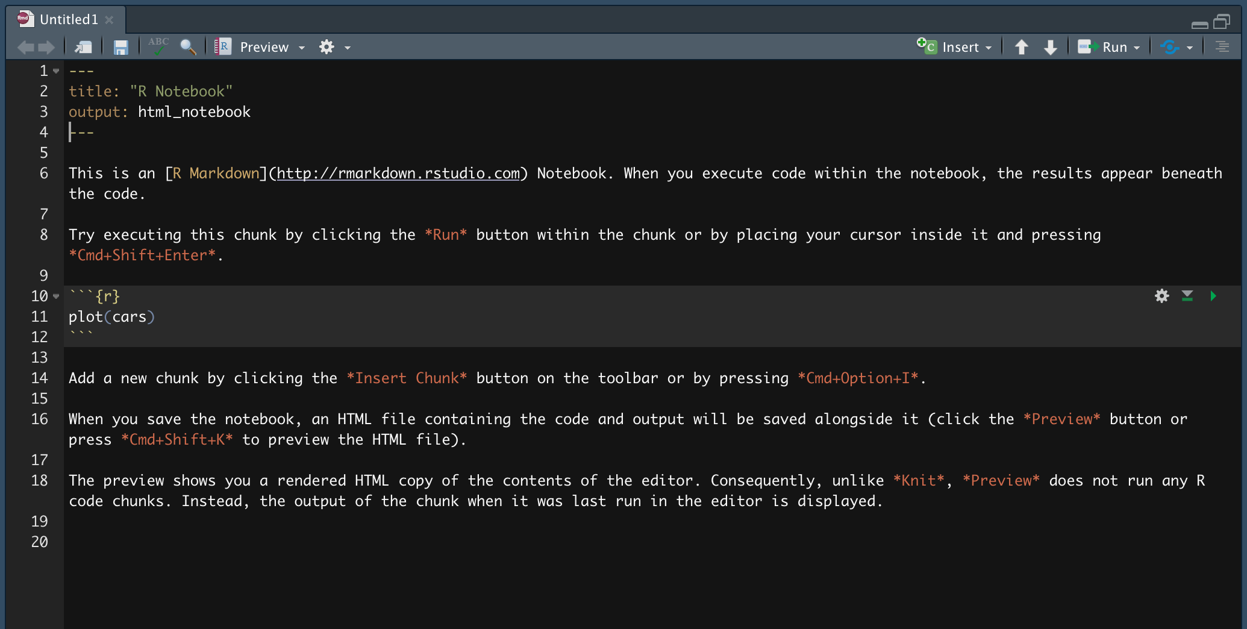
YAML header
Explanatory text
Link to a website
R code chunk
Play button
Formatting
Notes:
new_r_markdown3

Slide 7
Notes:
preview

Slide 8
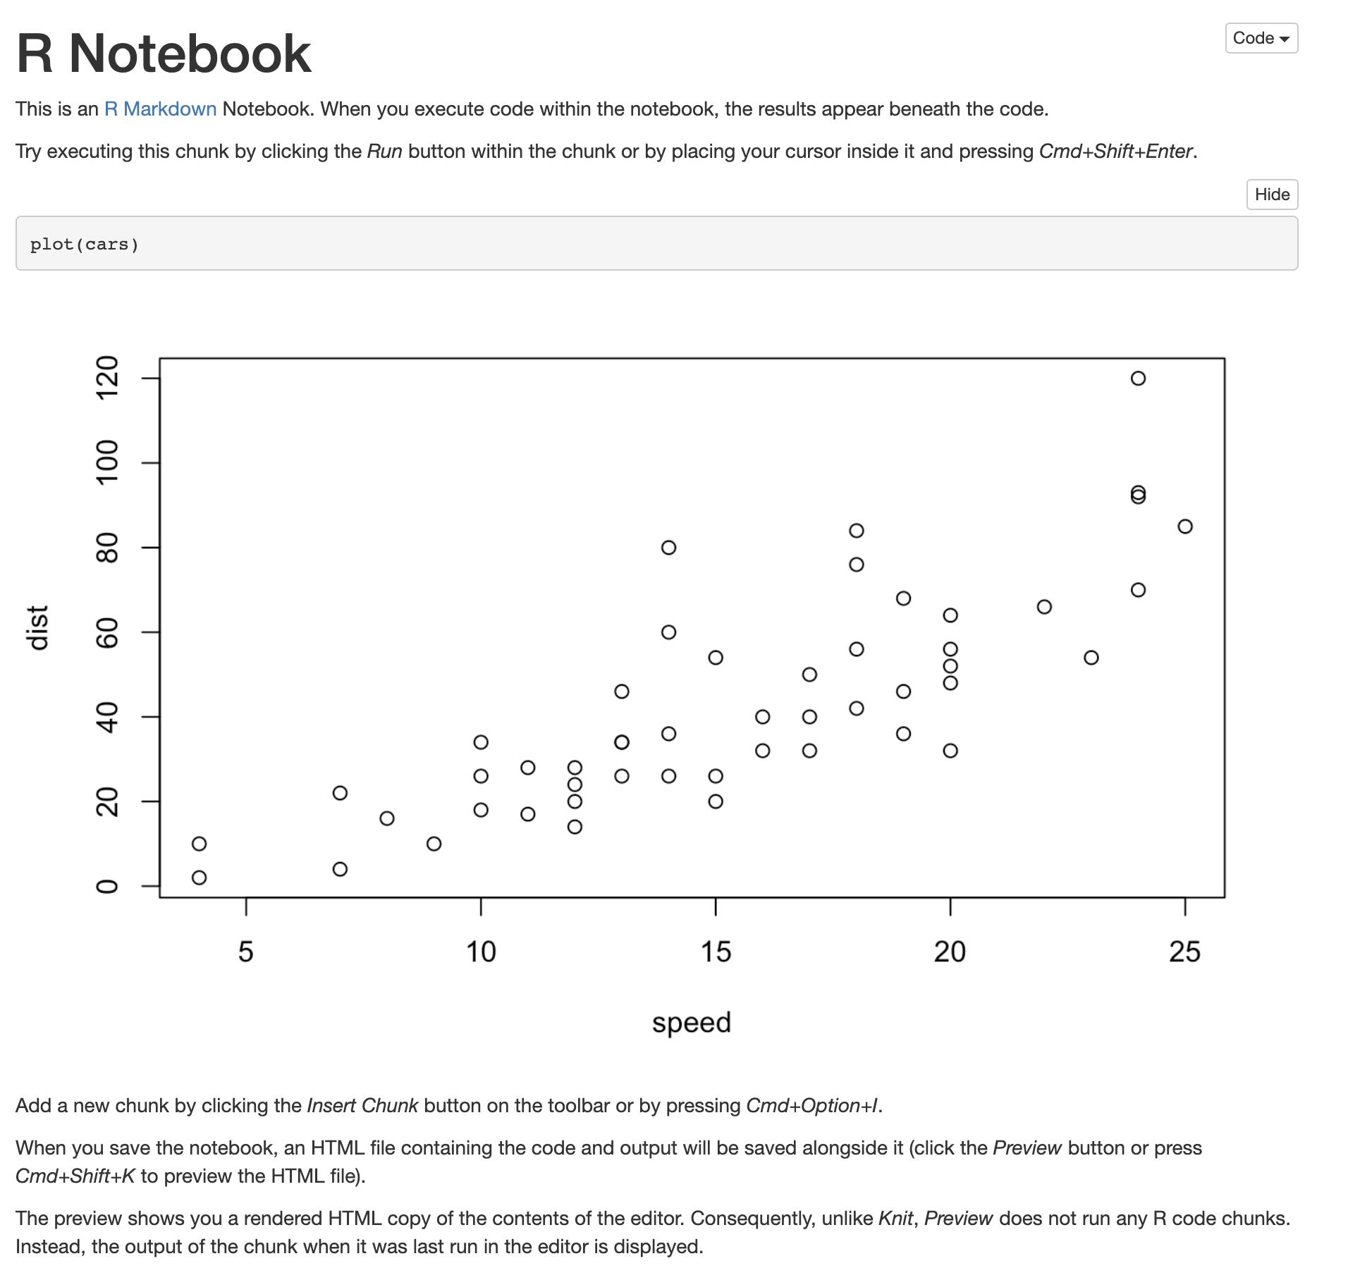
Notes:
rendered_r_notebook

Slide 9
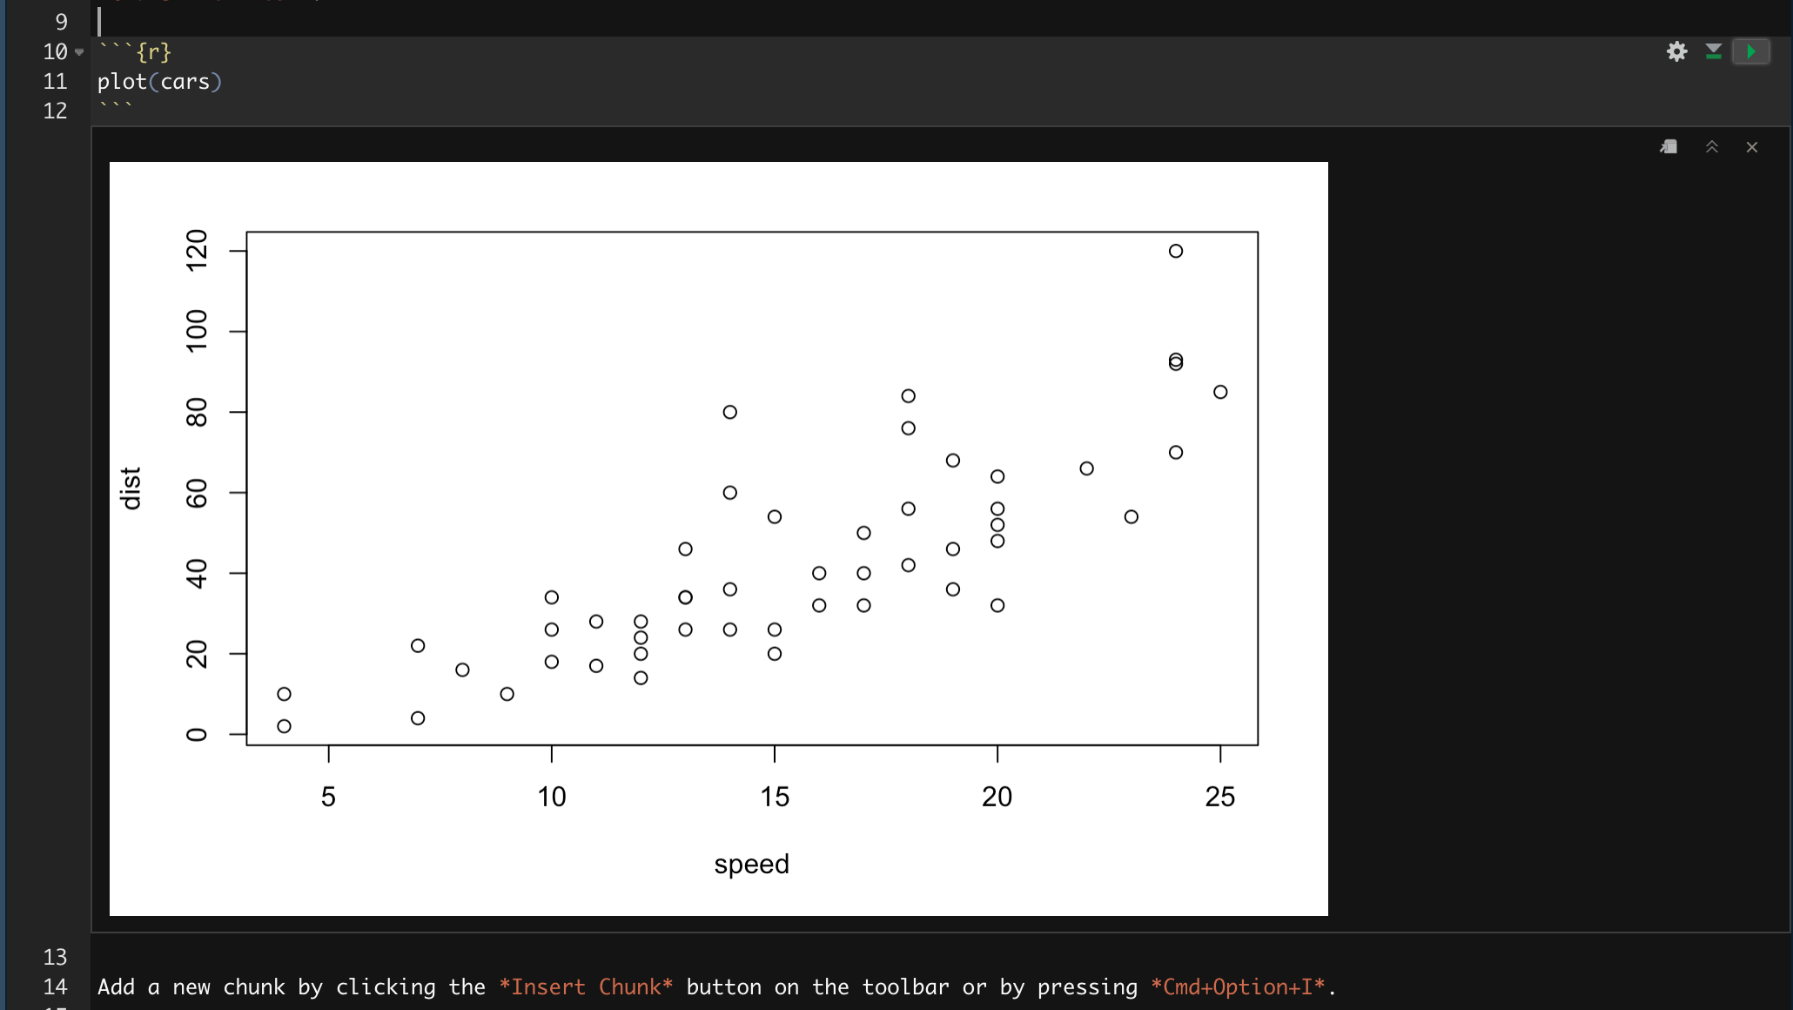
Result of the R code chunk
Notes:
code_chunk_output

