Slide 1


A comparative study between algorithms for time series forecasting
(ARIMA vs. HMM vs. LSTM)
Jianzhi Li, Yixuan Wang, Ziyu Lei
Dec. 11, 2019

Slide 2

Overview
Problem formulation
Datasets description
Methodology & Result
Conclusion
2

Slide 3
Problem Formulation
Have you ever wondered:
“Which model performs the best when it comes to different types of time series data in terms of level, trend, seasonality and noise and why?”
And yes, we’ve wondered and we tried to experiment with three most widely-used model on time series data (ARIMA, HMM, LSTM) on two time series data respectively, though awaiting to be generalized, but hoping to gain the insights.
3

Slide 4
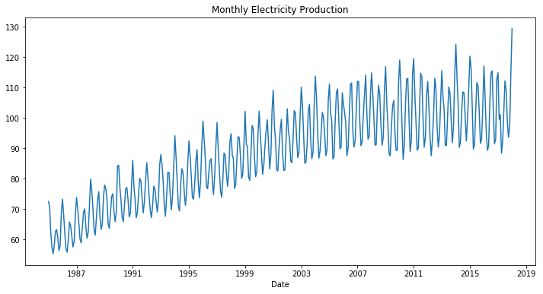
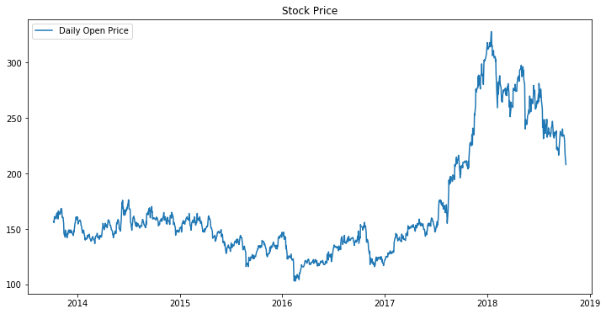
Datasets Description
Monthly Electric Production
Date from 1985-01 to 2017-04 monthly (396 data points)
Daily Stock Price
Date from 2013-10-08 to 2018-10-01 daily (1235 data points)
4

Slide 5
Methodology
ARIMA
Hidden Markov Model (HMM)
Long Short Term Memory (LSTM)
5

Slide 6
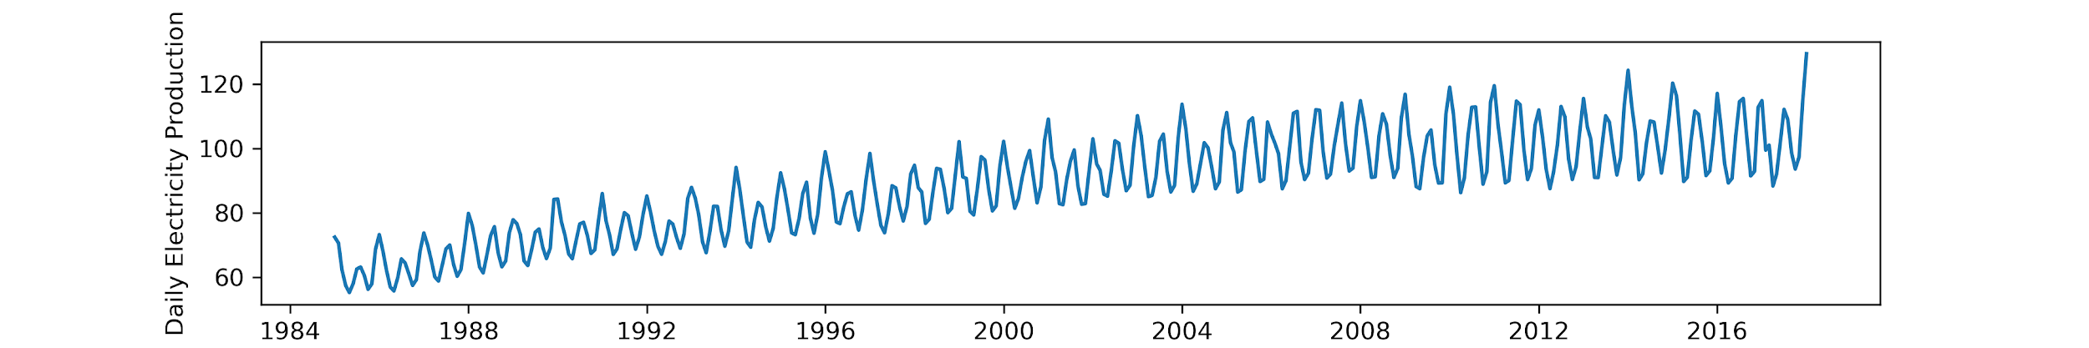
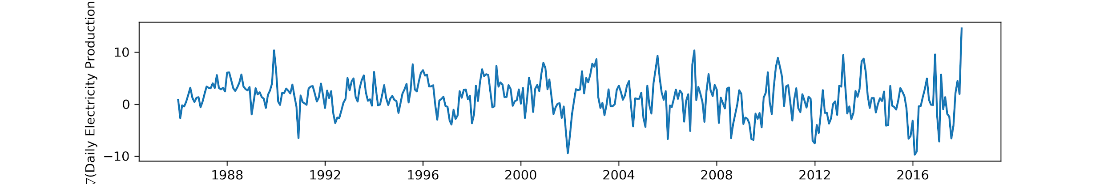
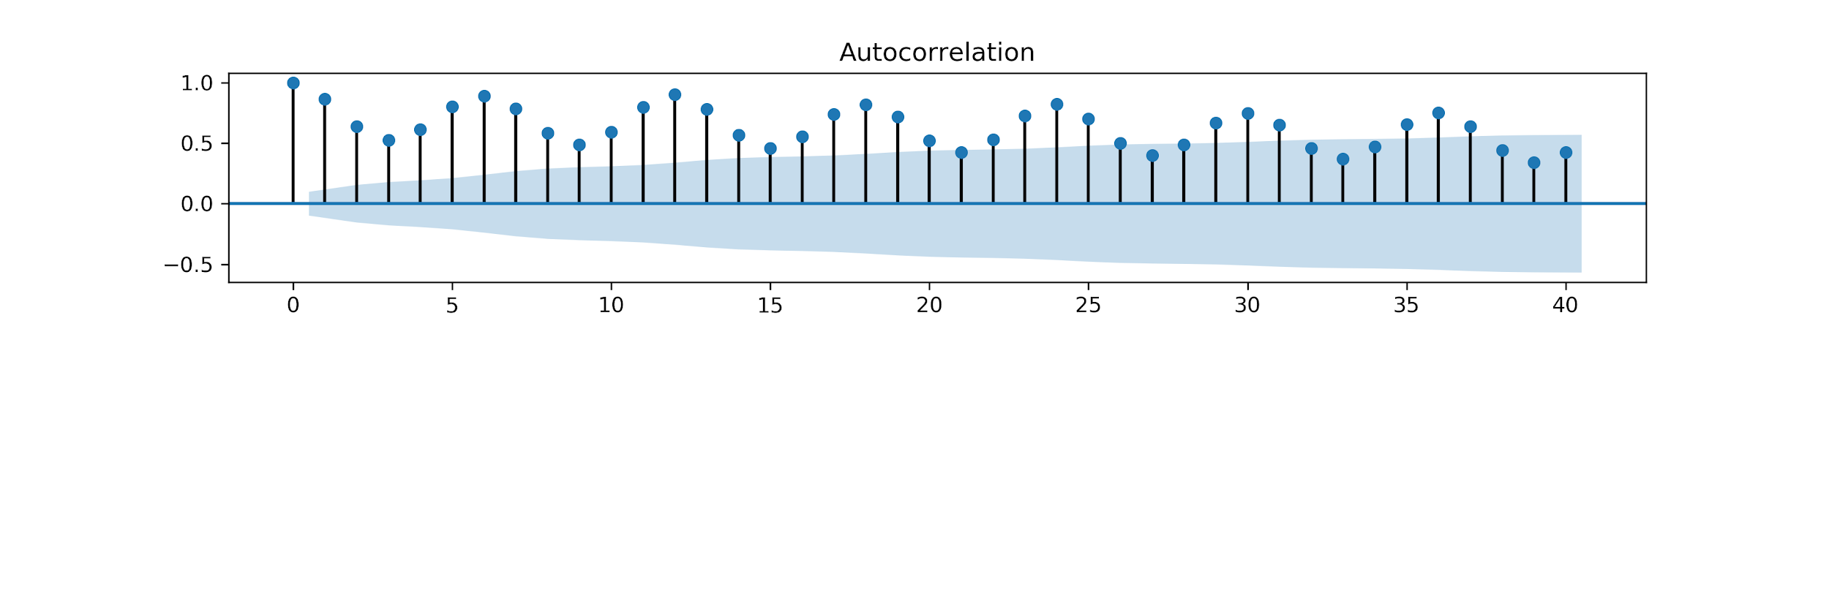
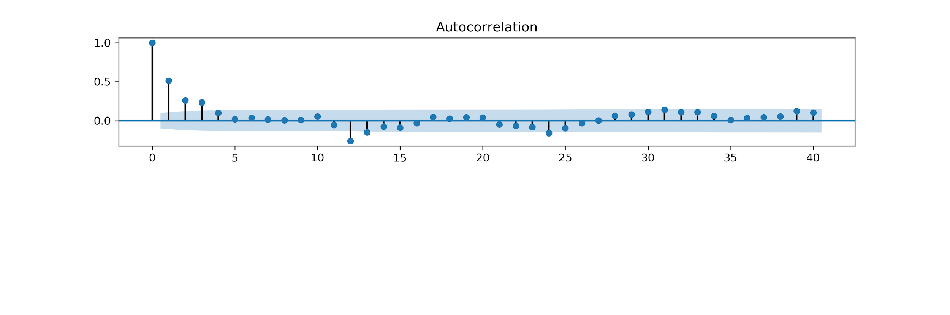
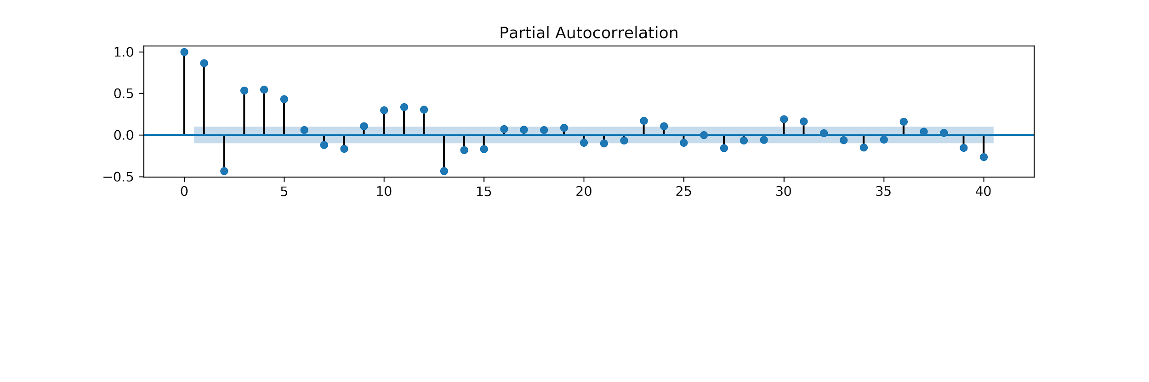
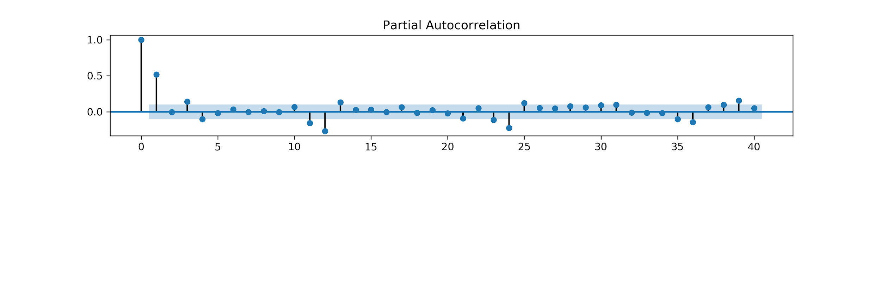
ARIMA

Slide 7
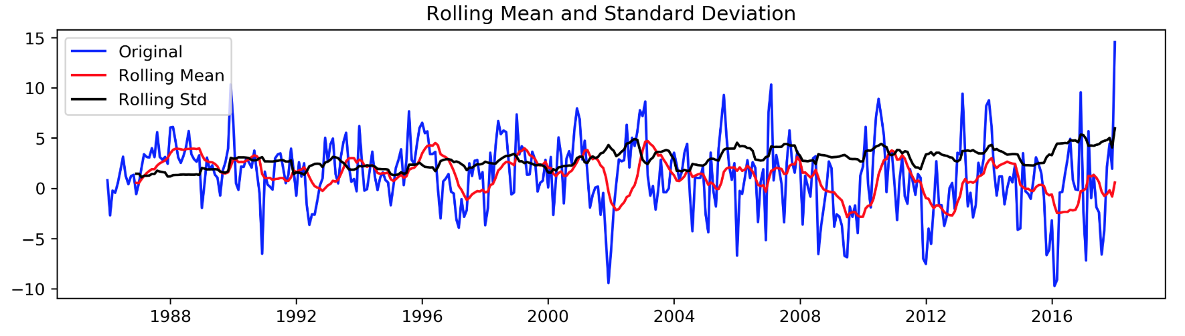
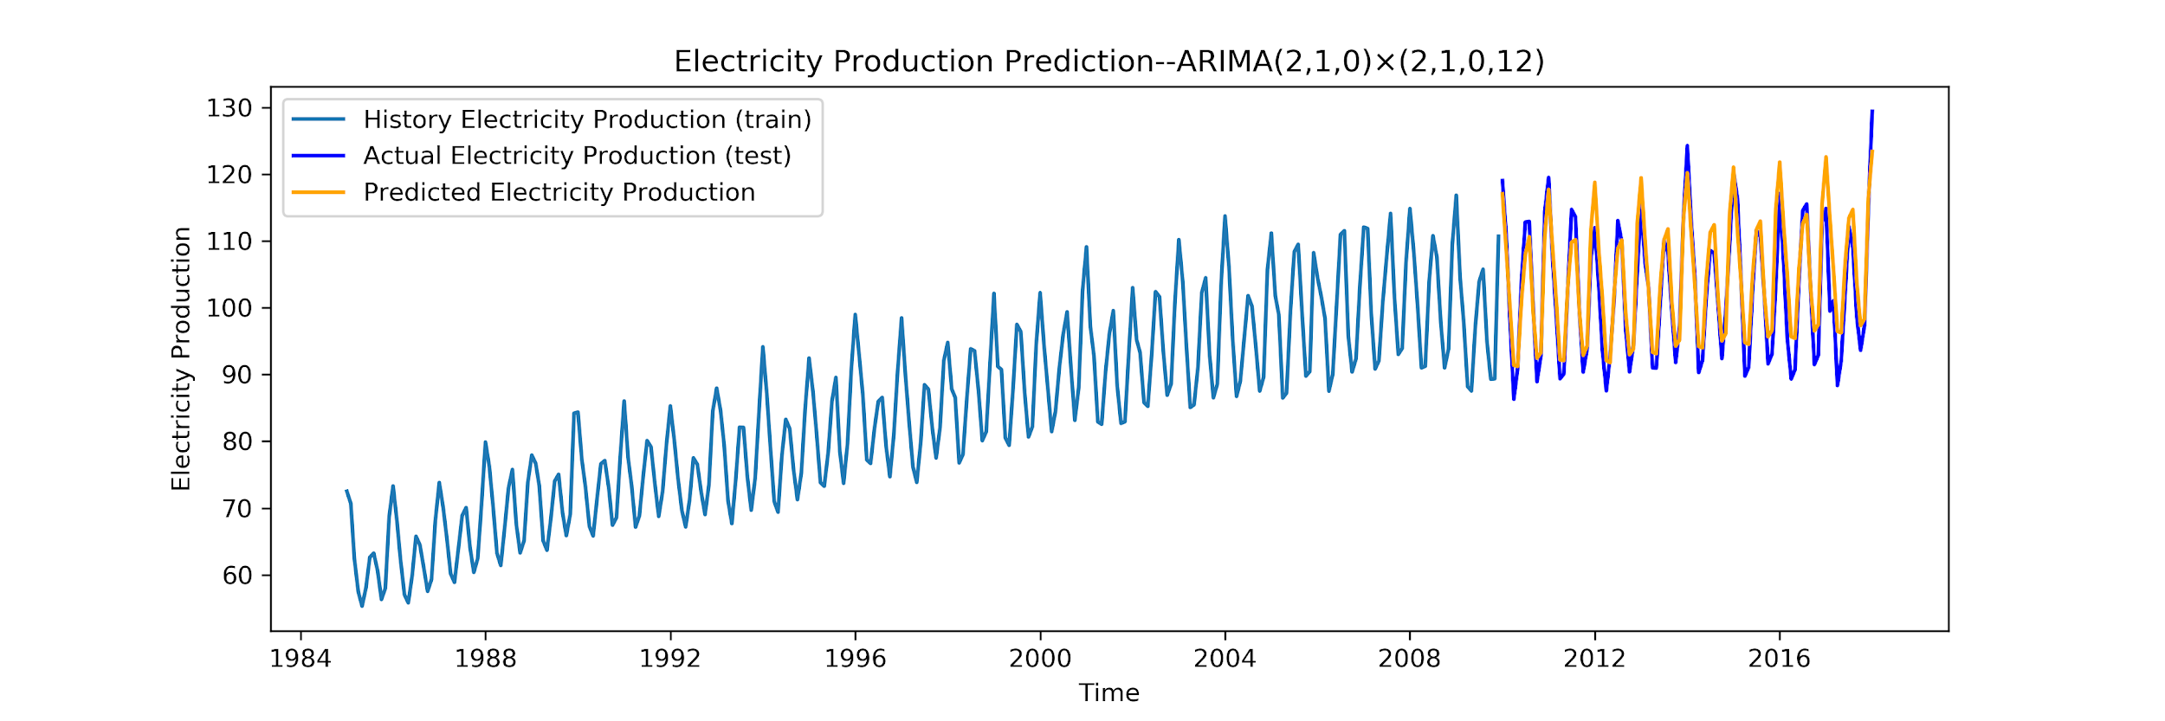


Slide 8
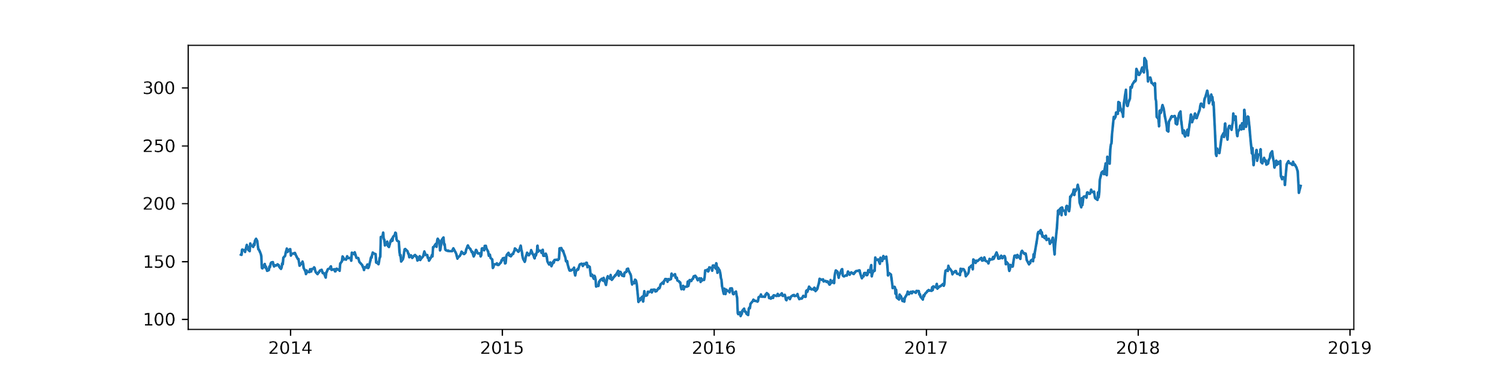
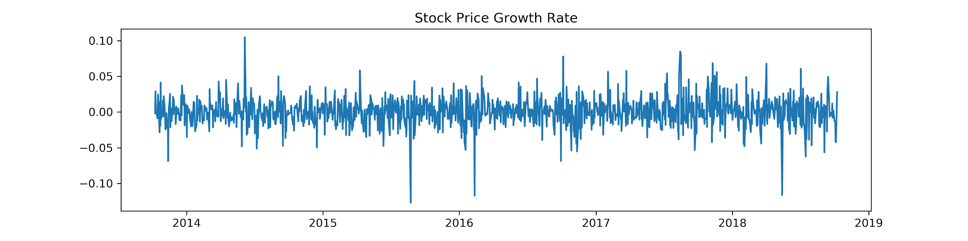
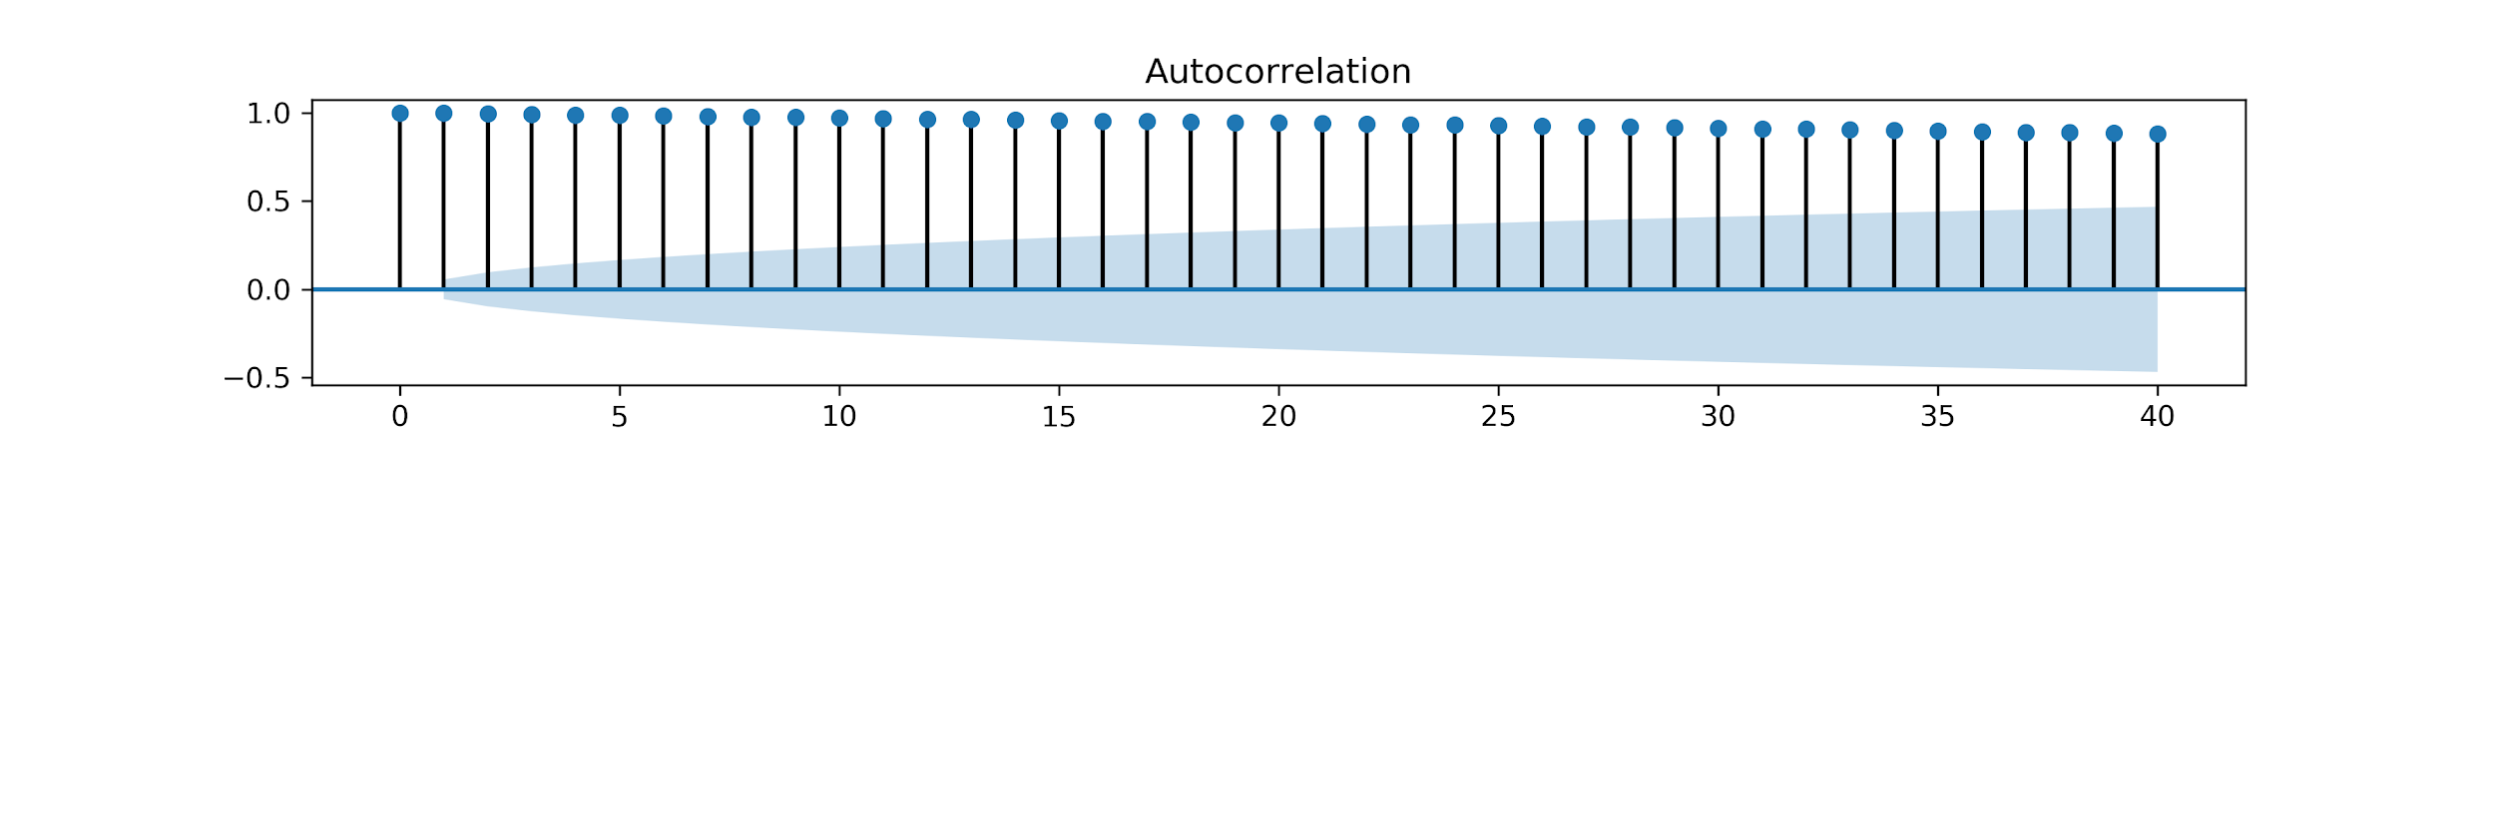
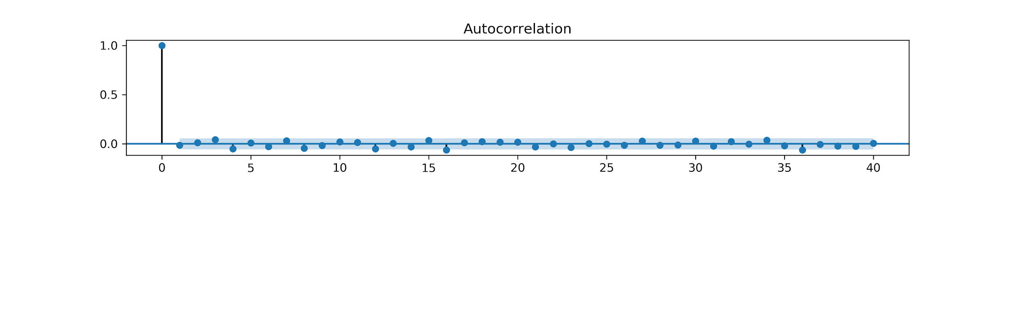
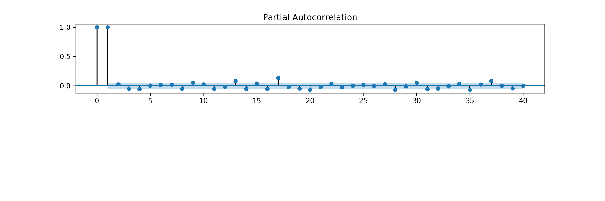
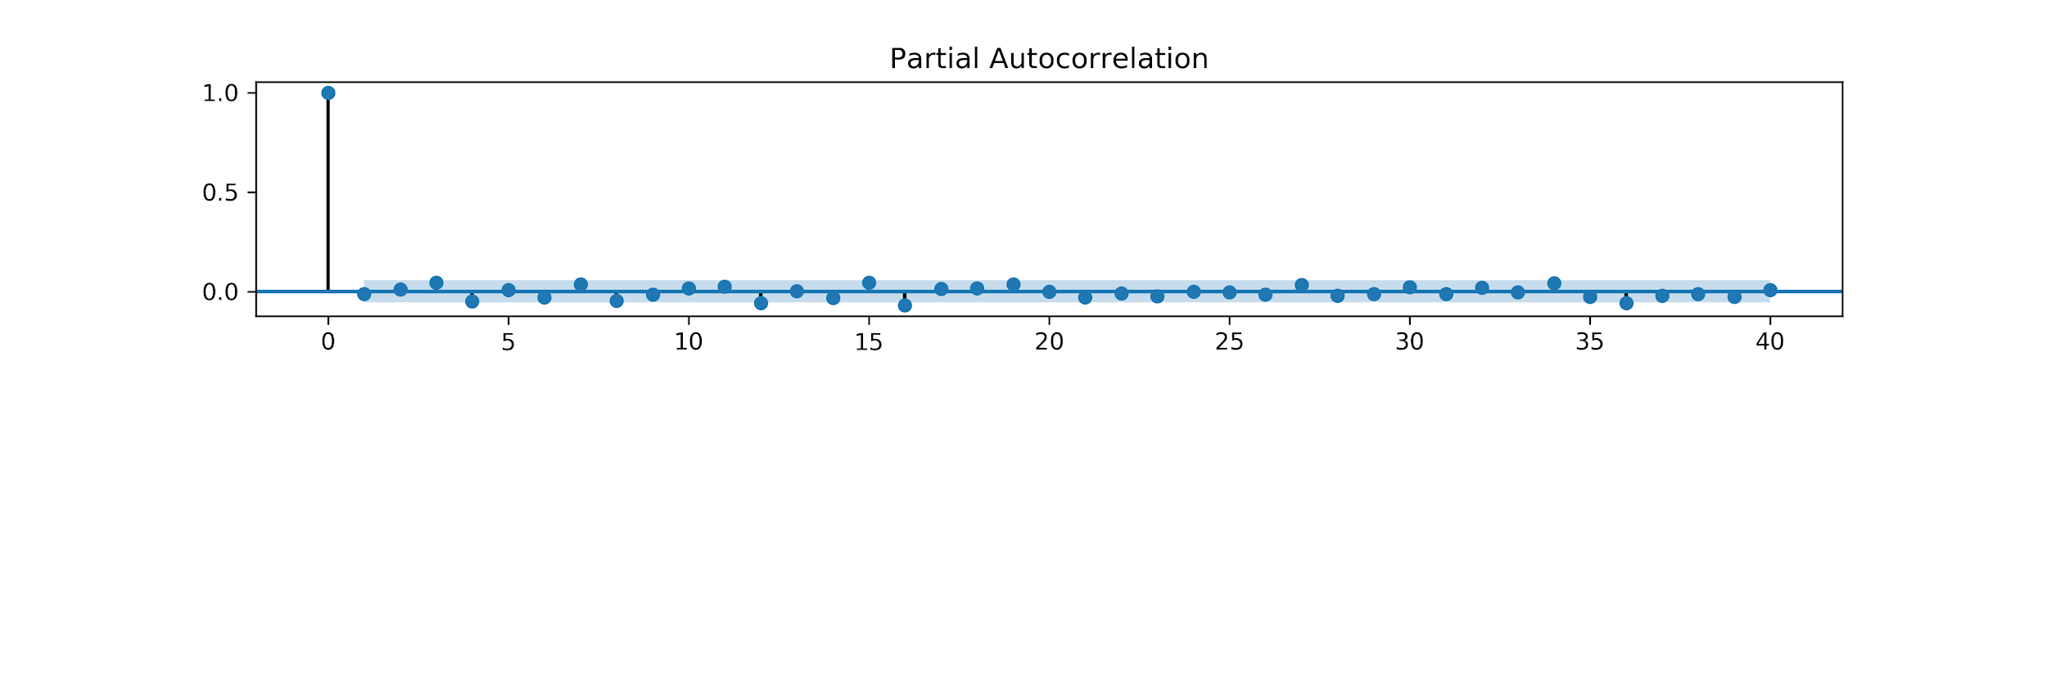

Slide 9
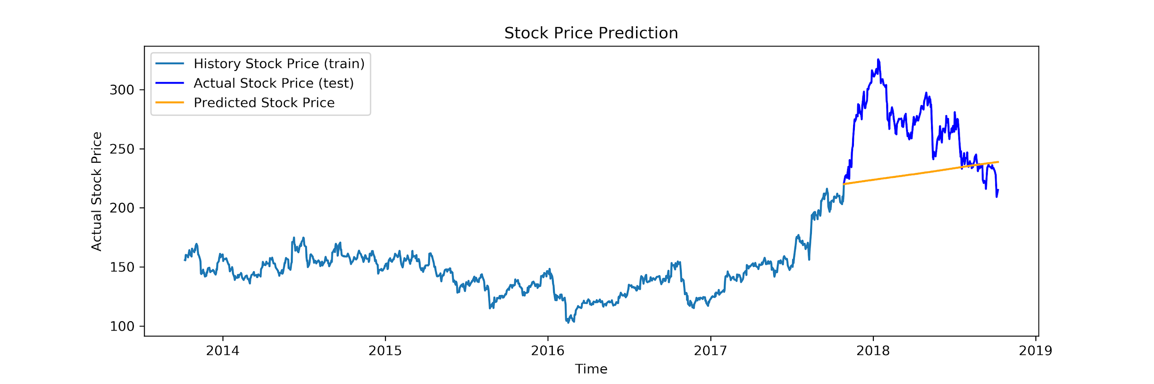
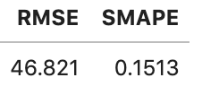

Slide 10
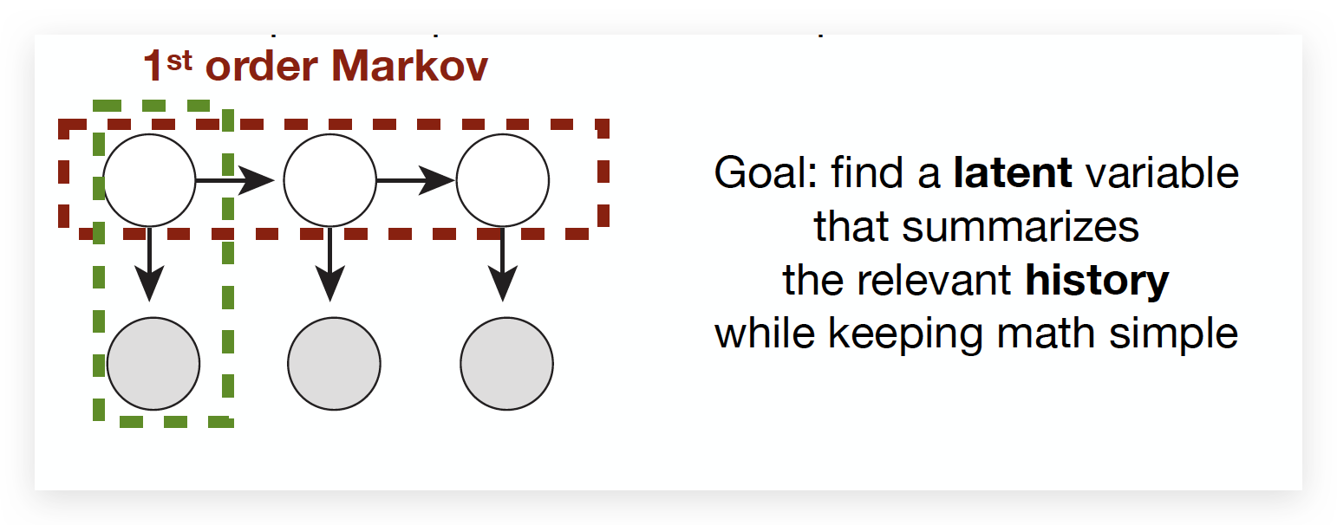
HMM
A latent state model in which the system being modeled is assumed to be 1st order Markov process with discrete hidden states.
(From Lecture5)
Three common types:
Multinomial HMM
Gaussian HMM
Poisson HMM
10

Slide 11
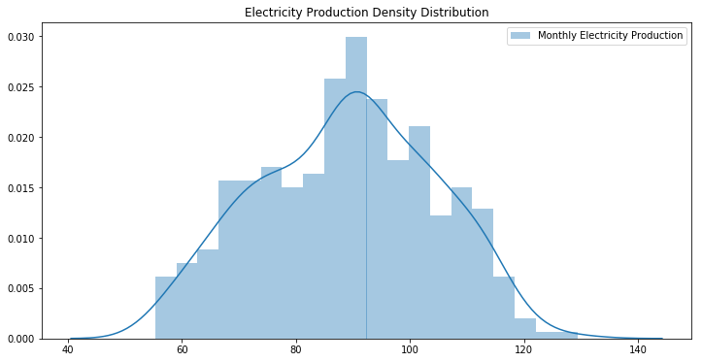
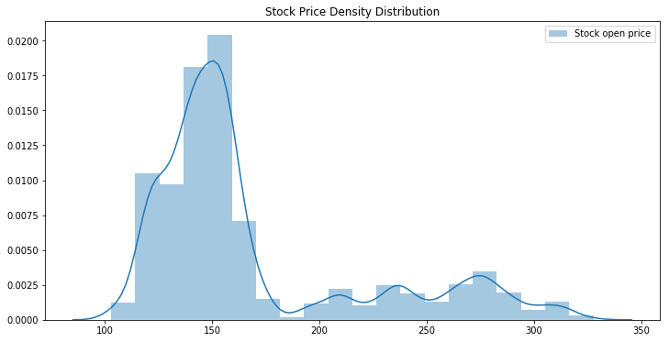
HMM
To decide which type of HMM fits our data, let’s take a look of the data distribution:
Gaussian HMM
(My implementation from HW3)
Gaussian HMM
and
Poisson HMM
(https://github.com/nhchristianson/PoissonHMM)
11

Slide 12
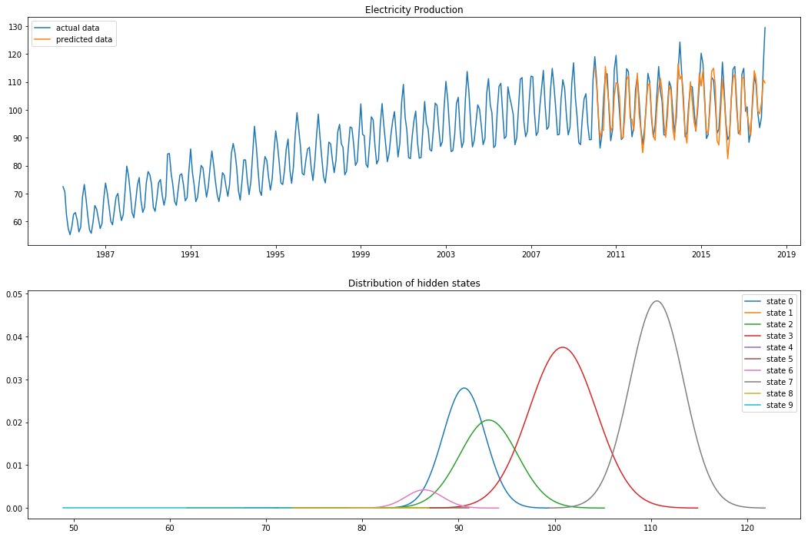
HMM Results (Electric Production Data)
Tune Num of hidden states
K | SMAPE | RMSE
2 | 0.1113 | 14.2978
4 | 0.0973 | 12.7575
6 | 0.0881 | 11.5942
8 | 0.0523 | 7.6392
10 | 0.0383 | 5.5284
12 | 0.0471 | 6.9750
12

Slide 13
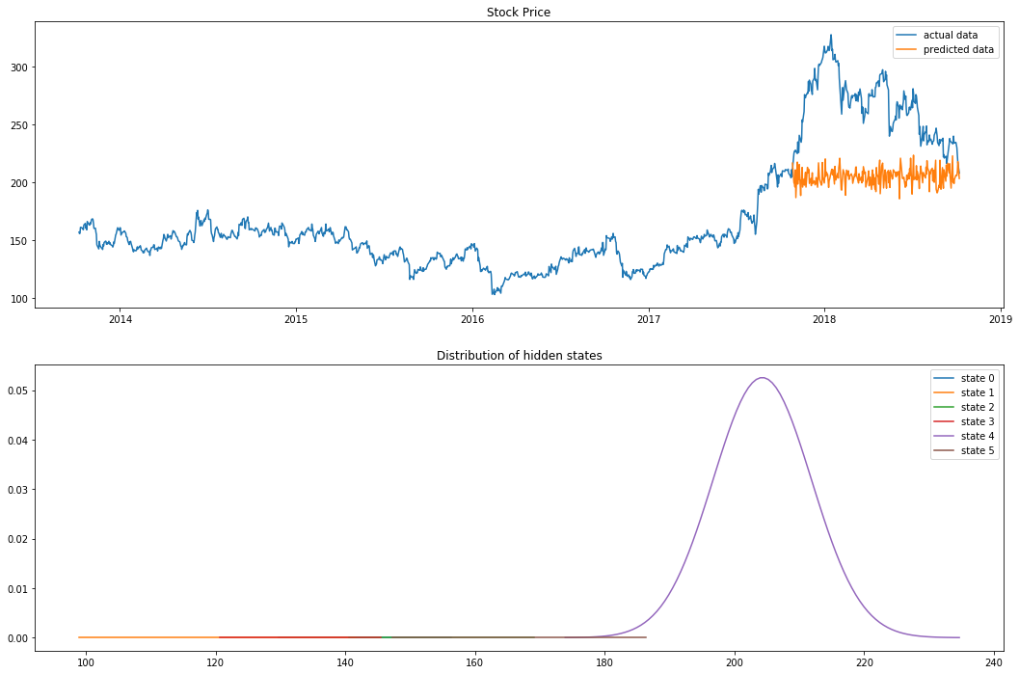
HMM Results (Stock Price Data)
Tune Num of hidden states
K | SMAPE | RMSE
Gaussian
2 | 0.6055 | 128.16
4 | 0.3574 | 86.91
6 | 0.2529 | 66.51
8 | 0.3576 | 86.94
Poisson
2 | 0.5068 | -108.09
4 | 0.5068 | -108.09
6 | 0.5068 | -108.09
8 | 0.5068 | -108.09
13

Slide 14
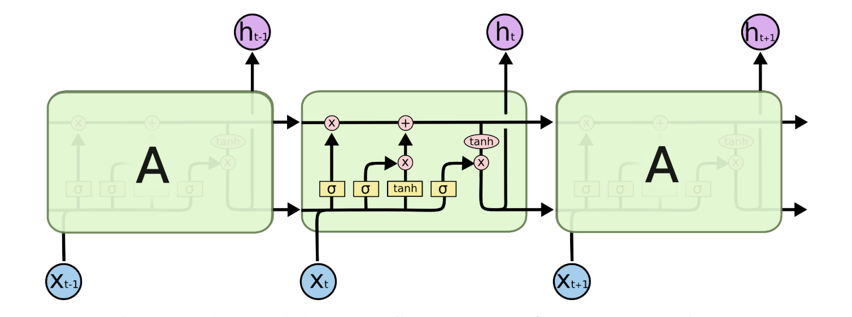
LSTM
Core idea of LSTM: The LSTM can remove and add information to the cell gates.
Main architecture:
Input gate: add the new information to the cell.
Forget gate: remove the old information that is not required to this model.
Output gate: decide the information to be shown as output.
(Understanding of LSTM Networks)
14

Slide 15
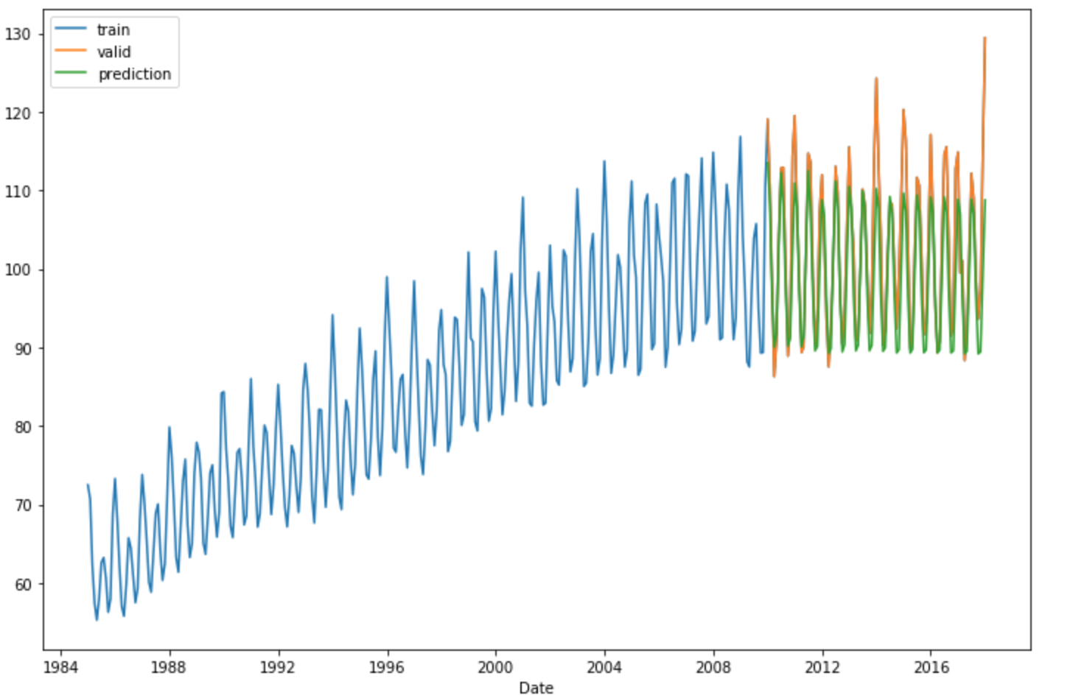
Hyperparameter Tuning
LSTM Results
Monthly Electricity Production
HIDDEN SIZE | DROPOUT RATE | SMAPE | RMSE
64 | 0.1 | 0.1451 | 18.3054
64 | 0.2 | 0.0727 | 9.9877
64 | 0.3 | 0.1211 | 15.3697
128 | 0.1 | 0.0764 | 10.2475
128 | 0.2 | 0.0716 | 8.7348
128 | 0.3 | 0.1576 | 17.6577
256 | 0.1 | 0.0731 | 9.5159
256 | 0.2 | 0.0803 | 9.6082
256 | 0.3 | 0.0536 | 7.3905
Validation Data vs. LSTM Predictions
15

Slide 16
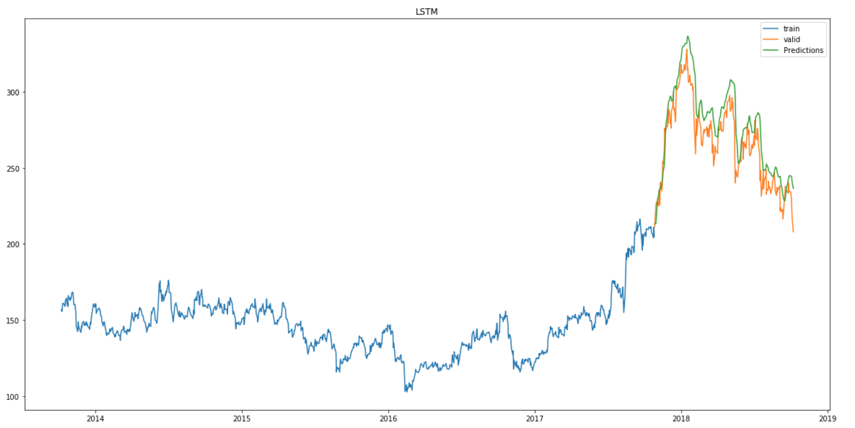
Hyperparameter Tuning
LSTM Results
Stock Open Price
HIDDEN SIZE | DROPOUT RATE | SMAPE | RMSE
64 | 0.1 | 0.0554 | 16.4124
64 | 0.2 | 0.0670 | 19.5818
64 | 0.3 | 0.0302 | 11.0500
128 | 0.1 | 0.0260 | 9.0698
128 | 0.2 | 0.0373 | 12.7634
128 | 0.3 | 0.0281 | 9.6750
256 | 0.1 | 0.0469 | 14.0101
256 | 0.2 | 0.0321 | 11.2940
256 | 0.3 | 0.0492 | 15.0351
Validation data vs. LSTM Predictions
*
16

Slide 17
Conclusion
Model | SMAPE | RMSE
Monthly Electric Production Data
ARIMA | 0.0316 | 4.0870
HMM | 0.0383 | 5.5284
LSTM | 0.0536 | 7.3905
Daily Stock Open Price Data
ARIMA | 0.1513 | 46.8210
HMM | 0.2529 | 66.5100
LSTM | 0.0260 | 9.0698
ARIMA achieves the best evaluation score on the monthly electric production data.
LSTM model outperforms the Hidden Markov Model and ARIMA on the stock price forecasting task.
17

Slide 18

Thank You!

