Slide 1

HoopRoutine
WEEK 3 PROJECT
A basketball training app for planning a session and reviewing the work afterward.
Notes:
Introduce HoopRoutine. The Week 3 build connects workout choice, custom planning, result entry, and progress. The cover art is a generated illustration, not a photograph of a real session.

Slide 2
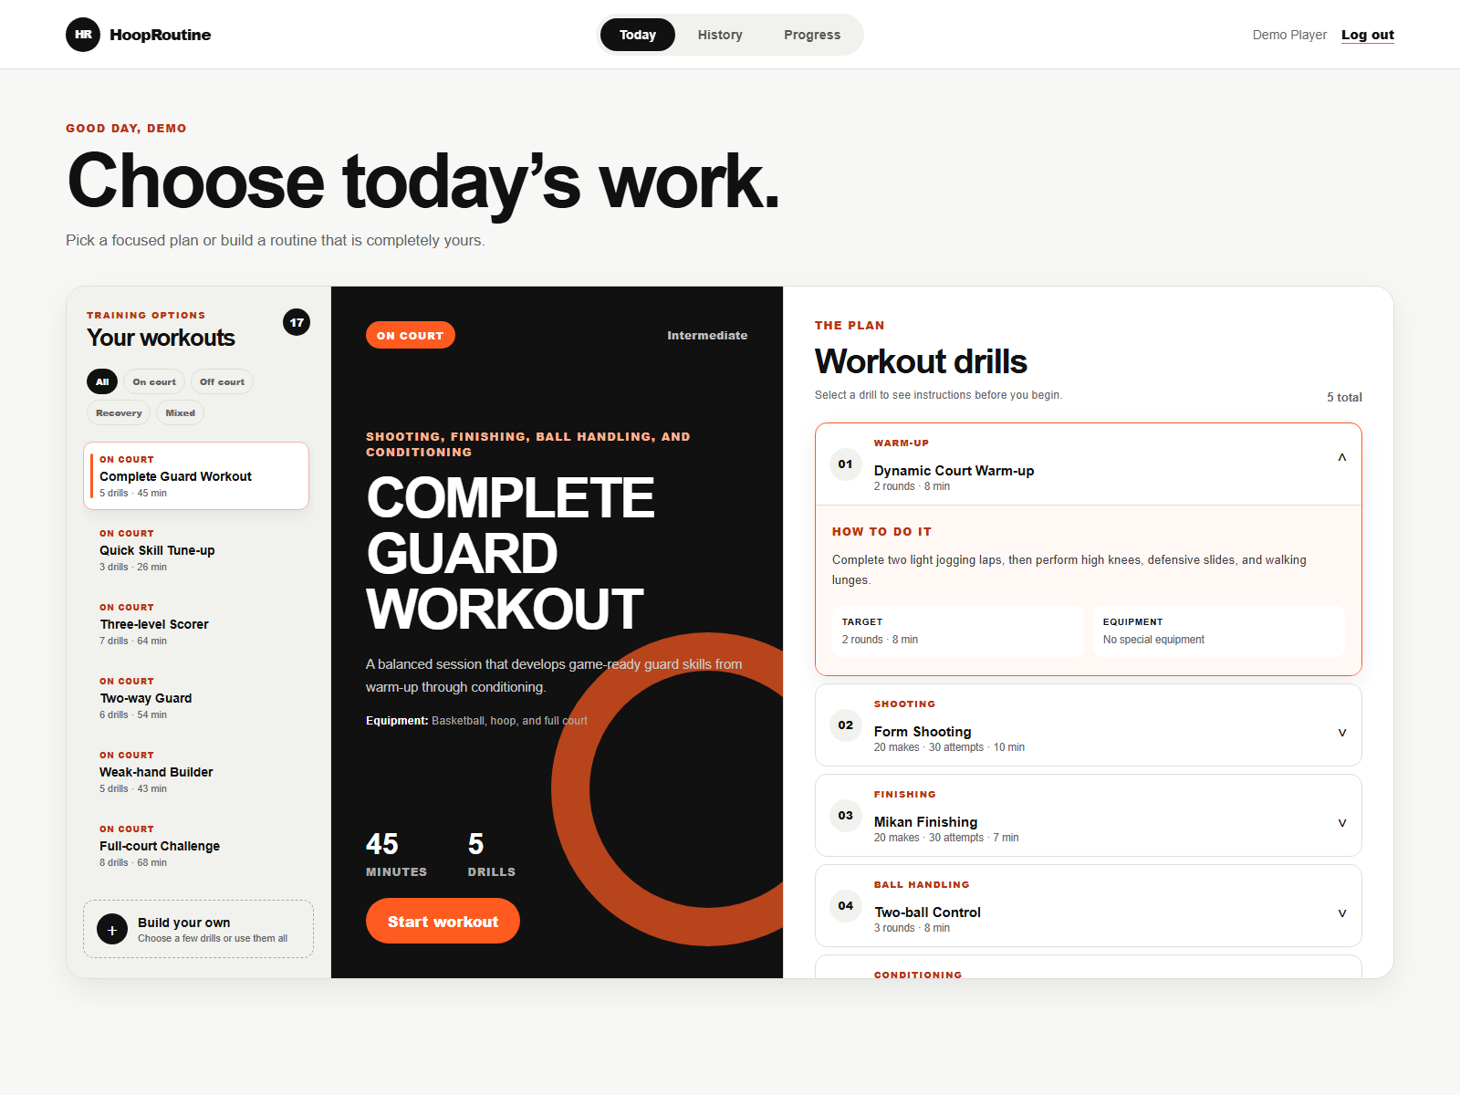
Choose a workout
16 preset routines
Filter by training type. Review equipment and drill instructions before starting.
On court, off court, recovery, and mixed plans share the same workout flow.
Notes:
Show the Today screen. Call out the 16 presets, training type filters, equipment field, and expanded drill guide. The screenshot uses sample data in a dedicated demo account.

Slide 3
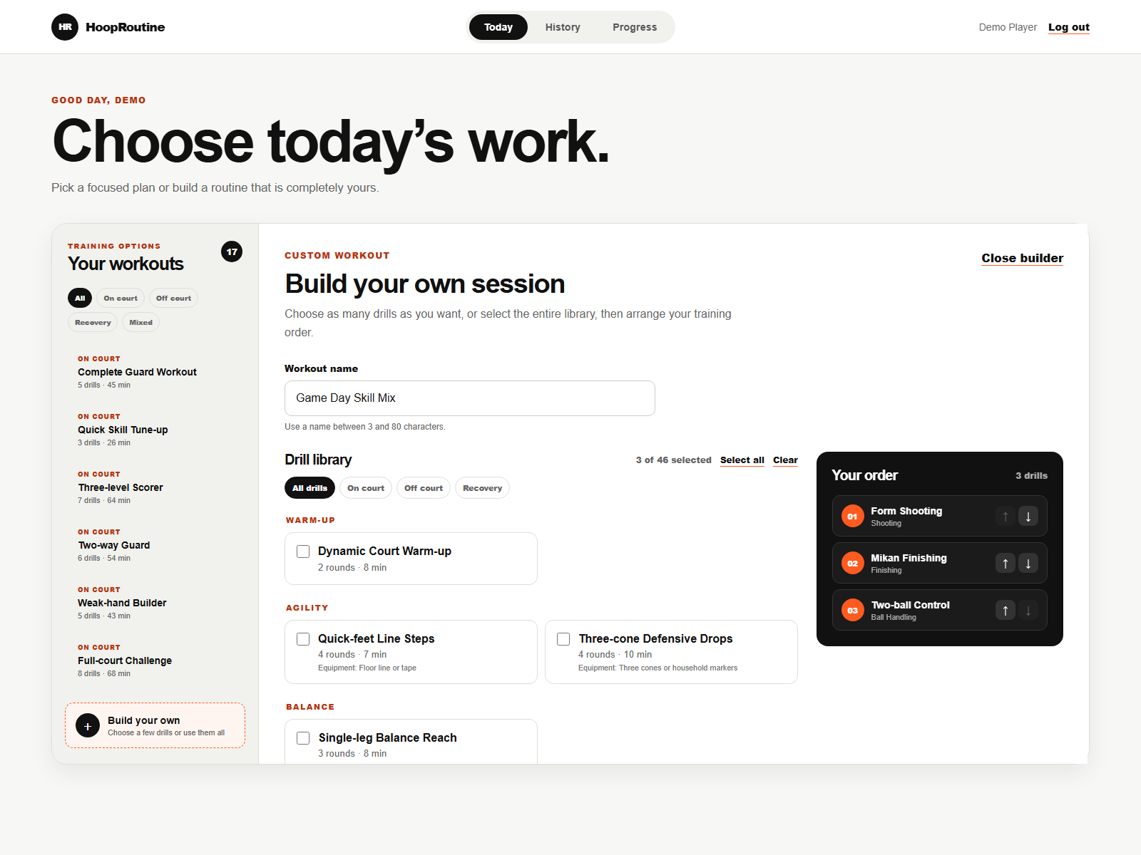
Build a personal routine
46 drills
Choose drills, arrange their order, and save a private routine.
Editing a routine keeps earlier session history intact.
Notes:
Open Build your own. Select a few drills, demonstrate reordering, and save. Mention that custom routines belong to the signed-in player and historical sessions remain available after edits.

Slide 4
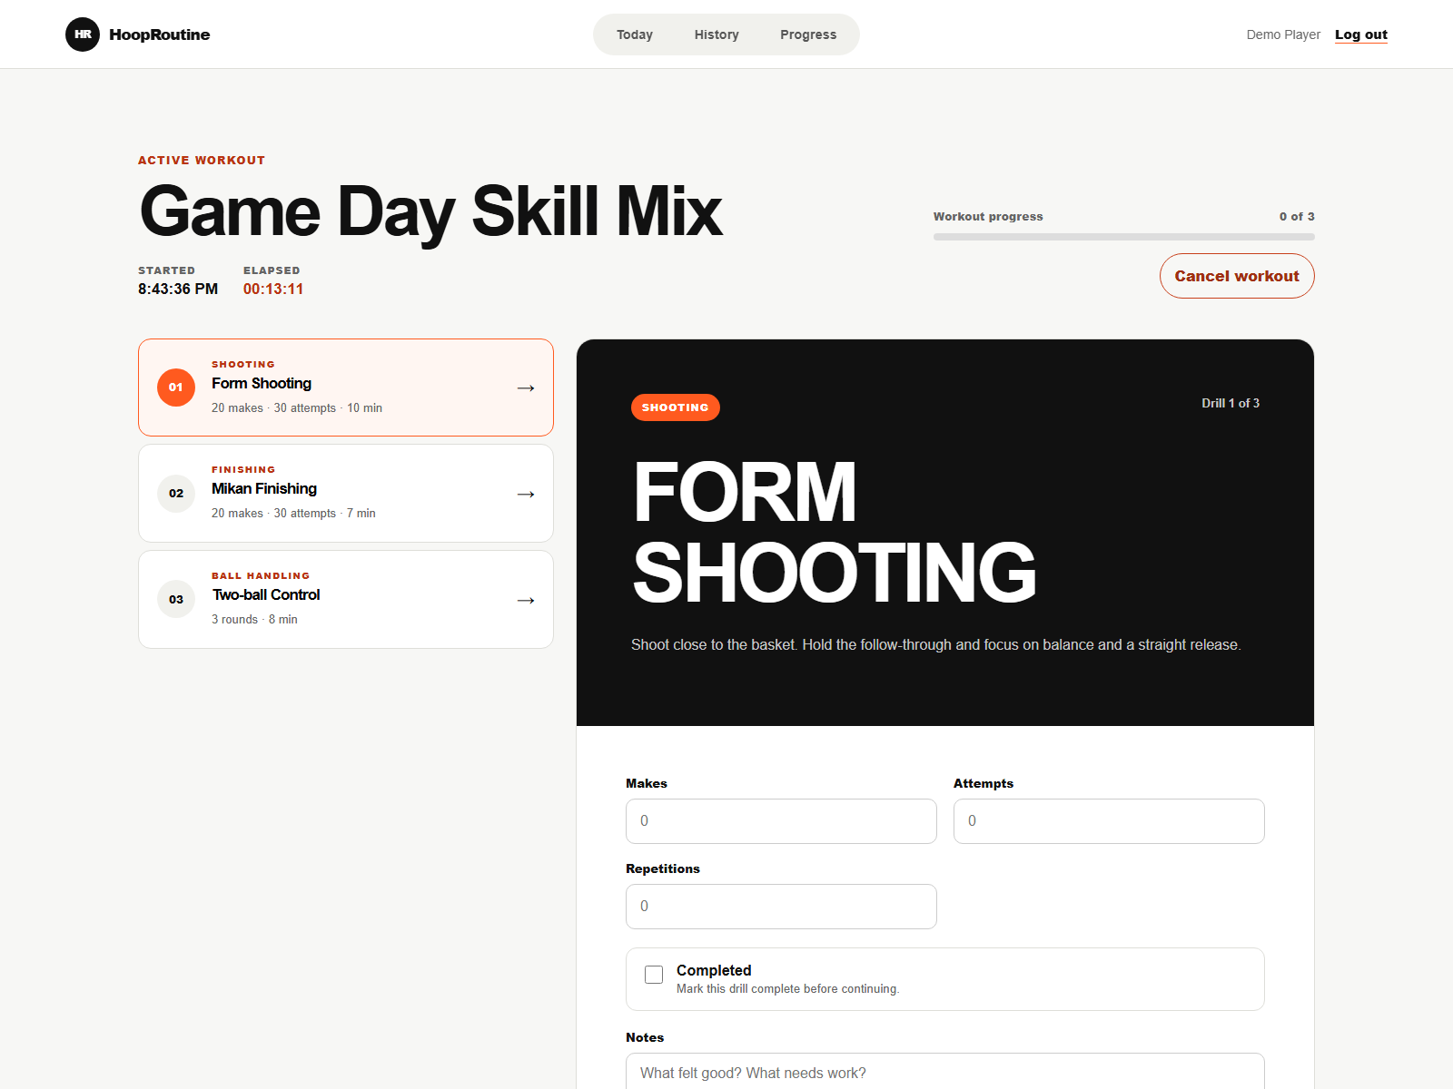
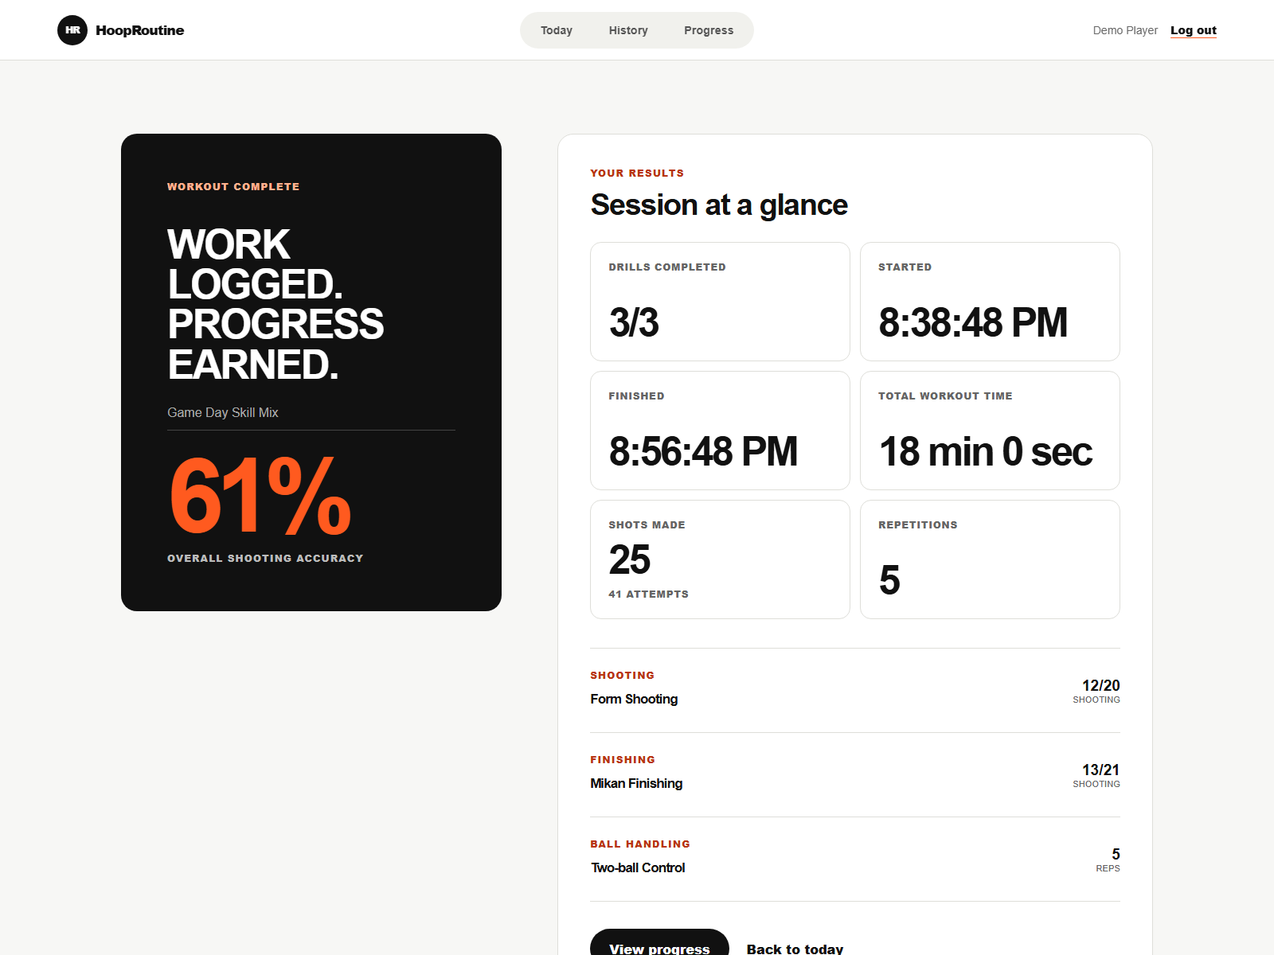
Record and review a session
Active workout
Workout summary
Save each drill result, then view totals and whole-session time.
Notes:
Demonstrate makes, attempts, repetitions, completed status, and notes. Finish the workout to show the saved summary, including start, finish, duration, and shooting accuracy. Screenshot values are sample demo data.

Slide 5
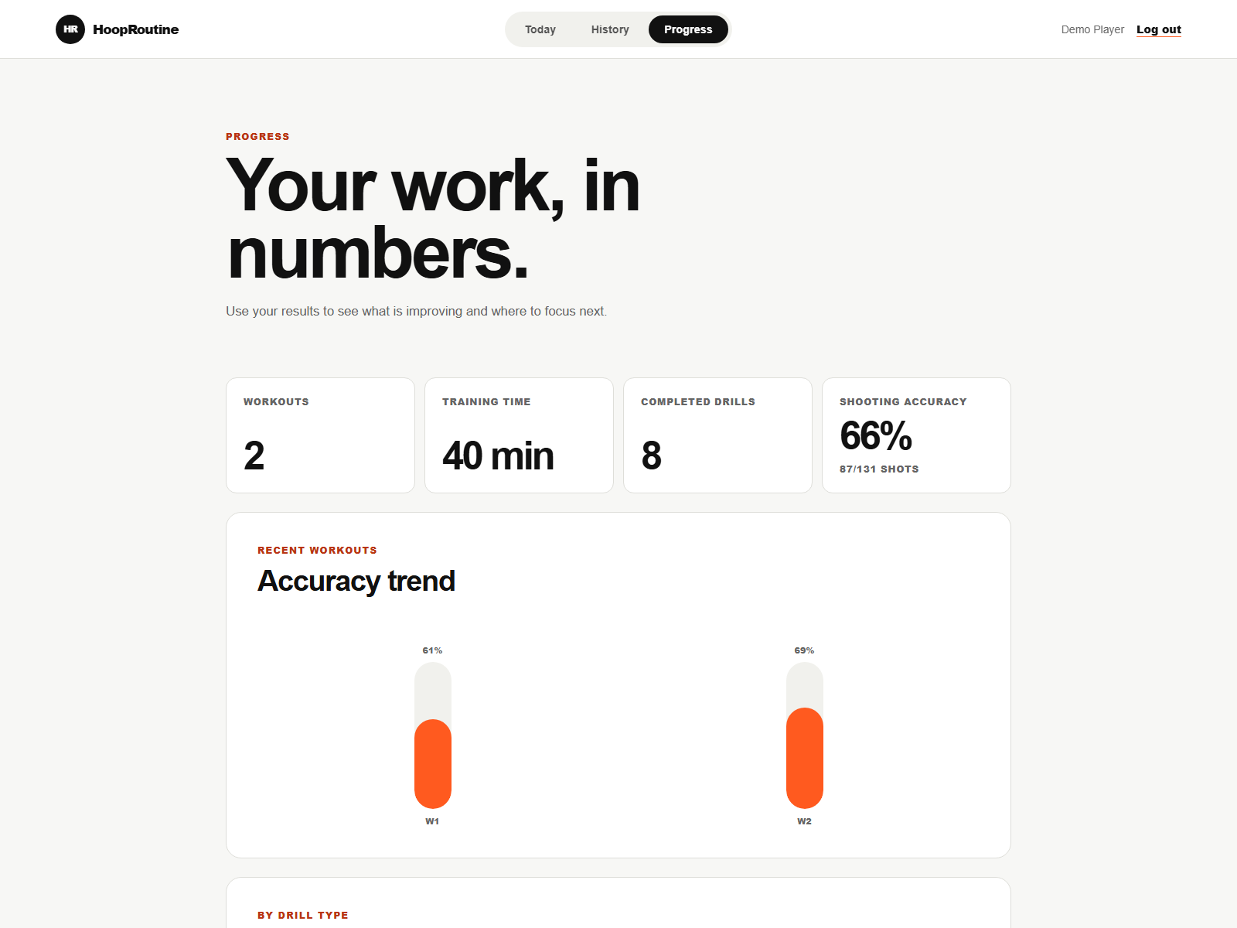
Progress and final checks
History keeps completed and unfinished sessions accessible.
Progress shows training time, completed drills, and shooting trends.
Before submission
Hosted database tests, accessibility and device review, deployment.
Notes:
Explain that History can resume unfinished sessions and open completed summaries. Progress aggregates completed work. Close with the remaining checks from README: route and database integration tests, accessibility and physical device testing, and deployment and production configuration. Do not claim those are complete.

