Slide 1

CV1711 ENGINEERING DRAWING & 3D BUILD
INFO MODEL (LAB)

Slide 2
WEEK 5 – Auxiliary Projection
Very Import, Closely Related to Quiz1, Please Pay Attention!

Slide 3

WEEK 5 – Auxiliary Projection – Recap
First Angle Projection
Third Angle Projection

Slide 4
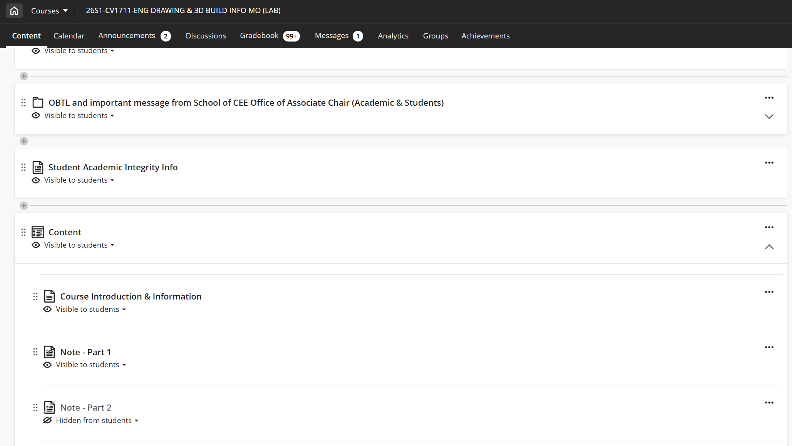
WEEK 5 – Auxiliary Projection – Materials for Self-learning
Read this before hands-on exercises!
Note there may be a few minor errors!

Slide 5
WEEK 5 – Auxiliary Projection – Assignments
Finish – E9, E10, E11
Submission – E10

Slide 6
WEEK 5 – Auxiliary Projection – Terms
First (Primary) Auxiliary Projection: A view projected onto a plane that is perpendicular to one principal view, used to show an inclined surface in its true size and shape.
First / Primary:
The projection obtained by rotating once from a principal view (front, top, or side). Not First Quadrant.

Slide 7
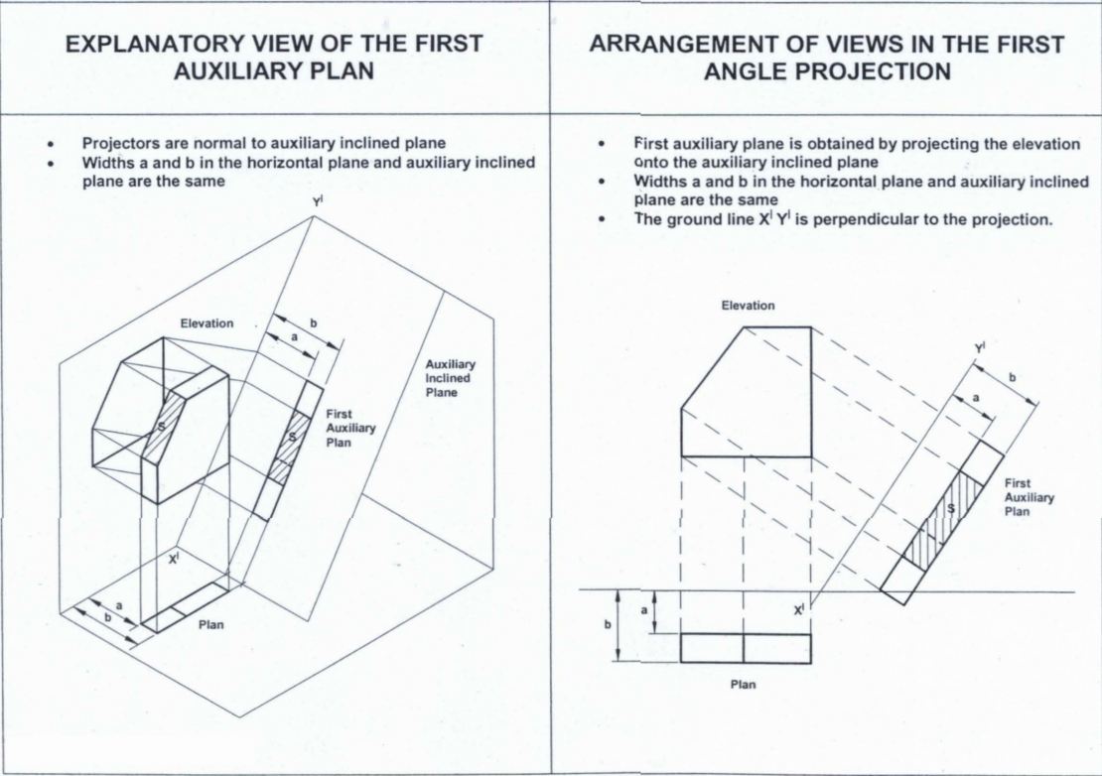
WEEK 5 – Auxiliary Projection – Auxiliary Plan
Some Kind of Plan:
– More Like Plan
– Perpendicular to Elevation View

Slide 8
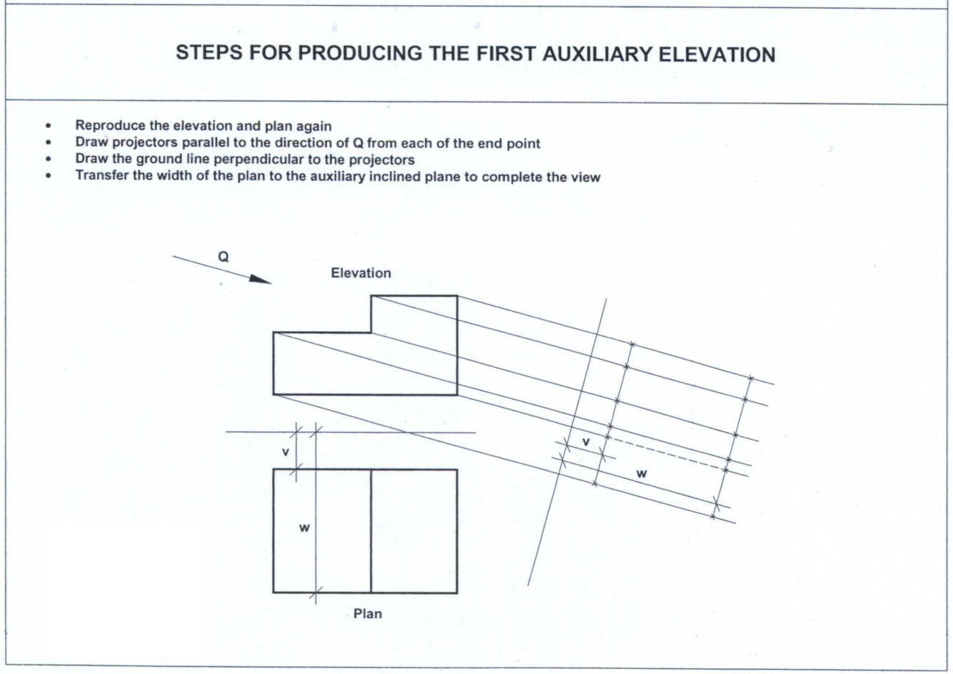
PLAN
Very Import!

Slide 9
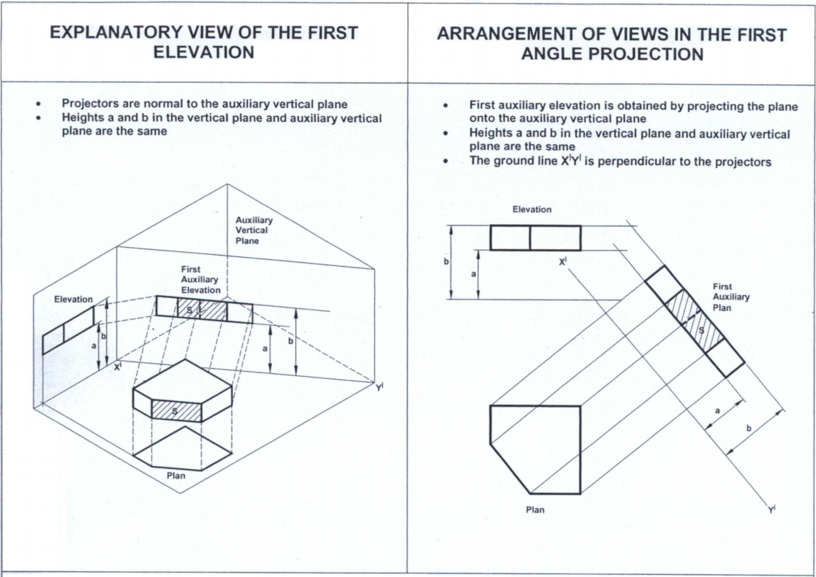
WEEK 5 – Auxiliary Projection – Auxiliary Elevation
Some Kind of Elevation:
– More Like Elevation
– Perpendicular to Plan View

Slide 10
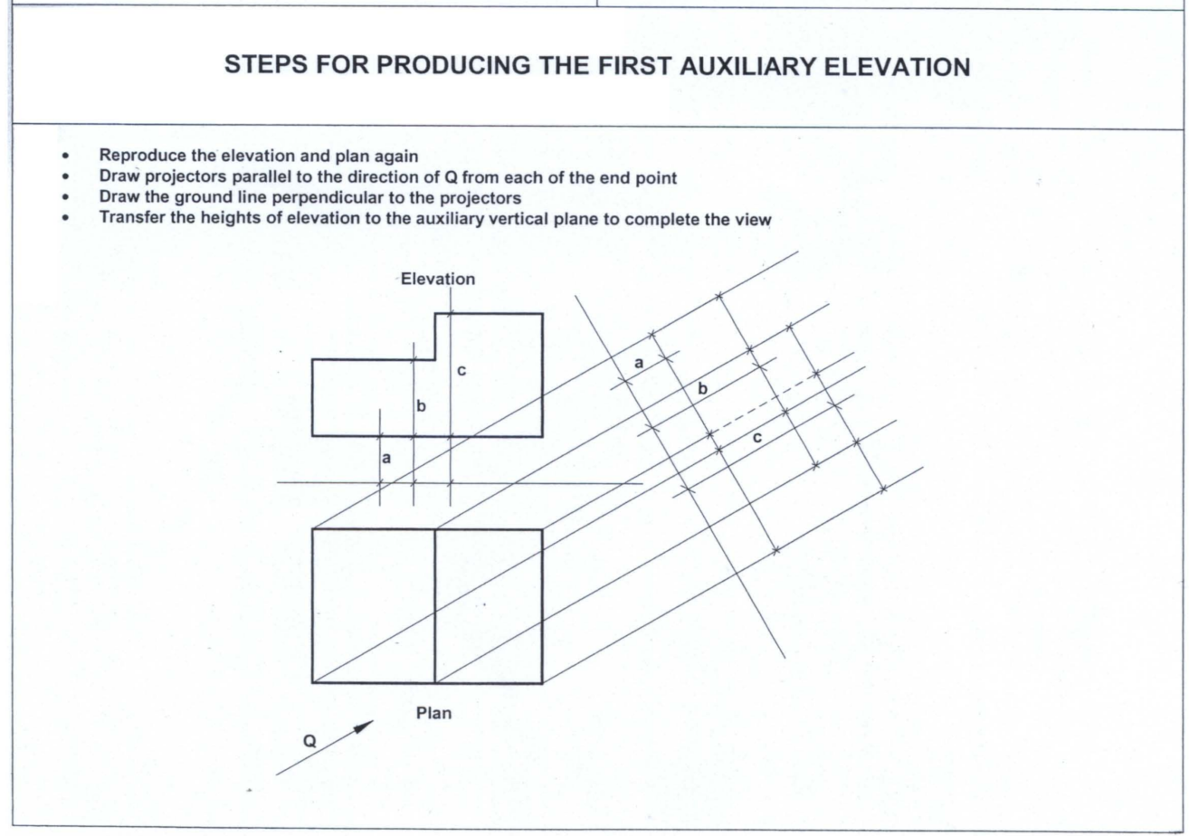
WEEK 5 – Auxiliary Projection
Very Import!

Slide 11
WEEK 5 – Auxiliary Projection
More likely for quiz1
First Quadrant (Angle)
Auxiliary Plan
Third Quadrant (Angle)
Auxiliary Elevation

Slide 12
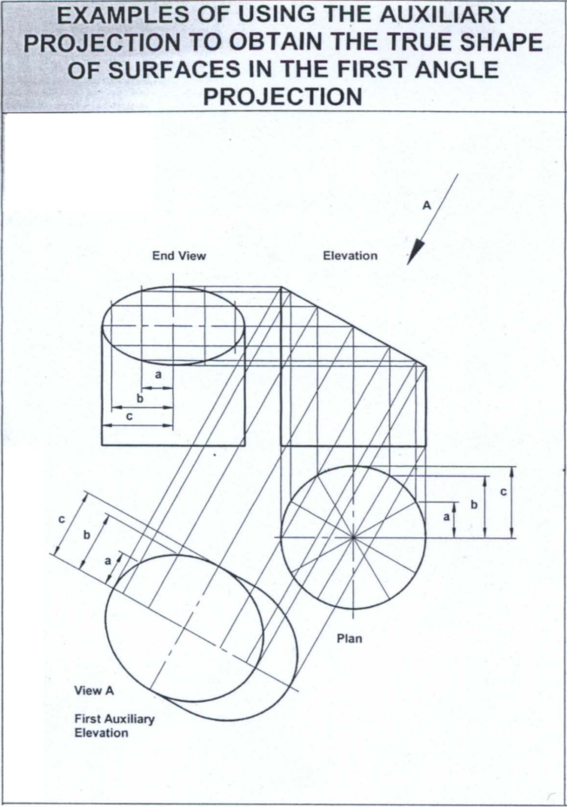
Example
- First Angle
- First Auxiliary Plan
Features:
- Projection behind the Object
- Perpendicular to Elevation View Projection

Slide 13
Example
- First Angle
- First Auxiliary Elevation
Features:
- Projection behind the Object
- Perpendicular to Plan View Projection

Slide 14
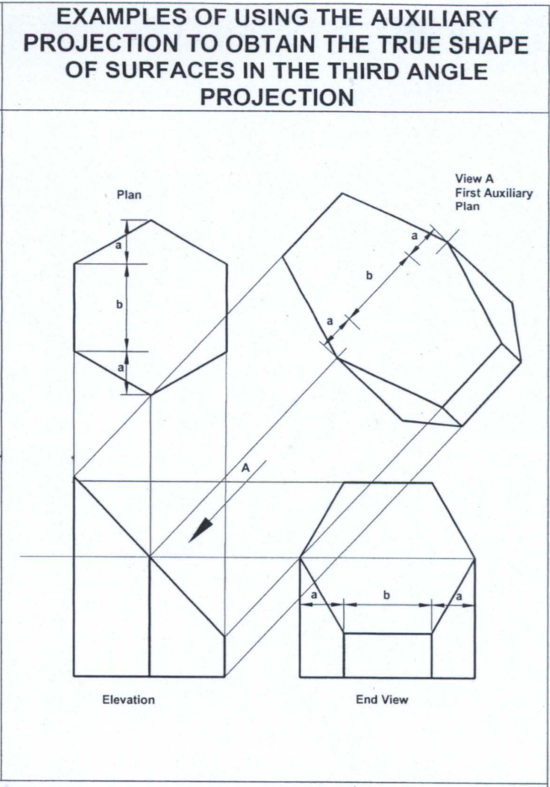
Example
- Third Angle
- First Auxiliary Plan
Features:
- Projection before the Object
- Perpendicular to Elevation View Projection

Slide 15
Example
- Third Angle
- First Auxiliary Elevation
Features:
- Projection before the Object
- Perpendicular to Plan View Projection

Slide 16
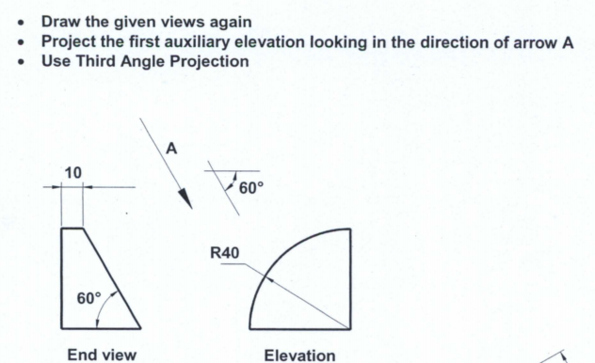
EXAMPLE 1
PLAN
A

Slide 17
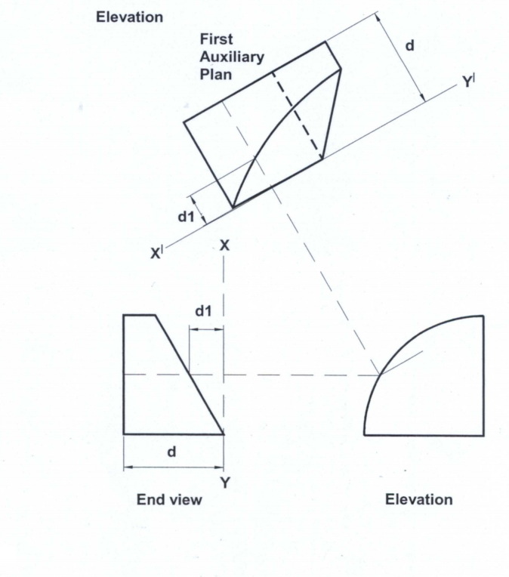
EXAMPLE 1
A

Slide 18
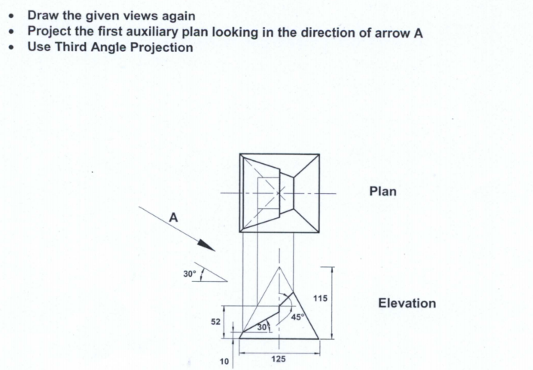
EXAMPLE 2
A

Slide 19
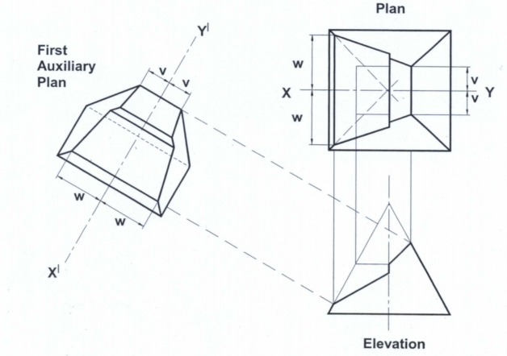
EXAMPLE 2

Slide 20
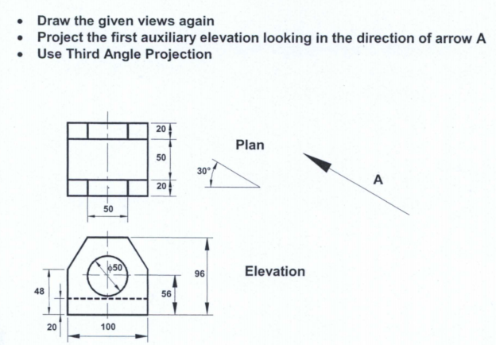
EXAMPLE 3
A

Slide 21
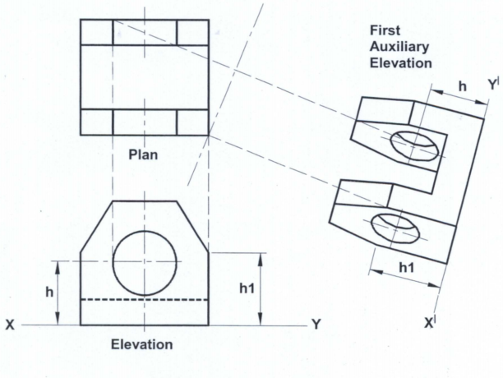
EXAMPLE 3
hidden line missed!

Slide 22
EXAMPLE 3

Slide 23


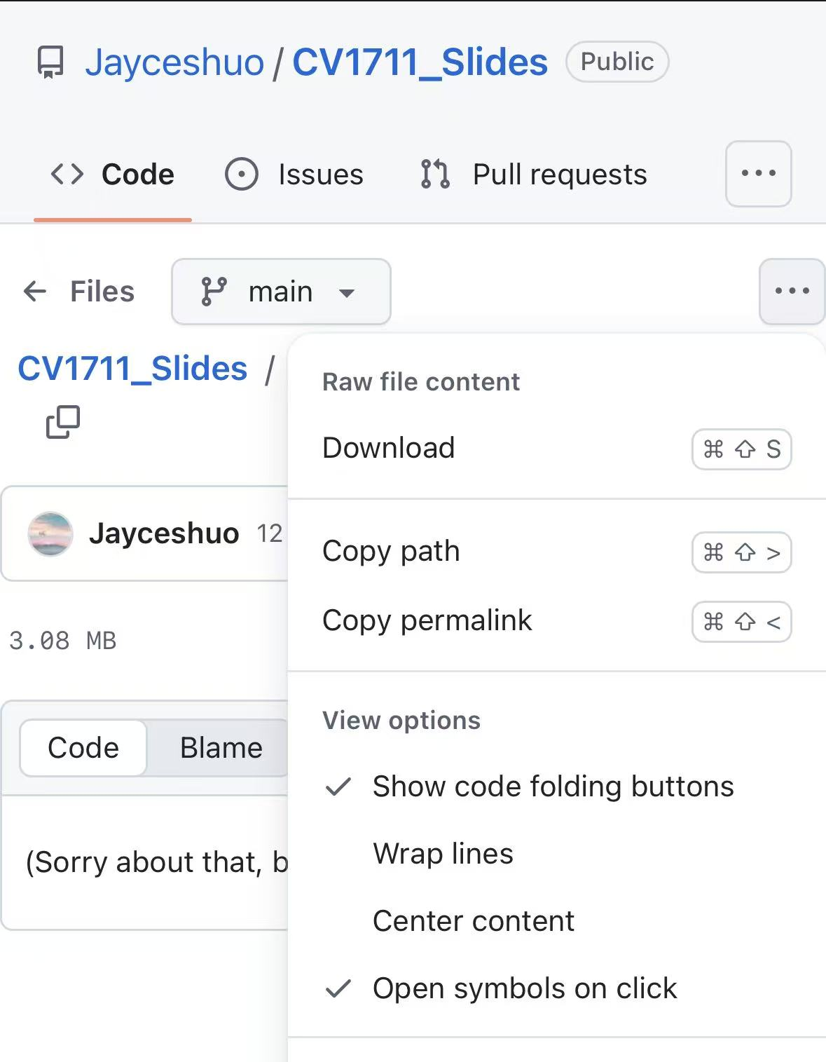
Where to download the slides?

