Slide 1


Username
Password
Enter

Slide 2
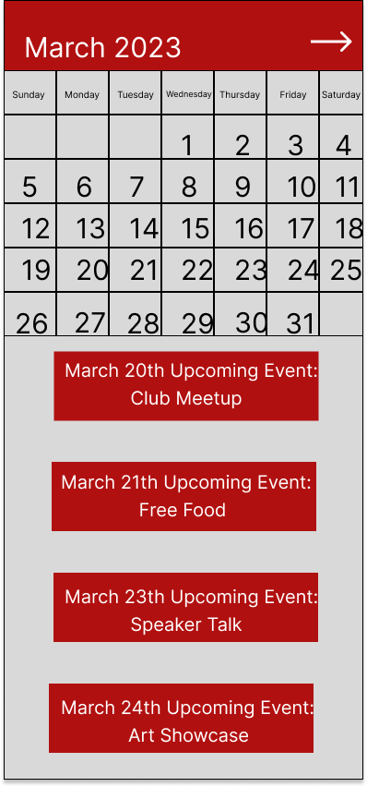

Slide 3
March 20th:
Club Meetup
Information:
Time: 3:30
Location: TBD
Host: TBD
RSVP
Contact Administrator

Slide 4
Leave questions for Administrator
Hello where will the meeting be held?
Type here…..

