Slide 1


Username
Password
Enter

Slide 2
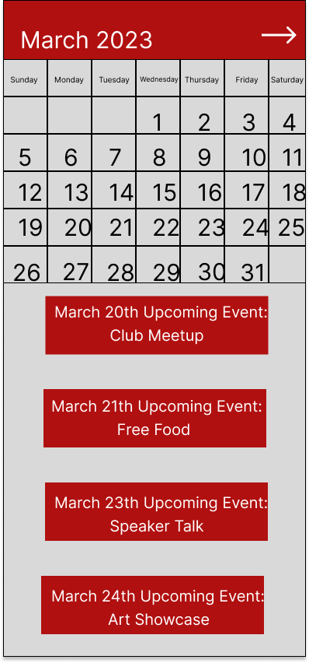

Slide 3

Attendee Event View
March 20th:
Club Meetup
Information:
Time: 3:30
Location: TBD
Host: TBD
RSVP
Contact Administrator

Slide 4
Leave questions for Administrator
Hello where will the meeting be held?
Type here…..

Slide 5
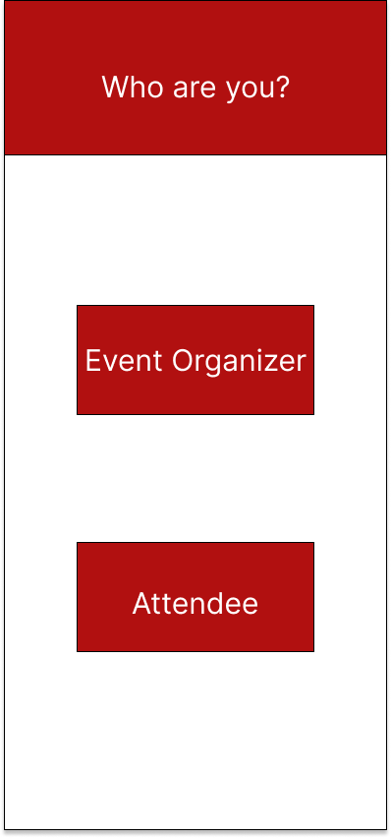

Slide 6
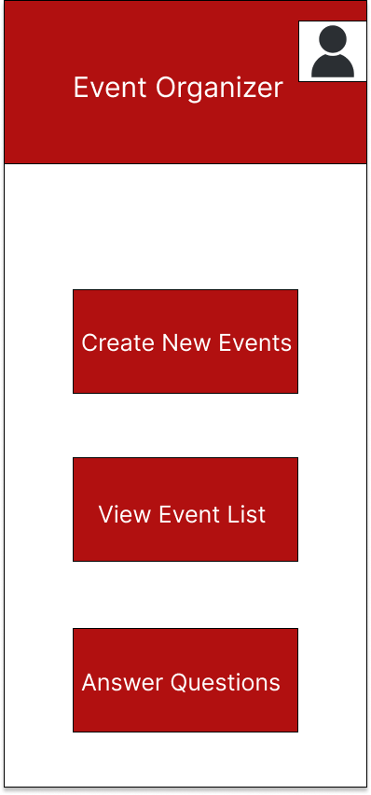

Slide 7
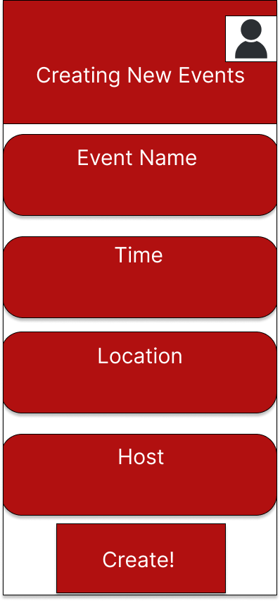
Type here…..
Type here…..
Type here…..
Type here…..

Slide 8
