Slide 1

Present By : Jaydeep purohit
Registration Number : 2202140
Predictive Models for Breast Cancer Diagnosis using Machine Learning Algorithms
"Cancer may have started the fight, but I will finish it."

Slide 2
An introduction
Breast cancer is the second leading cause of cancer death in women, second only to lung cancer.
The leading risk factor for breast cancer is simply being a women. Though breast cancer does occur in men, the disease is 100 times more common in women.
Men can also get a breast cancer. In 2017, the American cancer society estimates 2470 new cases of invasive breast cancer will be diagnosed in men in the U.S.
A women has about one in eight chance of being diagnosis with breast cancer in her lifetime, according to the national cancer institute.
Most women (about eight out of ten) who get breast cancer do not have a family history of the disease.
But women have close blood relatives with breast cancer have a higher risk, having a first degree relative (mother, sister or daughter) with breast cancer almost double a women’s risk.

Slide 3
Background Research Area
A research study proved that BC prediction with ML classifiers in the early phases does not just increase the survival chances but can control the diffusion of cancerous cells in the body (Rabiei R, et al., 2022).
The SVM based method for BC diagnosis and achieved practical results in prediction (Kamyab, M., et al., 2018).
Similarly, Furey et al. (2023) also employed SVM for cancer tissue classification with a linear kernel and attained a 93.4% accuracy.
Later, this work was extended by Zheng et al. (2022) by delivering a K-SVM hybrid model for WDBC dataset classification and acquiring 97% accuracy.
Meanwhile, some other researchers worked on different classifiers, such as Seddik et al. (2023), who proposed a method based on tumor variables for a binary logistic model to diagnose BC WDBC data and secure good results.
Likewise, Mert et al. (2023) used a KNN classifier to predict breast cancer by designing a feature reduction method with independent component analysis. It distributed the features with reduced one feature and 30 features and computed the performance, and attained 91% accuracy.

Slide 4
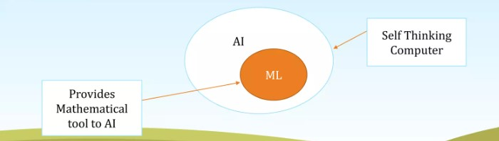
What is machine learning and why we are using it ?
Machine learning is a field of Artificial intelligence that uses statistical technique to give computer system the ability to “learn” (e.g., progressively improve performance on a specific task) from data, without being explicitly programmed

Slide 5
overview
In this research, four different prediction models were formulated with four machine learning algorithms such as SVM, KNN, LR, and EC to deal with a massive volume of tumor features for the extraction of essential information for the diagnosis of BC.
The objective was to explore an accurate and efficient prediction model for tumor classification by using DM techniques such as DET, Feature Distribution, Elimination, and Constructing a Hyperparameter for the practical analysis of WDBC.
These techniques enabled the machine learning predictive models to improve accuracy and enhance diagnostic efficiency.
Brest cancer
Data set
Machine learning
Diagnosis

Slide 6
Objectives
With the WDBC BC dataset, which improved in quality by identifying the tumor and classifying it as benign or malignant, we looked at 4-prediction ML algorithms such as SVM, KNN, LR as well as EC.
Before putting several ML classifiers into use as prediction models, these methods the forecasting methods to reach their highest levels of diagnosis accuracy for BC.
We design tests to verify the models' time complexity prediction as well as classification accuracy, and we provide comparative analysis with literature review as well as different evaluation matrices.
Classify
Prediction
Testing

Slide 7
Proposed Methodology
List of Machine Learning algorithms below:
Support Vector Classification (SVC)
Linear Regression (LR) (Hasan, A.S.M.T.; et al., 2022)
K-Nearest Neighbor (KNN) (Soham Chattopadhyay; et al., 2022)
Random Forest (EC) (Hager Saleh, et al., 2022)
Decision Tree
Gradient Boosting

Slide 8
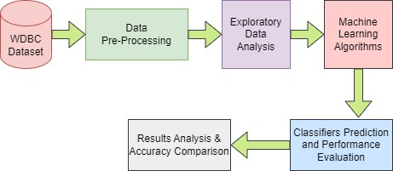
Flow of Working
Flow of Working

Slide 9
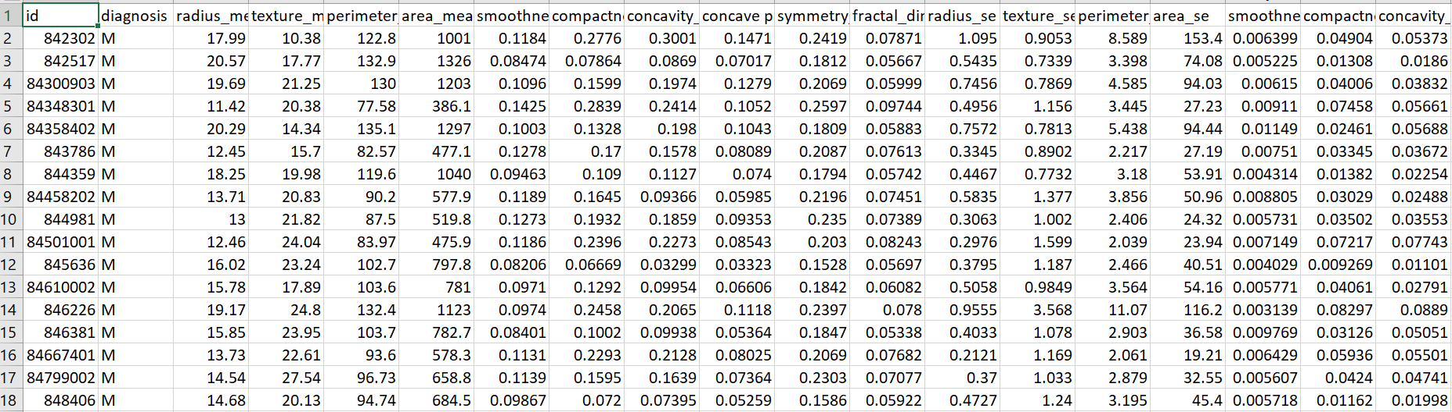
Step 1: Collecting data
The WDBC dataset contains data from 569 patients and includes 10 breast tumor feature characteristics. It was delivered by Dr. William H. Wolberg at the University of Wisconsin Madison's General Surgery Department in the USA.
WDBC dataset available on Kaggle website and dataset source link is here: (https://www.kaggle.com/code/meetnagadia/breast-cancer-classification/input) Based on the digital scan, cytological feature analysis was then carried out using software named Xcyt. Finally, the diagnosis of each sample such as Malignant (M) or Benign (B).
the breast cancer data includes 569 examples, each with 32 attributes.

Slide 10
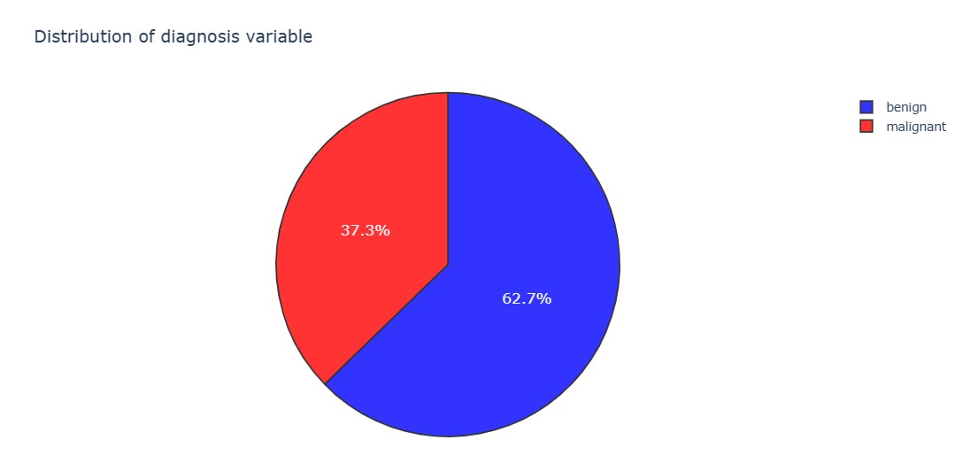
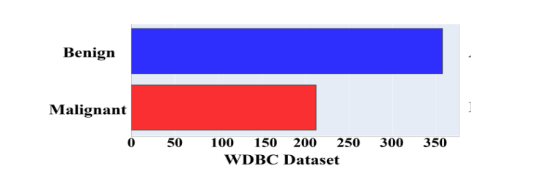
Step 2: Exploring and preparing the data
In general, benign and malignant are two classes of tumors. Although benign is not life-threatening and cancerous, it may boost the chances of BC risk.
In contrast, malignant is more alarming and cancerous tumors. A study performed BC detection and reported 20% of women died due to malignant tumors (Leo, et al., 2021).
In WBCD dataset around 62.7% patient of benign and 37.3% patient of malignant.

Slide 11
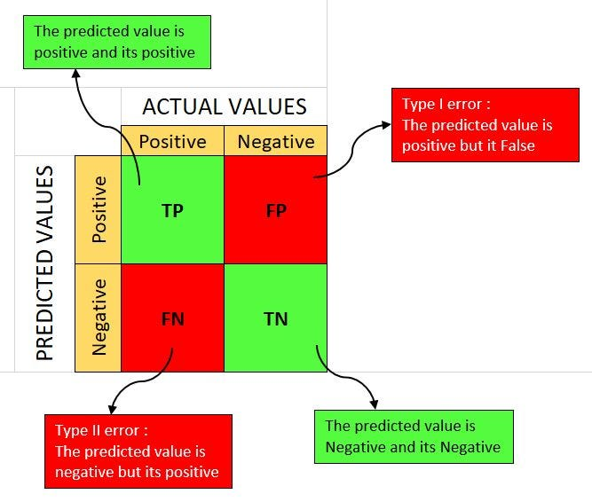
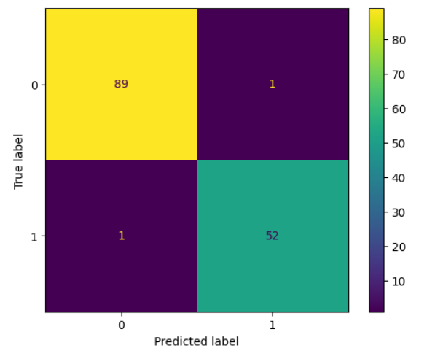
Step 3: Result – Confusion matrix
A confusion matrix is a useful tool for evaluating the performance of a classification model. It helps you understand how well your model is performing in terms of making correct and incorrect predictions.
True Positives (TP): These are cases where the model correctly predicted the positive class. For example, the model correctly identified 50 people with a disease as having the disease.
True Negatives (TN): These are cases where the model correctly predicted the negative class. For example, the model correctly identified 200 people without a disease as not having the disease.
False Positives (FP): These are cases where the model incorrectly predicted the positive class when it should have predicted the negative class. For example, the model incorrectly identified 10 people without a disease as having the disease.
False Negatives (FN): These are cases where the model incorrectly predicted the negative class when it should have predicted the positive class. For example, the model incorrectly identified 5 people with a disease as not having the disease.

Slide 12
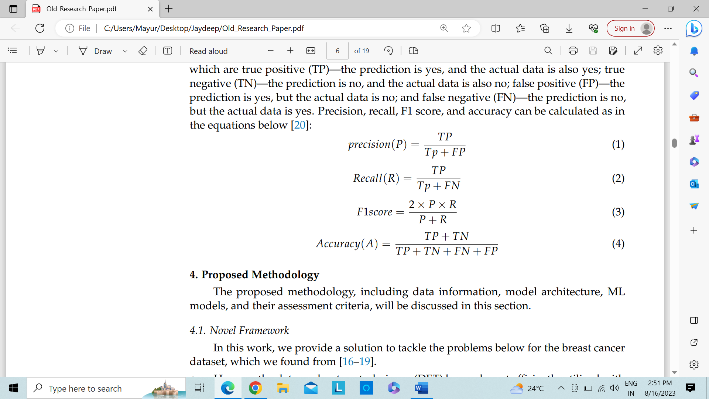
Performance Evaluation Matrices
In this study, we compared the precision, recall, F1 score, and accuracy cross-validation matrices.
The numbers in the confusion matrix could be used to create these matrices since they remain TP, meaning that both the prediction and the observed data remain true;
TN – both the prediction as well as the data support the negative conclusion
Both FP as well as FN situations in which the forecast is true but the actual data contradicts it. You may calculate P, R, F1-score, and A using the formulas below (L. Liu et al., 2023):
Where,
TP = true positive, FP = false positive, TN= true negative, FN = false negative

Slide 13
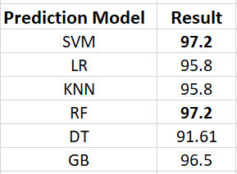
Step: 3 Results
The comparison between prediction model. Here we can see clearly SVM(support vector machine) and RF(random forest) has high percentage.
So I decide go with RF because
Ease of Use
Scalability
Feature Importance
Ensemble Averaging

Slide 14
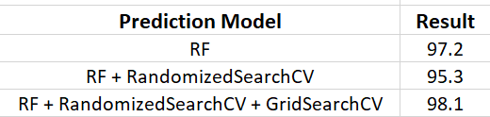
Step: 3 Results - Continue
Now I add random search and grid search more technique in the RF model for getting better result.
Random search and grid search are techniques used in machine learning to tune hyperparameters and optimize the performance of a model. These methods help you find the best combination of hyperparameters for your model without manually trying different values.
After add these two technique in the prediction model I got the below result.

Slide 15
Conclusion
One of the primary objectives of this study was the implementation of DET before the execution of ML classifiers on the WDBC dataset. These DM techniques enabled us to improve the prediction model’s performance with a maximum F1 score and an accuracy score higher than before. We got the RF with grid search model had acquired the highest accuracy (98.1%).
Meanwhile, RF also secured 97.2% accuracy, which shows that DET effectively detect higher accuracy.
Our outcomes depict the competence of our prediction models for BC diagnosis and provide adequate results by utilizing a short time for training the model. These sophisticated models, techniques, and results would help the physician and data analyst to apply a more intelligent classifier to diagnose BC features.

Slide 16
Future Work
We will conduct experiments on the datasets from other countries and try to answer whether or not the different area patient’s data affect the model’s performance
We will add some more techniques and see what will happen.

Slide 17
Present By : Jaydeep purohit
Registration Number : 2202140
Thank you

