Slide 1
Deep Learning-Based Speech Enhancement & Separation for the Cocktail Party Problem
Minor Project Evaluation
Jaydeep Parmar — 23BIT133
Yatharth Tadvi — 23BIT143
Department of ICT, PDEU
Mentor: Dr. Jigar Shah
Notes:
[Jaydeep, ~20s] Good afternoon, sir. Our project is on the Cocktail Party Problem: picking one voice out of a mixed recording. We started by removing background noise, and then moved to separating two overlapping speakers using Conv-TasNet. First, why this problem is hard.KEY: We moved from removing noise to separating overlapping voices.

Slide 2
Introduction & Motivation — The Cocktail Party Problem
Humans can focus on one voice in a crowd. A microphone records one overlapping mixture: x(t) = s₁(t) + s₂(t)
Speech Denoising
Speech Separation
Speaker 1
+
+
Speech
Noise
Clean Speech
Speaker 1
Speaker 2
Speaker 2
Speech + Noise → Clean Speech
Speaker 1 + Speaker 2 → Speaker 1 / Speaker 2
Applications: hearing aids · voice assistants · teleconferencing · speech recognition
True Cocktail Party Problem = overlapping human speech
2
Notes:
[Jaydeep, ~50s] In a crowded room, a person can focus on one speaker. A microphone can't: it records every voice added together as one waveform. This matters for hearing aids, voice assistants, meeting calls and transcription. Now the key distinction. Denoising takes speech plus noise and returns speech; the noise is a different kind of sound, so it is easier. Separation takes two speakers and must return both. Both are human speech with similar frequencies, so it is much harder. That is the true Cocktail Party Problem, and it is our target. (Diagram shows 2 speakers, the case we built.)KEY: Denoising removes non-speech; separation untangles speech from speech.

Slide 3
Objectives
01
02
03
04
05
Compare
Denoise
Separate
Optimize
Evaluate
Spectrogram U-Net vs Conv-TasNet
Speech + noise → clean speech
Two overlapping speakers → two voices
Scale data and accelerate training
SI-SDR / SI-SDRi, PESQ, STOI
3
Notes:
[Jaydeep, ~40s] We had five objectives. One: compare a frequency-domain model, the Spectrogram U-Net, with a time-domain model, Conv-TasNet. Two, Phase 1: remove environmental noise. Three, Phase 2: separate two overlapping speakers, the real Cocktail Party Problem. Four: build a training pipeline efficient enough for large data on a single Colab T4. Five: evaluate with SI-SDR for distortion, PESQ for quality, STOI for intelligibility.KEY: Compare, denoise, separate, optimize, evaluate.

Slide 4
Literature Survey
Approach | Main idea | Limitation
Spectral Subtraction / Wiener Filter | Estimate and suppress noise | Stationary-noise assumption
Spectrogram U-Net | Predict spectrogram mask | Uses noisy phase
Conv-TasNet (Luo & Mesgarani, 2019) | Waveform → TCN → separated speakers | Data/compute intensive
SepFormer | Transformer-based separation | Future work, not tested in this project
Our chosen approach: Conv-TasNet
PAPER result (not ours)
15.3 dB SI-SDRi
WSJ0-2mix · 5.1M params
Raw waveform
Encoder
TCN → masks
Decoder
4
Notes:
[Jaydeep, ~60s] The literature shows a progression. Traditional methods, spectral subtraction and Wiener filtering, assume stationary noise, so they struggle in real environments. Deep learning moved to spectrograms: a U-Net predicts a mask on the STFT magnitude but reuses the noisy phase; in our Phase 1 it worked very well for denoising. The key paper is Conv-TasNet by Luo and Mesgarani, 2019. It removes the STFT: a learned encoder turns the raw waveform into features, a temporal convolutional network estimates masks, and a decoder rebuilds the audio. The paper reports 15.3 dB SI-SDR improvement on WSJ0-2mix. Transformer models like SepFormer are future work. Now, the gap.KEY: Conv-TasNet separates directly on the waveform: encoder, TCN, decoder, no STFT.

Slide 5
Research Gap & Required Improvement
LIMITATION
PHASE 2
PHASE 1
Overlapping speakers remain unsolved
Speaker 1 + Speaker 2 → True Separation
Speech + Noise → Denoising
REQUIRED IMPROVEMENTS
Speaker + environmental noise together
More speaker pairs
Larger model
Faster training
Better evaluation
2,700 → 14,269
1.4M → 3.4M
training pairs
parameters
5
Notes:
[Jaydeep, ~50s] Phase 1 only handled one speaker plus environmental noise, which does not solve overlapping people: gap one. Gap two is scale. Our Phase 2A baseline had only 2,700 training pairs and a 1.4 million parameter model, and reached 6.98 dB improvement against the paper's 15.3. Large-scale training also hit I/O and GPU limits. Gap three is evaluation: Phase 1 used one test sample and no PESQ or STOI. So our improvement is two-speaker separation, 14,269 pairs, a scaled 3.4M Conv-TasNet, an optimized pipeline, and SI-SDR, PESQ and STOI evaluation. Over to Yatharth.KEY: The gap is not noise removal; it is separating speech from speech at scale.

Slide 6
Proposed Methodology
DATA PREPARATION
LibriSpeech
Speaker A
+ Speaker B
16 kHz
→ 8 kHz
Random SNR
−5 to +5 dB
Mix
A + B
4-second
chunks
CONV-TASNET
TCN
Separator
Speaker
Masks
Speaker 1
+ Speaker 2
Encoder
Decoder
PIT — solves the unknown output-speaker order
Two outputs
order unknown
Try both orders
Out1→S1 or Out2→S1
Keep the better
loss = −SI-SDR
Evaluate
SI-SDR / SI-SDRi
AdamW + FP16
251
14,269
3,396,144
NVIDIA T4
speakers
mixture pairs
parameters
GPU
optimizer · precision
6
Notes:
[Yatharth, ~90s] We start with LibriSpeech train-clean-100: 28,539 utterances from 251 speakers. We group by speaker so we never mix a person with themselves, and resample from 16 to 8 kHz, the benchmark rate that halves computation. We pair Speaker A with a different Speaker B, trim to the shorter, scale B at a random relative SNR between minus 5 and plus 5 dB, add them, guard against clipping, and take a random 4-second chunk. That gives 14,269 pairs. The model is Conv-TasNet. The encoder, a 1D convolution, turns the waveform into learned features, replacing the STFT. The separator, a temporal convolutional network, builds one mask per speaker, deciding which features belong to whom. The decoder rebuilds the waveform. The network outputs two signals but does not know which is Speaker 1, so Permutation Invariant Training tries both assignments and trains on the better one, with negative SI-SDR as the loss. We evaluate with SI-SDR and its improvement, plus PESQ and STOI.KEY: Encoder learns features, TCN assigns them to speakers, decoder rebuilds audio, PIT fixes the speaker order.

Slide 7
Work Done
PHASE 1
PHASE 2A
PHASE 2B
DENOISING
BASELINE SEPARATION
SCALING + OPTIMIZATION
2,700
14,269
3.4M
Spectrogram U-Net
training pairs
training pairs
parameters
1.4M
FP16/AMP
Batch 4 → 12
Conv-TasNet
parameters
mixed precision
batch size
+6.98 dB
Local SSD
14 → 4.5 min
Environmental noise
test SI-SDRi
data staging
per epoch
7
Notes:
[Yatharth, ~60s] Our work has three stages. Phase 1: the denoising dataset, a Spectrogram U-Net and a Conv-TasNet. Phase 2A: our first separation baseline: 2,700 training pairs, a 1.4 million parameter model, 50 epochs, and 6.98 dB improvement on the test set. Phase 2B: 14,269 pairs from 251 speakers and a 3.4 million parameter model. The biggest engineering result is training time: Phase 2B epochs dropped from about 14 minutes to 4.5, roughly 70 percent less. Four fixes: data moved from Google Drive to the local SSD, batch size from 4 to 12, FP16 mixed precision on the T4's Tensor Cores, and epsilon raised to 1e-5 to stop FP16 NaN errors. We also fixed audio clipping at inference with peak normalization.KEY: Phase 2B epochs went from 14 to 4.5 minutes through storage, batch size, FP16 and a stability fix.

Slide 8
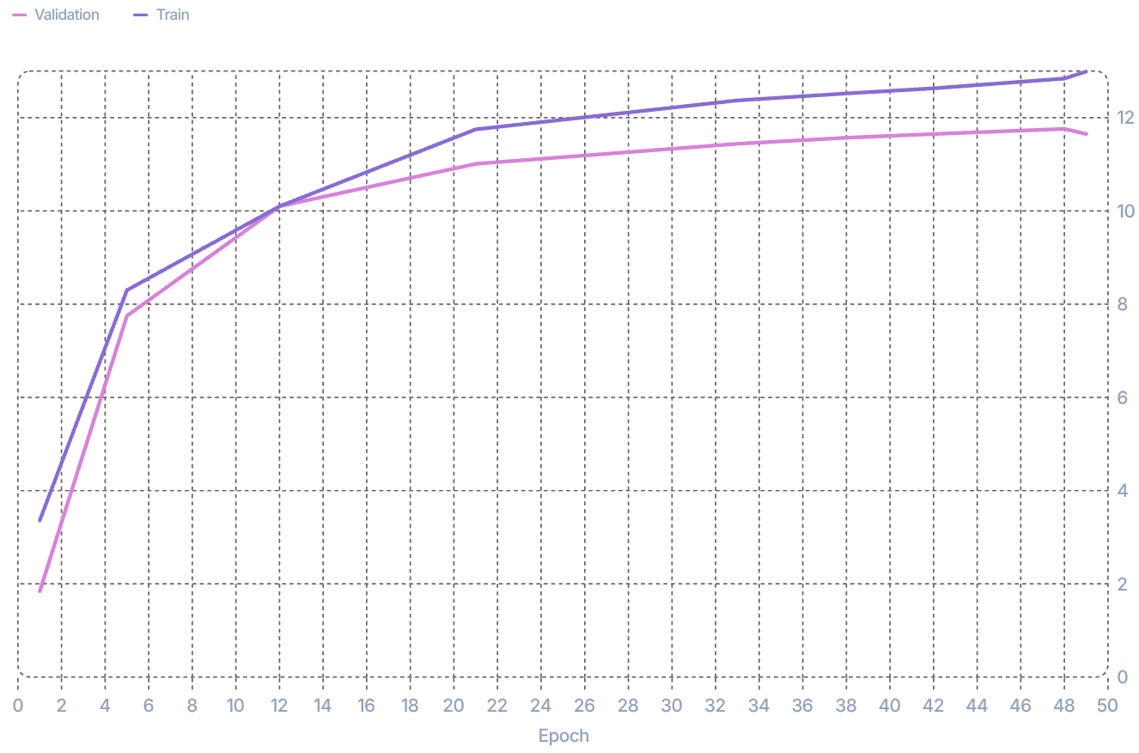
Results Obtained
+11.76 dB
+11.06 dB
14 → 4.5 min
Best Validation SI-SDR
Mean Test SI-SDRi
Training time per epoch
Training vs validation SI-SDR (dB)
PESQ · perceived quality
STOI · intelligibility
1.59 → 2.36
71.3% → 88.1%
Phase 2A → 2B | 2A | 2B
Training pairs | 2,700 | 14,269
Parameters | 1.4M | 3.4M
Validation SI-SDR | 8.66 dB | 11.76 dB
Test SI-SDRi (mean) | 6.98 dB | 11.06 dB
Best val +11.76 dB (epoch 48); train +12.99 dB (epoch 49)
SI-SDR = validation quality (4-s crops) · SI-SDRi = test improvement over the mixture
8
Notes:
[Yatharth, ~70s] Three views, kept separate because they are different measurements. Training: validation SI-SDR rose from 1.84 dB at epoch 1 to 10.10 at epoch 12 and peaked at 11.76 dB at epoch 48; training SI-SDR reached 12.99 at epoch 49. The gap is about one dB and validation is flattening, so more training with learning-rate decay is next. Comparison with our baseline, like for like: validation SI-SDR went from 8.66 to 11.76 dB; on the test evaluation, mean SI-SDR improvement went from 6.98 to 11.06 dB and the median from 8.26 to 12.23. Perceptual: PESQ, perceived quality, rose from 1.59 to 2.36; STOI, intelligibility, from 71.3 to 88.1 percent. The Phase 1 numbers are a different task and not comparable.KEY: Best validation 11.76 dB; test SI-SDRi 6.98 → 11.06 dB; PESQ 1.59 → 2.36; STOI 71.3 → 88.1%.CONFIRM before presenting: 11.06 / 12.23 / PESQ / STOI come from the mid-evaluation document only.

Slide 9
Conclusion & Future Work
WHAT WE ACHIEVED
FUTURE WORK
1
Denoising → true 2-speaker separation
Continue training with LR decay
Full-length held-out test evaluation
Speaker + environmental noise
SepFormer comparison
Harder real-world conditions
2
2,700 → 14,269 pairs
3
1.4M → 3.4M parameters
4
14 → 4.5 min/epoch
5
Best validation SI-SDR = +11.76 dB
THANK YOU
9
Notes:
[Yatharth, ~20s: conclusion] We moved from denoising to true two-speaker separation. We scaled the model and the data, cut Phase 2B training time by about 70 percent, and reached 11.76 dB best validation SI-SDR with clear PESQ and STOI gains. We are still below the original paper's 15.3 dB, which used a different dataset, and training has not fully converged.[Jaydeep, ~20s: future work] Next we will continue training with learning-rate decay, evaluate on full-length held-out audio, fine-tune on speakers plus noise, and compare with SepFormer. Thank you; we are happy to take questions.KEY: Denoising → separation, scaled and optimized; next step is speakers plus noise.

