Slide 1
Note: Theory Internal Marks based on Assignment Work/Quiz (25%)
Practical Internal Marks based on Experimental Lab Work (50%)

Slide 2
Assignment 1: Mathematical Preliminaries - I: Linear Algebra
MACHINE LEARNING LAB (20IC313P)
ICT - Semester 6 – Dept. Elective Course

Slide 3
Ref.:
Chapter 2; Topic 2.1 of Book:
Machine Learning Fundamentals; Hui Jiang; 2020; Cambridge University Press.
Topics to Learn:
Vectors and Matrices
Linear Transformation
Basic Matrix Operations
Eigen Values and Eigen Vectors
Matrix Calculus

Slide 4
Notations

Slide 5
Summary of the General Notation Rules

Slide 6
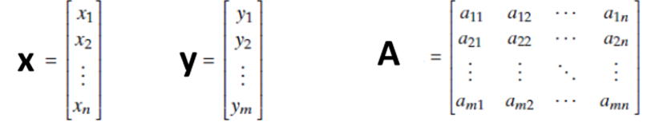
Vectors and Matrices
A scalar is a single number, often denoted by a lowercase letter, such as x or n. We also use x ∈ R to indicate that x is a real-valued scalar and n ∈ N for that n is a natural number.
A vector is a list of numbers arranged in order, denoted by a lowercase letter in bold, such as x or y. (OR variable with bar sign above it while teaching on board)
All numbers in a vector can be aligned in a row or column, called a row vector or column vector, accordingly. By default adopts the convention of writing a vector in a column.
We use x ∈ R^{n} to indicate that x is an n-dimensional vector containing n real numbers.
A matrix is a group of numbers arranged in a two-dimensional array, often denoted by an uppercase letter in bold, such as A or B.
For example, a matrix containing m rows and n columns is called an m x n matrix.
We use A ∈ R^{m x n} to indicate that A is an m x n matrix containing all real numbers.
Along the same lines, we can arrange a group of numbers in a three-dimensional or higher-dimensional array, which is often called a tensor.

Slide 7
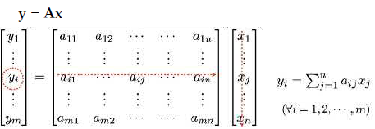
Linear Transformation as Matrix Multiplication
Using the matrix multiplication, any point x in the first space R^{n} is transformed into another point y in a different space R^{m}.
The exact mapping between x and y depends on all numbers in the matrix A.
If A is a square matrix in R^{nxn}, this mapping can also be viewed as transforming one point x ∈ R^{n} into another point y in the same space R^{n}.
However, this matrix multiplication cannot implement any arbitrary mapping between two spaces.
The matrix multiplication actually can only implement a small subset of all possible mappings called linear transformations.
must satisfy two conditions: (i) the origin in R^{n} is mapped to the origin in R^{m}; (ii) every straight line in R^{n} is always mapped to a straight line (or a single point) in R^{m}.

Slide 8
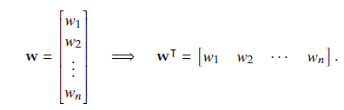
Basic Matrix Operations
Transpose and Inverse of a matrix:

Slide 9

Inner (Dot) Product and L_{p} norm of vectors
L₂ (2nd) norm is also called magnitude of a vector and it is used to normalize any vector
and to find unit vector (vector with magnitude = 1); Normalized vector w = w / ||w||
In general: L_{p}-norm of vector x = [x₁, x₂, ….., x_{n}]^{T}
p=1,2,……∞.

Slide 10
CAUCHY-SCHWARTZ (CS) INEQUALITY
Let x and y ∈ R^{n}. The Cauchy-Schwartz inequality states that |x·y| ≤ ||x|| ||y||

Slide 11

Example:

Slide 12
Trace of a Matrix

Slide 13

Eigen Values and Eigen Vectors
Solve: |λI-A| = 0 to get Eigen values (get n Eigen values for n x n matrix); I is n x n identity matrix
For each Eigen value use Au =λu to get corresponding Eigen vectors and normalize it such that ||u|| =1
For symmetric real matrix, the eigenvalues are always real and corresponding eigen vectors are always orthogonal to each other.
In general for any matrix A, eigenvalues are complex and corresponding eigenvectors are not always orthogonal.

Slide 14
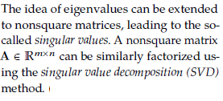
Eigen Values and Eigen Vectors: Eigen Value Decomposition (EVD)
(A is real symmetric matrix
with distinct Eigen Values)
; U is orthogonal matrix here

Slide 15
Matrix Calculus
y = f(x) or y = f(A)
(Gradient vector of function y=f(x)

Slide 16
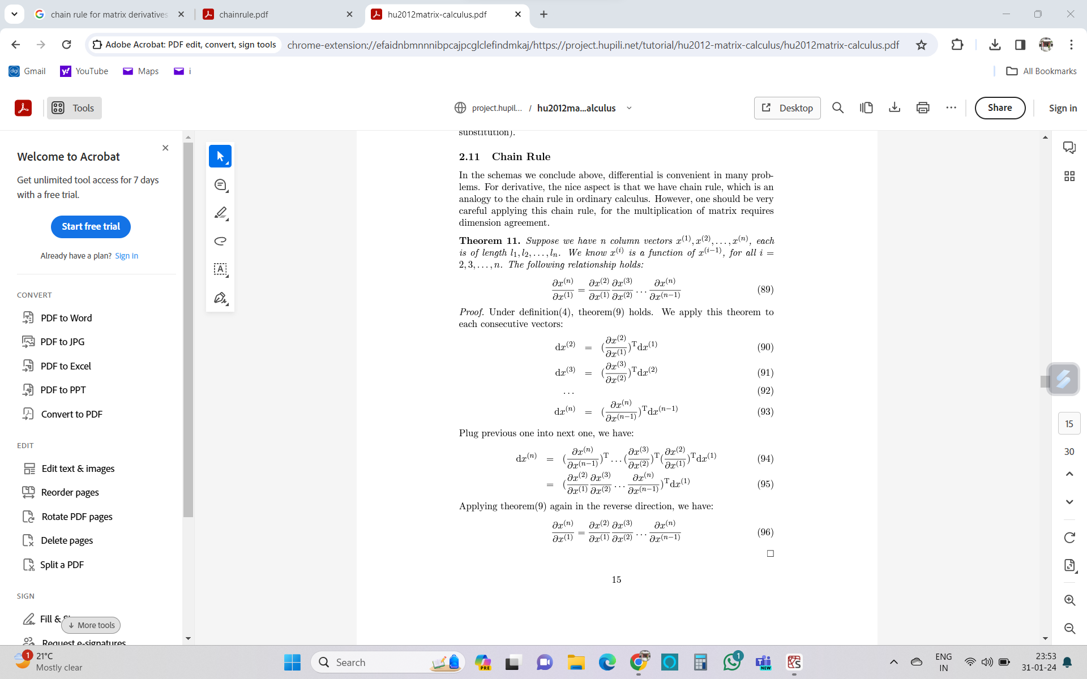
Matrix Calculus Identities for ML

Slide 17
Assignment 1
Solve Exercise Problems:
Q2.1 to Q2.4

Slide 18
Work Flow:
Assignment Problem Statement (Handwritten)
Solution (Handwritten)

