Slide 1
Note: Theory Internal Marks based on Assignment Work (25%)
Practical Internal Marks based on Experimental Lab Work (50%)

Slide 2
Assignment 2: Mathematical Preliminaries - II: Mathematical Optimization
MACHINE LEARNING LAB (20IC313P)
ICT - Semester 6 – Dept. Elective Course

Slide 3
Reference:
Chapter 2; Topic 2.4 of Book:
Machine Learning Fundamentals; Hui Jiang; 2020; Cambridge University Press.
Topics to Learn:
General Optimization Problem
Unconstrained Optimization Problem and Solution
Constrained Optimization with Equality Conditions and Solution: Lagrange’s multiplier method
Constrained Optimization with Inequality Conditions and Solution: KKT conditions
Numerical Optimization Algorithms: GD, SGD, Mini-Batch SGD

Slide 4
Reference:
Chapter 2; Topic 2.4 of Book:
Machine Learning Fundamentals; Hui Jiang; 2020; Cambridge University Press.
Topics to Learn:
General Optimization Problem
Unconstrained Optimization Problem and Solution
Numerical Optimization Algorithms: Gradient Descent (GD) Algo.
Constrained Optimization with Equality Conditions and Solution: Lagrange’s multiplier method
Constrained Optimization with Inequality Conditions and Solution: KKT conditions

Slide 5
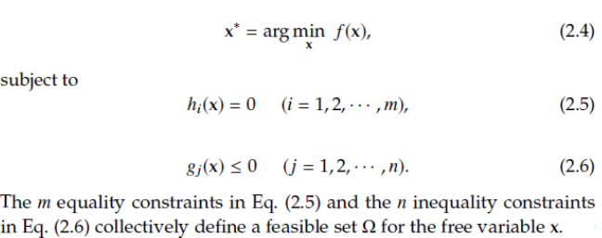
Mathematical Optimization
Find the best-fit candidate among a family of feasible choices in that it satisfies certain design criteria
Start with a criterion and formulate an objective function that can quantitatively measure the underlying criterion as a function of all available choices
The optimization problem is solved by just finding the variables that maximize or minimize the objective function among all feasible choices.
The feasibility of a choice is usually specified by some constraints in the optimization problem.
General Formulation:

Slide 6
Mathematical Optimization
Mainly focused on a more general group of optimization problems called Convex Optimization
The optimization is a convex optimization problem if the objective function f(x) is a convex function and the feasible set Ω defined by all constraints is a convex set
A set is said to be convex if for any two points in the set, the line segment joining them lies entirely within the set.
A function is considered a convex function when the straight line joining any two different points on its graph lies entirely above the function's curve.
All convex differentiable functions have the nice property that a local mininum solution is guaranteed to be globally mininum
For concave differentiable function it guarantees a global maximum.
The functions which are neither convex nor concave have different local and global optimum points

Slide 7


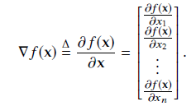
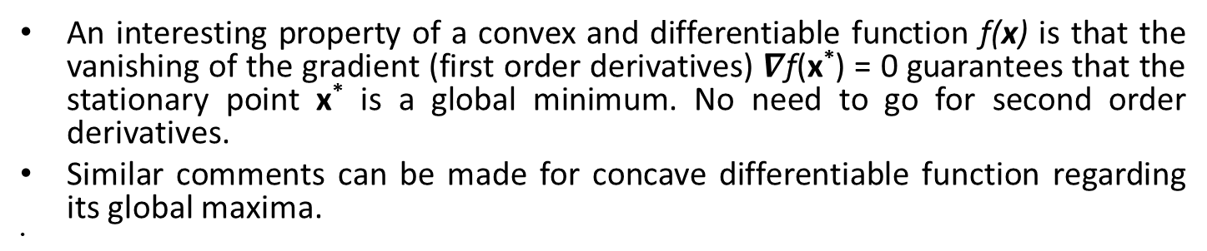
Optimality Conditions for Unconstrained Optimization
An interesting property of a convex and differentiable function f(x) is that the vanishing of the gradient (first order derivatives) $∇$f(x*) = 0 guarantees that the stationary point x* is a global minimum. No need to go for second order derivatives.
Similar comments can be made for concave differentiable function regarding its global maxima.

Slide 8
Numerical Optimization Methods
For many optimization problems arising from real-world applications, the analytical methods based on the optimality conditions do not always lead to a useful closed-form solution.
For these practical problems, we have to rely on numerical methods to derive a reasonable solution in an iterative fashion.

Slide 9

Gradient (Steepest) Descent Method for Unconstrained optimization
Consider a simple unconstrained optimization problem:
Note: arguments of the minima is abbreviated arg min or argmin.
Assume function f(x) is differentiable: we can compute all partial derivatives with respect to each element in x.
The gradient vector of a multivariate function 𝑓(x) is defined as a column vector:
A point x* is said to be a stationary point of f(x) if all partial derivatives are 0 at x*; that is, the gradient vanishes at x* .
Which is minima here for f(x).
If the gradient of is nonzero, it points to the direction of the fastest increase of the function value at x.

Slide 10
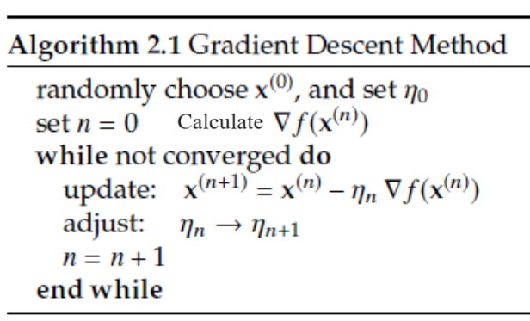
Gradient Descent (GD) Algorithm
As shown in Figure, starting from any point on the function surface, if we move a sufficiently small step along the direction of the negative gradient, it is guaranteed that the function value will be more or less decreased.
We can repeat this step over and over until it converges to any stationary point.
This idea leads to a simple iterative optimization method, called gradient descent (a.k.a. steepest descent).
Because the gradient cannot tell us how much we should move along the direction, we have to use a manually specified step size η_{n} for each move.

Slide 11
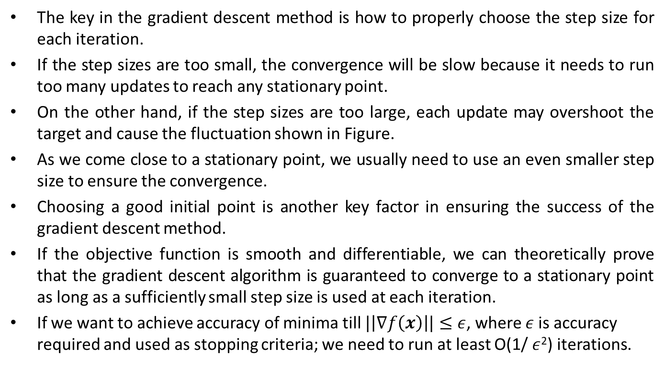
Gradient Descent Algorithm
The key in the gradient descent method is how to properly choose the step size for each iteration.
If the step sizes are too small, the convergence will be slow because it needs to run too many updates to reach any stationary point.
On the other hand, if the step sizes are too large, each update may overshoot the target and cause the fluctuation shown in Figure.
As we come close to a stationary point, we usually need to use an even smaller step size to ensure the convergence.
Choosing a good initial point is another key factor in ensuring the success of the gradient descent method.
If the objective function is smooth and differentiable, we can theoretically prove that the gradient descent algorithm is guaranteed to converge to a stationary point as long as a sufficiently small step size is used at each iteration.
If we want to achieve accuracy of minima till $|\left|∇f\left(x\right)\right||≤ε$, where $ε$is accuracy required and used as stopping criteria; we need to run at least O(1/ $ε$²) iterations.

Slide 12
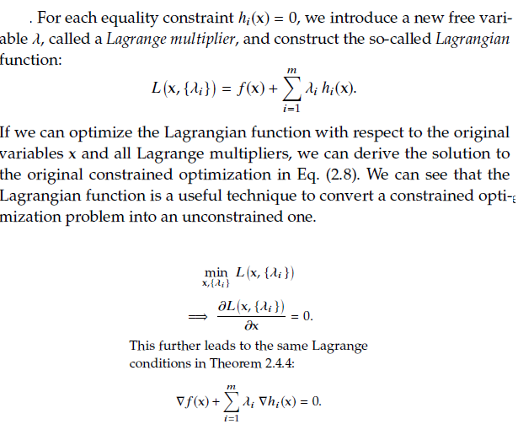
Optimality Conditions with Equality Constraints: Lagrange Multiplier Method

Slide 13
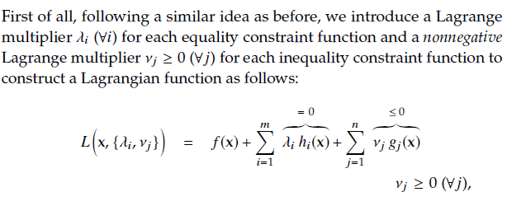
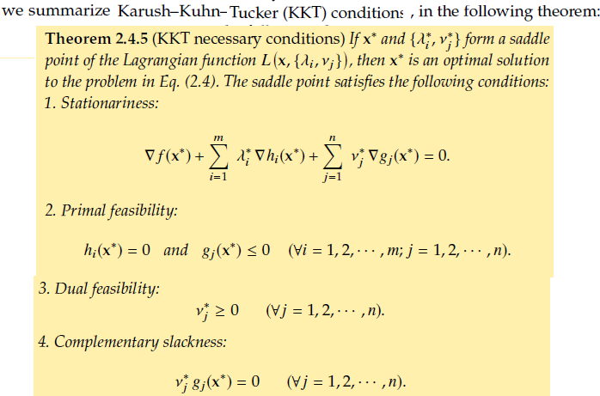
Optimality Conditions with Inequality Constraints: KKT Conditions

Slide 14
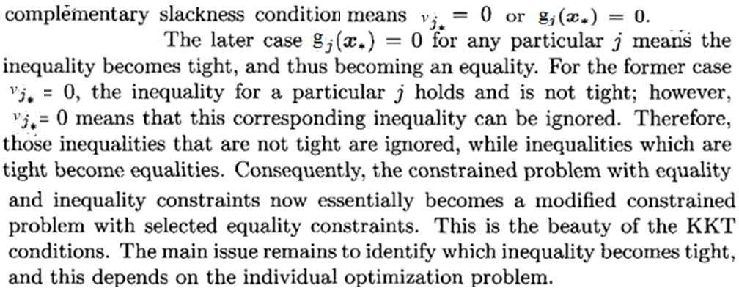
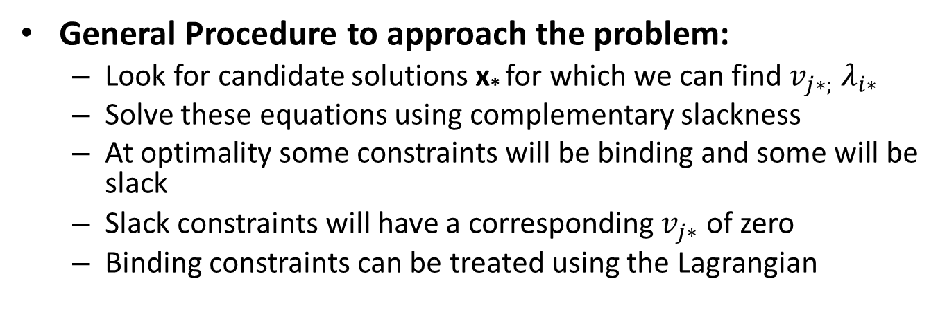
Optimality Conditions with Inequality Constraints: KKT Conditions
General Procedure to approach the problem:
Look for candidate solutions x* for which we can find $v_{j∗;}{ λ}_{i∗}$
Solve these equations using complementary slackness
At optimality some constraints will be binding and some will be slack
Slack constraints will have a corresponding $v_{j∗}$ of zero
Binding constraints can be treated using the Lagrangian

Slide 15
Examples:
A function is given by z = f (w); w ∈ ℝ²; f (w) is square of 2nd norm of w. Write an optimization problem to minimize z with constraint that sum of elements of w should be equal to 1. Solve it by using Lagrange’s multiplier method.
A function is given by z = f (w); w ∈ ℝ^{2;} f (w) is square of 2nd norm of w. Write an optimization problem to minimize z with constraint that sum of elements of w should be less than or equal to 1. Solve it by using KKT condition method.

Slide 16
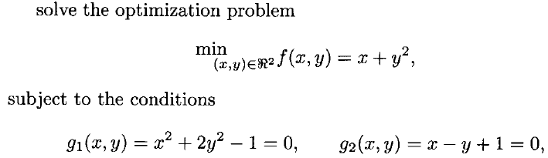
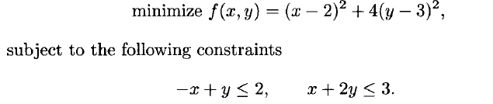
Assignment 2
Note: The independent variable x = [x, y]^{T}
1. Find minima
2.
3.
4.

Slide 17
Work Flow:
Assignment Problem Statement (Handwritten)
Solution (Handwritten)

