Slide 1
Experiment 9: Back Propagation Algorithm (BPA) for Simple ANN
MACHINE LEARNING AND APPLICATIONS LAB
EC - Semester 5

Slide 2
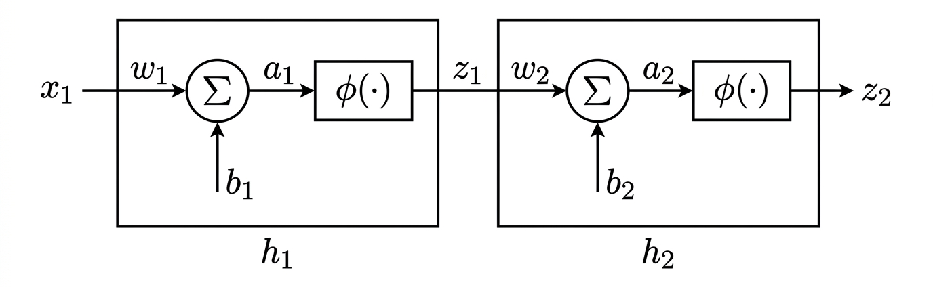
Given Simple ANN
ϕ(.) is sigmoid activation function .

Slide 3
Train and Test Simple ANN using generated dataset
Generate 100 data point using relationship y= e^{-0.1x}; where x in range of [0,10]. Display overall dataset.
Train given ANN for 5 epochs using BPA (use derived equations and method learned in class).
Use Cross-validation method to split the data set into training and testing parts.
Test the ANN on testing data set in every epoch.
Display weights of trained ANN, RMSE of training and testing after every epoch.

Slide 4
Work Flow:
Aim of Experiment (Handwritten)
Python code with results and graphs (print)
Conclusion (Handwritten)

