Slide 1
Diabetes Analysis on Female
Prepared by :
Jaydeep Chotaliya

Slide 2
Agenda
Project focus on health related factors which affect the diabetes such as Insulin, Age, Blood Pressure, BMI, exc.
Develop an accurate and efficient diabetes detection model using machine learning techniques.

Slide 3
Diabetes Statistics: The Rising Global Burden
Diabetes stems from insufficient insulin production or ineffective insulin utilization, a hormone vital for blood glucose regulation.
In 2019, diabetes caused 1.5 million deaths, with 48% occurring before age 70, while 8.5% of adults had diabetes in 2014.
By 2040, an estimated 642 million individuals globally will be affected by diabetes, indicating that one in ten adults will be living with the condition.
Another 460 000 kidney disease deaths were caused by diabetes, and raised blood glucose causes around 20% of cardiovascular deaths

Slide 4
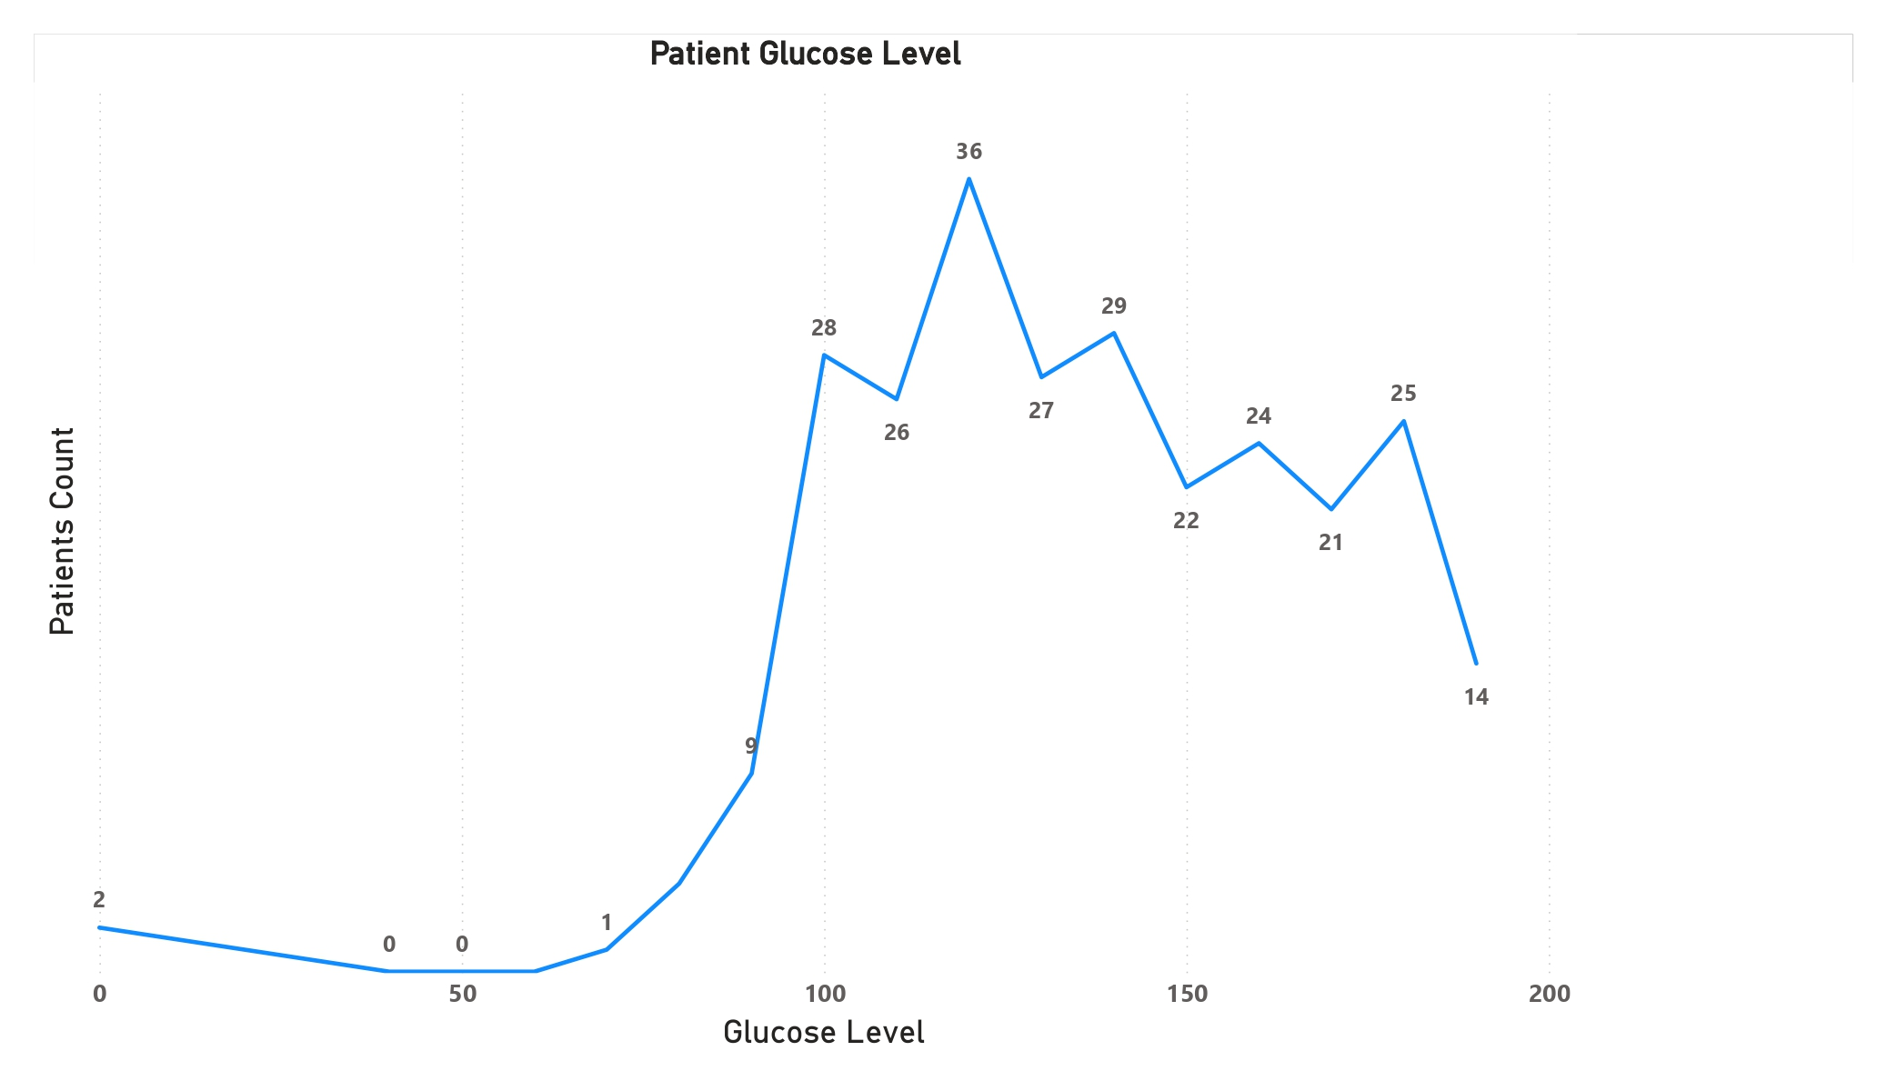
Analysis

Slide 5
Firstly, the problem is analyzed by identifying various factors. The most prominent factor is the glucose level which is correlated to diabetes.
The Previous picture illustrates that a high glucose level indicates a person has more chance of diabetes.
In a real-life scenario Several factors can play a role in high glucose levels in people with diabetes.
In a person without diabetes, the pancreas produces insulin, a hormone that helps cells absorb glucose from the bloodstream, thus regulating blood sugar levels. However, in individuals with diabetes, either the body doesn't produce enough insulin (Type 1 diabetes), or the insulin it does produce is not effectively used (Type 2 diabetes). They include food and physical activity, illness, and medications not related to diabetes.

Slide 6
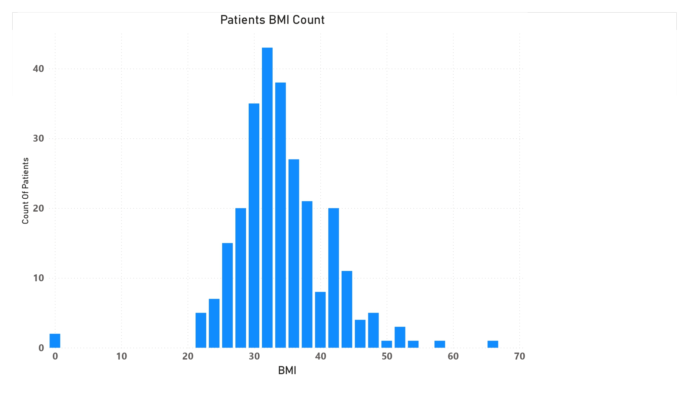
Additionally, Body Mass Index is more crucial for diabetes people here is the correlation between BMI and Diabetes.

Slide 7
The Body Mass Index (BMI) is a metric that assesses body fat in relation to height and weight. To compute it, weight in kilograms is divided by the square of height in meters. An individual with a BMI of 25 or more is classified as overweight, while a BMI of 30 or more indicates obesity.
The graph shows elevated glucose levels in patients compared to the average glucose level, suggesting potential implications for the individuals' health.

Slide 8
Analyzing the models
The objective of this study is to determine whether the individual under consideration is affected by diabetes based on an analysis of relevant health indicators.
Here is over main focus on categorizing data into predefined classes or categories based on features. It involves training a model to learn patterns in labeled data and make predictions on new, unseen data.
To achieve the desired goal, I've developed four models: Logistic Regression, Support Vector Machine, Decision Tree, and Random Forest.

Slide 9
In conclusion, after a comprehensive evaluation of four machine learning models for our classification problem, it is evident that the logistic regression model stands out as the best fit. Several factors contribute to this determination.
Firstly, logistic regression is known for its simplicity and interpretability, making it easy to understand and explain to stakeholders, aiding in decision-making processes. The model provides clear insights into the impact of each feature on the predicted outcome.
Secondly, logistic regression has demonstrated a high accuracy model with 81% accuracy, 0.7 precision score, 0.63 recall, and 0.66 F1-score.

Slide 10
THANK YOU

